Slide 1

旅遊相關高級文憑
Tourism Programmes

Slide 2




Three Tourism Programmes
FHDRTPM
FHDTAS
FHDTHS
Higher Diploma in Resort and Theme Park Management
Higher Diploma in Tourism and Airline Studies
Higher Diploma in Tourism and Hospitality Studies

Slide 3

Dean's Speech
院長致辭
https://drive.google.com/file/d/1lzeKxWE_EapKwS2VI7k-CrMUPPCCVfdT/view?usp=drive_link

Slide 4

Key Staffs of LiPACE 學院重要成員
Dean 院長
Dr Benjamin CHAN Tak-yuen
曾德源博士

Slide 5




Key Staffs of LiPACE 學院重要成員
Associate Directors
副院長
Dr Ching Ka Wai Larry
程家偉博士
Dr Chen Yi-Fan Yvonne
陳羿帆博士
Ms. Pang Hoi Ning Helen
彭海寧女士
Dr Chim Hiu Man Kathleen
詹曉雯博士

Slide 6





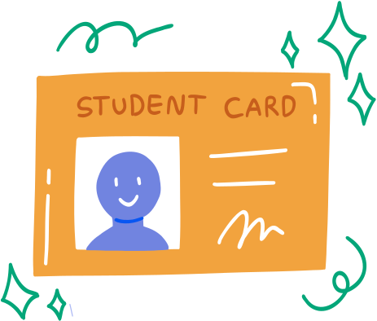
Table of Contents目錄
3i ACTIVITIES,
NET TEACHER, ENGLISH GRANT PROJECT
3i 文化、外藉英語老師及英語學習支援
LiPACE INFORMATION AND
STUDY PATH
學院及升學階梯
IMPORTANT INFORMATION
開學重要事項
Q & A SESSION
問答環節
STUDENT AFFAIR OFFICE
學生事務處
STUDENT CARD COLLECTION
領取學生證

Slide 7

課程類別及升學階梯
Programme Type & Study Pathway
Level 5
Level 4
Level 3
高級文憑課程
Higher Diploma
副學士課程
Associate Degree
(2 years full-time)
本地或海外學位課程
Local or Overseas Degree
(2-3 years full-time/
2 years part-time)
應用教育文憑課程
Diploma of Applied Education
文憑課程 Diploma
(1 year full-time)

Slide 8


課程類別及升學階梯
Programme Type & Study Pathway
Level 5
Level 4
Level 3
學士學位
Bachelor Degree
高級文憑課程
Higher Diploma
應用教育文憑課程
Diploma of Applied Education
PolyU
      Bachelor of Science (BSc) (Hons) Scheme in Hotel and Tourism Management
      Bachelor of Science (Honours) in Aviation Operations and Systems Tourism and Airline Studies
      HKMU
      Bachelor of International Hospitality and Attractions Management with Honours
度假區及主題樂園管理 (Resort and Theme Park Management)
旅遊及航空業 (Tourism and Airline Studies)
旅遊及款待業 (Tourism and Hospitality Studies)
旅遊及款待服務
航空
主題公園
酒店及餐飲
其他

Slide 9
Today’s Orientation Session
學員專區 全日制課程 Student Area Full-time Programme
學生紀律與學術誠信 Student Disciplines & Academic Integrity
啟動電郵戶口 Activating Email Account
啟動O365 Activating O365
網上學習系統 Online Learning Environment (OLE)
查閱成績 Checking Academic Results
語文科目豁免政策 Language Course Exemption
3i 文化倡議、外藉英語老師及英語學習支援 Introduction to 3i activities, our NET teacher and the English grant project
學生事務處 Student Affairs Office
查閱上課時間表及所屬班別 Checking Programme Timetable & Class Division
完成入學問卷調查 Completion of Entry Survey
問答環節 Question & Answer Session
領取學生證 Student Card Collection

Slide 10
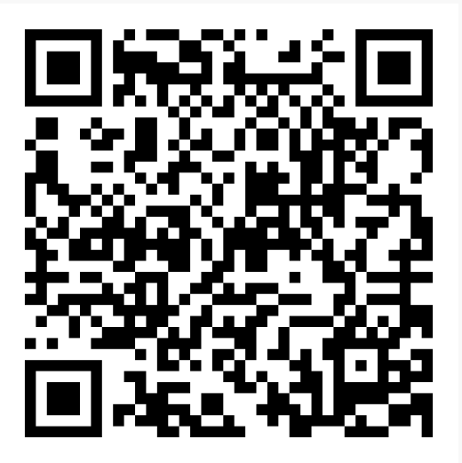
學員專區 全日制課程
Student Area Full-time Programme
Access to “Student Area”
登入「學員專區」
Path:
LiPACE Home Page > Support & Enquiries > Student Area > Full-time Programme
Website:
https://www.hkmu.edu.hk/lipace/ftp-student-area/
學員專區
QR Code

Slide 11
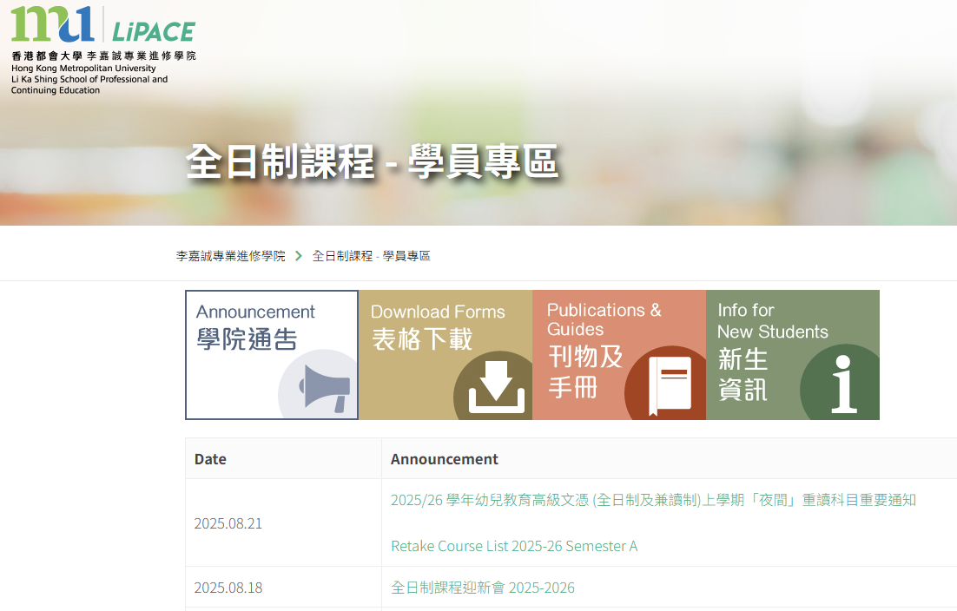
Other Important Information
其他重要資訊
DOWLOAD
Student Guideline
Checking Timetable & Result

Slide 12
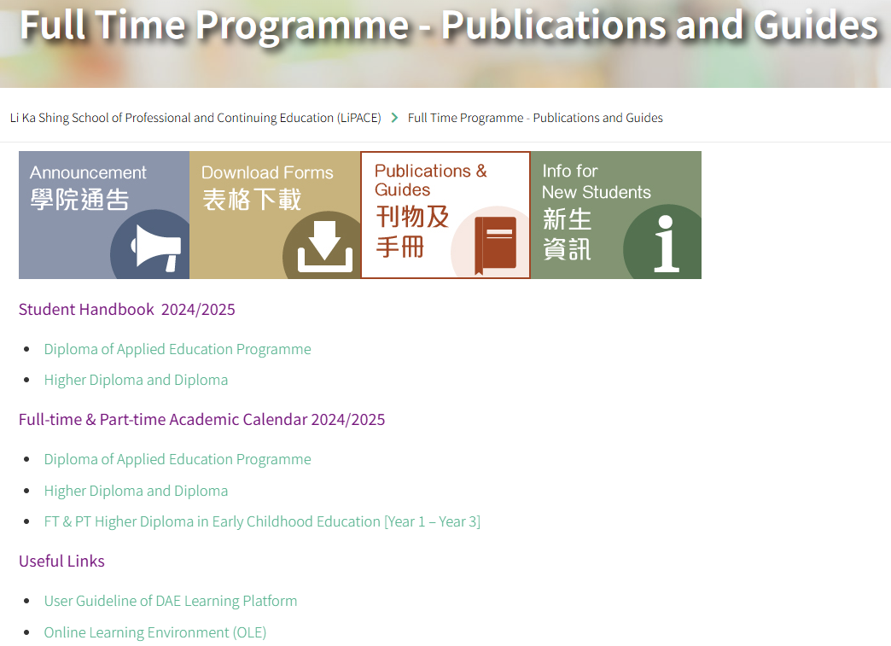
Other Important Information
其他重要資訊
DOWLOAD
Student Handbook
Academic Calendar

Slide 13

Student Handbook
學生手冊
DOWLOAD
Student Handbook
Academic Calendar
4.1.3 Class Attendance
4.3.9 Academic Integrity

Slide 14
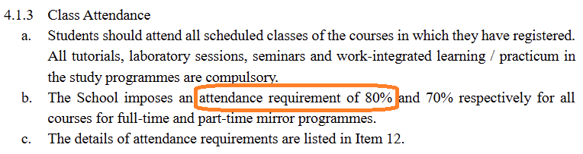
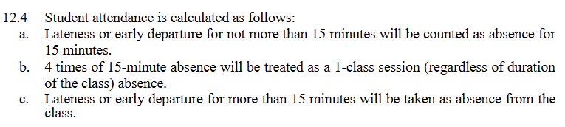
4.1.3 Class Attendance
4.1.3 Class Attendance

Slide 15
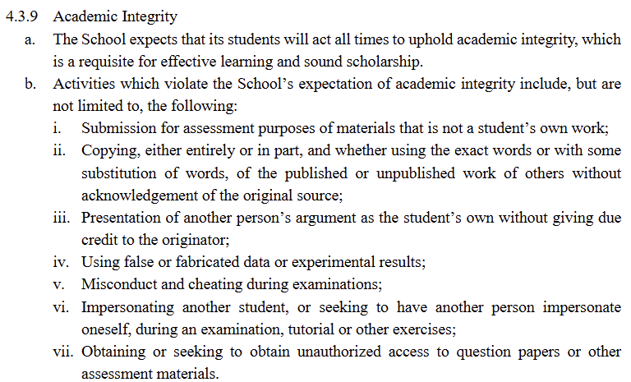
4.3.9 Academic Integrity
4.1.3 Class Attendance

Slide 16

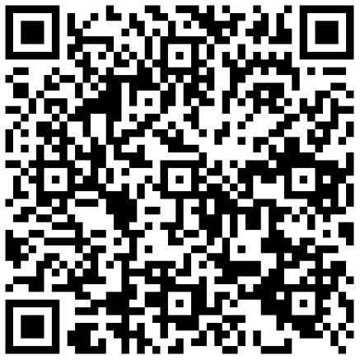
Activating Your Email Account
啟動電郵戶口
請參閱學生手冊
你需要先設定密碼
www.hkmu.edu.hk → 在學學生→本科生及副學位→ 聯絡及支援→ 統一密碼管理
Please refer to Student Handbook
(Appendix A: Activate Your Email Account)
Create a new password first
www.hkmu.edu.hk → Current Students → Undergraduate and Sub-degree→ Services and Support → Single Password Management

Slide 17
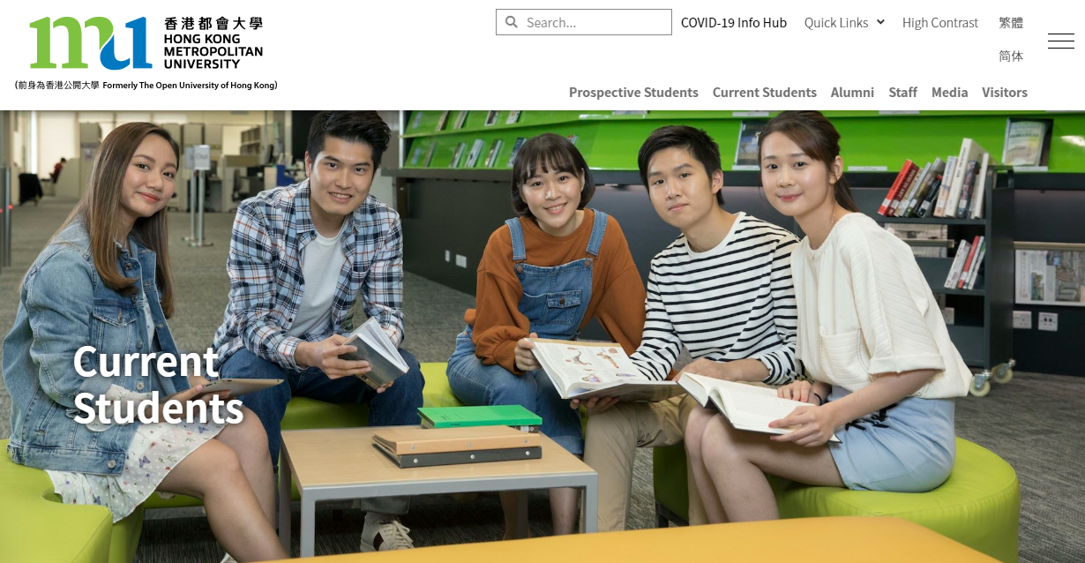
Activate Your Email Account
啟動電郵戶口
www.hkmu.edu.hk
→ Current Students
→ Undergraduate and Sub-degree
→ Services and Support
→ Single Password Management

Slide 18
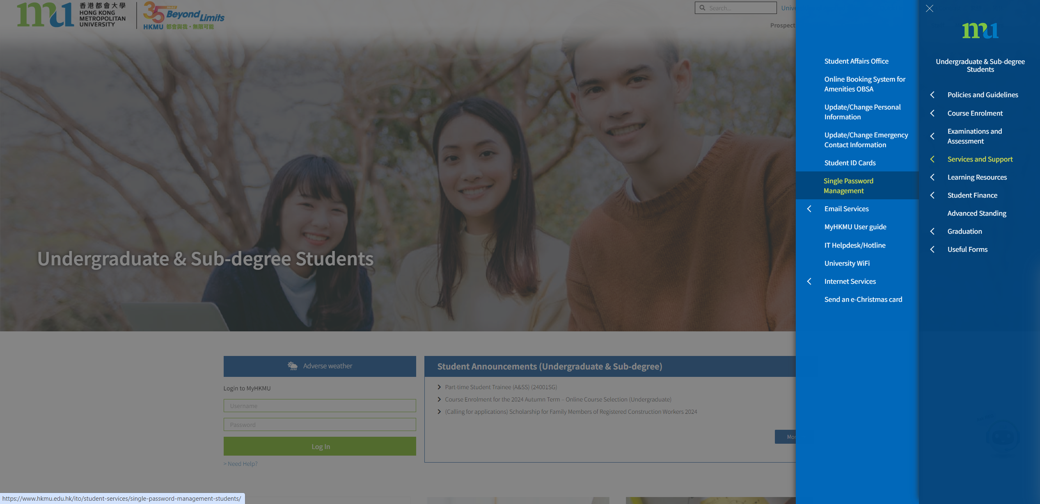
Activate Your Email Account
啟動電郵戶口
www.hkmu.edu.hk
→ Current Students
→ Undergraduate and Sub-degree
→ Services and Support
→ Single Password Management

Slide 19
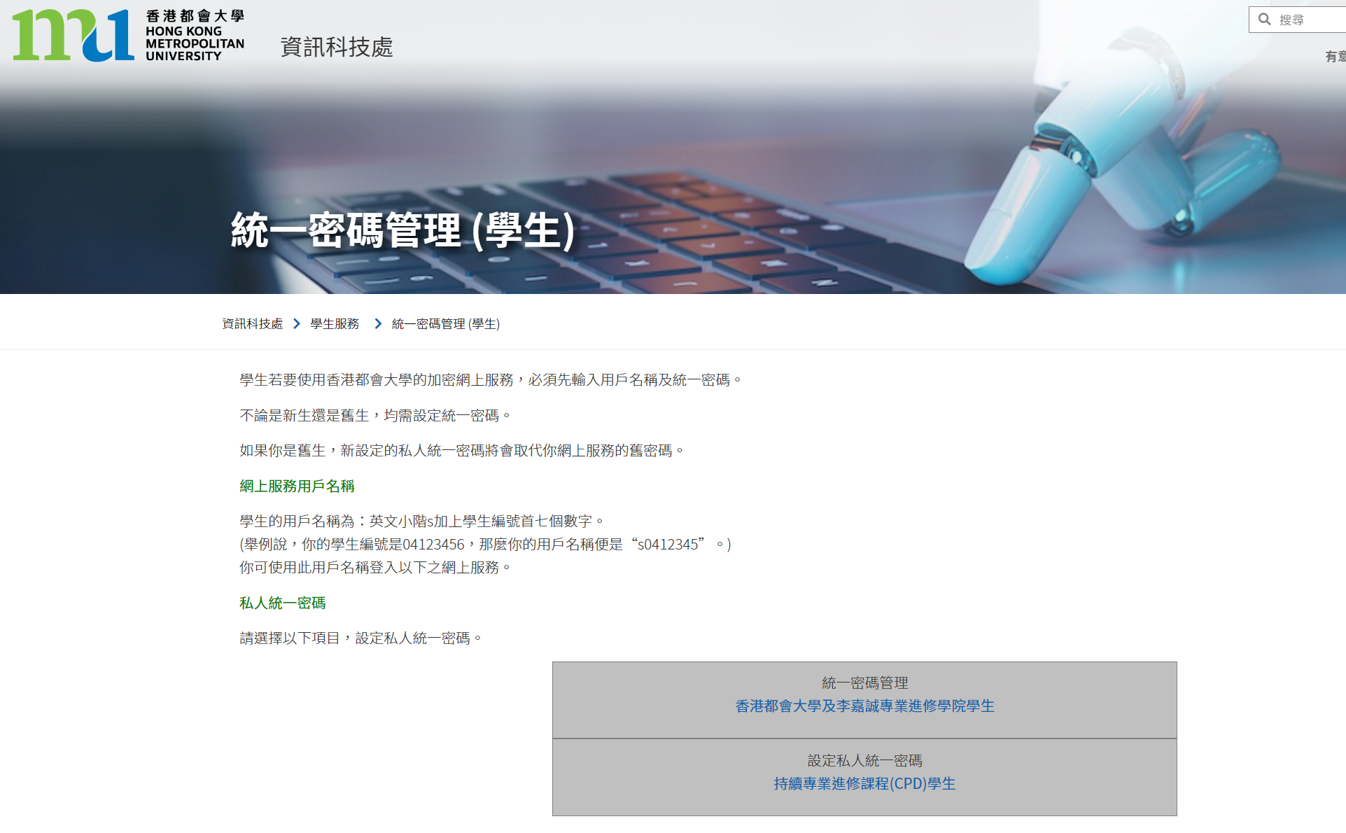
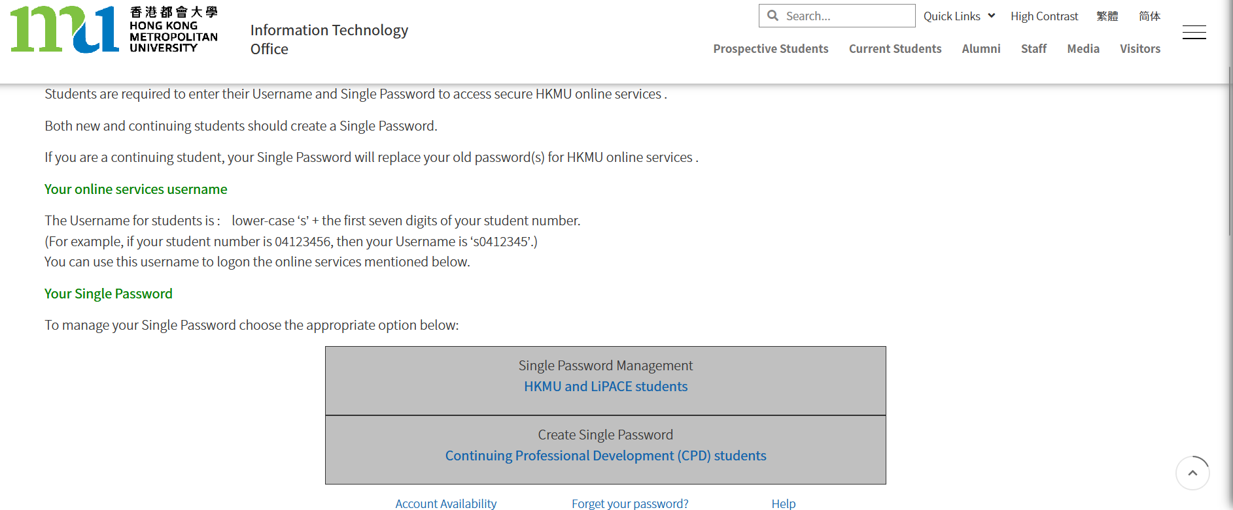


Slide 20
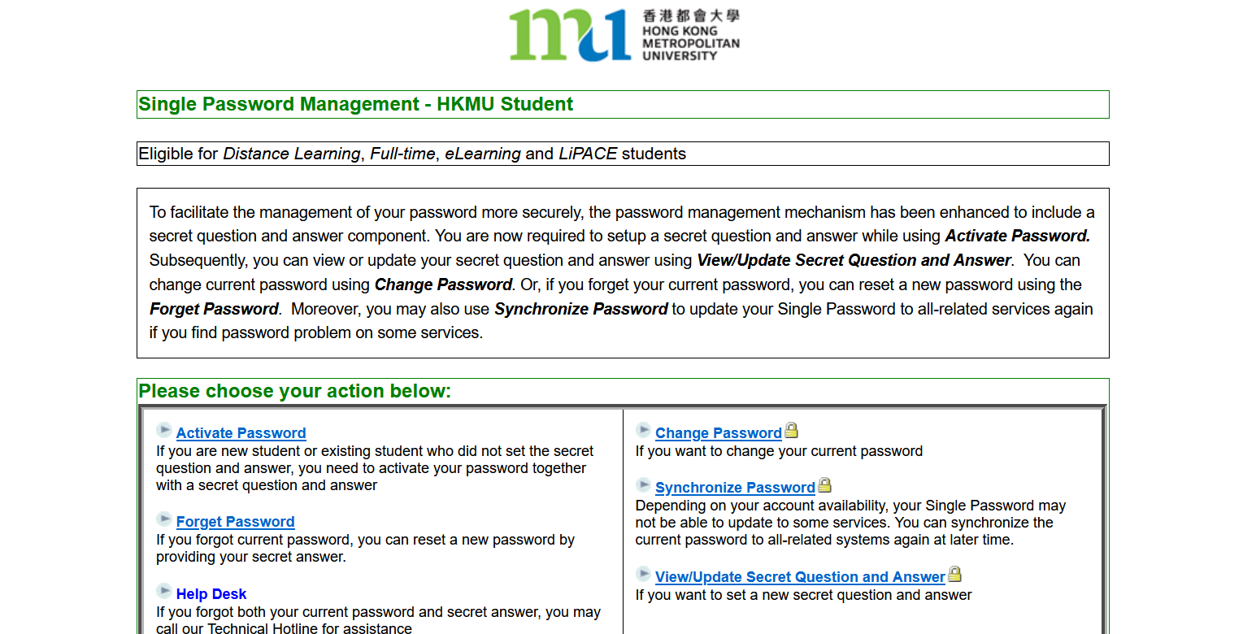
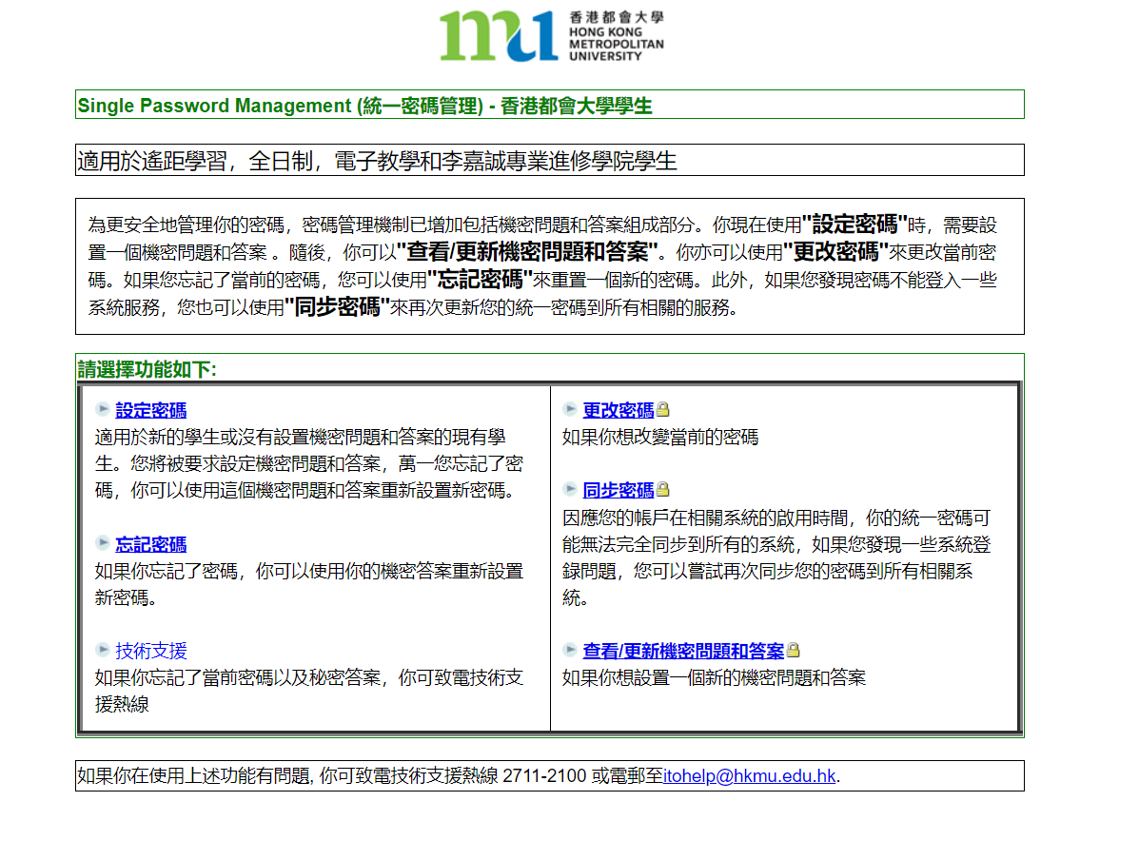

Slide 21
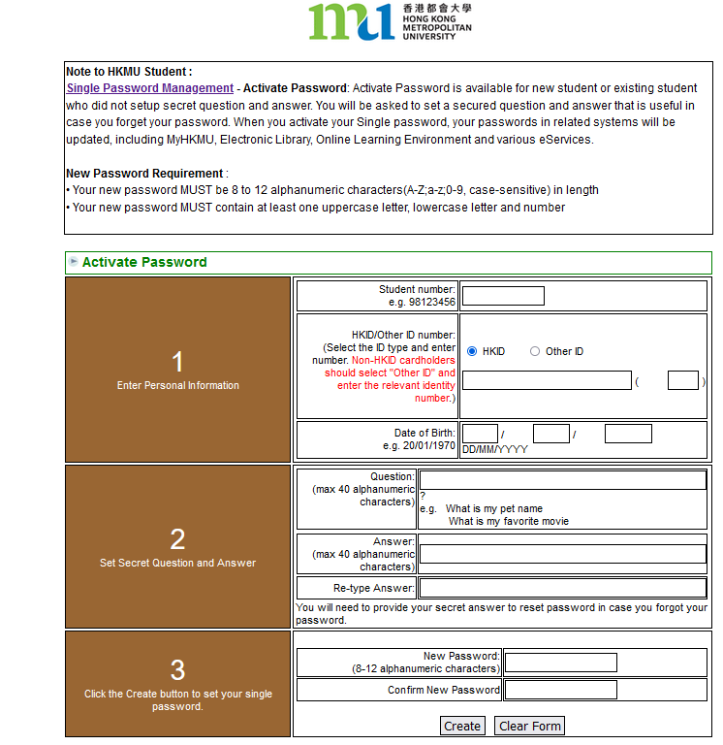
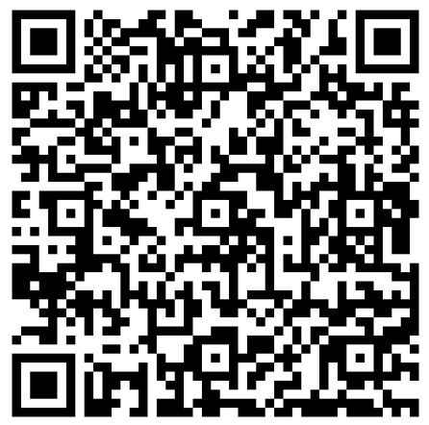
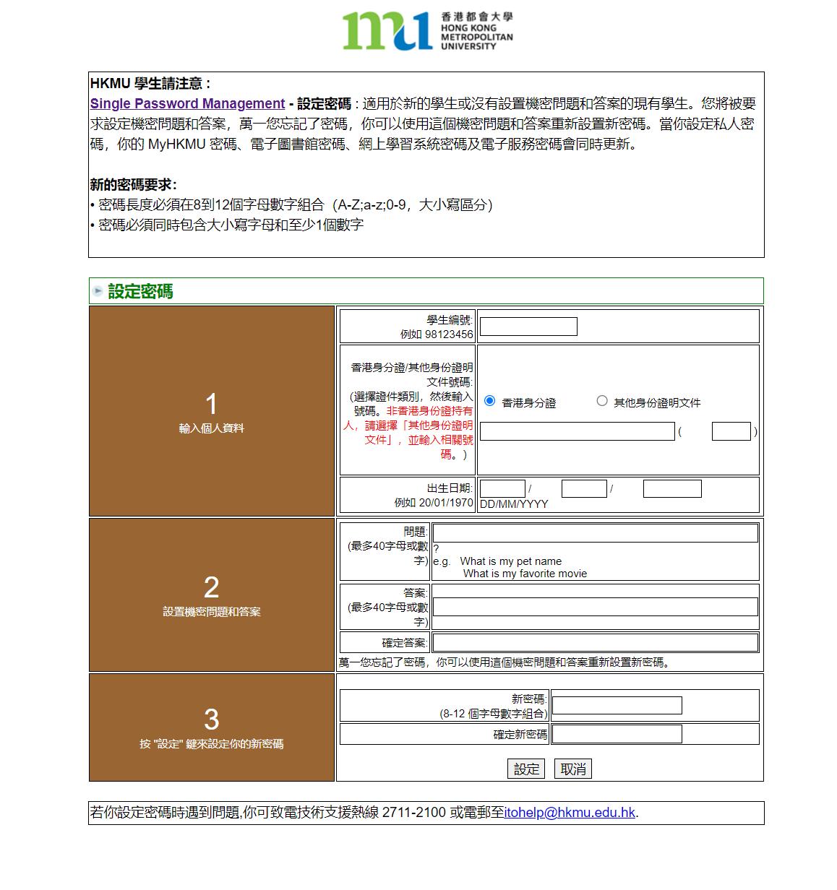
只可英文字母及數字
Letters & Numbers ONLY
(){}[]|`¬¦! "£$%^&*"<>:;#~_-+=,@.

Slide 22
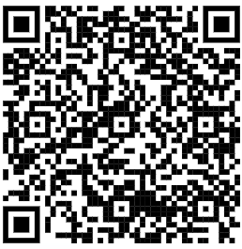
Activate Your Email Account
啟動電郵戶口
登入電郵戶口
香港都會大學主頁 → 在學學生
→ 本科生及副學位 → 服務及支援→ O365 Email
Log in to Your Email Account
HKMU Home Page → Current Students
→ Undergraduate & Sub-degree → Communication & Support → O365 Email
O365 Email: https://student.intranet.hkmu.edu.hk/hkmu_o365/index_c.html?r=0

Slide 23
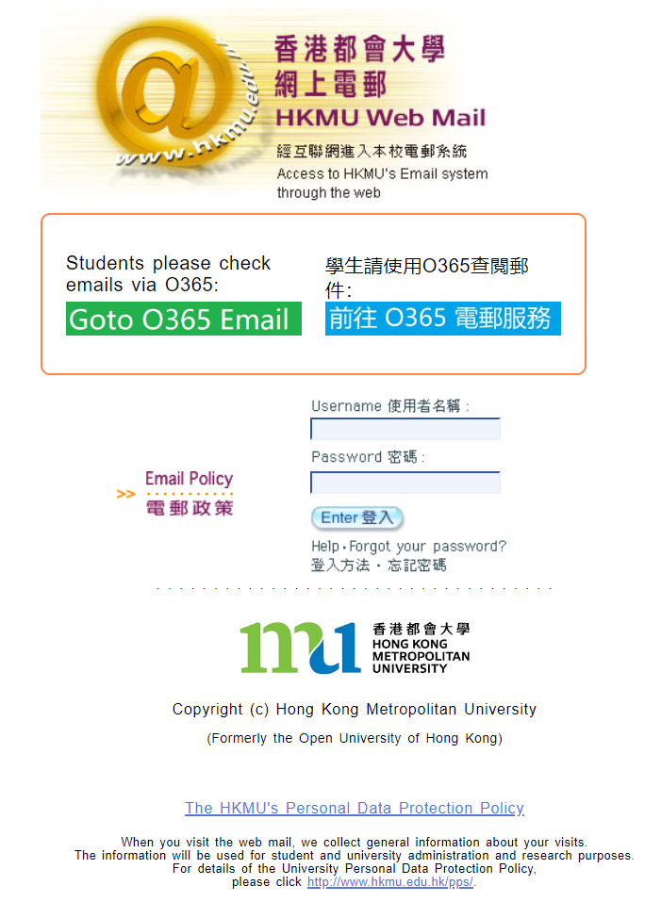

Login to Your Email Account
登入學生電郵帳戶
輸入您的用戶名稱和密碼：
用戶名稱： “s”+ 學員學生証號碼的 前七位數字
密碼：已自行設定的密碼
Input your user name and password:
User name : “s” + first 7 digits of your student number
Password : the single password that you have created
請記緊!!
學生証號碼是八個位!
https://student.intranet.hkmu.edu.hk/hkmu_o365

Slide 24
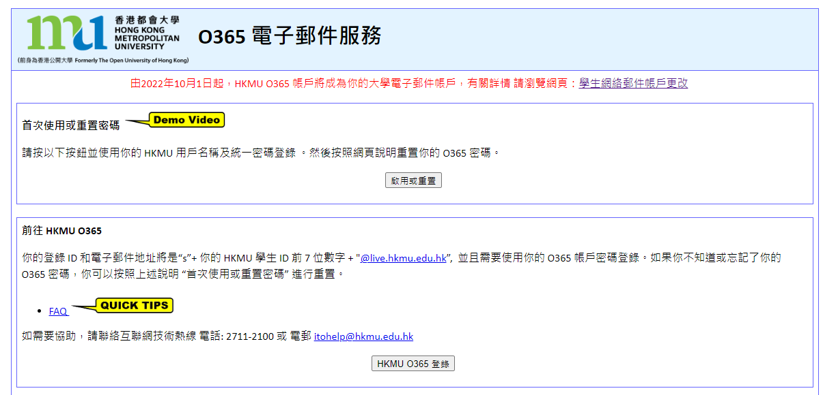
Activation of O365
啟動O365
First Time User or Reset Password
Username: “s” + the first 7 digits of your student number
Password: the single password that you have created
O365 Email address: sXXXXXXX@live.hkmu.edu.hk

Slide 25

Online Learning Environment (OLE)
網上學習系統
請參閱學生手冊
登入 https://elipace.hkmu.edu.hk/
在網上學習系統的登入版面輸入您的使用者名稱和密碼
(跟使用電郵服務一樣用戶)
Please refer to Student Handbook
Log in to https://elipace.hkmu.edu.hk/
Enter your Username and Password
(same as the one created for the e-mail service)

Slide 26
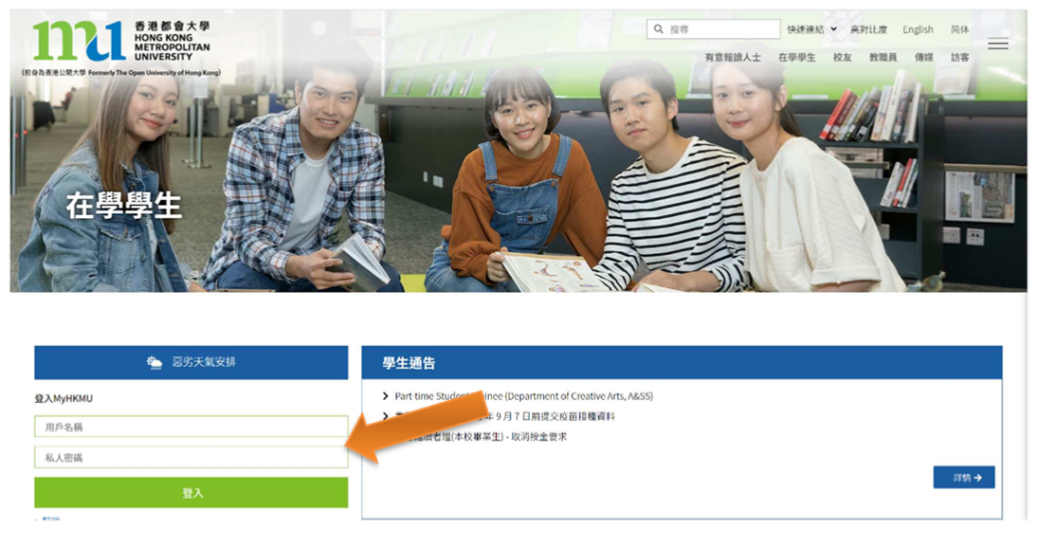

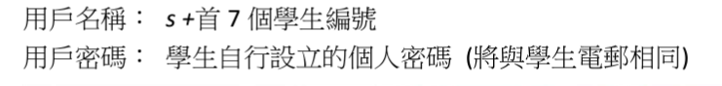
Online Learning Environment (OLE)
網上學習系統

Slide 27
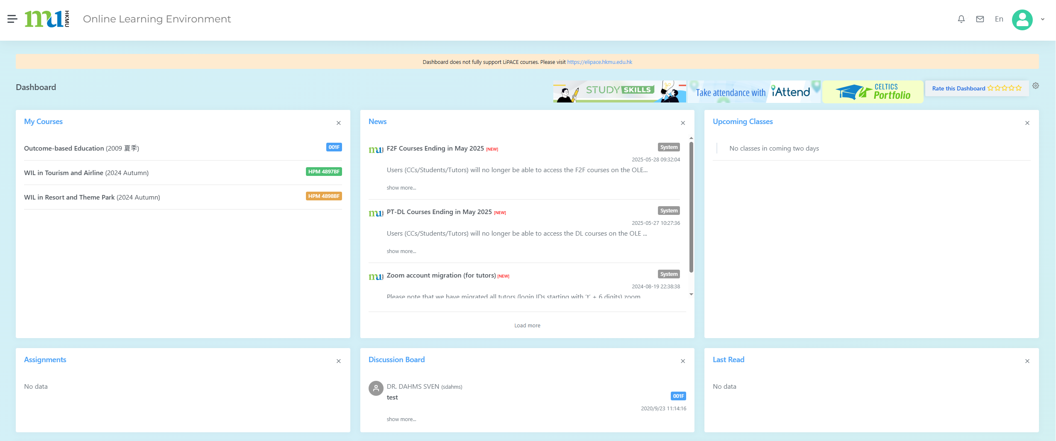

HKMU LiPACE
(Click HERE)
Dashboard

Slide 28
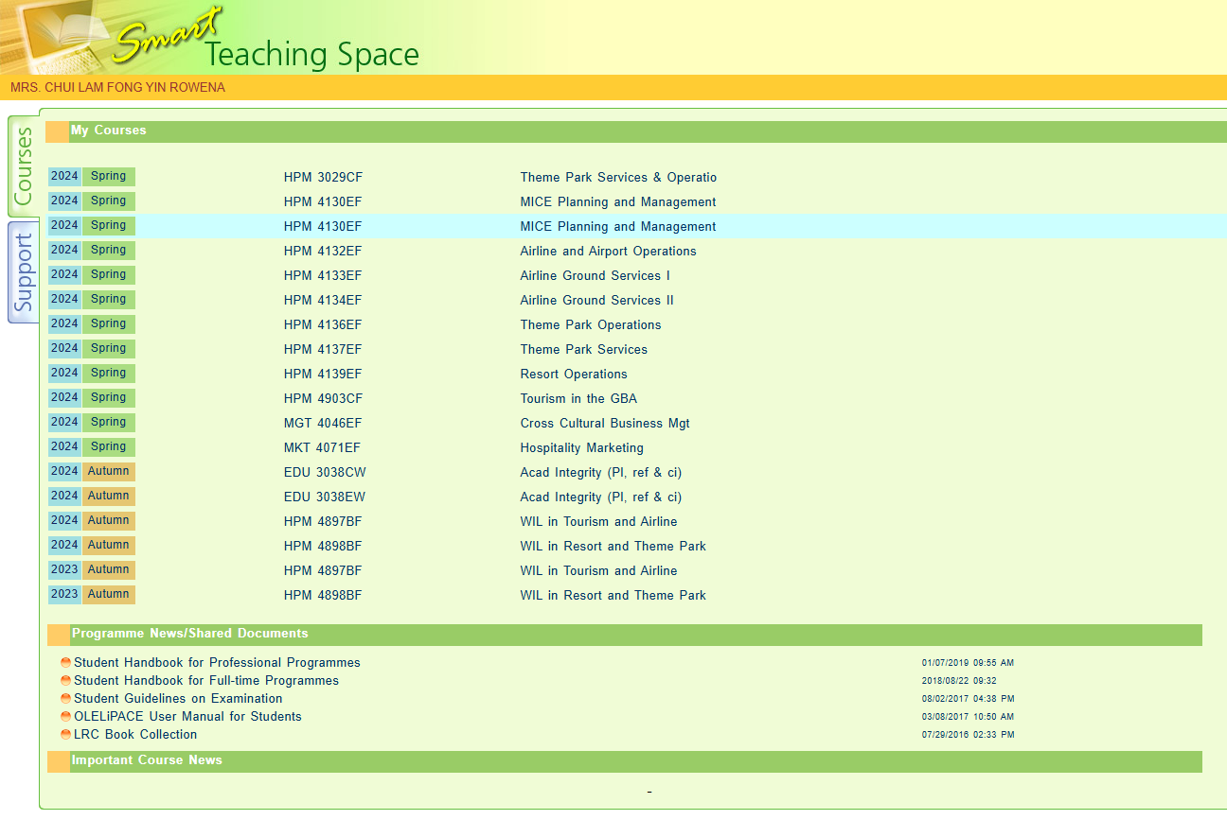
Find Course
Download Handbook

Slide 29
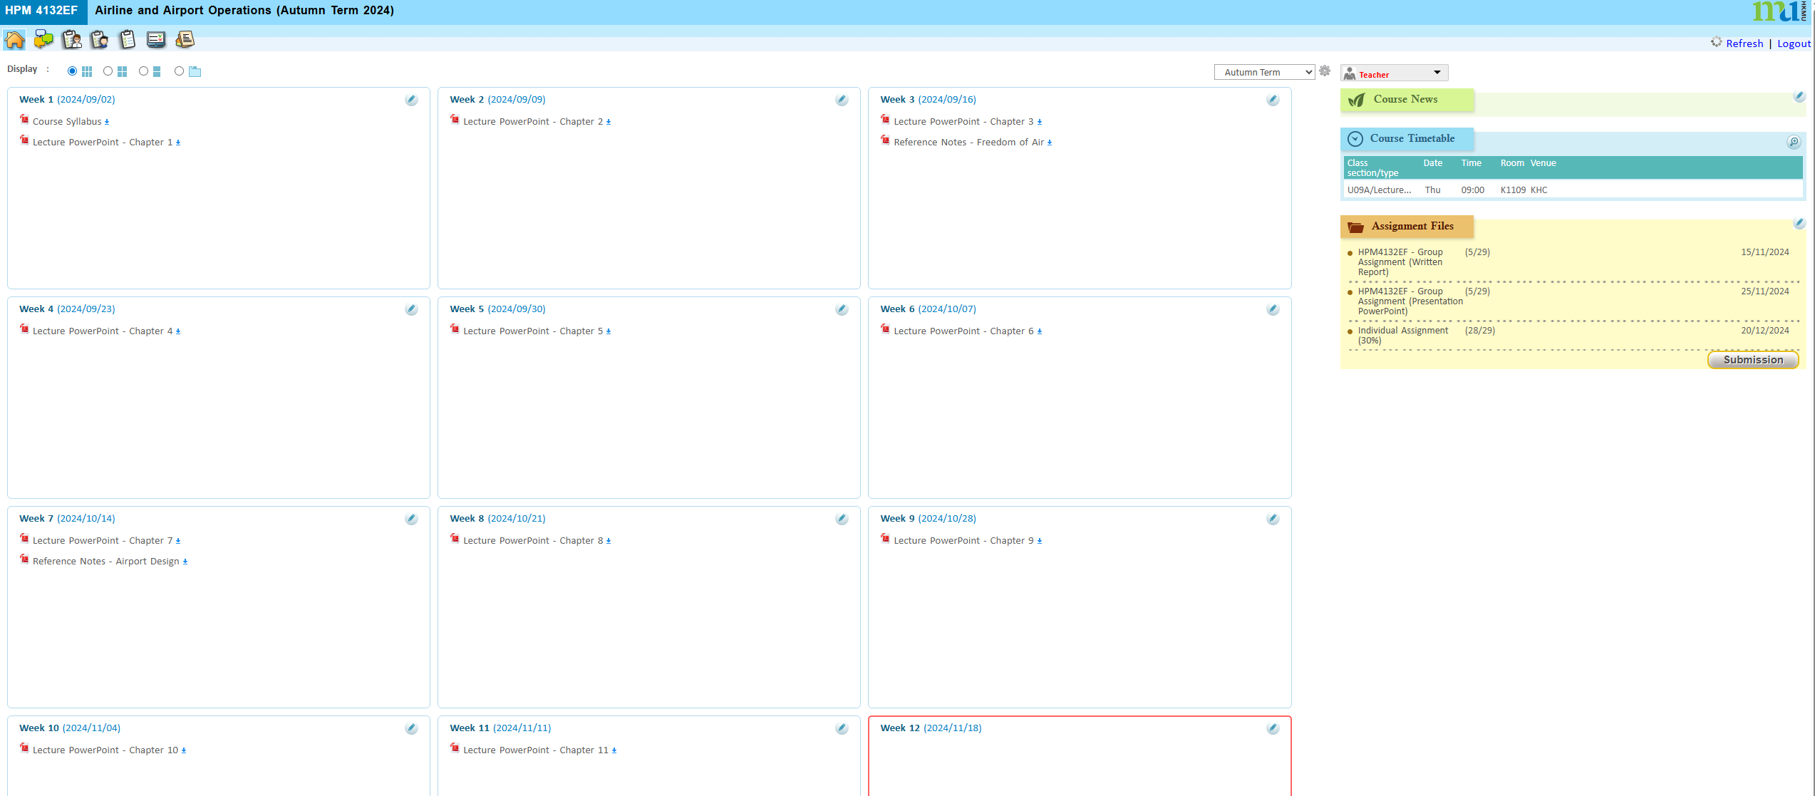
Download Lecture Notes, Course News, upload Assignment Files
下載課程講義、課程最新資訊、上傳作業文件

Slide 30
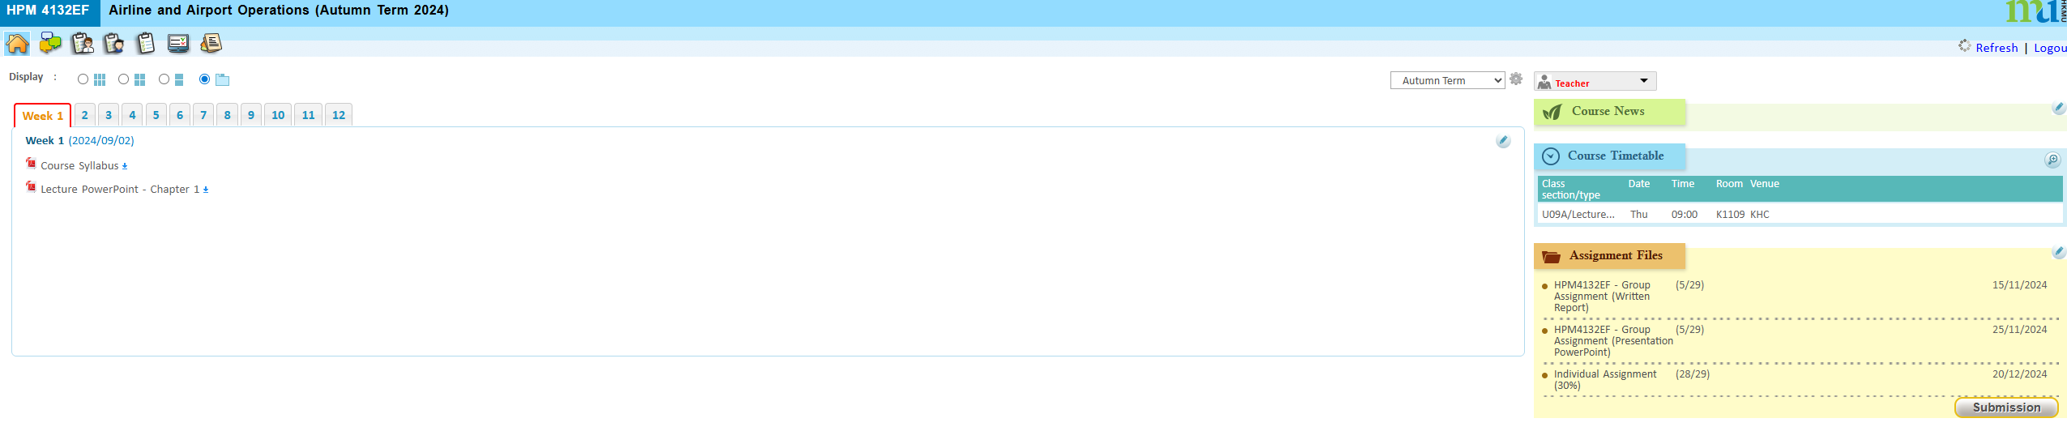
Download Lecture Notes, Course News, upload Assignment Files
下載課程講義、課程最新資訊、上傳作業文件

Slide 31
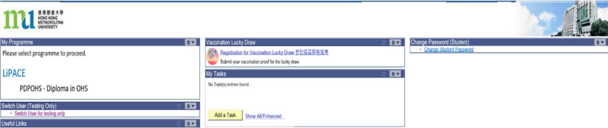
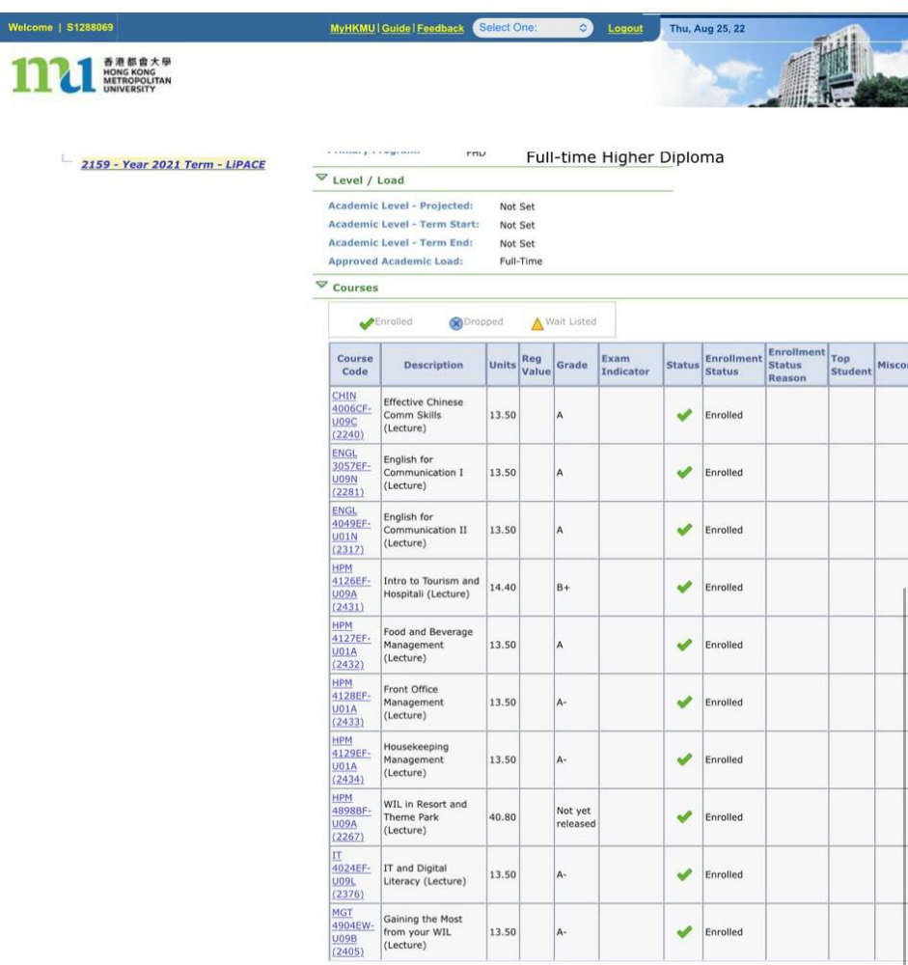
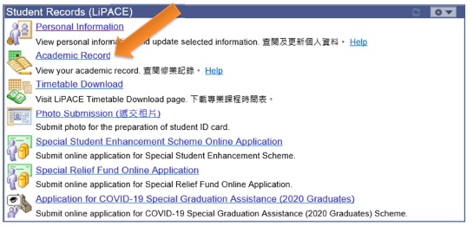

Checking Academic Results 查閱成績
MyHKMU
Academic Record

Slide 32
Checking Academic Results 查閱成績

Slide 33


One Student Account
(User Name:s1234567)
Timetable and Class Division
上課時間表及所屬班別
Online Learning Environment (OLE)
網上學習系統
MyHKMU
Student Email Account
學生電郵帳戶

Slide 34
語文科目豁免政策
Language Course Exemption

Slide 35
Chinese/English courses – QF Level 3 & 4
Holders of any qualifications mentioned below:
A locally accredited sub-degree (at QF Level 4) or a post-secondary diploma offer by a recognized university or higher education institute overseas, or
A locally accredited Bachelor’s degree or above (at QF Level 5 or above) or a Bachelor’s degree or above offered by a recognized university overseas.
The qualification should be awarded by a university or institute where the medium of instruction and assessments of this qualification must be in English. This includes UK and colonies, US (mainland and territories), Canada, Australia, New Zealand, South Africa (must be in English speaking, not Afrikaans), Ireland and Singapore. Other English-medium universities in the British Commonwealth will be considered on a case-by-case basis.

Slide 36
Chinese/English courses – QF Level 3 & 4
Completion of a prior Chinese/English course at QF Level 3/4 or above
The course should be non-career specific.
(e.g. Business English courses and English courses for Tourism will not be considered.)

Slide 37
English courses – QF Level 3 & 4
Holders of a public examination qualification from a recognized examination body
 | QF Level 3 English for Communication I | QF Level 4 English for Communication II | QF Level 4 English for Communication III
HKDSE Level 3 or above | ✓
HKALE/GCE A-level Grade D or above | ✓
IELTS 6.0 or above overall and a minimum of 5.5 for each individual component | ✓
IELTS 6.5 or above overall and 6 in listening and speaking component | ✓ | ✓

Slide 38
English courses – QF Level 3 & 4
Holders of a public examination qualification from a recognized examination body (cont.)
The results of IELTS and TOEFL must not be more than 2 years from the date of the test or final examination to the date of commencement of study at LiPACE.
 | QF Level 3 English for Communication I | QF Level 4 English for Communication II | QF Level 4 English for Communication III
IELTS 6.5 or above overall and 6 in reading and writing component | ✓ |  | ✓
TOEFL scored -60 (iBT) | ✓
TOEFL score -79 (iBT) | ✓ | ✓ | ✓
TEFL/TESOL certification, Or CELTA holder | ✓ | ✓ | ✓

Slide 39


Documents required for exemption application
01
02
Course Issues Application Form
https://www.hkmu.edu.hk/lipace/tc/admission/enrollment-form/
Qualification certificate awarded by a recognized university/institute/examination body; or
Syllabus from a prior course providing information on learning outcomes, academic standard, coverage, duration and assessment criteria
Application deadline:
22 September 2025 (Monday)

Slide 40

Course Issues Application Form 課程事項申請表

Slide 41

THANKS
Staff contacts
Head of Languages
Dr. Sylvia SZE | swsze@hkmu.edu.hk | 3120 9715
Deputy Head of Languages
Ms. Melissa YEUNG | mylyeung@hkmu.edu.hk | 3120 9719
Effective Chinese Communication Skills 應用中文傳意技巧
Ms. Konnie TANG | kyhtang@hkmu.edu.hk | 3120 9822

Slide 42
香港都會大學
李嘉誠專業進修學院
課外活動、外藉英語老師及
英語學習支援
Heidi Cheng
https://drive.google.com/file/d/1fRO0az-JW6hWbN3-tUWhKmDn5q70_epP/view?usp=sharing

Slide 43
Student Affairs Office
學生事務處
https://drive.google.com/file/d/1Rj6_MKb9ElRzNpPh2F2Uau8e_F8BgONH/view?usp=sharing

Slide 44
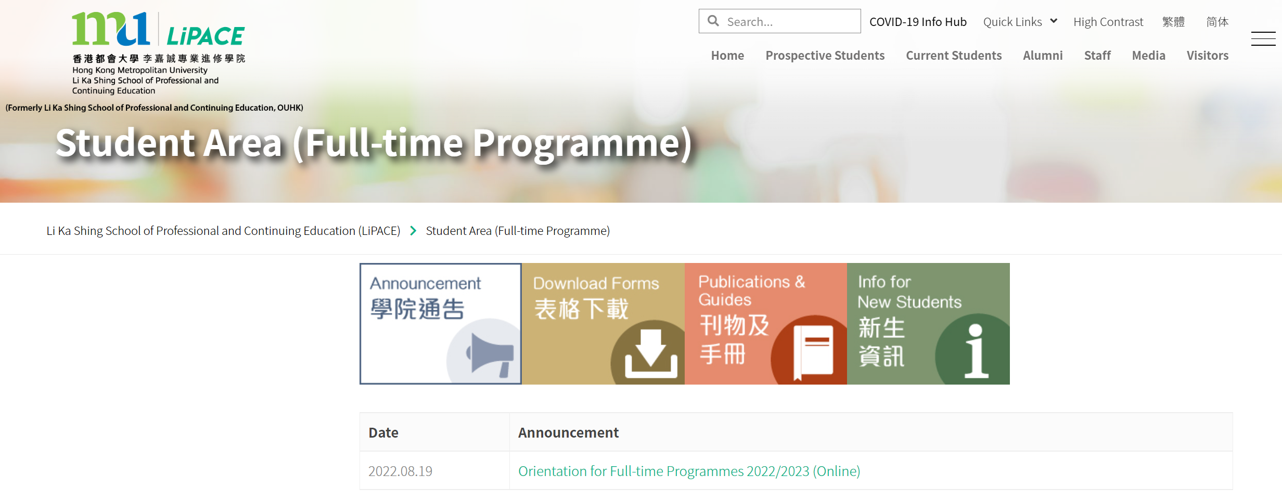
Checking Programme Timetable (Class Division)
查閱上課時間表(所屬班別)
https://www.hkmu.edu.hk/lipace/tc/ftp-student-area/

Slide 45
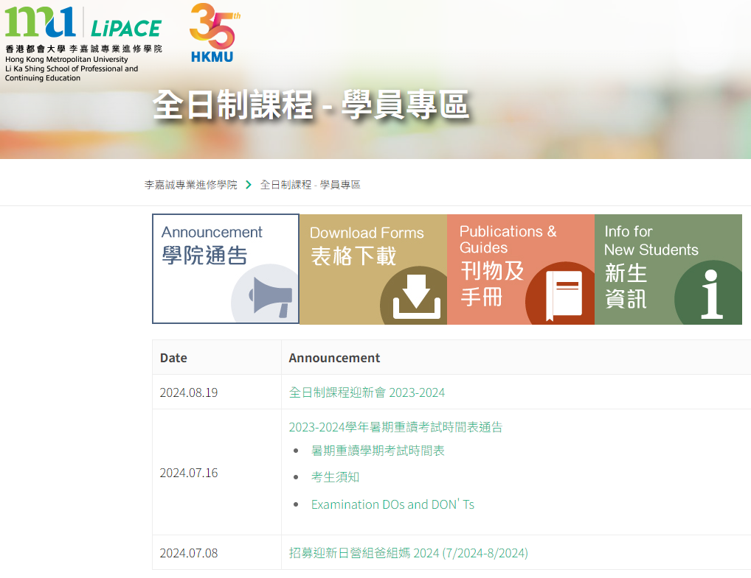
Checking Programme Timetable (Class Division)
查閱上課時間表(所屬班別)
Google Search
“LiPACE Student Area”
https://www.hkmu.edu.hk/lipace/tc/ftp-student-area/

Slide 46
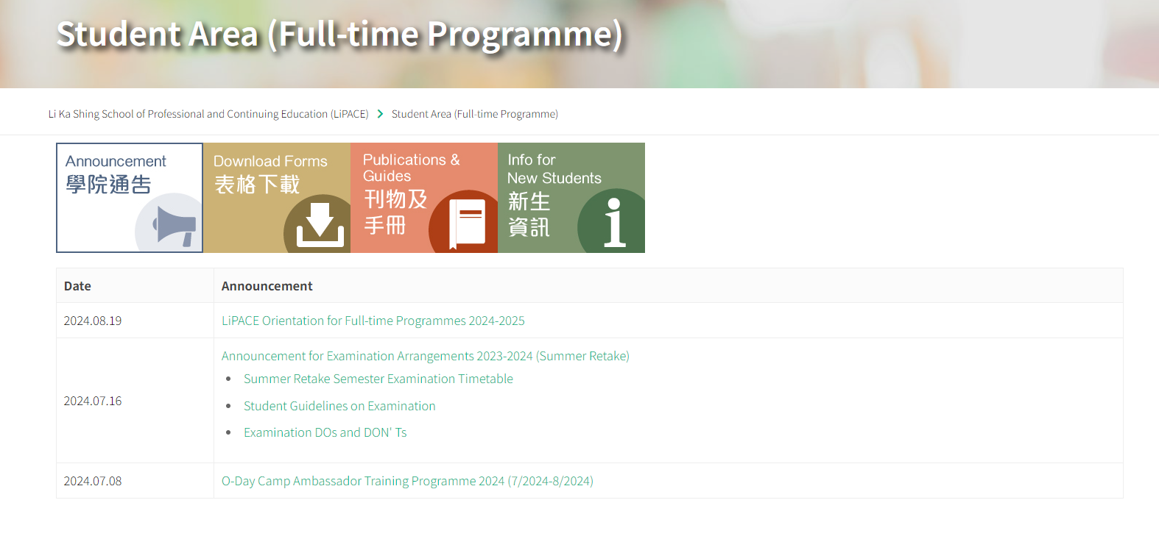
Checking Programme Timetable (Class Division)
查閱上課時間表(所屬班別)

Slide 47
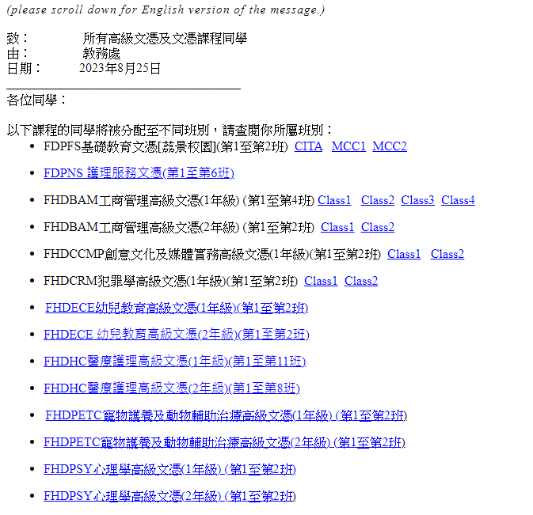
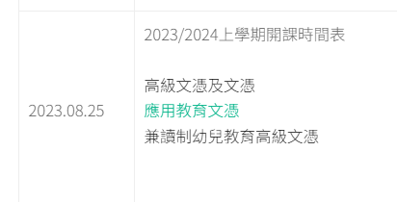
Checking Programme Timetable (Class Division)
查閱上課時間表(所屬班別)

Slide 48
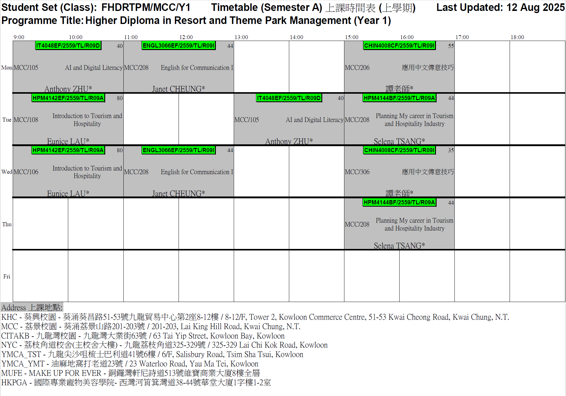
FHDRTPM Timetable

Slide 49
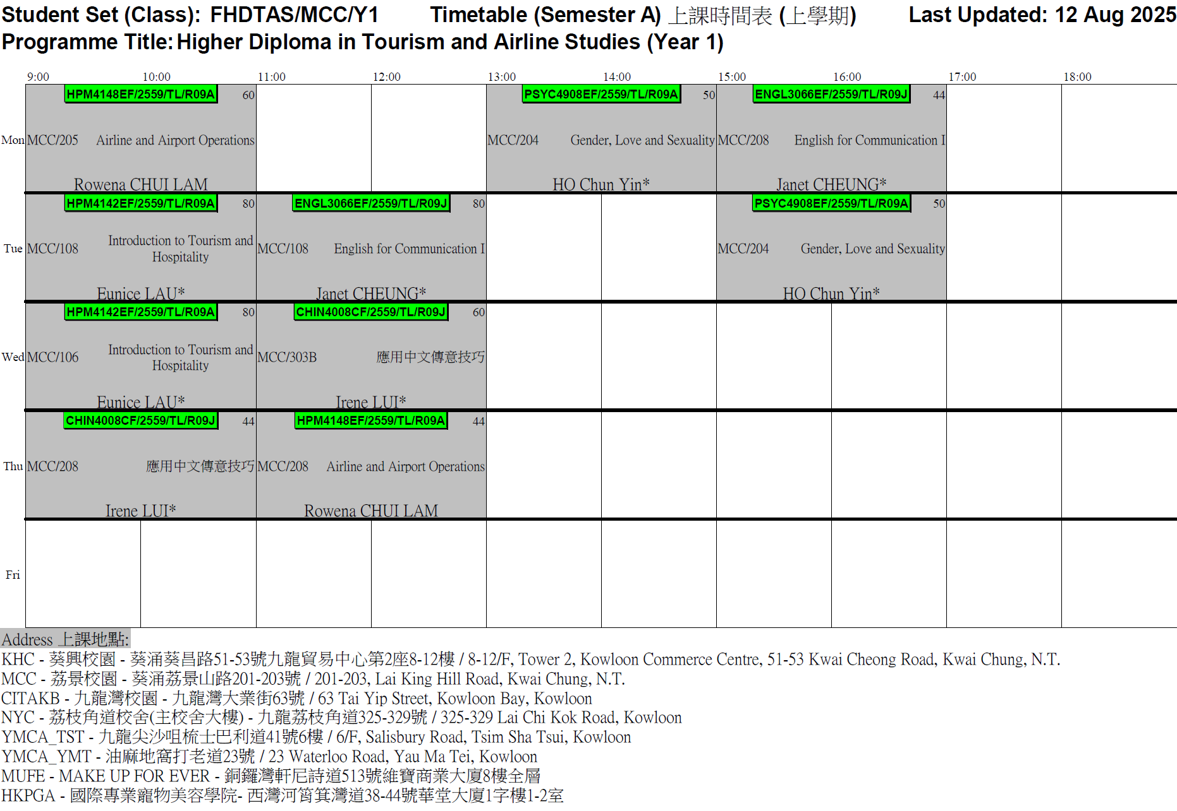
FHDTAS Timetable

Slide 50
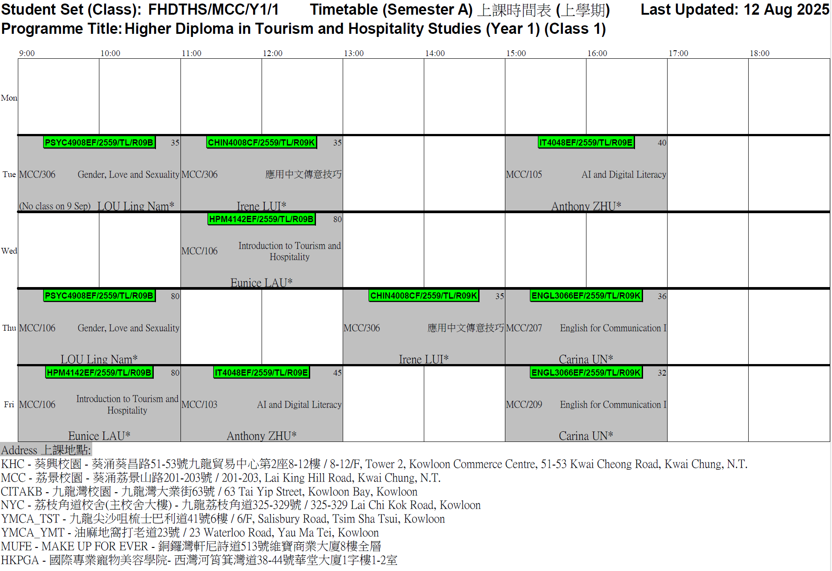
FHDTHS Timetable (Class 1)

Slide 51
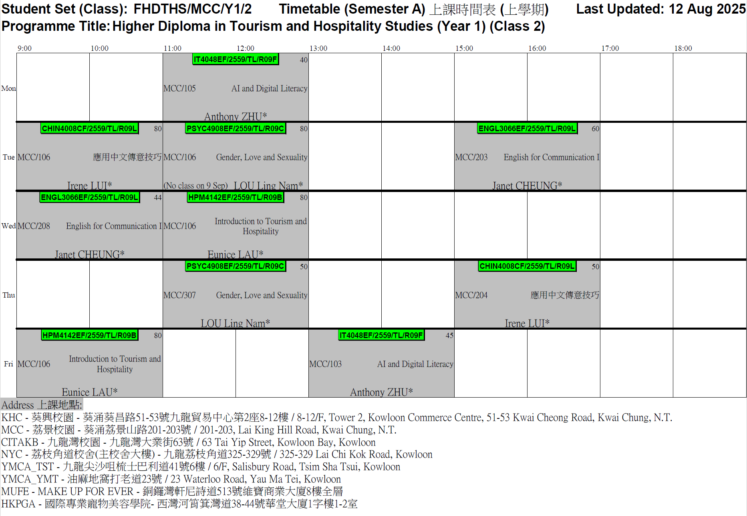
FHDTHS Timetable (Class 2)

Slide 52
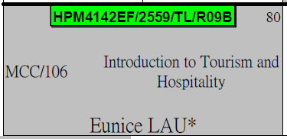
課程編號 / 學年 / 班號
Course Code / Intake / Class
HPM4142EF / 2559 / R09B
Teaching Venue
上課地點
Course Name
課程名稱
MCC - 荔景校園
(葵涌荔景山路201-203號)
201-203, Lai King Hill Road, Kwai Chung
Lecturer’s Name
講師名稱

Slide 53

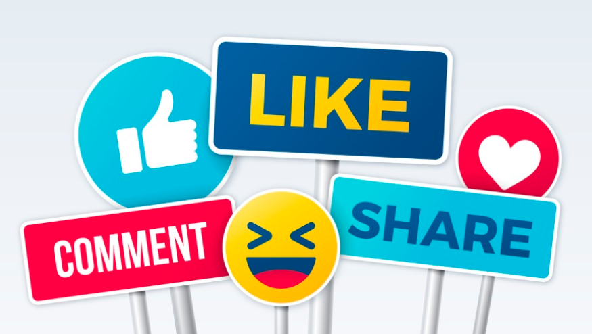
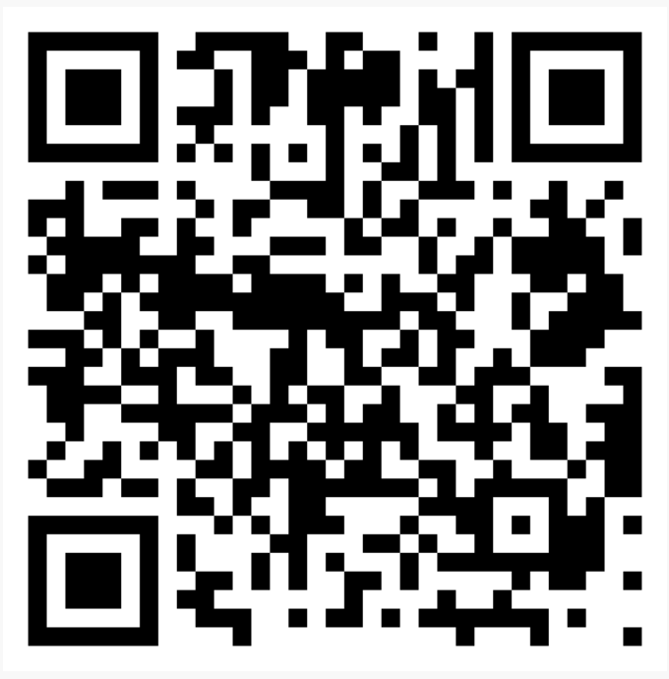

FB QR Code
FHDTHS Higher Diploma in Tourism and Hospitality Studies
      旅遊及款待業高級文憑
FHDTAS Higher Diploma in Tourism and Airline Studies
旅遊及航空業高級文憑
FHDRTPM Higher Diploma in Resort and Theme Park Management
度假區及主題樂園管理

Slide 54



Completion of Entry Survey 完成入學問卷調查
https://hkmu.qualtrics.com/jfe/form/SV_bpB3veks5h4YdZc
Collection of Student Card 領取學生證
To help us understand about your learning expectation and support at LiPACE, please complete the Entry Survey before you pick up your Student ID Card and save the screenshot of the last page .
為了讓我們更了解您的學習期望和所需支援，請在領取學生證前完成入學問卷調查，並將最後一頁屏幕截圖。
Please show the screenshot / email proof of survey completion for collecting the Student Card.
請在領取學生證時出示完成問卷的屏幕截圖/電子郵件證明。

Slide 55
FHDTHS
Enquiry 查詢
Programme Leader | Ms. Crystal CHEN
Office Number / WhatsApp | 3588 7851
Email | zchen@hkmu.edu.hk
Programme Administrative Support | Mr. Frizen TSE
Email | fkhtse@hkmu.edu.hk
WhatsApp | 3588 XXXX

Slide 56
FHDRTPM & FHDTAS
Enquiry 查詢
Programme Leader | Mrs. Rowena CHUI LAM
Office Number / WhatsApp | 3588 XXXX
Email | rfylam@hkmu.edu.hk
Programme Administrative Support | Mr. Frizen TSE
Email | fkhtse@hkmu.edu.hk
WhatsApp | 3588 XXXX

Slide 57
THANK YOU

