Slide 1


心理學高級文憑
Higher Diploma in Psychology

Slide 2
Today’s Agenda
歡迎及介紹 Welcome and Introductions
重要資訊 Essential Information
領取學生證 Student Card Collection

Slide 3
Welcome to LiPACE!

Slide 4
歡迎及介紹
Welcome and Introductions

Slide 5
歡迎及介紹 Welcome and Introductions
學院重要成員 Key Staffs of LiPACE
院長歡迎辭 Welcome Message from Dean
課程重要成員 Key Staffs of Programme
破冰活動 Icebreaking Activity
導師網上見面 Zoom Introduction to Instructors
大合照 Group Photo
查詢方式 Contact Information
通訊禮儀 WhatsApp/Email Etiquette

Slide 6

學院重要成員 Key Staffs of LiPACE
Dean 院長
Dr Benjamin CHAN Tak-yuen
曾德源博士

Slide 7
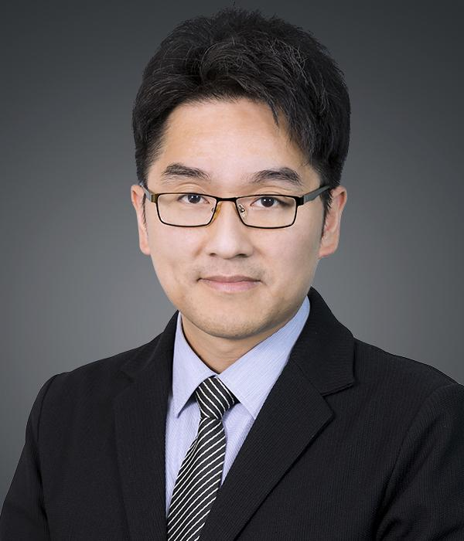
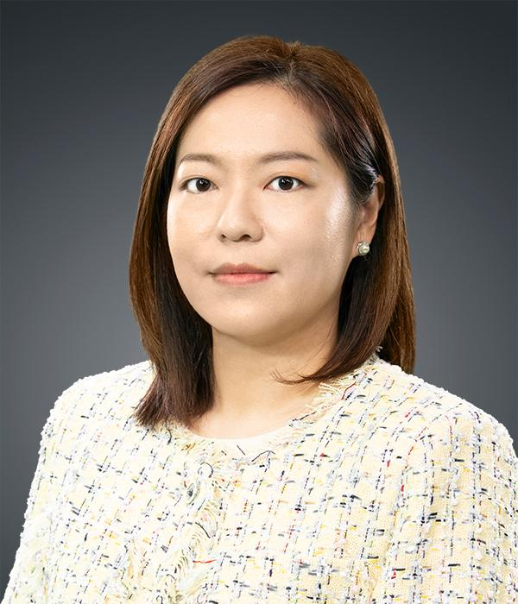

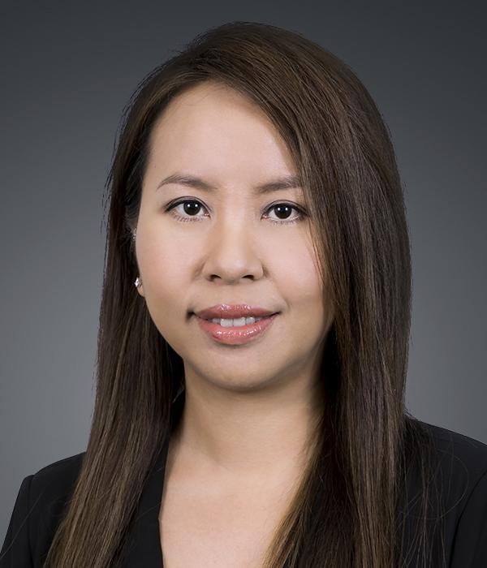
Associate Directors 副院長
學院重要成員 Key Staffs of LiPACE
Dr Ching Ka Wai Larry
程家偉博士
Dr Chen Yi-Fan Yvonne
陳羿帆博士
Ms. Pang Hoi Ning Helen
彭海寧女士
Dr Chim Hiu Man Kathleen
詹曉雯博士

Slide 8
歡迎及介紹 Welcome and Introductions
學院重要成員 Key Staffs of LiPACE
院長歡迎辭 Welcome Message from Dean
課程重要成員 Key Staffs of Programme
破冰活動 Icebreaking Activity
導師網上見面 Zoom Introduction to Instructors
大合照 Group Photo
查詢方式 Contact Information
通訊禮儀 WhatsApp/Email Etiquette

Slide 9
Dean's Speech​
院長致辭​
https://drive.google.com/file/d/1lzeKxWE_EapKwS2VI7k-CrMUPPCCVfdT/view?usp=drive_link

Slide 10
歡迎及介紹 Welcome and Introductions
學院重要成員 Key Staffs of LiPACE
院長歡迎辭 Welcome Message from Dean
課程重要成員 Key Staffs of Programme
破冰活動 Icebreaking Activity
導師網上見面 Zoom Introduction to Instructors
大合照 Group Photo
查詢方式 Contact Information
通訊禮儀 WhatsApp/Email Etiquette

Slide 11
歡迎及介紹 Welcome and Introductions
學院重要成員 Key Staffs of LiPACE
院長歡迎辭 Welcome Message from Dean
課程重要成員 Key Staffs of Programme
破冰活動 Icebreaking Activity
導師網上見面 Zoom Introduction to Instructors
大合照 Group Photo
查詢方式 Contact Information
通訊禮儀 WhatsApp/Email Etiquette

Slide 12
Let’s Get Started!
破冰活動 Icebreaking Activity

Slide 13
歡迎及介紹 Welcome and Introductions
學院重要成員 Key Staffs of LiPACE
院長歡迎辭 Welcome Message from Dean
課程重要成員 Key Staffs of Programme
破冰活動 Icebreaking Activity
導師網上見面 Zoom Introduction to Instructors
大合照 Group Photo
查詢方式 Contact Information
通訊禮儀 WhatsApp/Email Etiquette

Slide 14

導師網上見面 Zoom Introduction to Instructors

Slide 15
歡迎及介紹 Welcome and Introductions
學院重要成員 Key Staffs of LiPACE
院長歡迎辭 Welcome Message from Dean
課程重要成員 Key Staffs of Programme
破冰活動 Icebreaking Activity
導師網上見面 Zoom Introduction to Instructors
大合照 Group Photo
查詢方式 Contact Information
通訊禮儀 WhatsApp/Email Etiquette

Slide 16

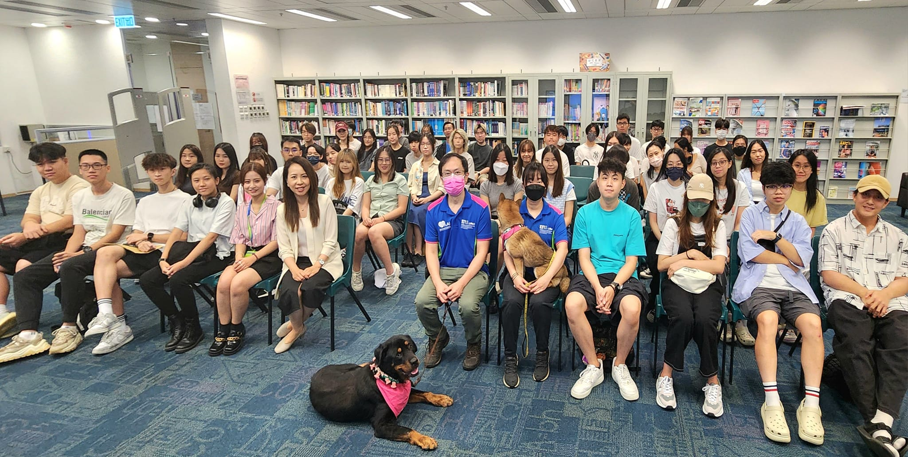

大合照 Group Photo
Orientation 2023
Orientation 2024

Slide 17
For Enquiry 查詢
Email | lipace_sc_ft@hkmu.edu.hk
Programme Leader | Ms Alice Lai | 3588 7912
Programme Administration Support | Ms. Jeslyn Li | 3588 7881
Course-related Support | Course Instructor
Online Learning Environment (OLE) | (852) 2768 6454 | olemaster@hkmu.edu.hk
Student IT Helpdesk/Hotline | (852) 2711 2100 | itohelp@hkmu.edu.hk
Please provide your student details (Full name, student ID, Programme, Class)
and screenshots in the email.

Slide 18
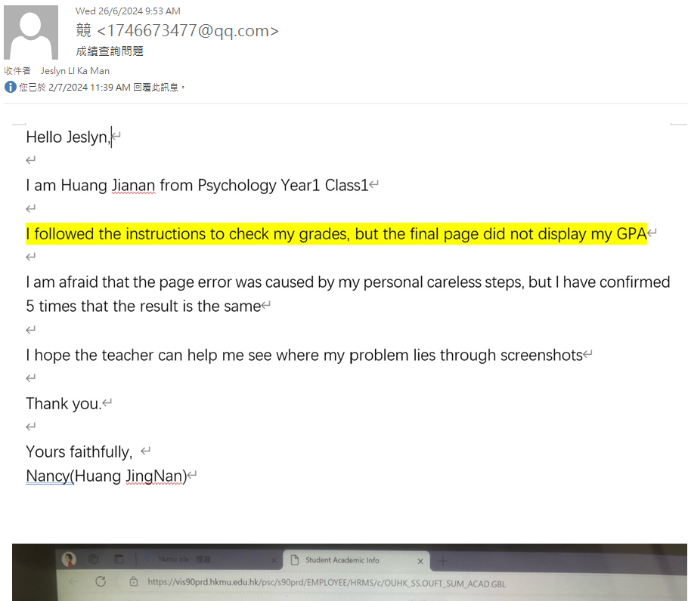
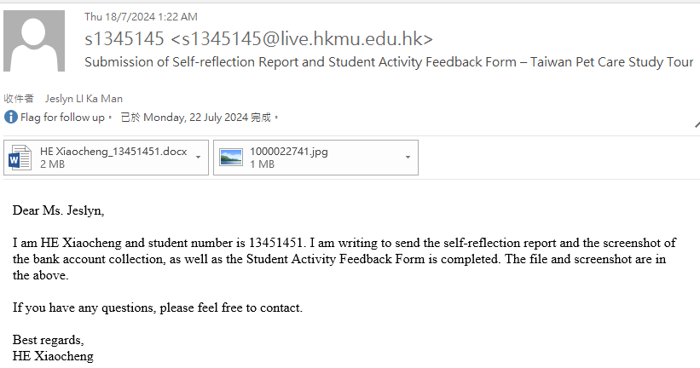
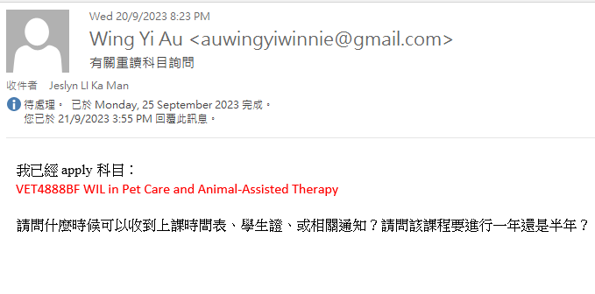
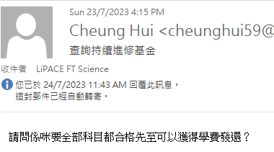
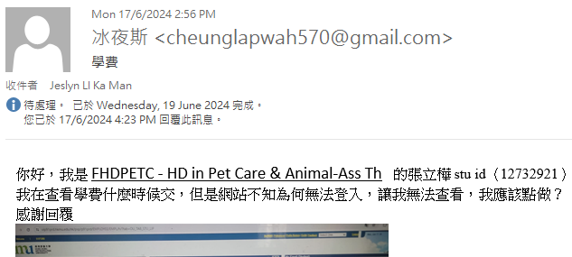
Examples of Enquiry 查詢例子 (Email)
Email subject, greeting, student details, sign-off, screenshots (if any) should be included in the email
Good Examples:
Bad Examples:
Email subject
Greeting
Student details
Thank you
Sign-off
Screenshot

Slide 19
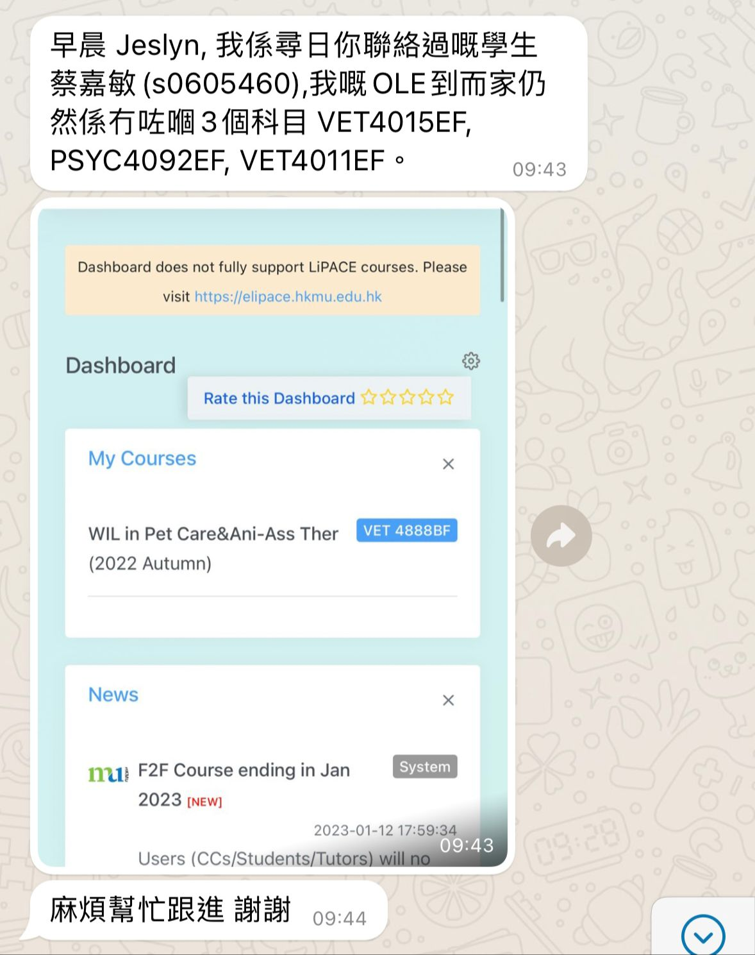
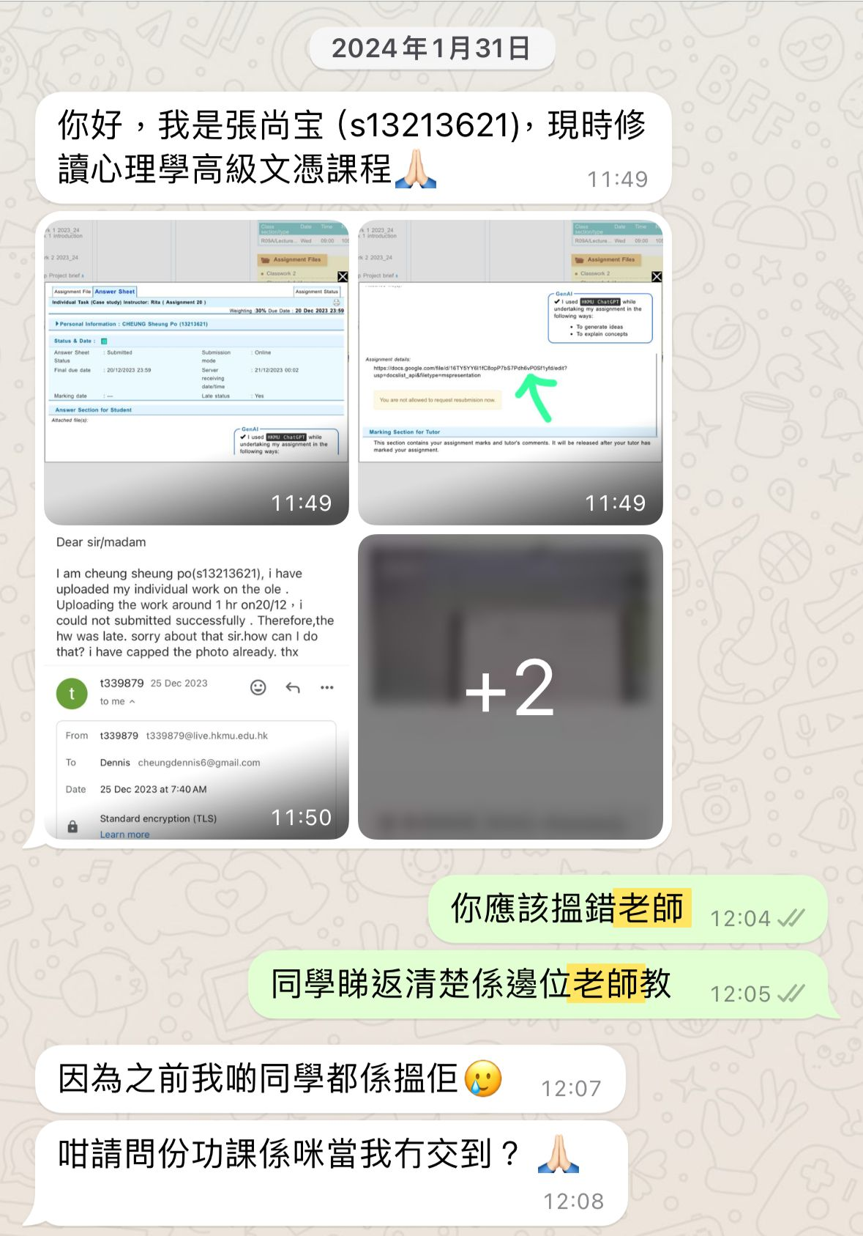
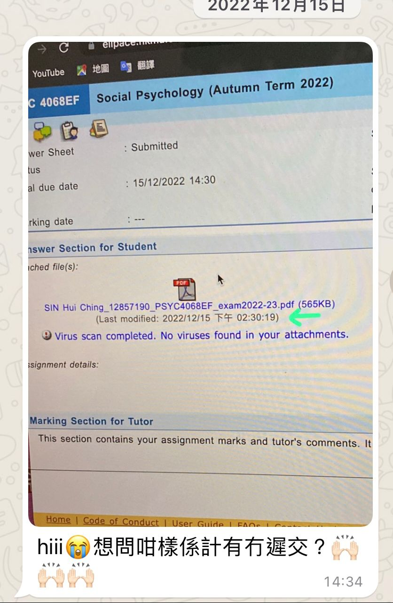
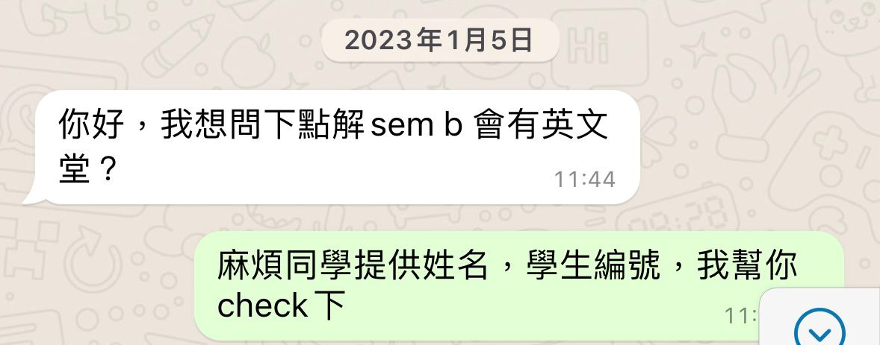
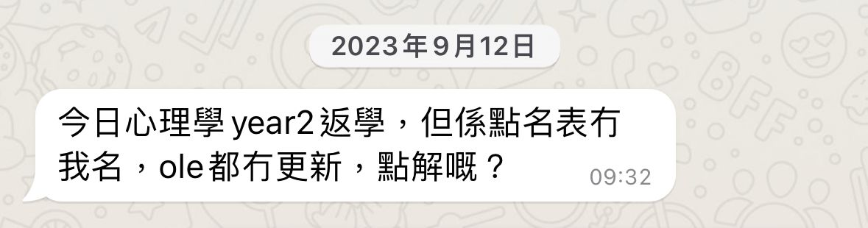
Examples of Enquiry 查詢例子 (WhatsApp)
Student details with screenshots (if any) should be provided.
Good Examples:
Bad Examples:
No student details provided

Slide 20
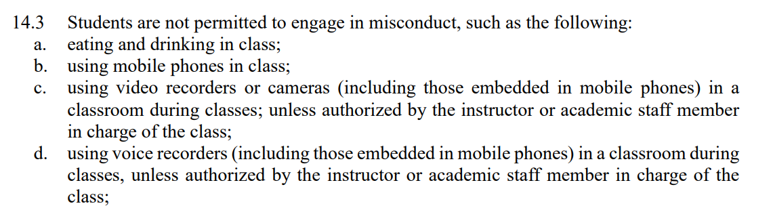
Classroom Etiquette
Students should not use any devices to record or take photographs unless authorised by the instructor

Slide 21

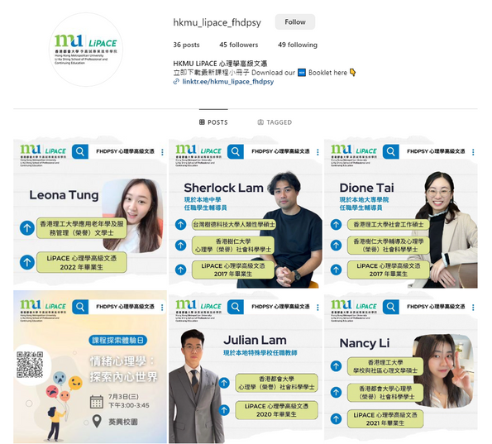


Follow us
Facebook page
@HKMULIPACEFHDPSY
Instagram page
@hkmu_lipace_fhdpsy

Slide 22
重要資訊
Essential Information

Slide 23
重要資訊 Essential Information
課程類別及升學階梯 Programme Type & Study Pathway
學生手冊 Student Handbook
查閱重要資訊 Checking Important Information
課程時間表 Programme Timetable
啟動電郵戶口 Activation of Email Account
MyHKMU 及 網上學習系統 MyHKMU & Online Learning Environment (OLE)
課堂出席要求 Attendance Requirements
語文科目豁免政策 Language Course Exemption
3i文化倡議、外籍英語老師及英語學習支援 Introduction to 3i activities, our NET teacher and the English grant project
學生事務處介紹 Introduction to Student Affairs Office

Slide 24
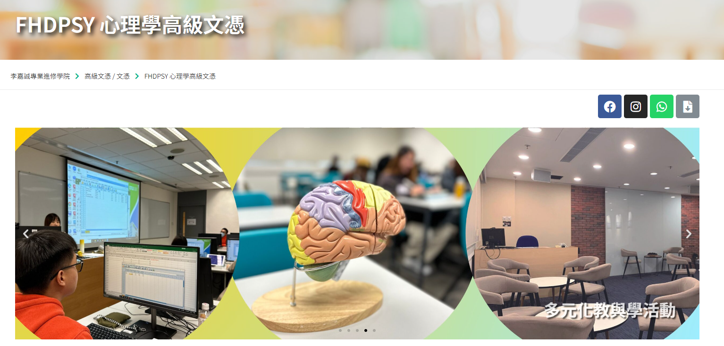
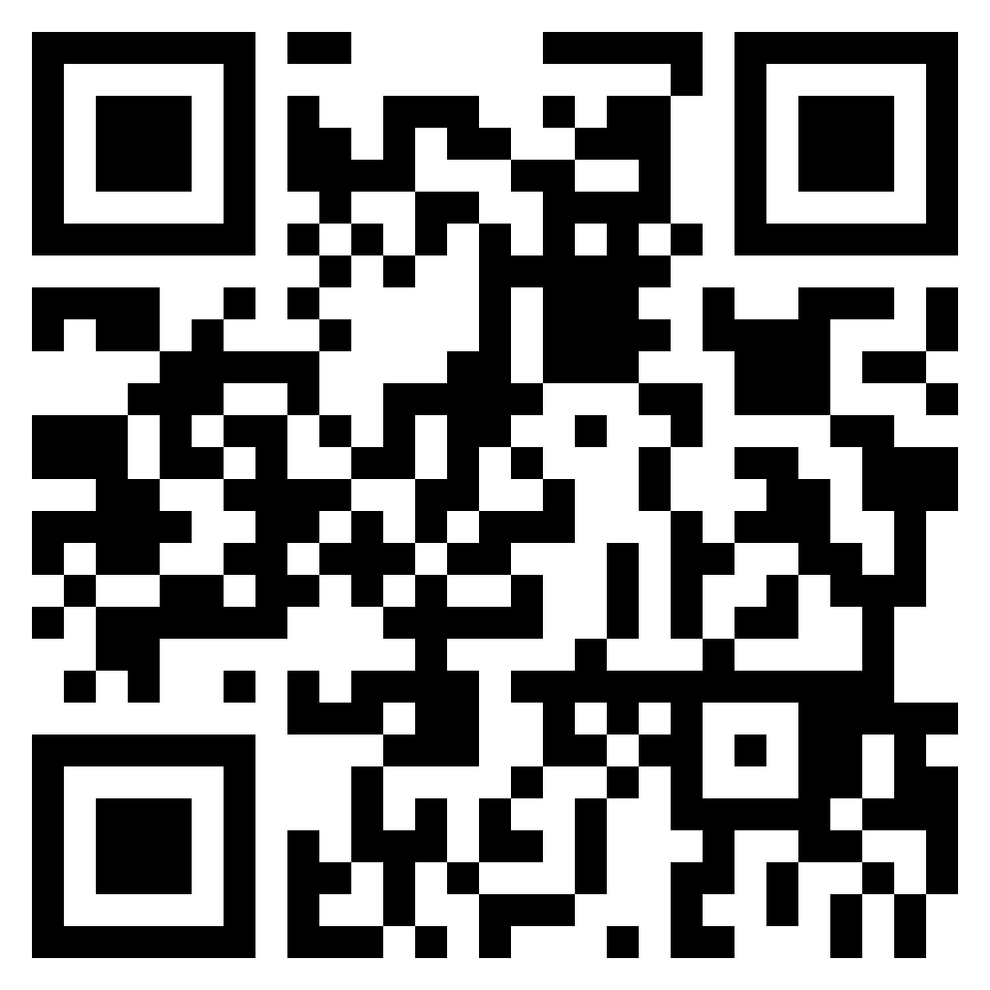
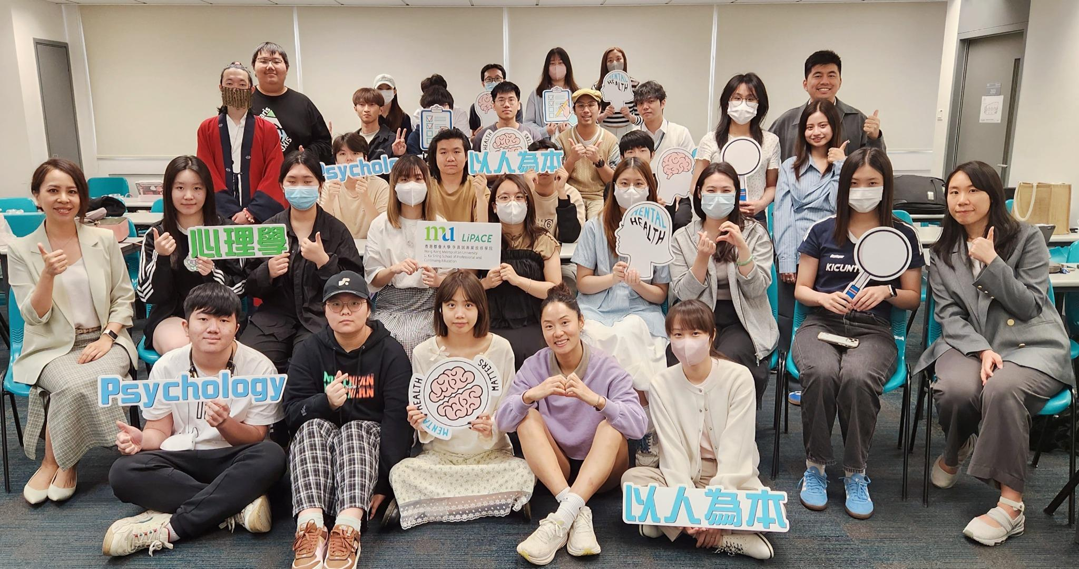
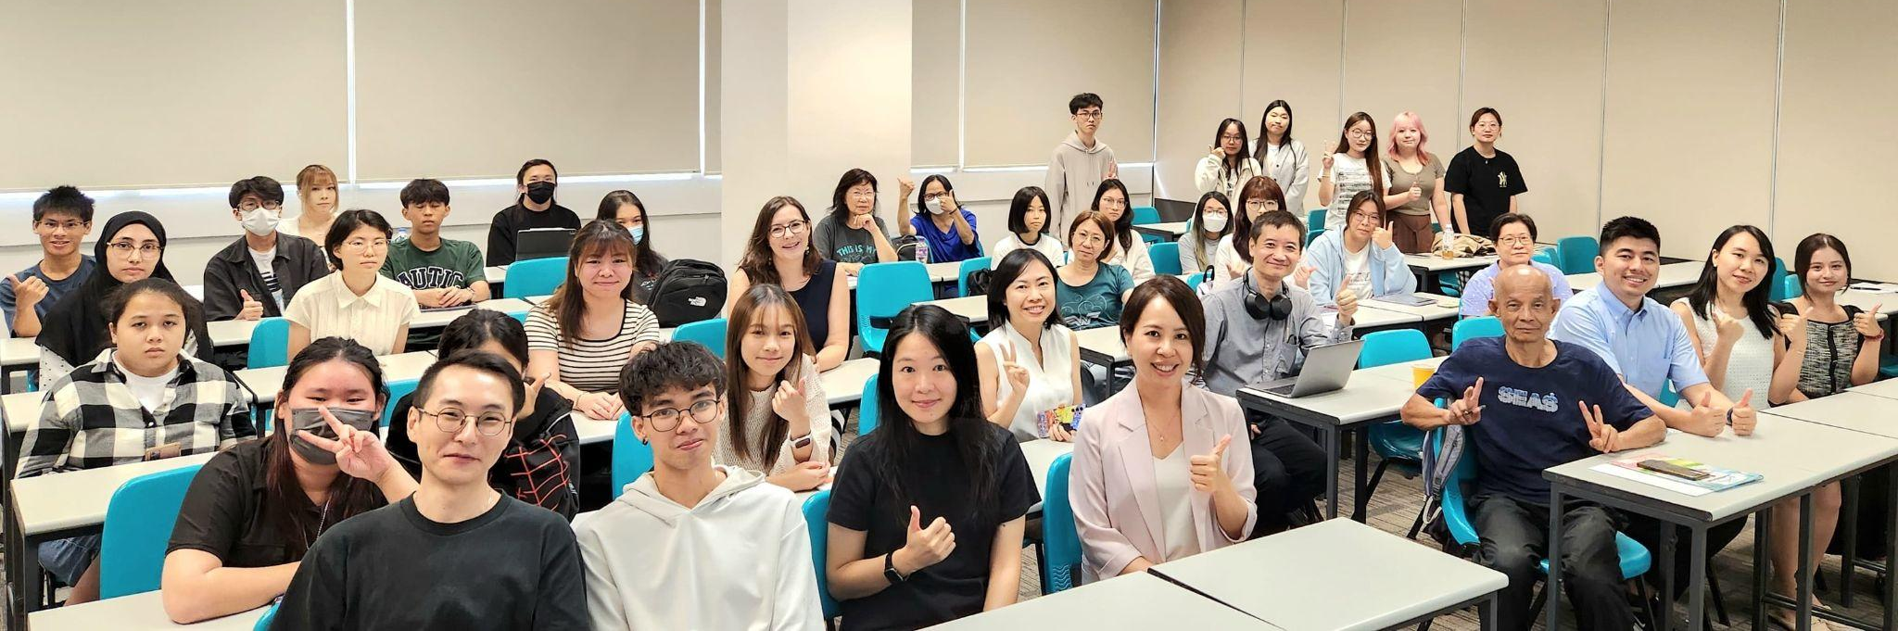
Higher Diploma in Psychology
心理學高級文憑
(Since 2012)
2023-25 Cohort
2024-26 Cohort

Slide 25



課程類別及升學階梯
Programme Type & Study Pathway
應用教育文憑課程
Diploma of Applied Education
文憑課程 Diploma
(1 year full-time)
高級文憑課程
Higher Diploma
副學士課程
Associate Degree
(2 years full-time)
本地或海外學位課程
Local or Overseas Degree
(2-3 years full-time/
2 years part-time)

Slide 26
本地學士銜接學位課程
Top-up / 3-Year Senior Year Degree Programme
應用教育文憑Diploma of Applied Education
心理學與輔導學
高級文憑
Higher Diploma
心理學
Psychology
學士學位
Degree
HKMU
BSSc (Hons) in Psychology /Psychology & Mental Health / Applied Social Studies / Politics & Public Administration
EdUHK
BSSc (Hons) in Psychology / BA (Hons) in Special Education
HKSYU
BSSc (Hons) Psychology / Psychology & Counselling
QF 3
QF 4
QF 5

Slide 27
課程結構
Programme Structure
  Introduction to Psychology 心理學概論
  Learning and Motivation for Personal Development 個人成長的學習與動機
  Biological and Cognitive Psychology 生物及認知心理學
  Developmental Psychology 發展心理學
  Social Psychology 社會心理學
  Abnormal Psychology 異常心理學
  Positive Psychology and Personal Growth 正向心理學與個人成長
  Introduction to Counselling 輔導學入門
  Personality Theories 人格理論
  Research Methods and Statistics 研究方法與統計
  Effective Chinese Communication Skills 應用中文傳意技巧
  English for Communication I, II & III 英語溝通技巧(一)、(二)及(三)
  AI and Digital Literacy 人工智能與數位素養
  Medicines and Supplements in Common Use (GE Course) 常用藥物與保健品 ( 通識科目 )
  Chinese Culture Appreciation (GE Course) 中華文化欣賞 ( 通識科目 )
  Equipment and Technologies for Smart Aging (GE Course) 樂齡產品與科技( 通識科目 )
  Work-integrated Learning in Psychology^ 心理學實習^

Slide 28
重要資訊 Essential Information
課程類別及升學階梯 Programme Type & Study Pathway
學生手冊 Student Handbook
查閱重要資訊 Checking Important Information
啟動電郵戶口 Activation of Email Account
MyHKMU 及 網上學習系統 MyHKMU & Online Learning Environment (OLE)
課堂出席要求 Attendance Requirements
語文科目豁免政策 Language Course Exemption
3i文化倡議、外籍英語老師及英語學習支援 Introduction to 3i activities, our NET teacher and the English grant project
學生事務處介紹 Introduction to Student Affairs Office

Slide 29
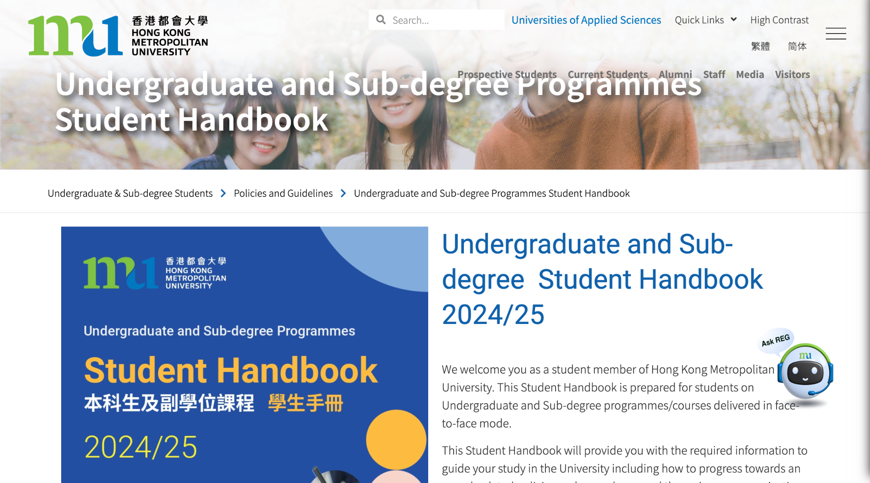
學生手冊 Student Handbook
Academic Integrity

Slide 30
重要資訊 Essential Information
課程類別及升學階梯 Programme Type & Study Pathway
學生手冊 Student Handbook
查閱重要資訊 Checking Important Information
啟動電郵戶口 Activation of Email Account
MyHKMU 及 網上學習系統 MyHKMU & Online Learning Environment (OLE)
課堂出席要求 Attendance Requirements
語文科目豁免政策 Language Course Exemption
3i文化倡議、外籍英語老師及英語學習支援 Introduction to 3i activities, our NET teacher and the English grant project
學生事務處介紹 Introduction to Student Affairs Office

Slide 31
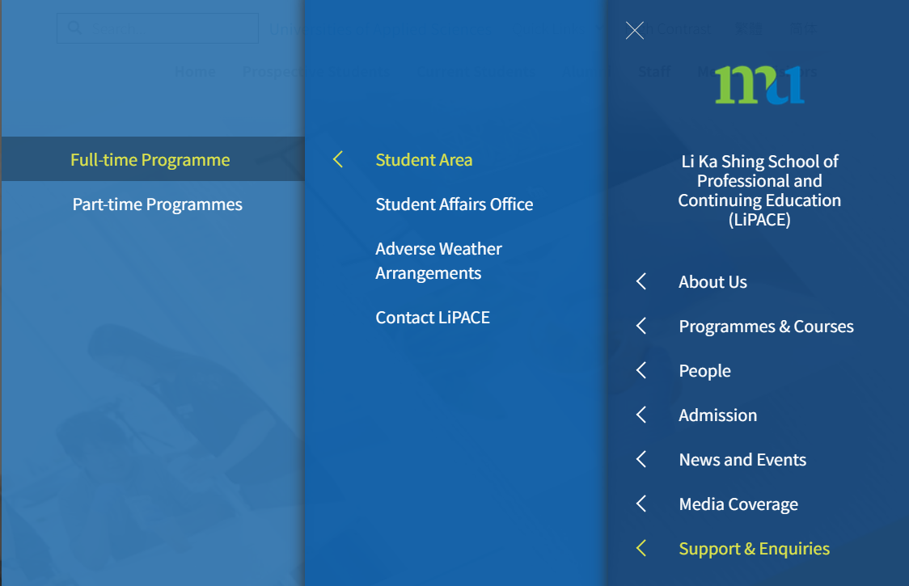
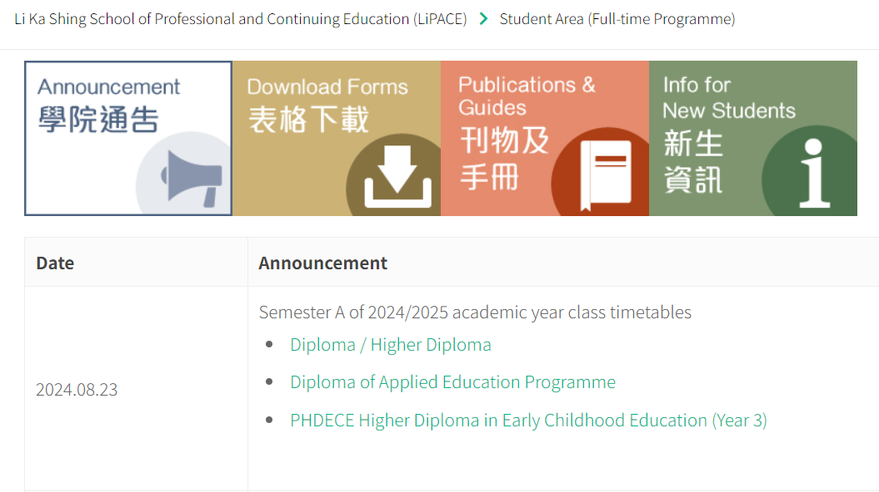
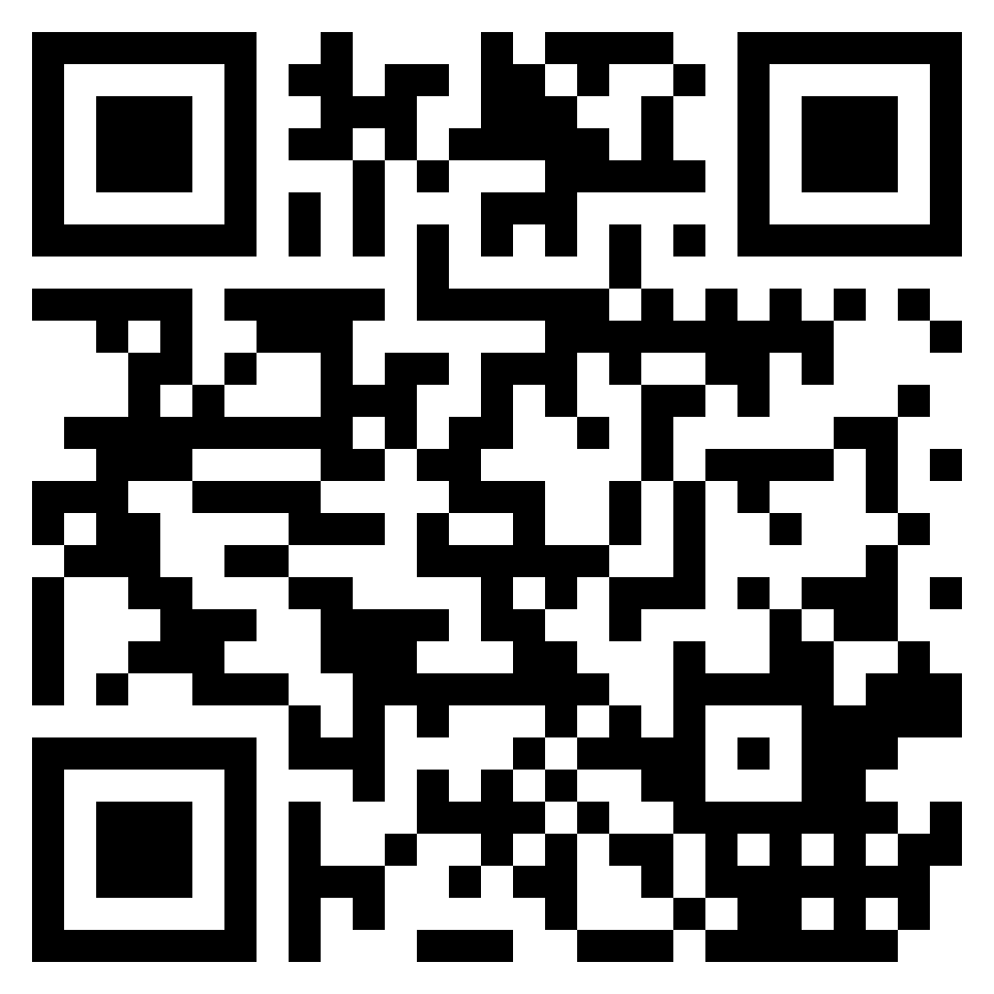
查閱重要資訊 Checking Important Information
登入「學員專區」 / Access to “Student Area”
LiPACE Home Page > Support & Enquiries > Student Area (Full-time Programme)
網址/Website: www.hkmu.edu.hk/lipace/ftp/studentarea

Slide 32
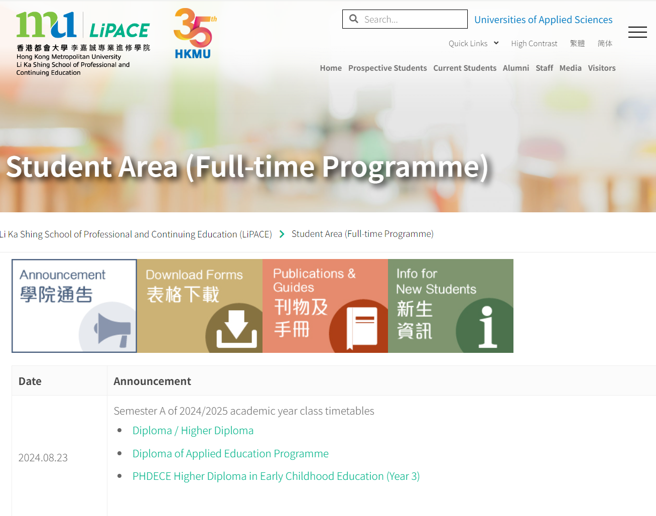
上課時間表 Class Timetable

Slide 33
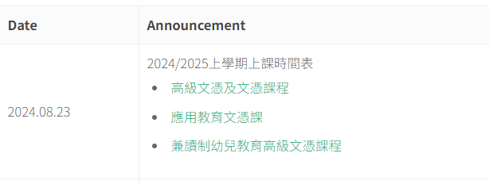
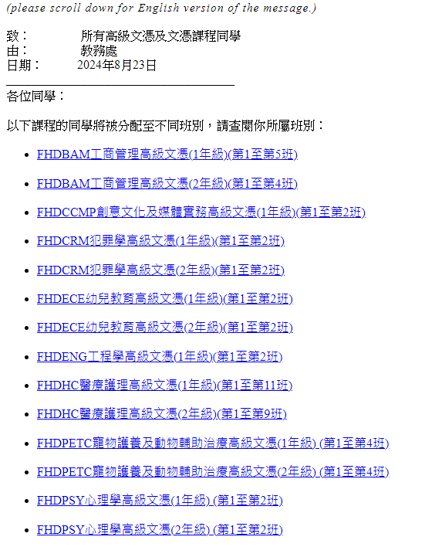
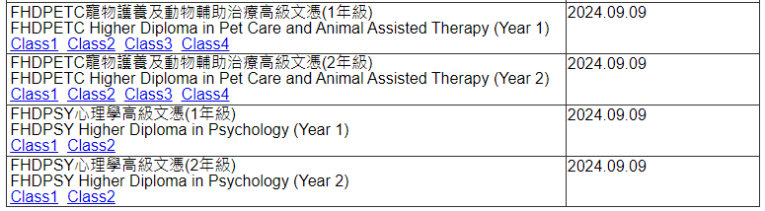
上課時間表 Class Timetable
Checking Class List

Slide 34
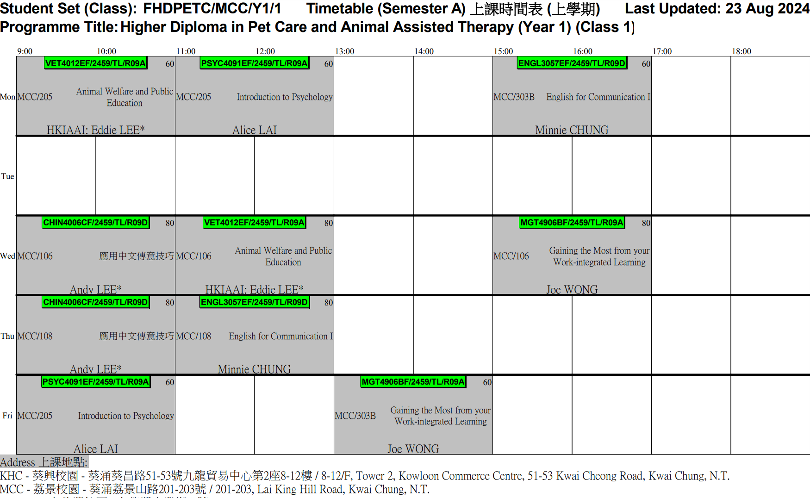
上課時間表 Class Timetable
Course code
Class no.
Venue
Course Title
Name of Instructor

Slide 35
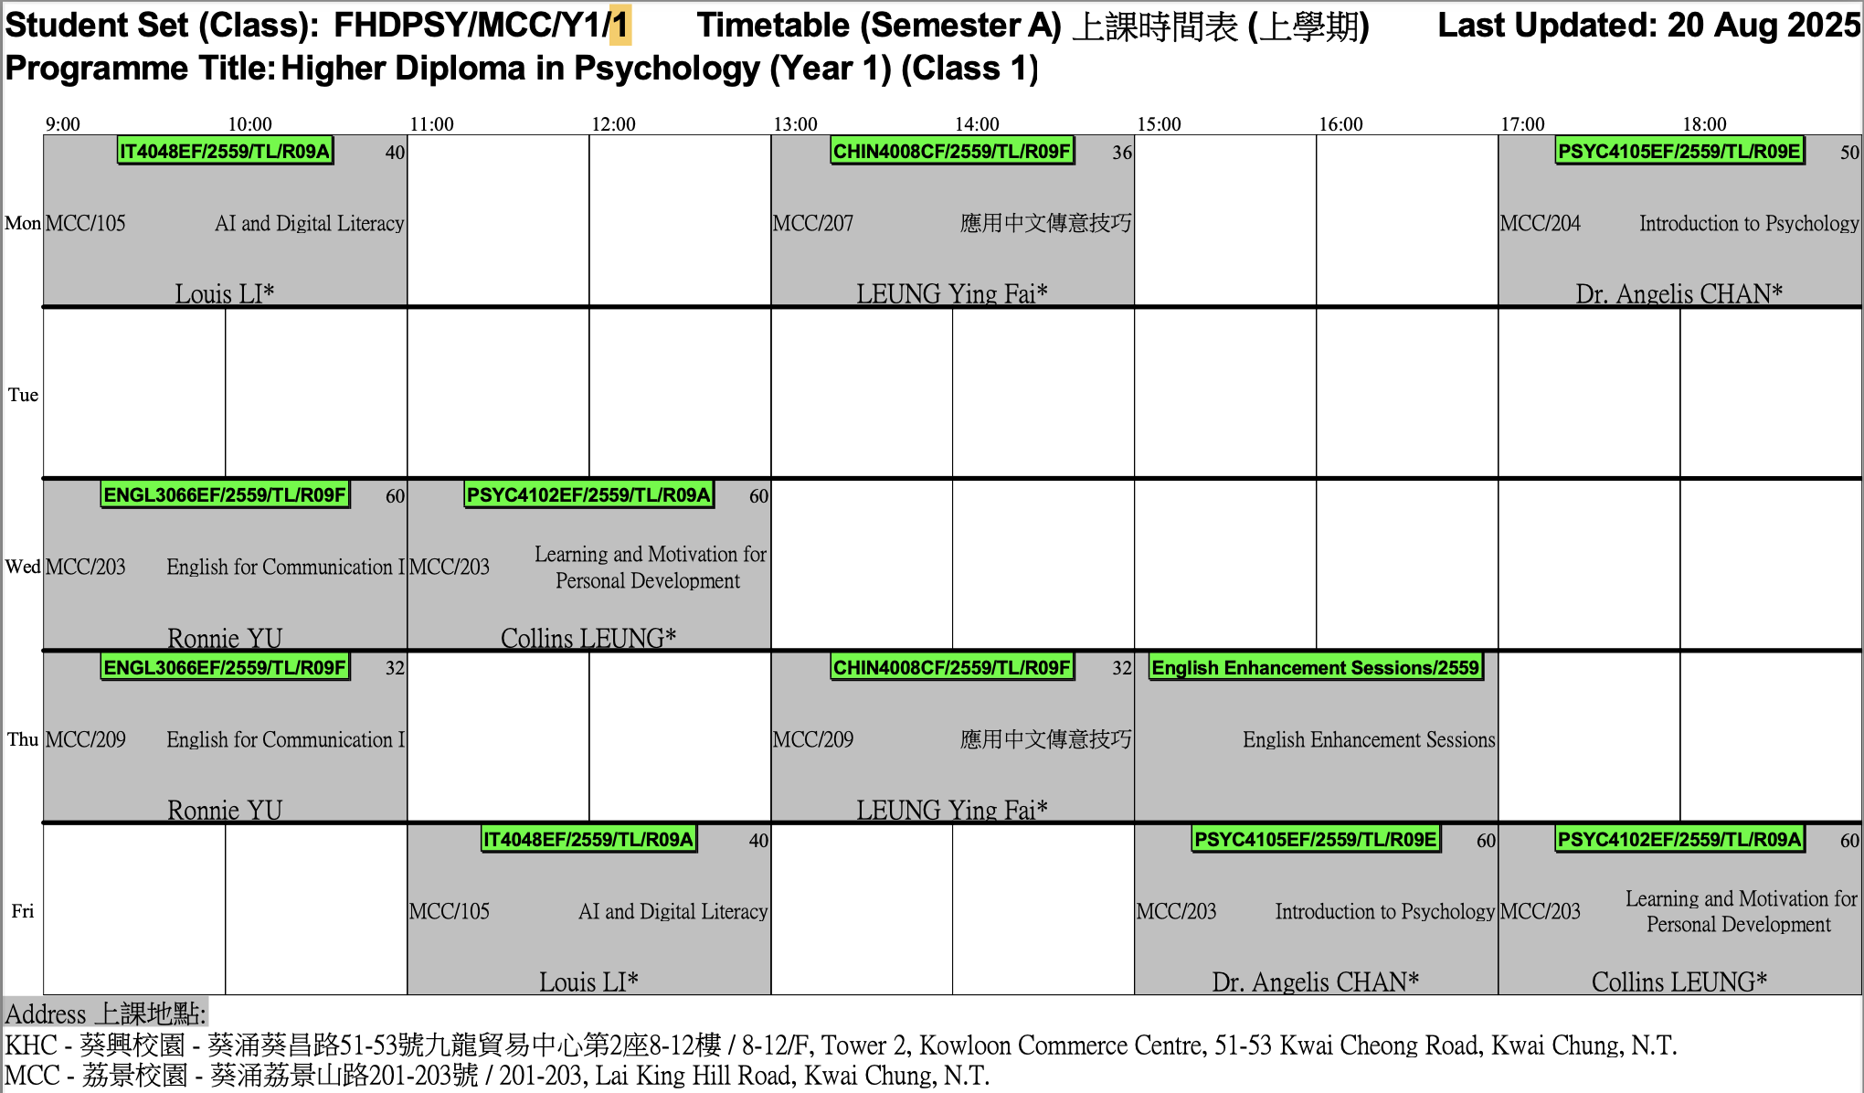
Timetable - FHDPSY Year 1 Class 1

Slide 36
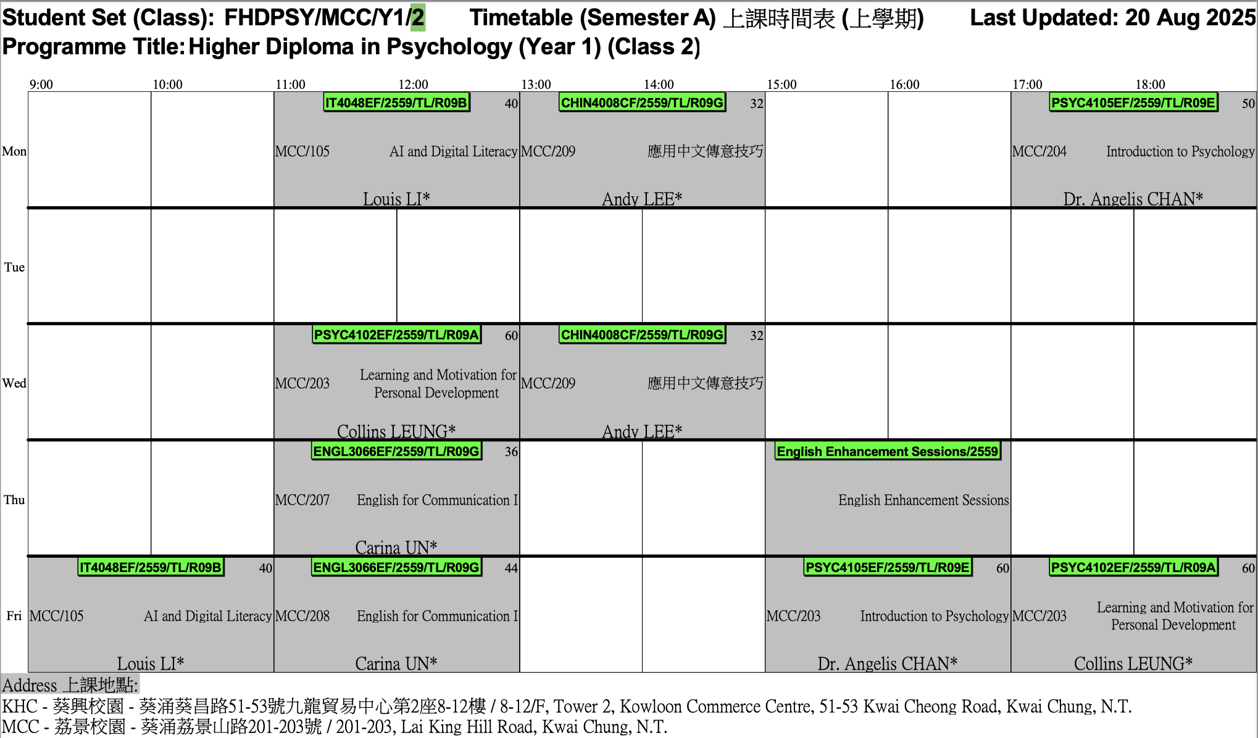
Timetable - FHDPSY Year 1 Class 2

Slide 37
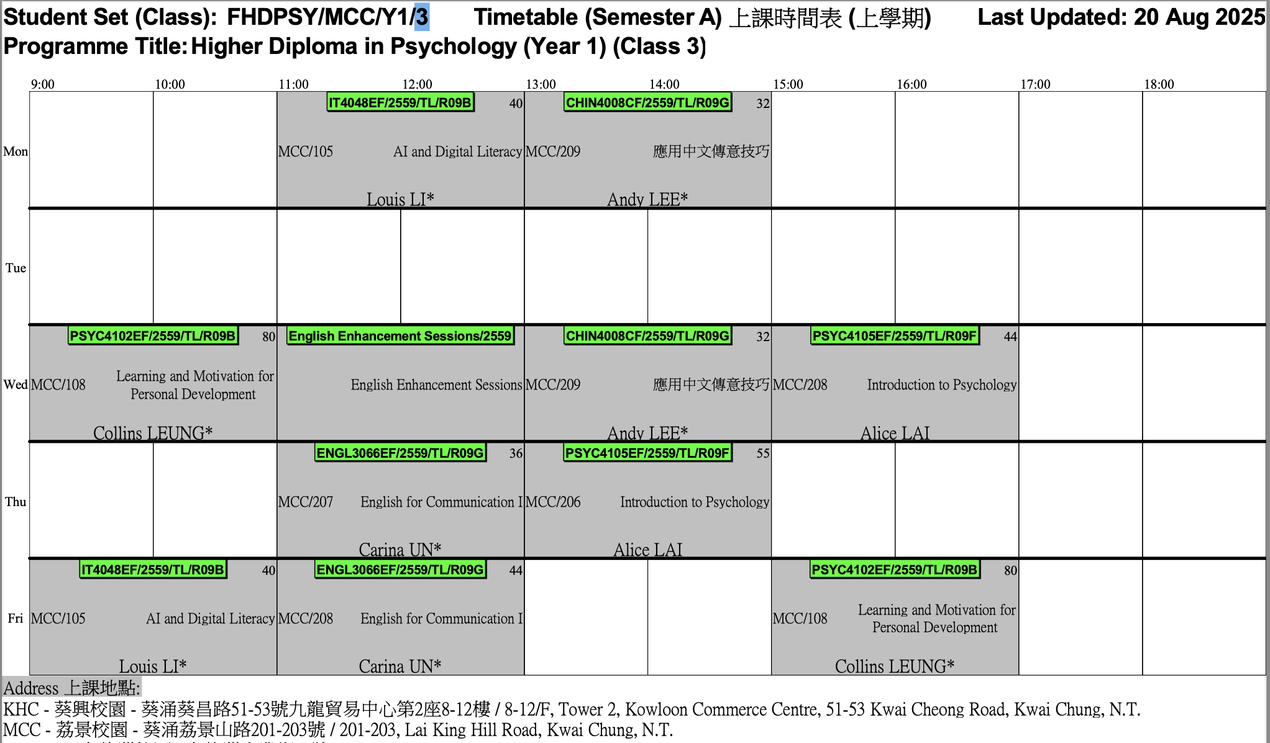
Timetable - FHDPSY Year 1 Class 3

Slide 38
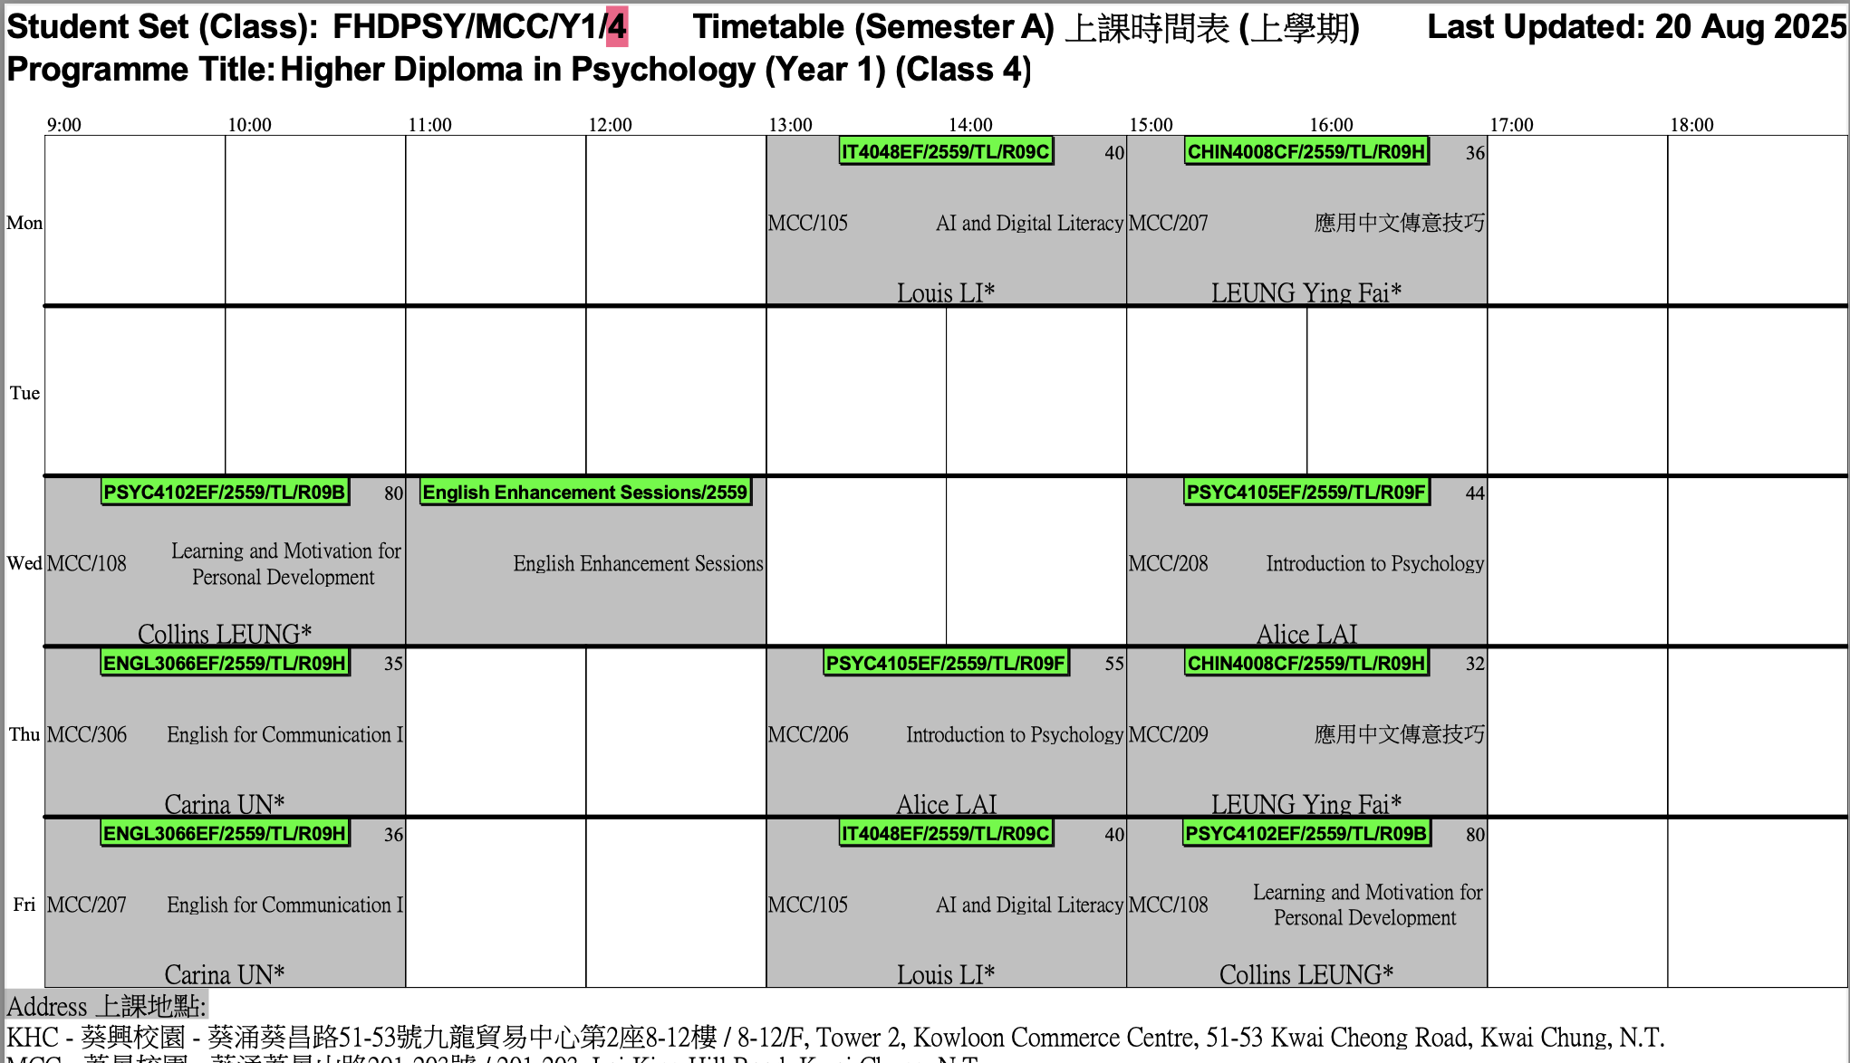
Timetable - FHDPSY Year 1 Class 4

Slide 39

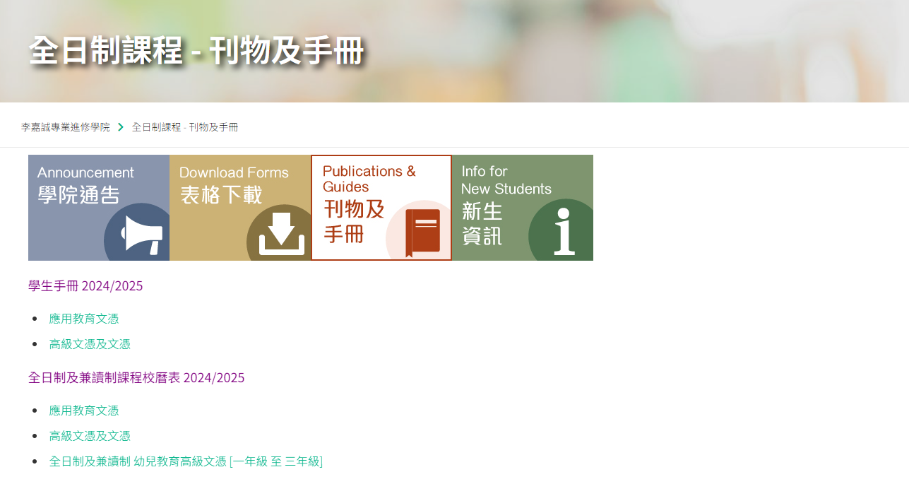
其他重要資訊 Other Important Information
Student Handbook
Academic Calendar

Slide 40
重要資訊 Essential Information
課程類別及升學階梯 Programme Type & Study Pathway
學生手冊 Student Handbook
查閱重要資訊 Checking Important Information
啟動電郵戶口 Activation of Email Account
MyHKMU 及 網上學習系統 MyHKMU & Online Learning Environment (OLE)
課堂出席要求 Attendance Requirements
語文科目豁免政策 Language Course Exemption
3i文化倡議、外籍英語老師及英語學習支援 Introduction to 3i activities, our NET teacher and the English grant project
學生事務處介紹 Introduction to Student Affairs Office

Slide 41
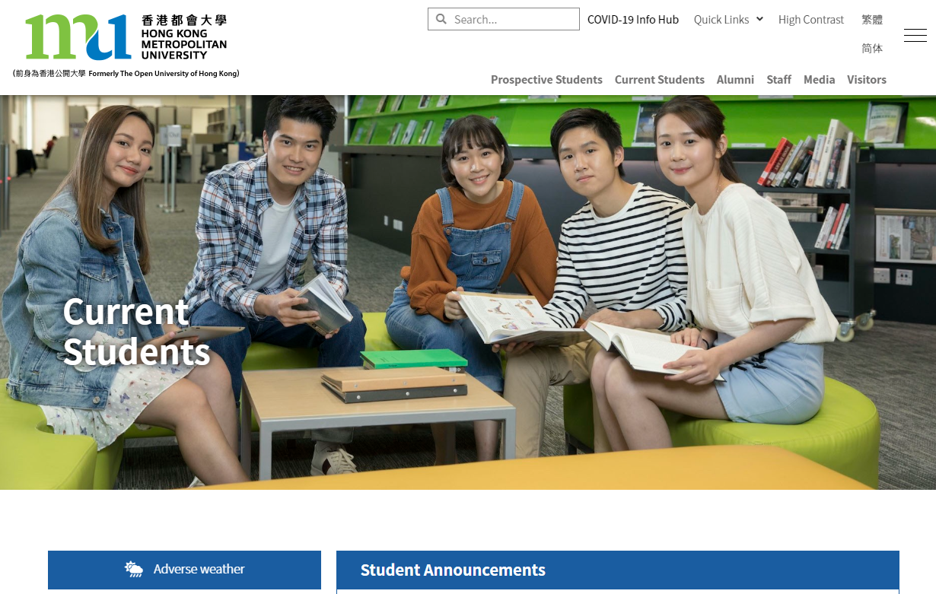
啟動電郵戶口 Activation of Email Account

Slide 42
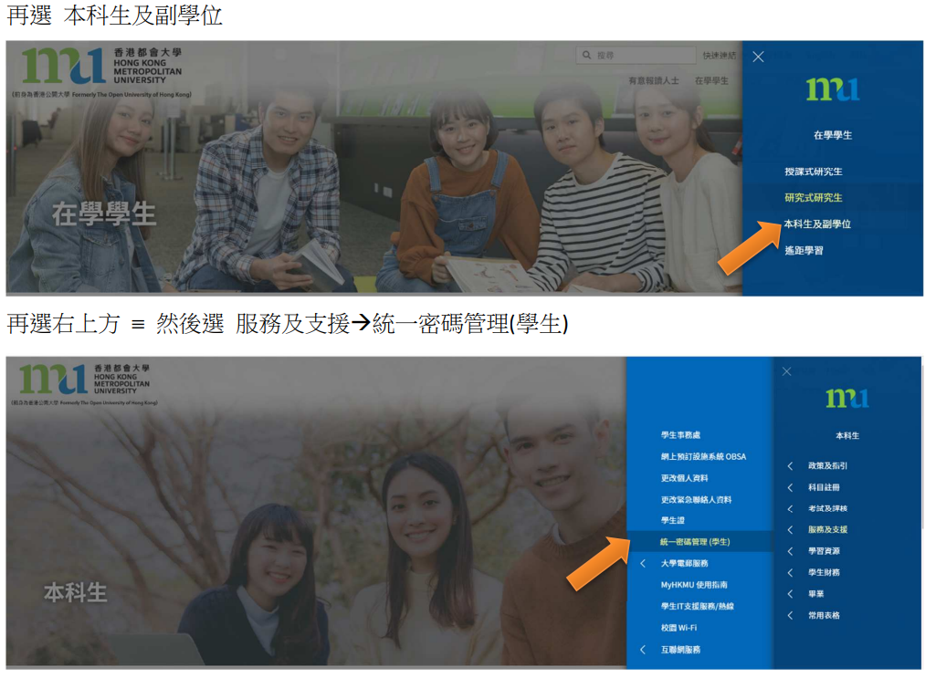
啟動電郵戶口 Activation of Email Account

Slide 43
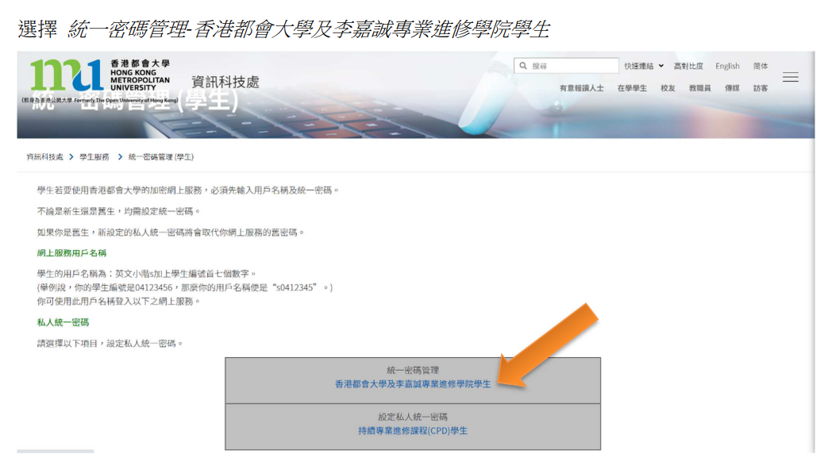
啟動電郵戶口 Activation of Email Account

Slide 44
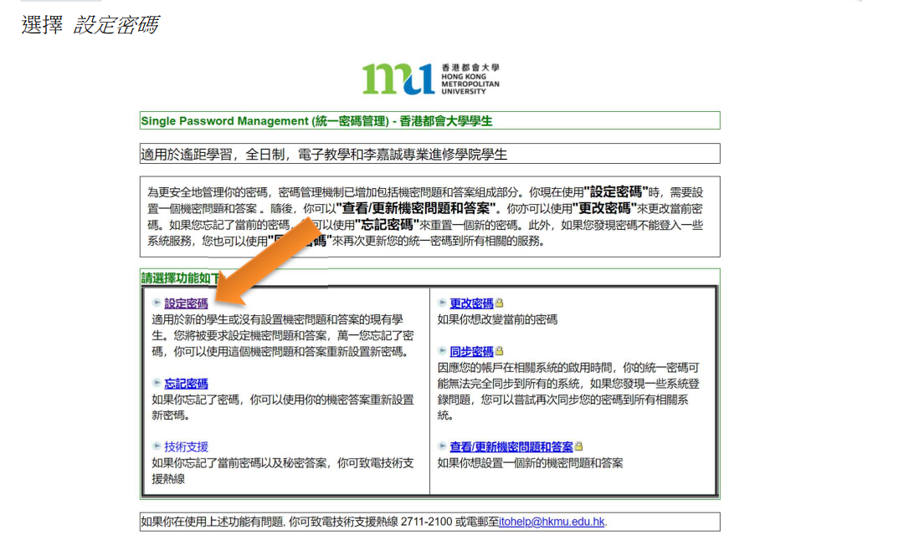
啟動電郵戶口 Activation of Email Account

Slide 45
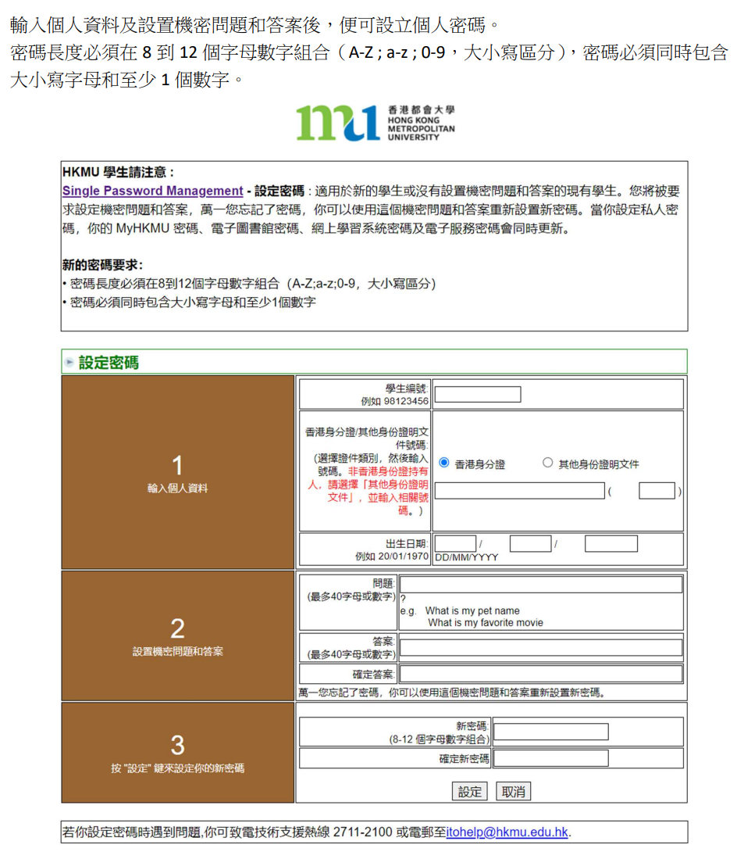
啟動電郵戶口 Activation of Email Account

Slide 46
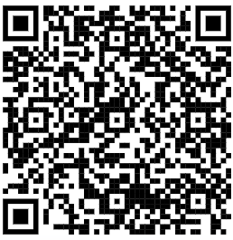
啟動電郵戶口 Activation of Email Account
登入電郵戶口
香港都會大學主頁 → 在學學生
→ 本科生及副學位 → 服務及支援→ O365 Email
Log in to Your Email Account
HKMU Home Page → Current Students
→ Undergraduate & Sub-degree → Services and Support → O365 Email
O365 Email: https://student.intranet.hkmu.edu.hk/hkmu_o365/index_c.html?r=0

Slide 47
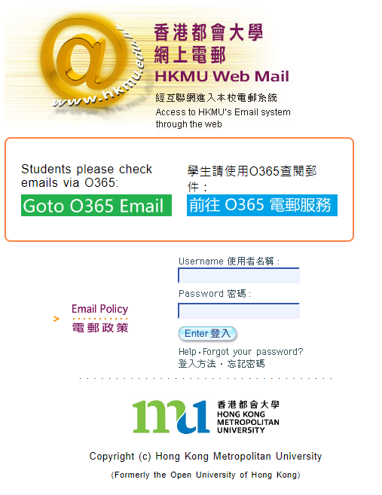
啟動O365電郵戶口 Activation of O365 Email Account

Slide 48
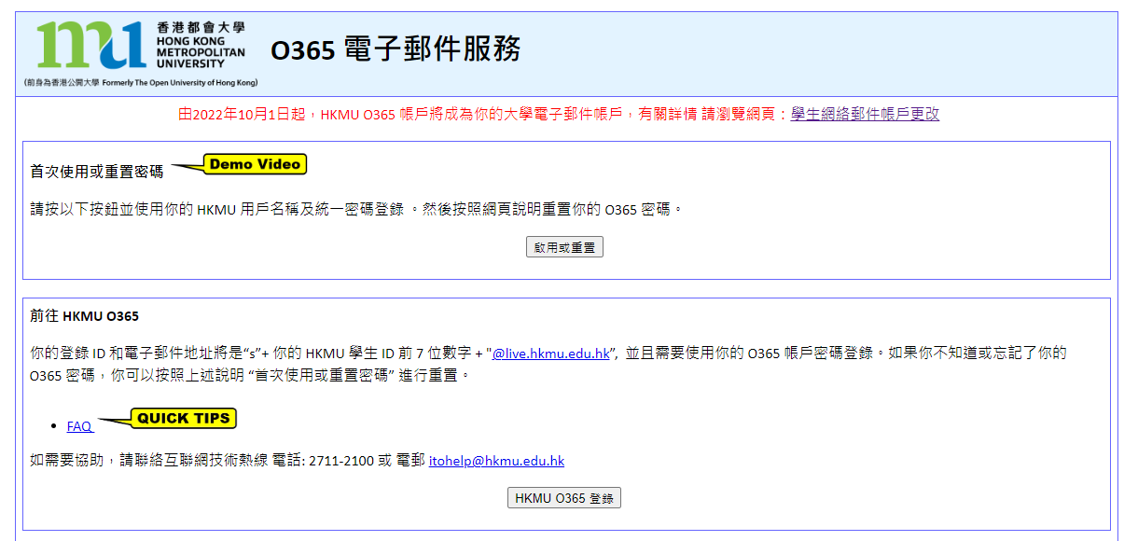
啟動O365電郵戶口 Activation of O365 Email Account
First Time User or Reset Password
Username: “s” + the first 7 digits of your student number
Password: your ‘Single Password’
O365 Email address: sXXXXXXX@live.hkmu.edu.hk

Slide 49
重要資訊 Essential Information
課程類別及升學階梯 Programme Type & Study Pathway
學生手冊 Student Handbook
查閱重要資訊 Checking Important Information
啟動電郵戶口 Activation of Email Account
MyHKMU 及 網上學習系統 MyHKMU & Online Learning Environment (OLE)
課堂出席要求 Attendance Requirements
語文科目豁免政策 Language Course Exemption
3i文化倡議、外籍英語老師及英語學習支援 Introduction to 3i activities, our NET teacher and the English grant project
學生事務處介紹 Introduction to Student Affairs Office

Slide 50

登入 MyHKMU Accessing MyHKMU

Slide 51
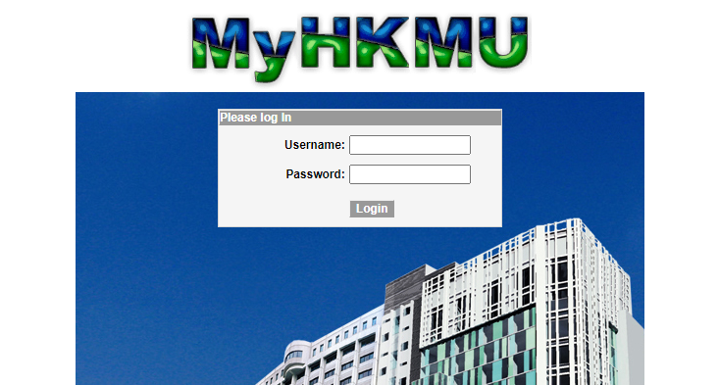
登入 MyHKMU Accessing MyHKMU
Google ‘MyHKMU’
OR
https://myhkmu.hkmu.edu.hk
Username: “s” + the first 7 digits of your student number
Password: your ‘Single Password’ (same as your live.HKMU.edu.hk email)
使用者名稱: “s” + 學生編號頭7位數字
密碼: 你的統一密碼 (跟使用電郵服務一樣)

Slide 52



登入 MyHKMU Accessing MyHKMU
You will see your Programme name: FHDPSY

Slide 53
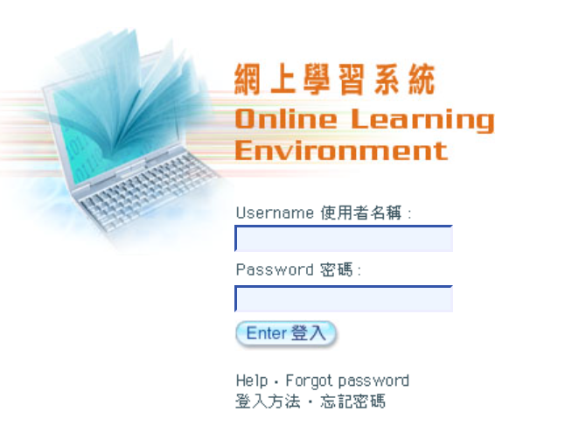
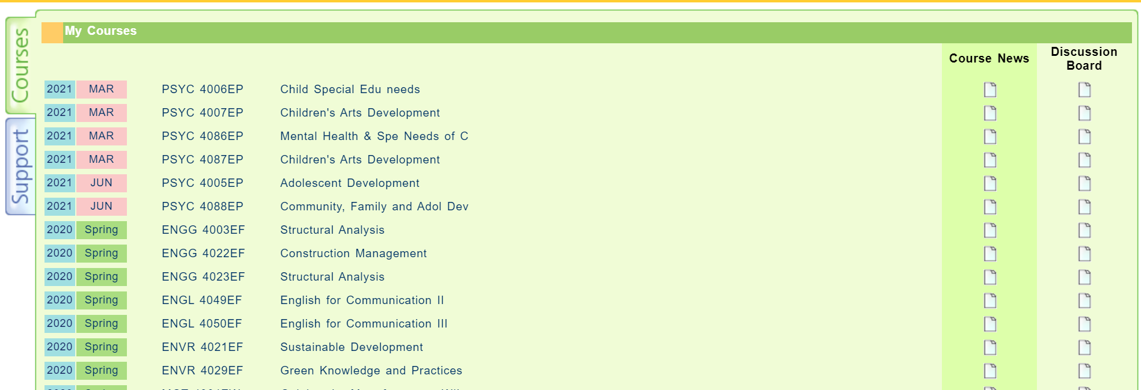
網上學習系統 Online Learning Environment (OLE)

Slide 54
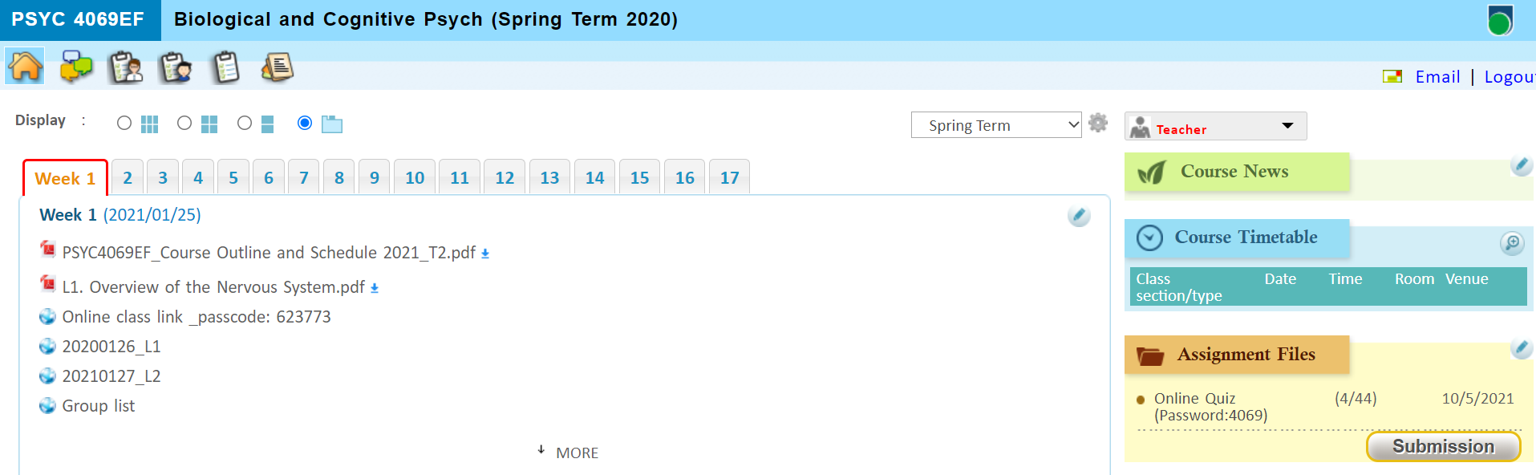
網上學習系統 Online Learning Environment (OLE)

Slide 55
查閱成績 Checking Academic Results
You will see your Programme name: FHDPSY

Slide 56
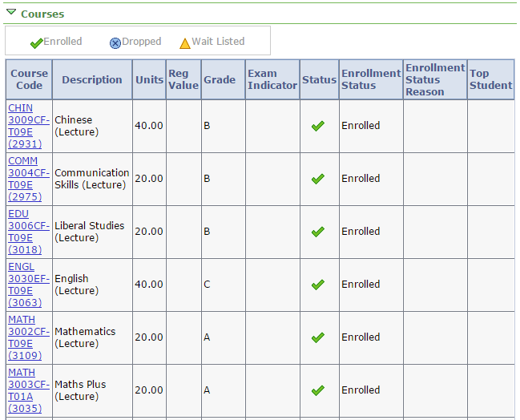
查閱成績 Checking Academic Results

Slide 57
重要資訊 Essential Information
課程類別及升學階梯 Programme Type & Study Pathway
學生手冊 Student Handbook
查閱重要資訊 Checking Important Information
啟動電郵戶口 Activation of Email Account
MyHKMU 及 網上學習系統 MyHKMU & Online Learning Environment (OLE)
課堂出席要求 Attendance Requirements
語文科目豁免政策 Language Course Exemption
3i文化倡議、外籍英語老師及英語學習支援 Introduction to 3i activities, our NET teacher and the English grant project
學生事務處介紹 Introduction to Student Affairs Office

Slide 58
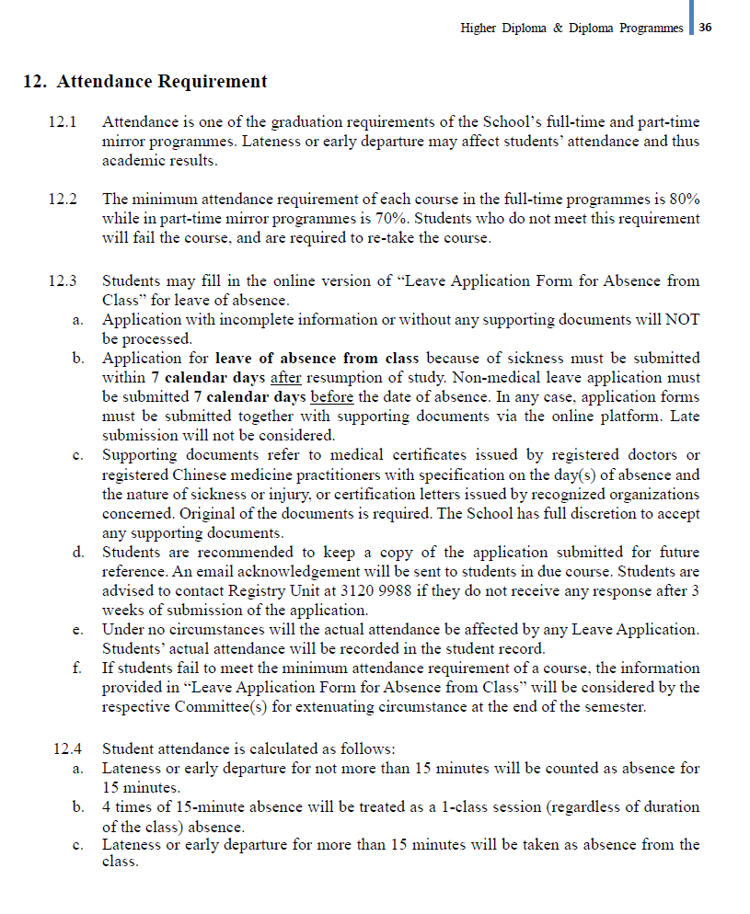
課堂出席要求 Attendance Requirements
Minimum attendance requirement of each course in the full-time programmes is 80%
Lateness or early departure may affect attendance and thus academic results
Students who do not meet this requirement will fail the course, and are required to retake the course
Refer to Student Handbook Chapter 12, p.36

Slide 59
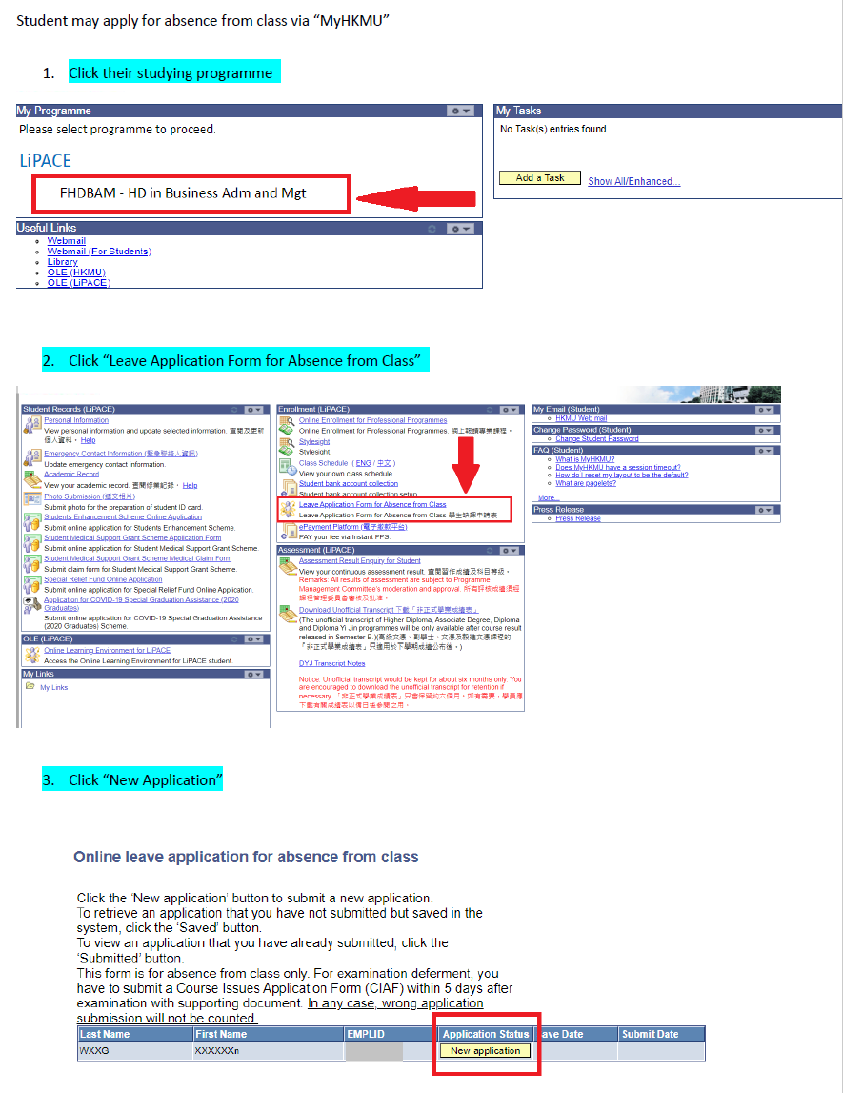
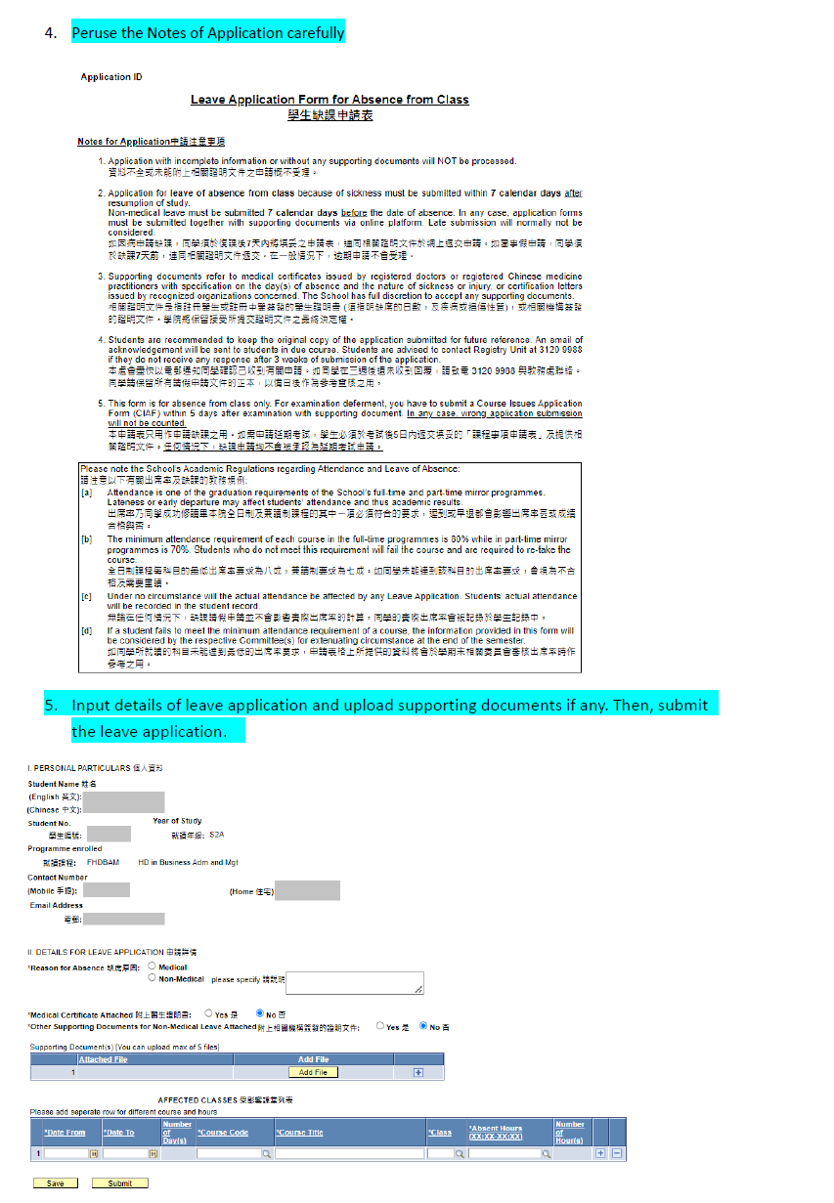
缺課申請 Guideline for Absence from Class Application

Slide 60
重要資訊 Essential Information
課程類別及升學階梯 Programme Type & Study Pathway
學生手冊 Student Handbook
查閱重要資訊 Checking Important Information
啟動電郵戶口 Activation of Email Account
MyHKMU 及 網上學習系統 MyHKMU & Online Learning Environment (OLE)
課堂出席要求 Attendance Requirements
語文科目豁免政策 Language Course Exemption
3i文化倡議、外籍英語老師及英語學習支援 Introduction to 3i activities, our NET teacher and the English grant project
學生事務處介紹 Introduction to Student Affairs Office

Slide 61
語文科目豁免政策
Language Course Exemption

Slide 62
Chinese/English courses – QF Level 3 & 4
Holders of any qualifications mentioned below:
A locally accredited sub-degree (at QF Level 4) or a post-secondary diploma offer by a recognized university or higher education institute overseas, or
A locally accredited Bachelor’s degree or above (at QF Level 5 or above) or a Bachelor’s degree or above offered by a recognized university overseas.
The qualification should be awarded by a university or institute where the medium of instruction and assessments of this qualification must be in English. This includes UK and colonies, US (mainland and territories), Canada, Australia, New Zealand, South Africa (must be in English speaking, not Afrikaans), Ireland and Singapore. Other English-medium universities in the British Commonwealth will be considered on a case-by-case basis.

Slide 63
Chinese/English courses – QF Level 3 & 4
Completion of a prior Chinese/English course at QF Level 3/4 or above
The course should be non-career specific.
(e.g. Business English courses and English courses for Tourism will not be considered.)

Slide 64
English courses – QF Level 3 & 4
Holders of a public examination qualification from a recognized examination body
 | QF Level 3 English for Communication I | QF Level 4 English for Communication II | QF Level 4 English for Communication III
HKDSE Level 3 or above | ✔
HKALE/GCE A-level Grade D or above | ✔
IELTS 6.0 or above overall and a minimum of 5.5 for each individual component | ✔
IELTS 6.5 or above overall and 6 in listening and speaking component | ✔ | ✔

Slide 65
English courses – QF Level 3 & 4
Holders of a public examination qualification from a recognized examination body (cont.)
The results of IELTS and TOEFL must not be more than 2 years from the date of the test or final examination to the date of commencement of study at LiPACE.
 | QF Level 3 English for Communication I | QF Level 4 English for Communication II | QF Level 4 English for Communication III
IELTS 6.5 or above overall and 6 in reading and writing component | ✔ |  | ✔
TOEFL scored -60 (iBT) | ✔
TOEFL score -79 (iBT) | ✔ | ✔ | ✔
TEFL/TESOL certification, Or CELTA holder | ✔ | ✔ | ✔

Slide 66


Documents required for exemption application
01
02
Course Issues Application Form
https://www.hkmu.edu.hk/lipace/tc/admission/enrollment-form/
Qualification certificate awarded by a recognized university/institute/examination body; or
Syllabus from a prior course providing information on learning outcomes, academic standard, coverage, duration and assessment criteria
Application deadline:
22 September 2025 (Monday)

Slide 67

課程事項申請表 Course Issues Application Form

Slide 68

Staff contacts
Head of Languages
Dr. Sylvia SZE | swsze@hkmu.edu.hk | 3120 9715
Deputy Head of Languages
Ms. Melissa YEUNG | mylyeung@hkmu.edu.hk | 3120 9719
Effective Chinese Communication Skills 應用中文傳意技巧
Ms. Konnie TANG | kyhtang@hkmu.edu.hk | 3120 9822

Slide 69
重要資訊 Essential Information
課程類別及升學階梯 Programme Type & Study Pathway
學生手冊 Student Handbook
查閱重要資訊 Checking Important Information
啟動電郵戶口 Activation of Email Account
MyHKMU 及 網上學習系統 MyHKMU & Online Learning Environment (OLE)
課堂出席要求 Attendance Requirements
語文科目豁免政策 Language Course Exemption
3i文化倡議、外籍英語老師及英語學習支援 Introduction to 3i activities, our NET teacher and the English grant project
學生事務處介紹 Introduction to Student Affairs Office

Slide 70
課外活動介紹、外籍英語老師及
英語學習支援
Introduction to School Activities, our NET teacher and the English grant project
https://drive.google.com/file/d/1fRO0az-JW6hWbN3-tUWhKmDn5q70_epP/view?usp=sharing

Slide 71

課外活動介紹、外籍英語老師及 英語學習支援
Introduction to School Activities, our NET teacher and the English grant project
Notes:
https://drive.google.com/file/d/1fRO0az-JW6hWbN3-tUWhKmDn5q70_epP/view?usp=sharing

Slide 72
重要資訊 Essential Information
課程類別及升學階梯 Programme Type & Study Pathway
學生手冊 Student Handbook
查閱重要資訊 Checking Important Information
啟動電郵戶口 Activation of Email Account
MyHKMU 及 網上學習系統 MyHKMU & Online Learning Environment (OLE)
課堂出席要求 Attendance Requirements
語文科目豁免政策 Language Course Exemption
3i文化倡議、外籍英語老師及英語學習支援 Introduction to 3i activities, our NET teacher and the English grant project
學生事務處介紹 Introduction to Student Affairs Office

Slide 73
學生事務處介紹
Introduction to Student Affairs Office
https://drive.google.com/file/d/1Rj6_MKb9ElRzNpPh2F2Uau8e_F8BgONH/view?usp=sharing

Slide 74

學生事務處
Student Affairs Office
Notes:
https://drive.google.com/file/d/1Rj6_MKb9ElRzNpPh2F2Uau8e_F8BgONH/view?usp=sharing

Slide 75
領取學生證
Student Card Collection

Slide 76



Completion of Entry Survey 完成入學問卷調查
https://hkmu.qualtrics.com/jfe/form/SV_bpB3veks5h4YdZc
Student Card Distribution Room (9/F K0917-K0919)
To help us understand about your learning expectation and support at LiPACE, please complete the Entry Survey before you pick up your Student ID Card and save the screenshot of the last page .
為了讓我們更了解您的學習期望和所需支援，請在領取學生證前完成入學問卷調查，並將最後一頁屏幕截圖。
Please show the screenshot / email proof of survey completion for collecting the Student Card.
請在領取學生證時出示完成問卷的屏幕截圖/電子郵件證明。

Slide 77




THANK YOU
More Details:
https://www.hkmu.edu.hk/lipace

