Slide 1


Higher Diploma in Health & Molecular Testing (FHDHMT)

Slide 2


Dean's Speech
院長致辭
https://drive.google.com/file/d/1lzeKxWE_EapKwS2VI7k-CrMUPPCCVfdT/view?usp=drive_link

Slide 3

Key Staffs of LiPACE 學院重要成員
Dean 院長
Dr Benjamin CHAN Tak-yuen
曾德源博士

Slide 4
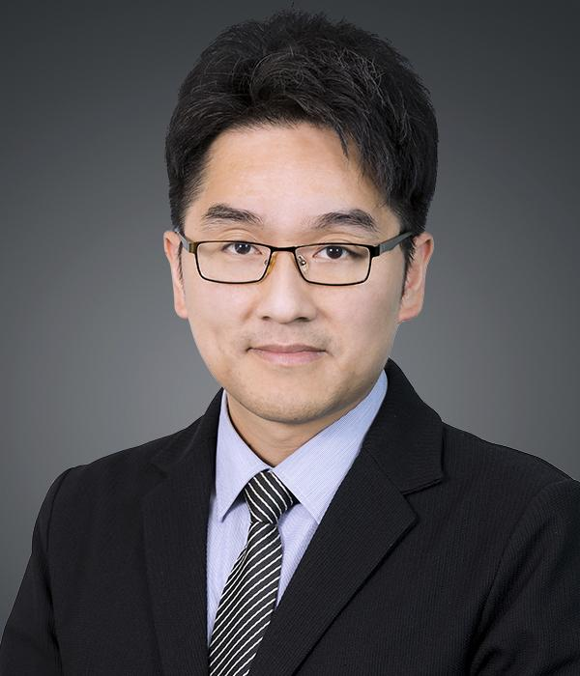
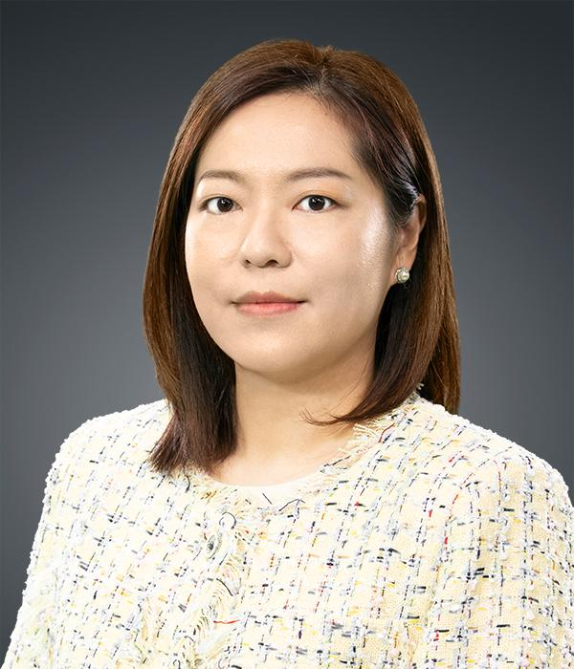

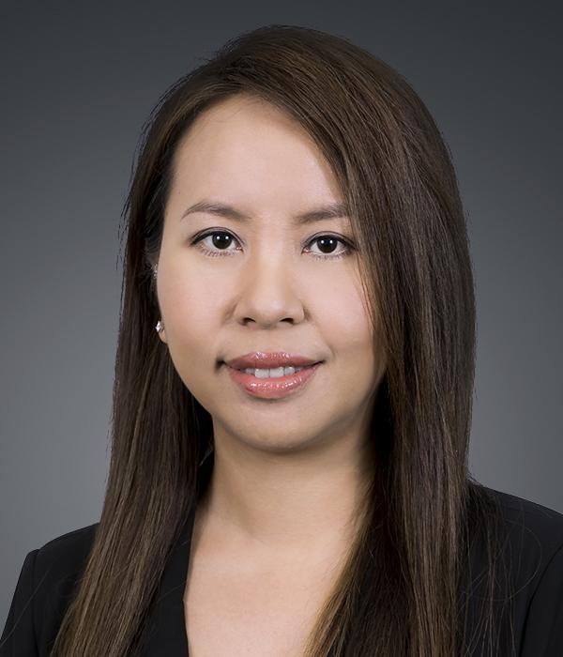
Key Staffs of LiPACE 學院重要成員
Associate Directors
副院長
Dr Ching Ka Wai Larry
程家偉博士
Dr Chen Yi-Fan Yvonne
陳羿帆博士
Ms. Pang Hoi Ning Helen
彭海寧女士
Dr Chim Hiu Man Kathleen
詹曉雯博士

Slide 5




升學階梯 Study Pathway
本地或海外學位課程
Local or Overseas Degree
(Top-up/Senior Year)
HKMU
BSc (Hons) in Life Science
BSc (Hons) in Testing Science and Certification
BSc (Hons) in Science (STEM)
BSc (Hons) in Food Testing Science
Poly U
BSc in Analytical Sciences for Testing and Certification
City U
BSc in Biological Sciences
CUHK
BSc in Natural Sciences
Queensland University
of Technology(AUS)
Bachelor of Biomedical Science
文憑課程 Diploma
基礎教育文憑
Diploma in Foundation
Studies (1 year full-time)
應用教育文憑
Diploma of Applied
Education (DAE)
(1 year full-time)
高級文憑課程
Higher Diploma in
Health & Molecular
Testing
健康及分子檢測
(2 years full-time)

Slide 6
Today’s content
Access to Student Area
Activation of Email Account
Login Email & Open Learning Environment (OLE)
Checking Class Division and Timetable
Checking Academic Results

Slide 7
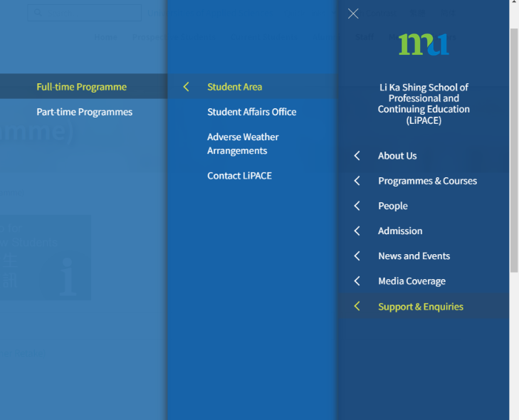
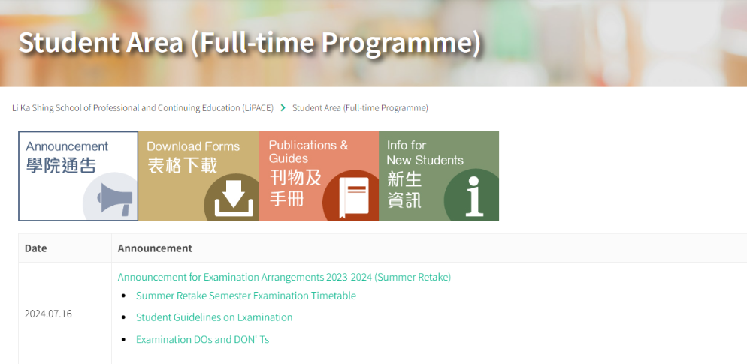
進入學生網頁 Access to Student Area
登入Go to: https://www.hkmu.edu.hk/lipace/ftp-student-area/
Student Handbook

Slide 8
啟動電郵戶口 Activation of Email Account
請參閱學生手冊
  你需要先設定密碼：
  www.hkmu.edu.hk → 在學學生 → 本科生及副學位→ 服務及支援→
  統一密碼管理 (學生)
Please refer to Student Handbook
  Create a new password first:
  www.hkmu.edu.hk → Current Students → Undergraduate and sub-degree→ Services and Support → Single Password Management

Slide 9
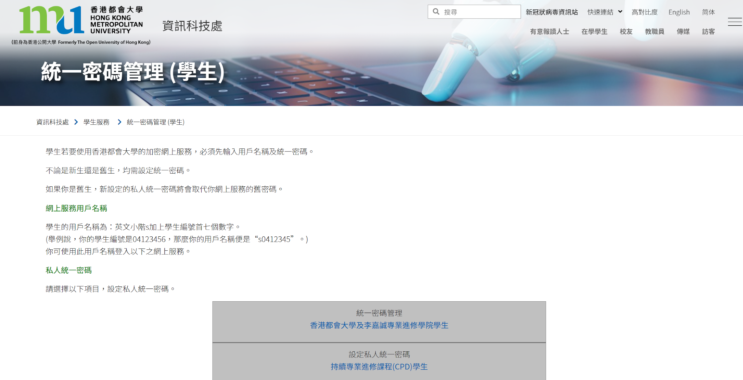

Slide 10
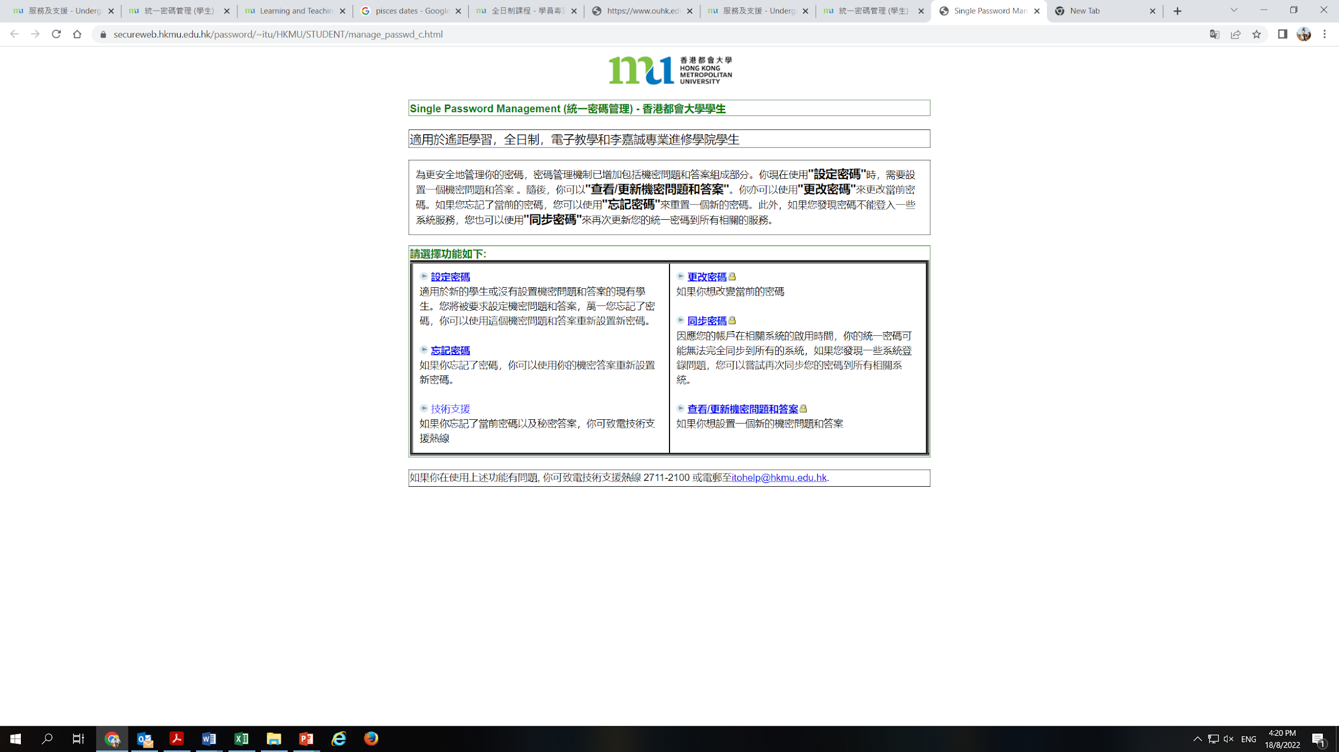

Slide 11
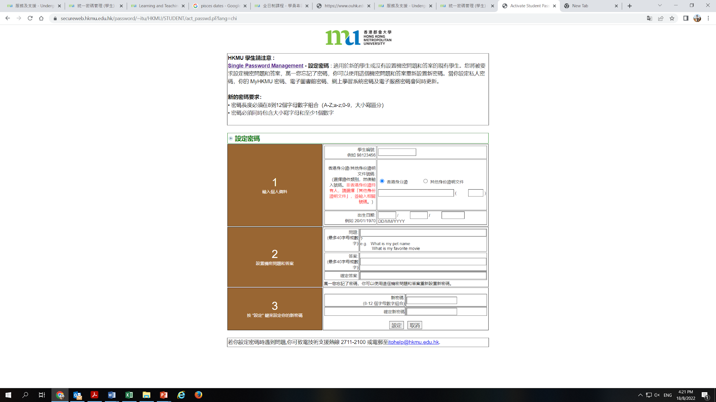
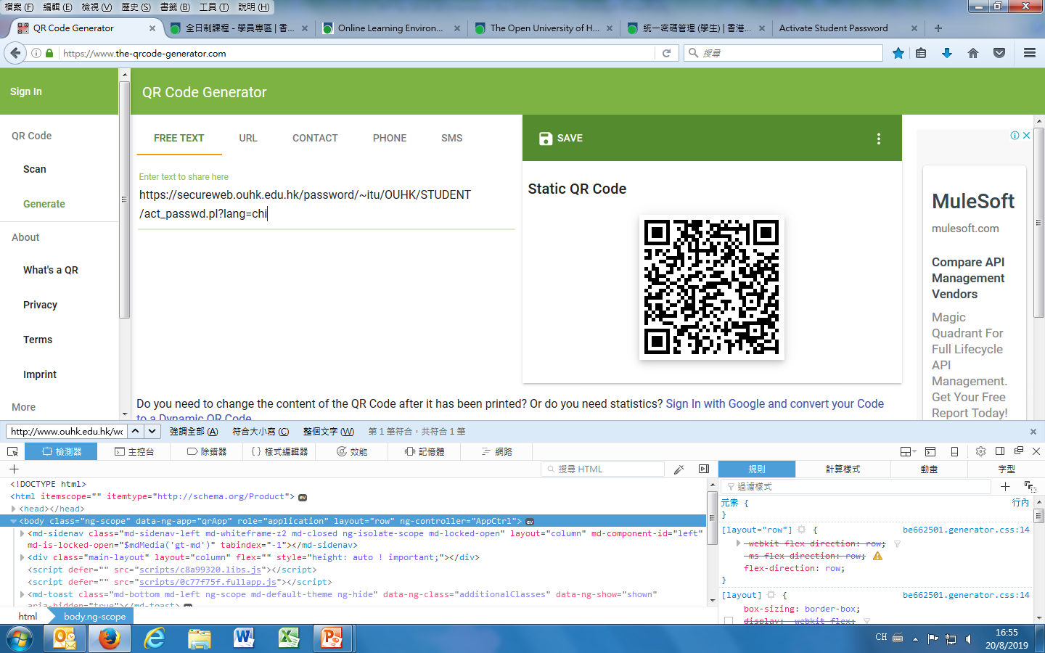

Slide 12
登入個人電郵帳戶 Login to Your Email Account
登入Go to: webmail.hkmu.edu.hk
Or
登入Go to: www.hkmu.edu.hk
在學學生→本科生及副學位→ 服務及支援→ 大學電郵服務→ 電子郵件/O365 Email
Current Students → Undergraduate and sub-degree → Services and Support → Email Service → Webmail/O365 Email

Slide 13
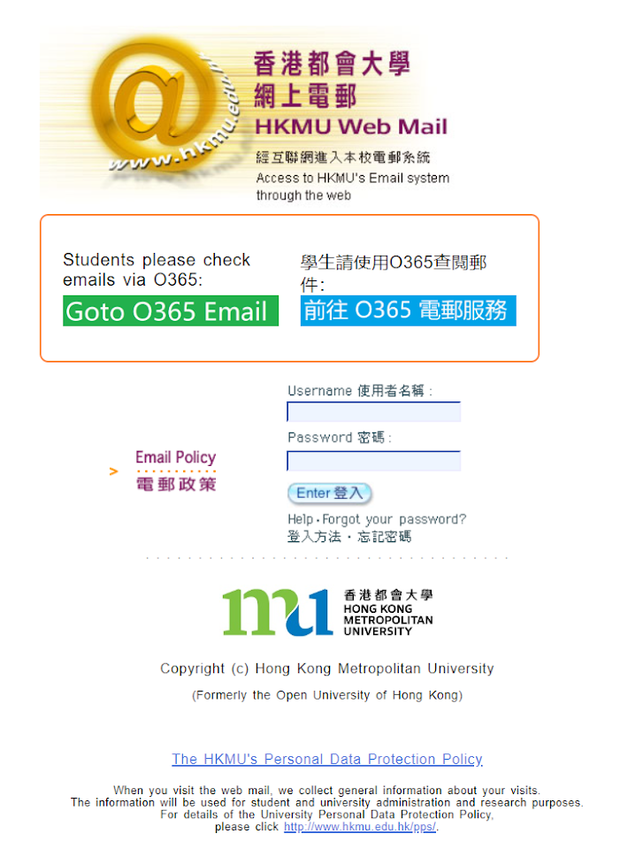

Slide 14

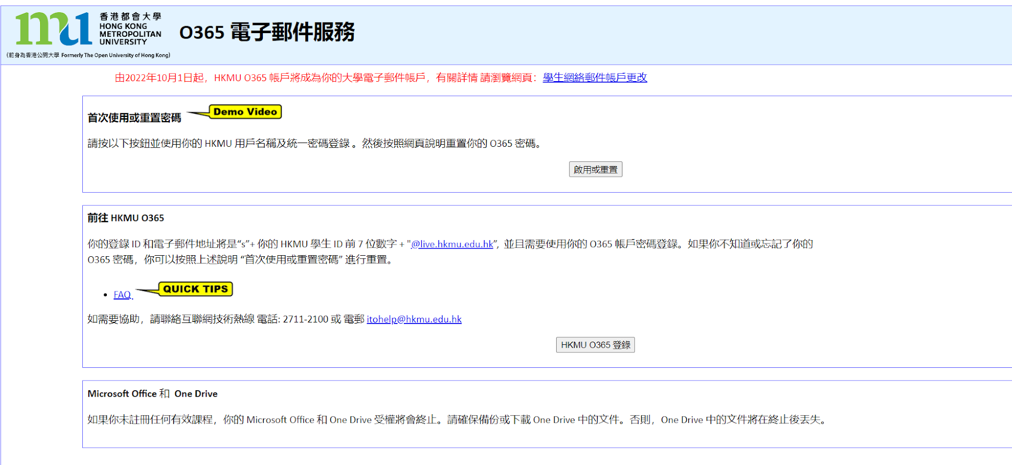
首次使用 First time set up
登入個人電郵帳戶 Login to Your Email Account

Slide 15
登入個人電郵帳戶 Login to Your Email Account
輸入您的用戶名稱和密碼：
  你的登錄 ID 和電子郵件地址將是
  “s”+ 你的 HKMU 學生 ID 前 7 位數字 + "@live.hkmu.edu.hk”, 並且需要使用你的 O365 帳戶密碼登錄
  例如: 學生証號碼是 12345678 電子郵件地址是s1234567@live.hkmu.edu.hk
Input your user name and password:
  User name : “s” + first 7 digits of your student number + "@live.hkmu.edu.hk”, and use your O365 password for log in
  Example Your student ID no is 12345678
  Your student email address is s1234567@live.hkmu.edu.hk

Slide 16

“s”+學員學生証號碼的前七位數字
  你的統一密碼
登入後，根據指示啟動O365戶口

Slide 17
登入 O365 電郵帳戶 Login O365 Email
登入: https://login.microsoftonline.com
  輸入你的「登入名稱」及 「密碼」
Enter the website: https://login.microsoftonline.com
Enter your Login ID and Password

Slide 18


  “s”+學員學生証號碼的前七位數字+ “@live.hkmu.edu.hk”
s1234567@live.hkmu.edu.hk
  密碼：已自行設定的O365帳戶密碼

Slide 19
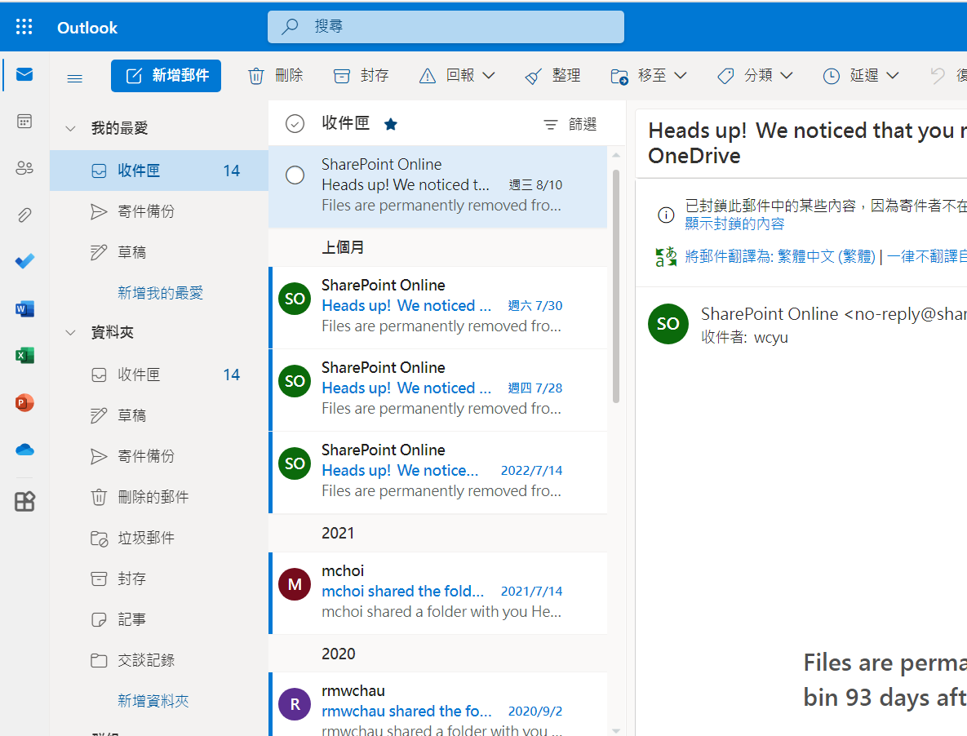
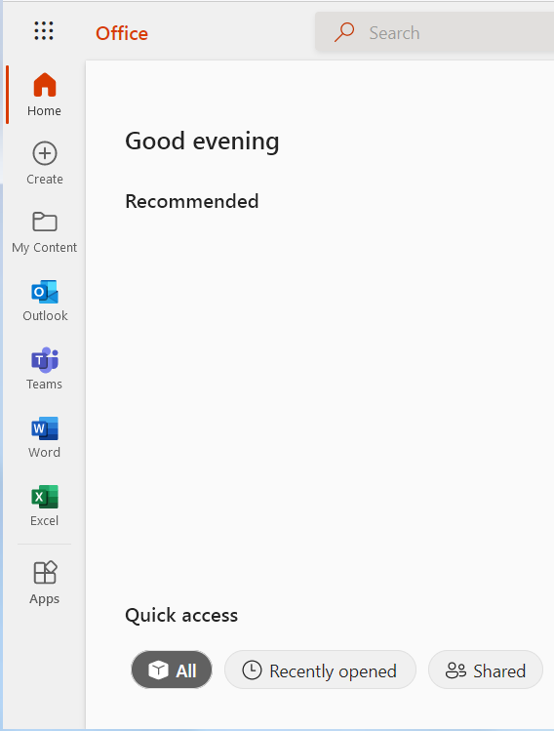

Slide 20

網上學習系統 Online Learning Environment (OLE)
請參閱學生手冊
  登入 elipace.hkmu.edu.hk/
  在網上學習系統的登入版面輸入你的「使用者名稱」及「密碼」
Please refer to Student Handbook
  Enter the website: elipace.hkmu.edu.hk/
  Enter your Username and Password
  ELiPACE User Manual for Students HKMU https://elipace.hkmu.edu.hk/ismart/OLE_Course_News.nsf/0/17EB3956271CF8B7482580DD000FA3E1/$File/ELiPACE%20User%20Manual%20for%20Students%20HKMU%20(2021).pdf?OpenElement&filename:ELiPACE%20User%20Manual%20for%20Students%20HKMU%20(2021).pdf

Slide 21
網上學習系統 Online Learning Environment (OLE)
You can download the course materials, e.g. PPT, course schedule
You can also download student handbook

Slide 22
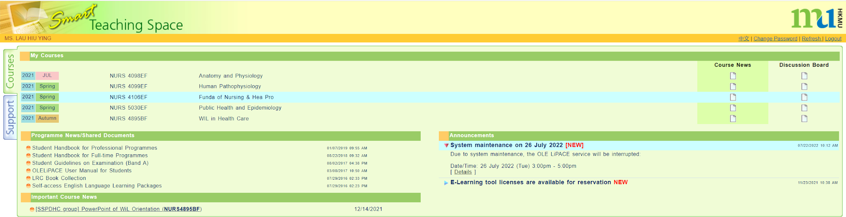
網上學習系統 Online Learning Environment (OLE)

Slide 23
查閱所屬班別及上課時間表
Checking Class Division and Timetable
登入Go to: https://www.hkmu.edu.hk/lipace/tc/ftp-student-area/

Slide 24
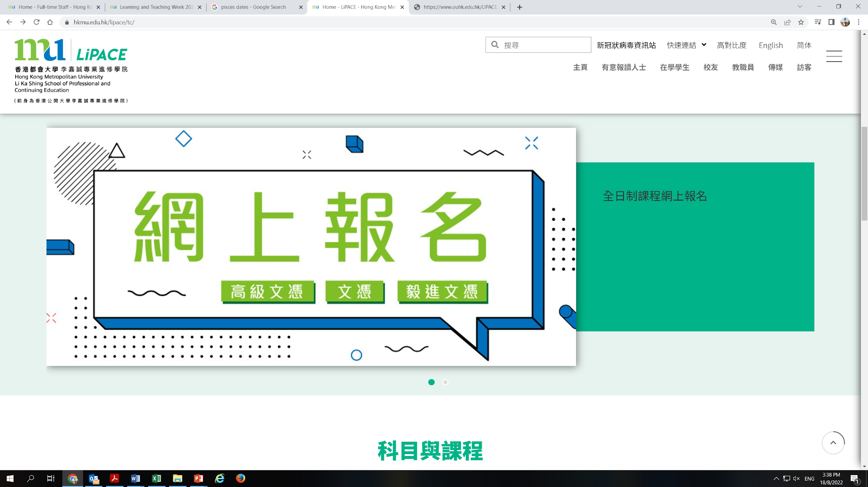
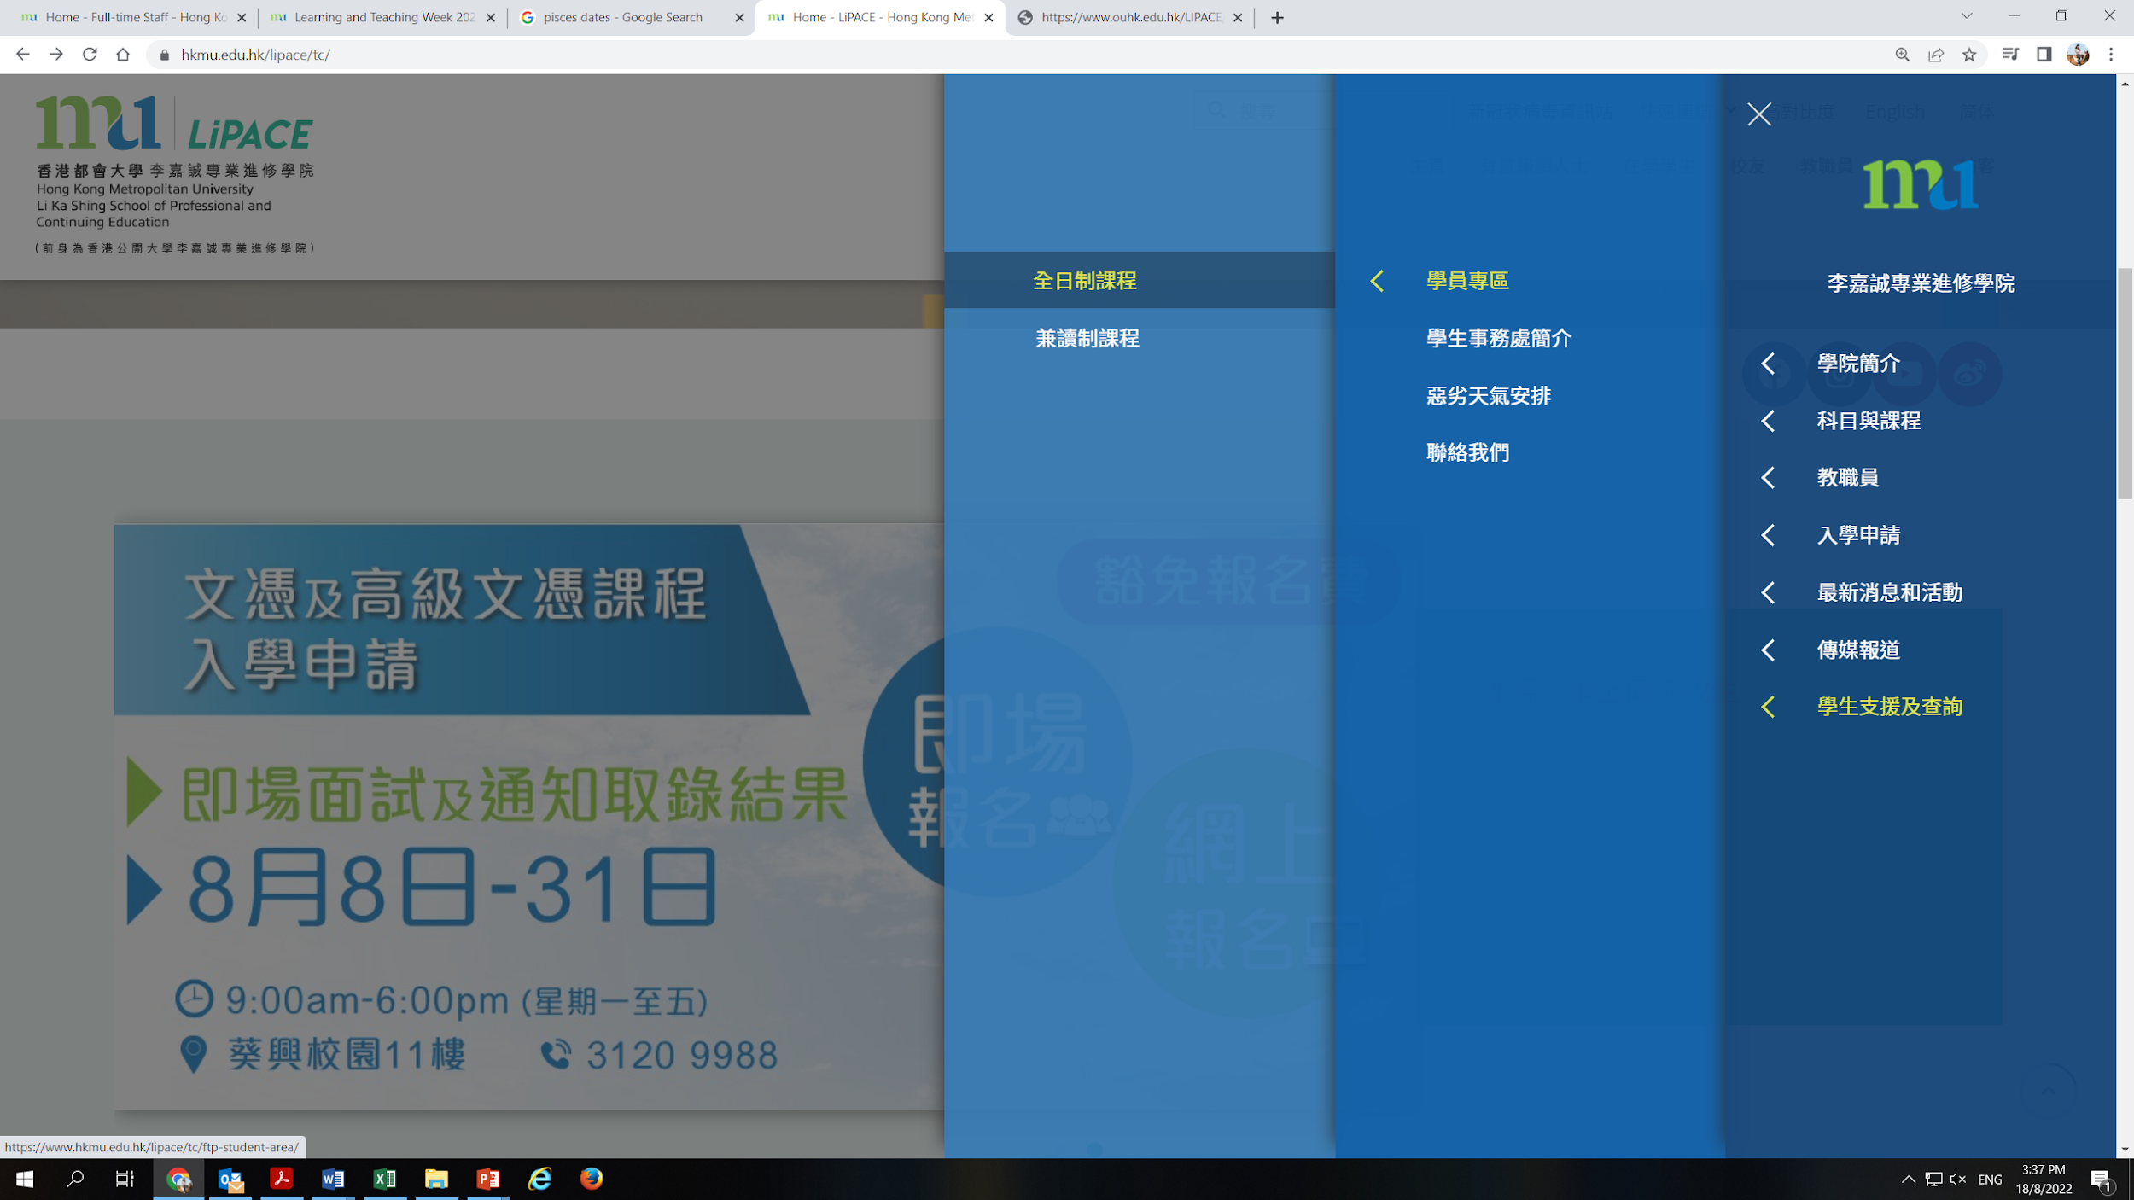
查閱所屬班別 Checking Class Division
1
2

Slide 25
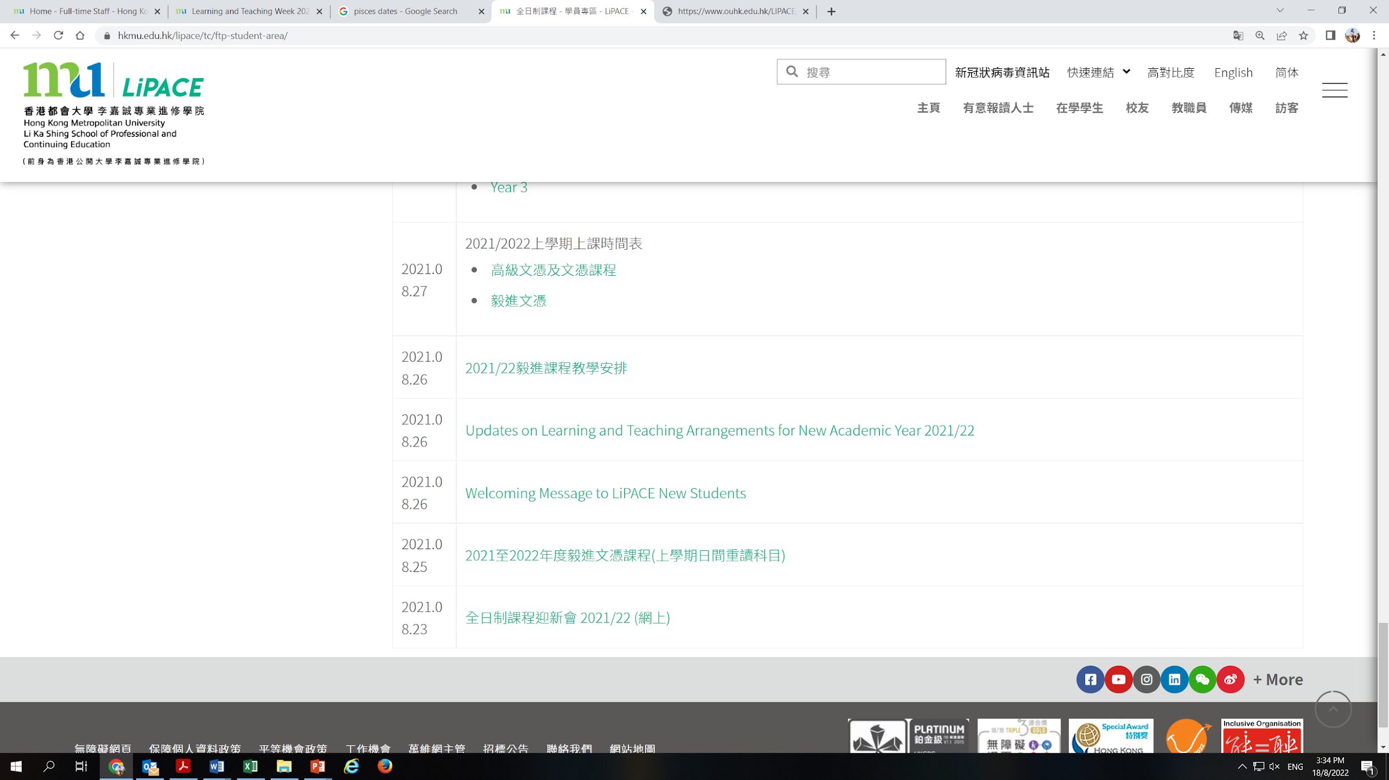
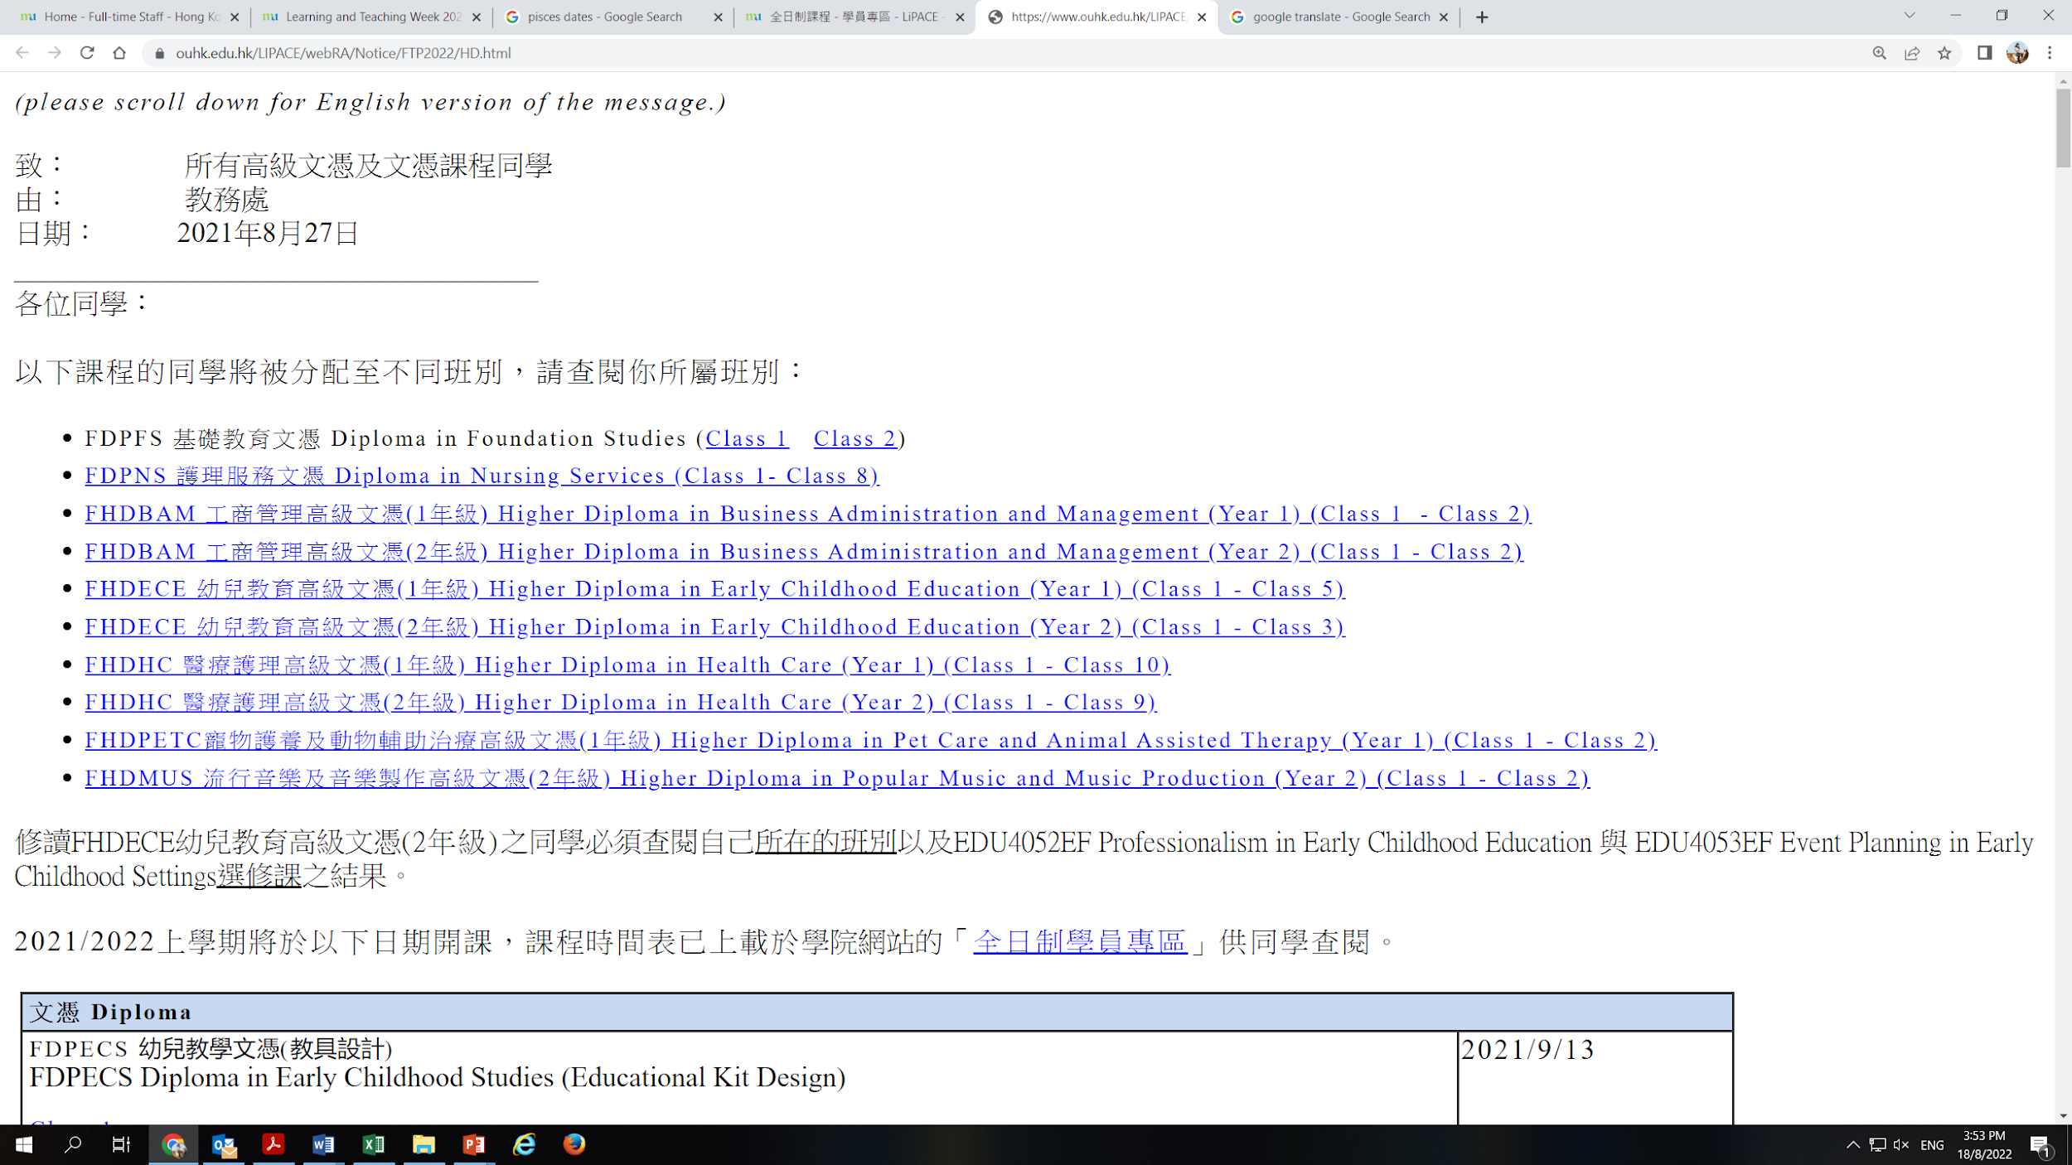
查閱所屬班別 Check Class Division
3
FHDHC Higher Diploma in Health Care 醫療護理高級文憑 /
FHDHMT Higher Diploma in Health & Molecular Testing 健康及分子檢測高級文憑 /
FDPNS Diploma in Nursing Services 護理服務文憑
4

Slide 26
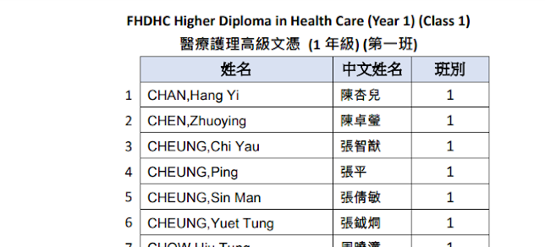
查閱所屬班別 Check Class Division
5
Diploma in Nursing Services (Class 1)
護理服務文憑 (第一班)

Slide 27
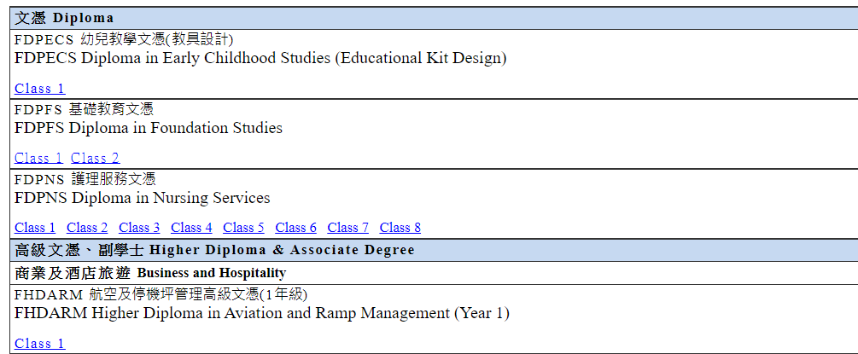
查閱上課時間表 Checking Timetable
1

Slide 28

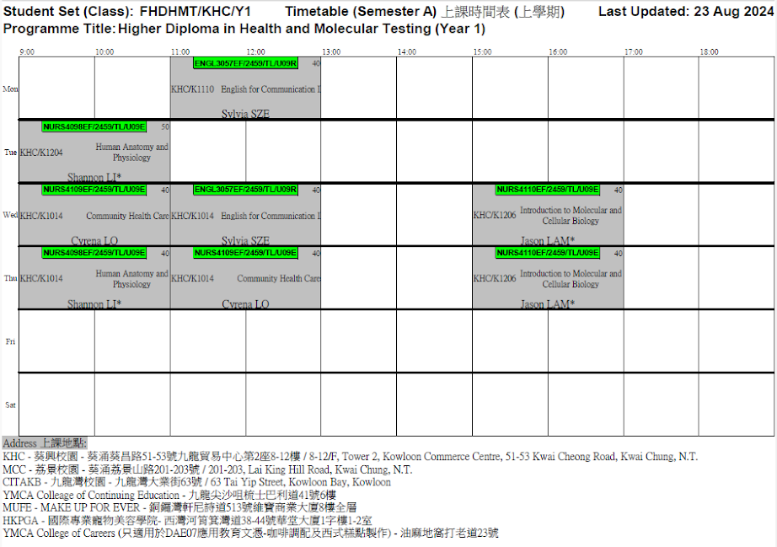
Programme code/Campus/Year/Class
Class 1
Class Group
Course Code
CourseGroup
Course Title
Venue
Instructor

Slide 29
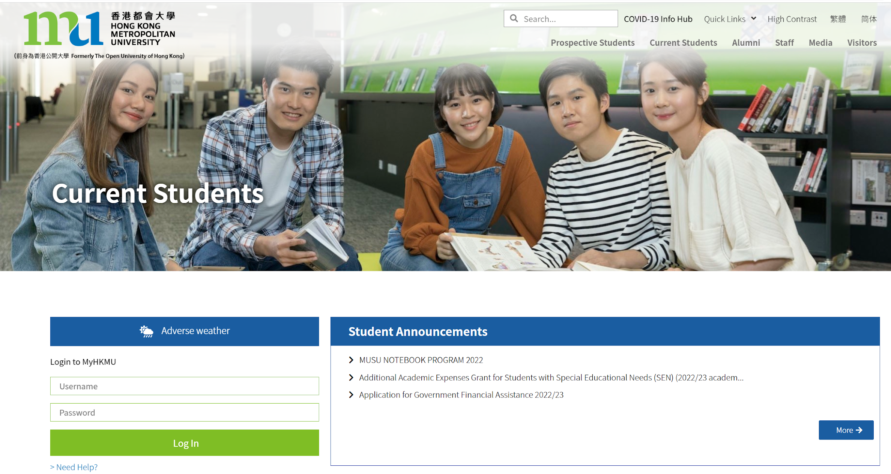
查閱成績 Checking Academic Results
登入 Login (MyHKMU)
www.hkmu.edu.hk/students

Slide 30
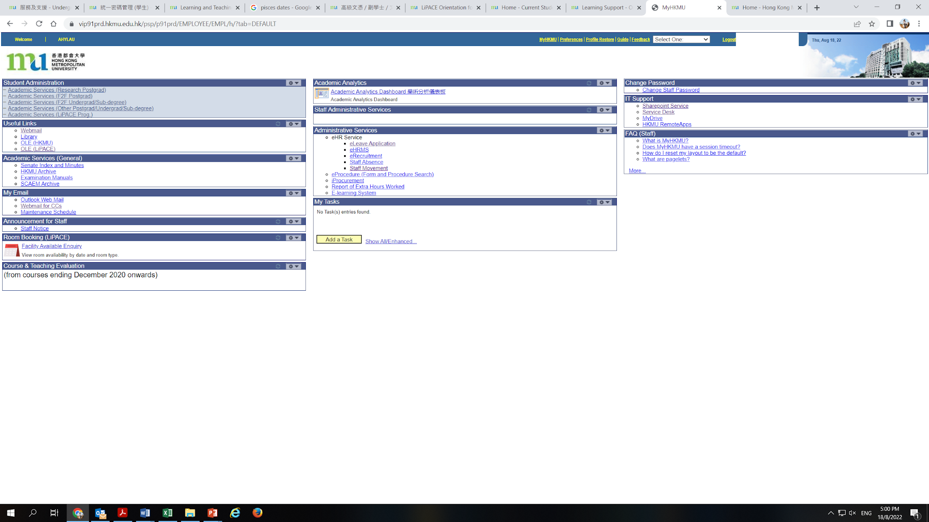



Slide 32
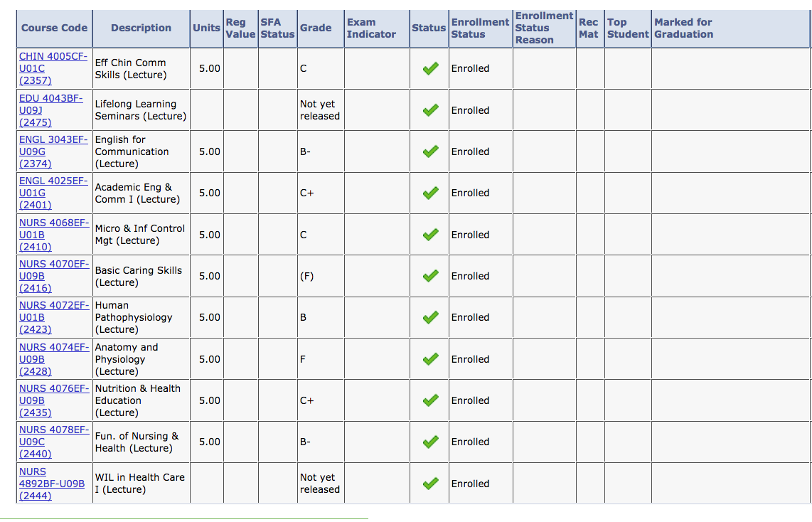

Slide 33



Completion of Entry Survey 完成入學問卷調查
https://hkmu.qualtrics.com/jfe/form/SV_bpB3veks5h4YdZc
Collection of Student Card 領取學生證
To help us understand about your learning expectation and support at LiPACE, please complete the Entry Survey before you pick up your Student ID Card and save the screenshot of the last page .
為了讓我們更了解您的學習期望和所需支援，請在領取學生證前完成入學問卷調查，並將最後一頁屏幕截圖。
Please show the screenshot / email proof of survey completion for collecting the Student Card.
請在領取學生證時出示完成問卷的屏幕截圖/電子郵件證明。

Slide 34
Enquiries
 | Higher Diploma in Health & Molecular Testing
Programme Leader | Dr. U Kin Pong
Office Number | 3120 9835
Email | kpu@hkmu.edu.hk
Administrative Support | Ms Winnie CHAN
Office Number | 3120 9845
Email | chanwy@hkmu.edu.hk
WhatsApp | 3120 9845

Slide 35
The Programme Specific Orientation will be conducted afterwards!
Don’t miss it!
Stay behind!

Slide 36
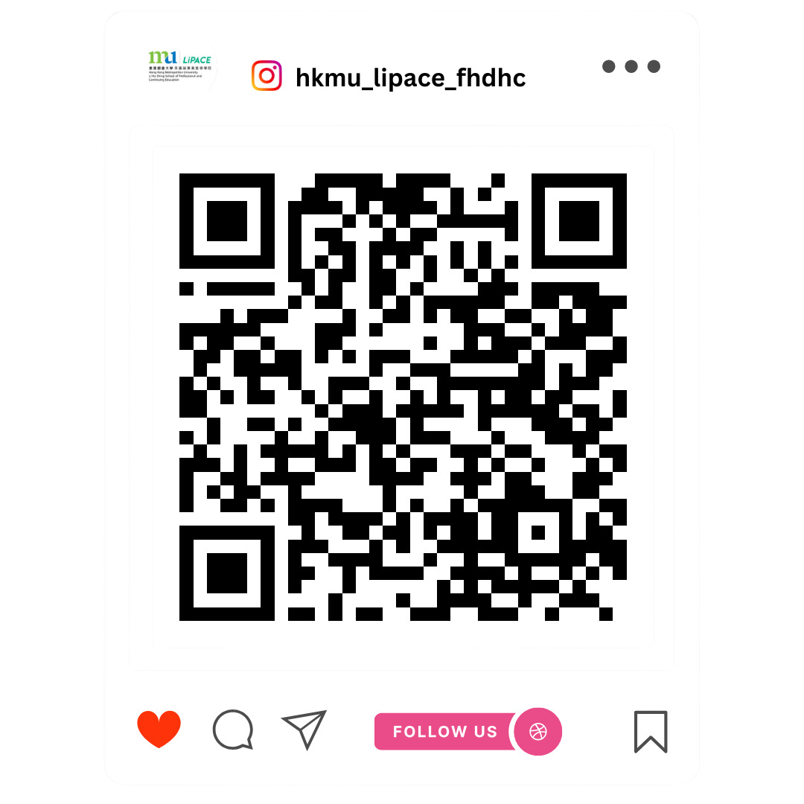
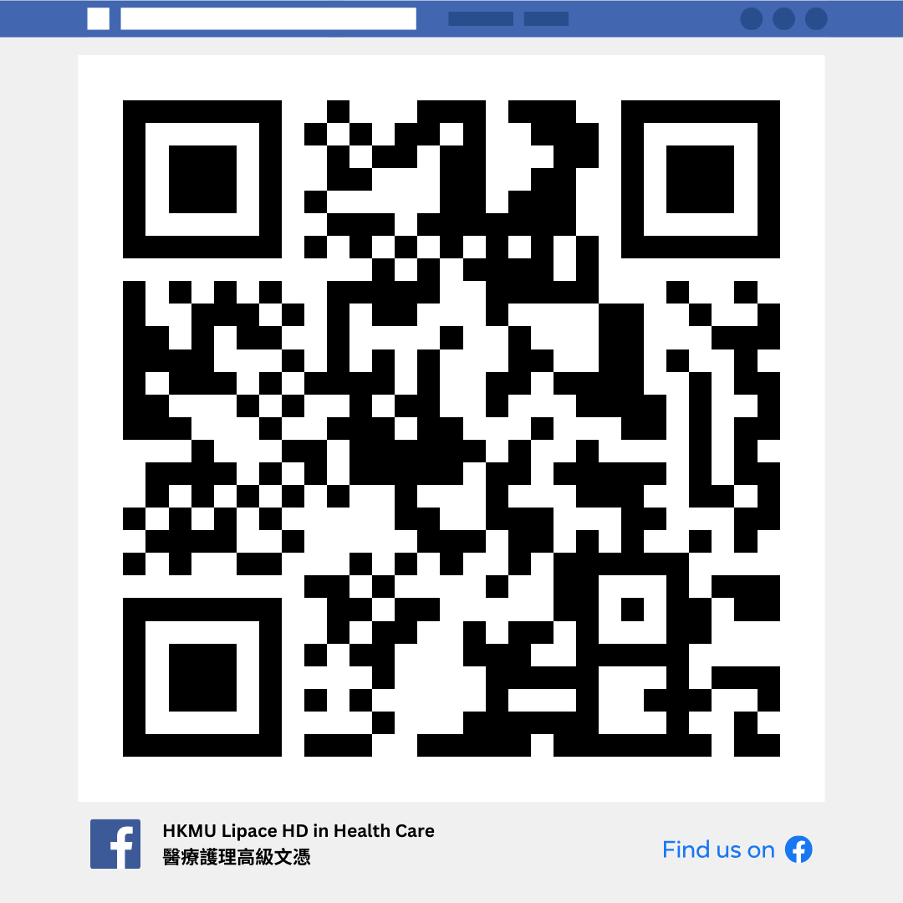
Higher Diploma in Health
& Molecular Testing (FHDHMT)
健康及分子檢測高級文憑 (2 years full-time)
34

Slide 37
語文科目豁免政策
Language Course Exemption

Slide 38
Chinese/English courses – QF Level 3 & 4
Holders of any qualifications mentioned below:
A locally accredited sub-degree (at QF Level 4) or a post-secondary diploma offer by a recognized university or higher education institute overseas, or
A locally accredited Bachelor’s degree or above (at QF Level 5 or above) or a Bachelor’s degree or above offered by a recognized university overseas.
The qualification should be awarded by a university or institute where the medium of instruction and assessments of this qualification must be in English. This includes UK and colonies, US (mainland and territories), Canada, Australia, New Zealand, South Africa (must be in English speaking, not Afrikaans), Ireland and Singapore. Other English-medium universities in the British Commonwealth will be considered on a case-by-case basis.

Slide 39
Chinese/English courses – QF Level 3 & 4
Completion of a prior Chinese/English course at QF Level 3/4 or above
The course should be non-career specific.
(e.g. Business English courses and English courses for Tourism will not be considered.)

Slide 40
English courses – QF Level 3 & 4
Holders of a public examination qualification from a recognized examination body
 | QF Level 3 English for Communication I | QF Level 4 English for Communication II | QF Level 4 English for Communication III
HKDSE Level 3 or above | ✔
HKALE/GCE A-level Grade D or above | ✔
IELTS 6.0 or above overall and a minimum of 5.5 for each individual component | ✔
IELTS 6.5 or above overall and 6 in listening and speaking component | ✔ | ✔

Slide 41
English courses – QF Level 3 & 4
Holders of a public examination qualification from a recognized examination body (cont.)
The results of IELTS and TOEFL must not be more than 2 years from the date of the test or final examination to the date of commencement of study at LiPACE.
 | QF Level 3 English for Communication I | QF Level 4 English for Communication II | QF Level 4 English for Communication III
IELTS 6.5 or above overall and 6 in reading and writing component | ✔ |  | ✔
TOEFL scored -60 (iBT) | ✔
TOEFL score -79 (iBT) | ✔ | ✔ | ✔
TEFL/TESOL certification, Or CELTA holder | ✔ | ✔ | ✔

Slide 42


Documents required for exemption application
01
02
Course Issues Application Form
https://www.hkmu.edu.hk/lipace/tc/admission/enrollment-form/
Qualification certificate awarded by a recognized university/institute/examination body; or
Syllabus from a prior course providing information on learning outcomes, academic standard, coverage, duration and assessment criteria
Application deadline:
22 September 2025 (Monday)

Slide 43

Course Issues Application Form 課程事項申請表

Slide 44

THANKS
Staff contacts
Head of Languages
Dr. Sylvia SZE | swsze@hkmu.edu.hk | 3120 9715
Deputy Head of Languages
Ms. Melissa YEUNG | mylyeung@hkmu.edu.hk | 3120 9719
Effective Chinese Communication Skills 應用中文傳意技巧
Ms. Konnie TANG | kyhtang@hkmu.edu.hk | 3120 9822

Slide 45

香港都會大學
李嘉誠專業進修學院
課外活動、外藉英語老師及
英語學習支援
Heidi Cheng
https://drive.google.com/file/d/1fRO0az-JW6hWbN3-tUWhKmDn5q70_epP/view?usp=sharing

Slide 46
Student Affairs Office
學生事務處
https://drive.google.com/file/d/1Rj6_MKb9ElRzNpPh2F2Uau8e_F8BgONH/view?usp=sharing

