Slide 1

Higher Diploma in Engineering
(Civil Engineering)

Slide 2

Content
Dean’s Speech
Introduction of Dean & Associate Directors
Higher Diploma in Engineering (Civil Engineering)
Study paths
Student Area
Student Handbook
Activation of Email Account
Login Email and Open Learning Environment (OLE)
Timetable
Academic Results
Entry Survey 2025
Language Course Exemption
Introduction to Activities, NET Teachers and the English Grant Project
Introduction to Student Affair Office

Slide 3

Dean's Speech
院長致辭
https://drive.google.com/file/d/1lzeKxWE_EapKwS2VI7k-CrMUPPCCVfdT/view?usp=drive_link

Slide 4

Key Staffs of LiPACE 學院重要成員
Dean 院長
Dr Benjamin CHAN Tak-yuen
曾德源博士

Slide 5




Key Staffs of LiPACE 學院重要成員
Associate Directors
副院長
Dr Ching Ka Wai Larry
程家偉博士
Dr Chen Yi-Fan Yvonne
陳羿帆博士
Ms. Pang Hoi Ning Helen
彭海寧女士
Dr Chim Hiu Man Kathleen
詹曉雯博士
Home - LiPACE - Hong Kong Metropolitan University

Slide 6
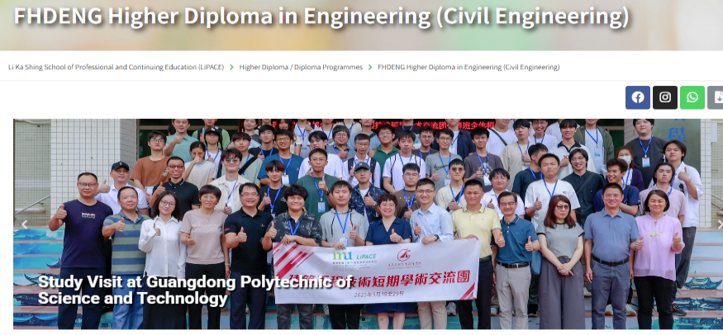
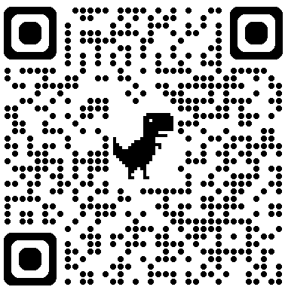

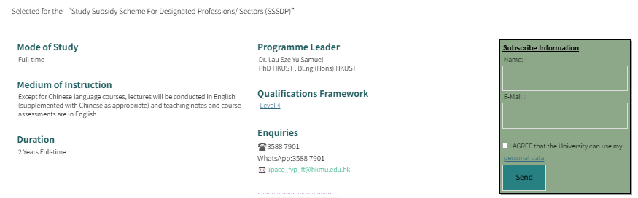
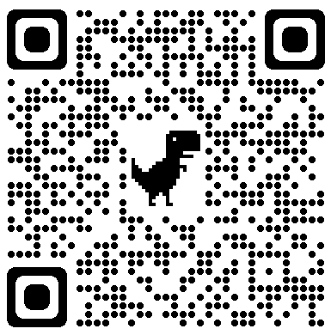
Higher Diploma in Engineering (Civil Engineering)
FHDENG
課程網頁
IG專頁

Slide 7
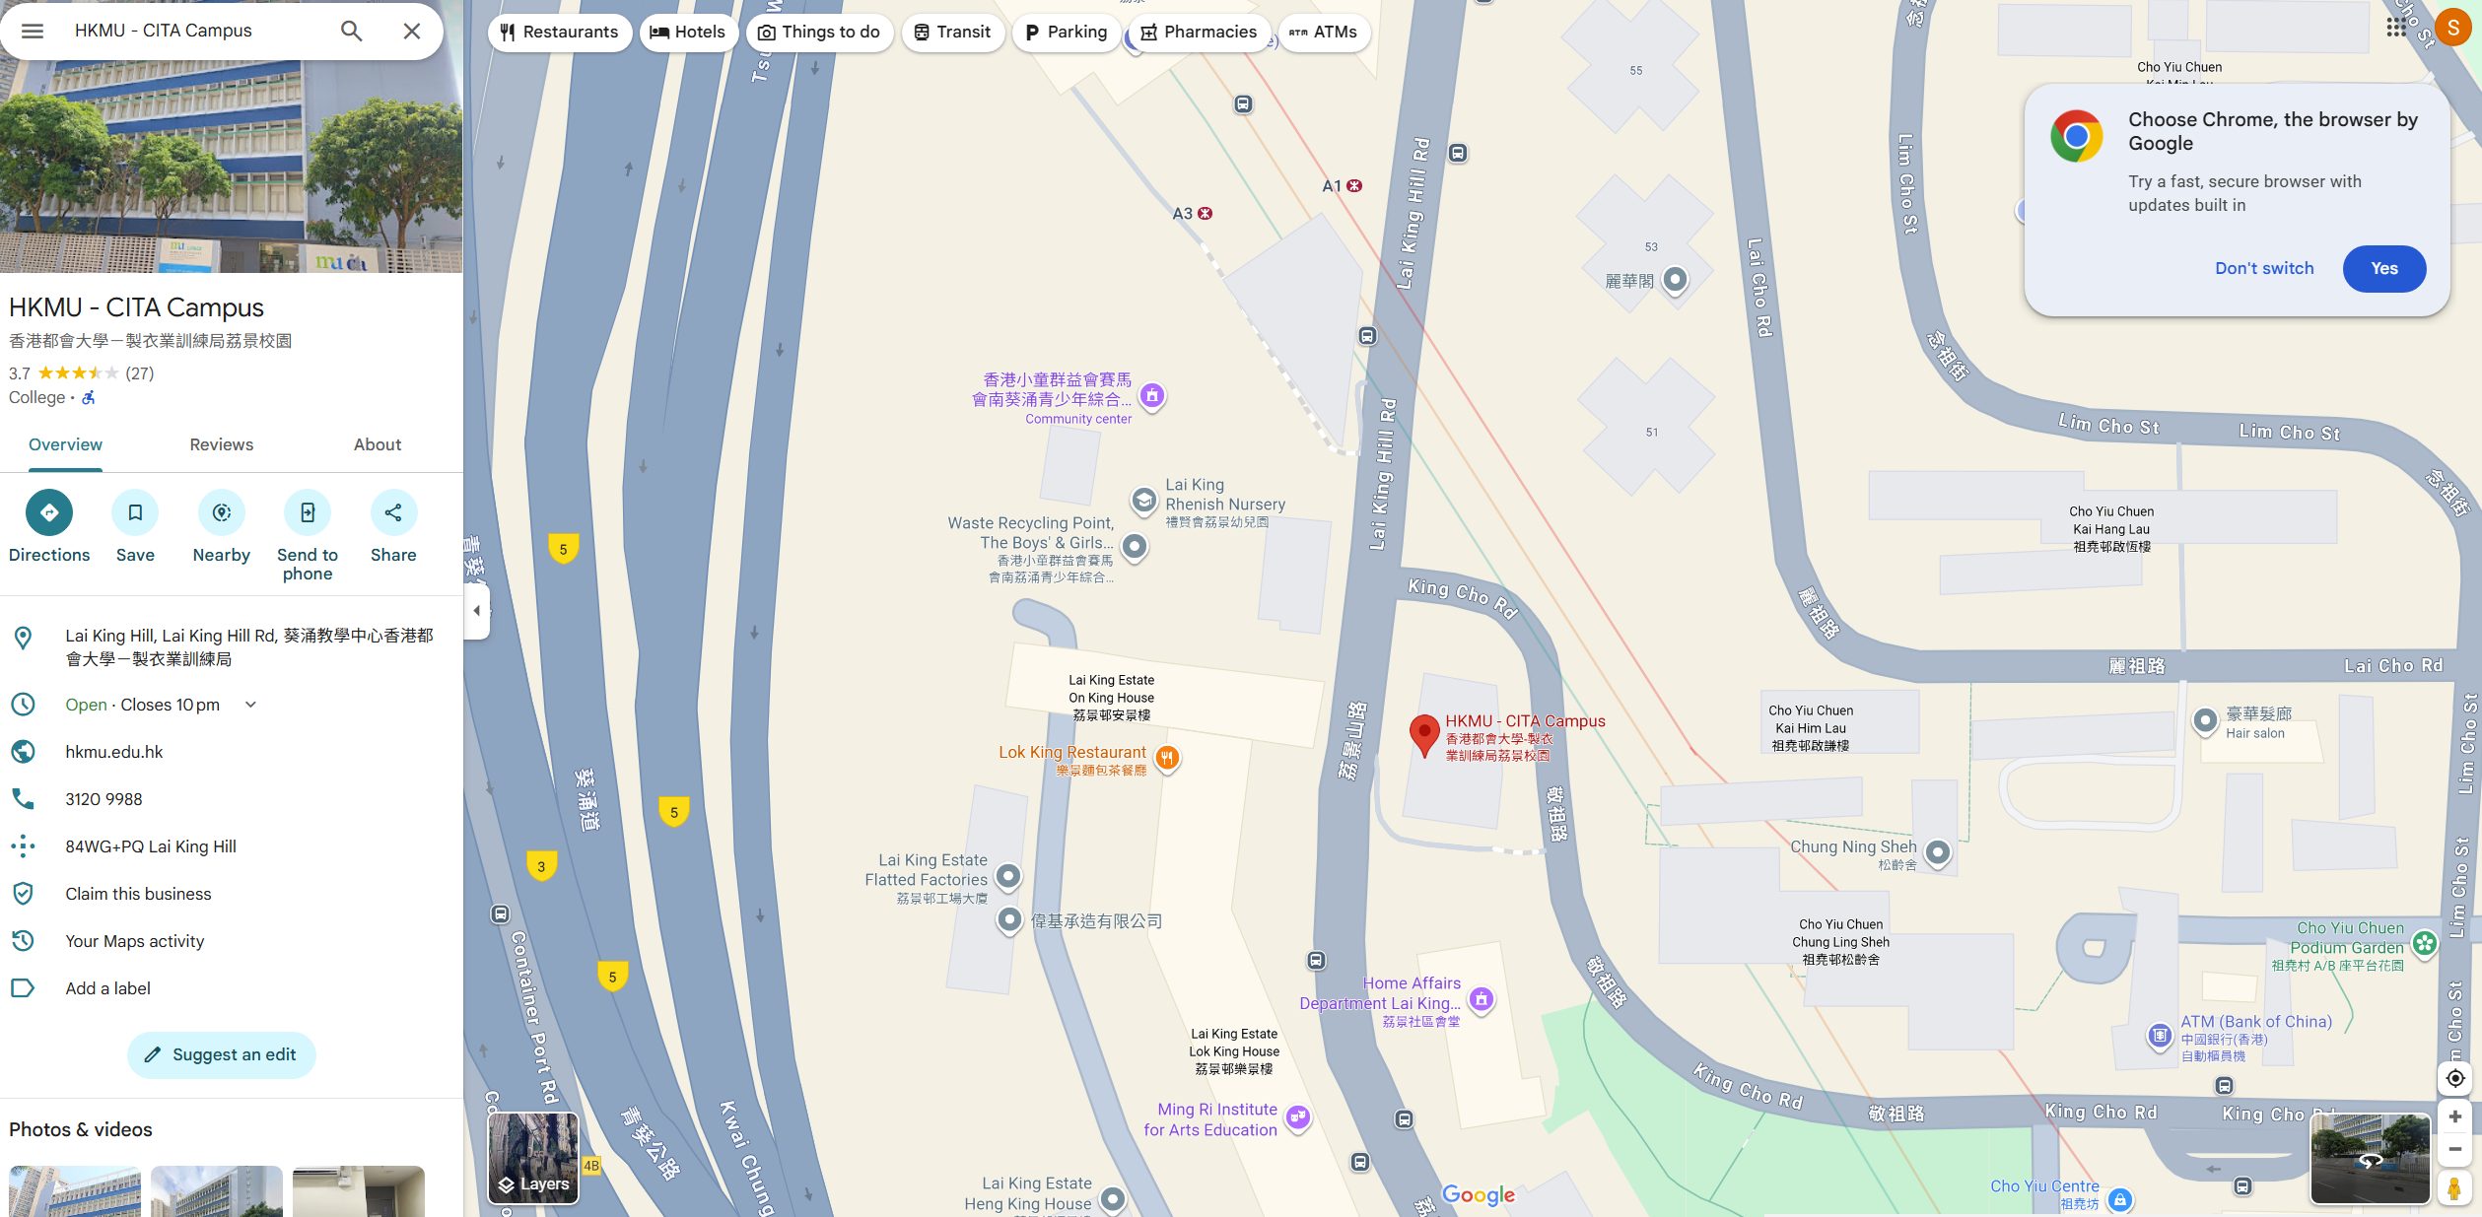
Higher Diploma in Engineering (Civil Engineering)
FHDENG
https://maps.app.goo.gl/qEez7e2rjxEBykf78

Slide 8
Higher Diploma in Engineering (Civil Engineering)
FHDENG
Programme Leader Dr Samuel LAU 3588 7870 ssylau@hkmu.edu.hk
Programme Administrator Ms Hyde TAM 3588 7863 htam@hkmu.edu.hk
課程網頁
IG專頁

Slide 9
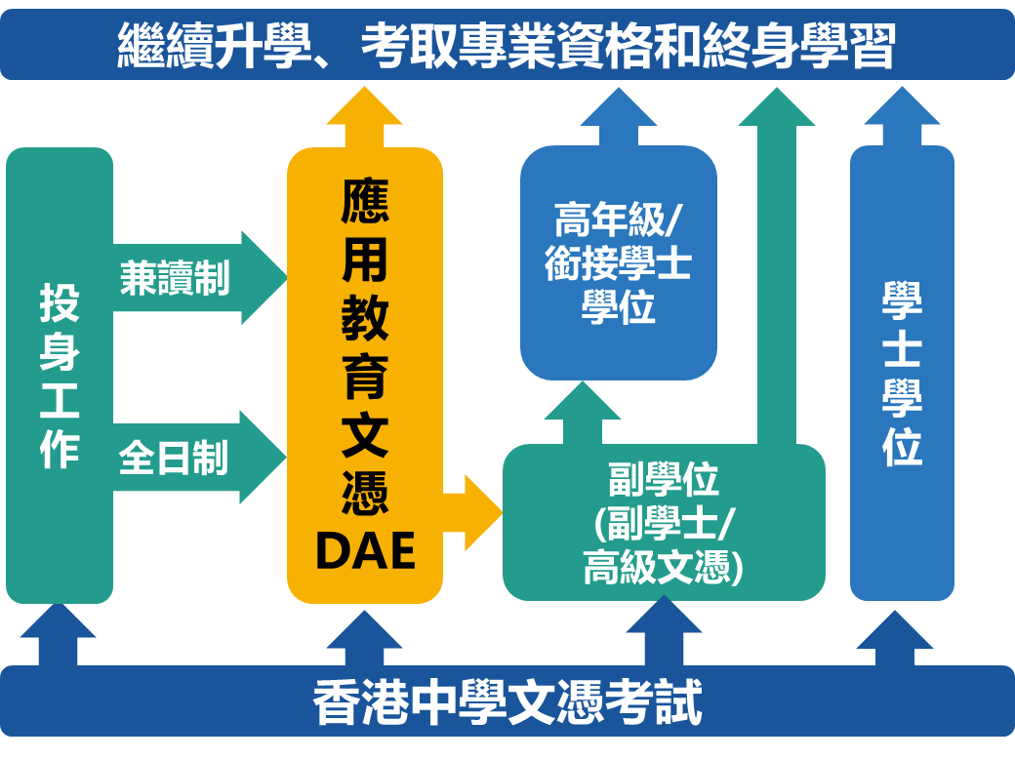
Study Paths

Slide 10
Study Paths
升學途徑:
畢業生合資格報讀本地或海外大學相關的學士學位課程
香港都會大學土木與環境工程學(榮譽)工學士三年級
香港科技大學工學(榮譽)學士(土木及環境工程)三年級
香港理工大學土木工程學(榮譽)工學士三年級
香港城市大學土木工程學(榮譽)工學士二年級
香港城市大學建築工程學(榮譽)工學士二年級
香港高等教育科技學院土木工程(榮譽)工學士三年級
備註:最終決定權屬於各院校。

Slide 11
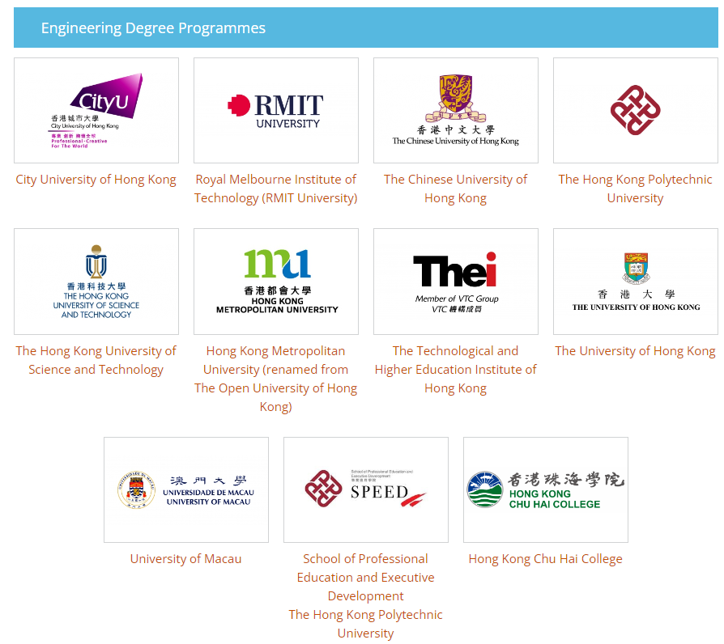
Study Paths
畢業生合資格報讀:
8所學府
18個通過香港工程師學會評審的課程
備註:最終決定權屬於香港工程師學會。

Slide 12

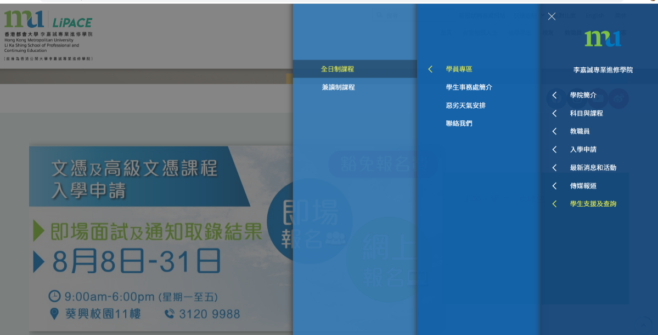
Student Area and Student Handbook
1
2

Slide 13
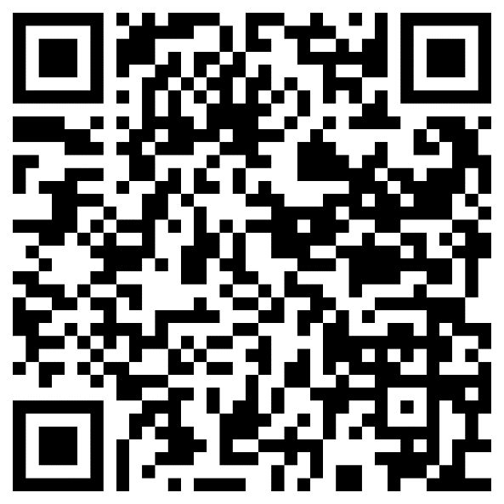
設定「統一密碼」 Activate Your Single Password
請參閱學生手冊
  www.hkmu.edu.hk → 在學學生 → 本科生及副學位 → 服務及支援 → 統一密碼管理 (學生)
Please refer to Student Handbook
  www.hkmu.edu.hk → Current Students → Undergraduate & Sub-degree → Services & Support → Single Password Management

Slide 14
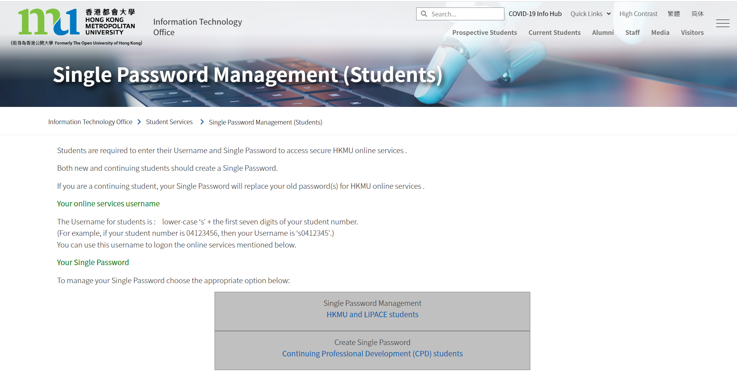

Slide 15
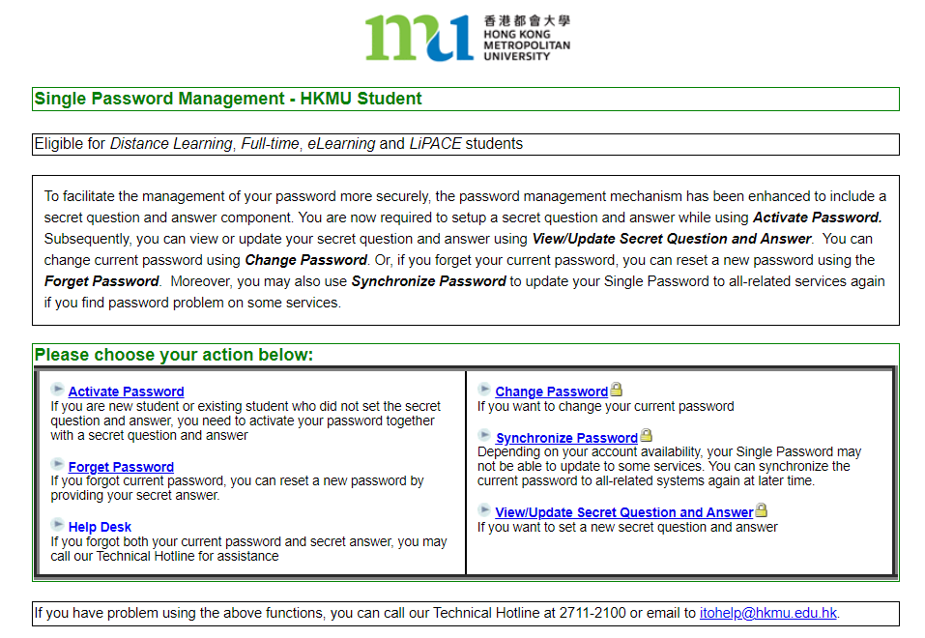

Slide 16
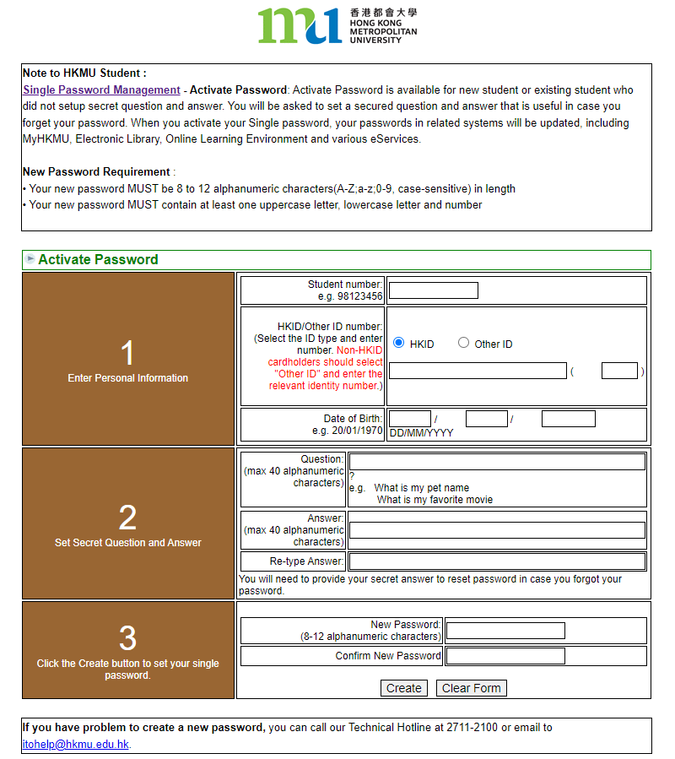
只可英文字母及數字 Letters & Numbers ONLY
(){}[]|`¬¦! "£$%^&*"<>:;#~_-+=,@.

Slide 17

Activation of Email Account
到以下連結，根據指示啟動O365戶口
Go to the links below and follow the instructions to activate your O365 account
https://student.intranet.hkmu.edu.hk/hkmu_o365/

Slide 18

“s”+學員學生証號碼的前七位數字
  你的統一密碼
登入後，根據指示啟動O365戶口

Slide 19
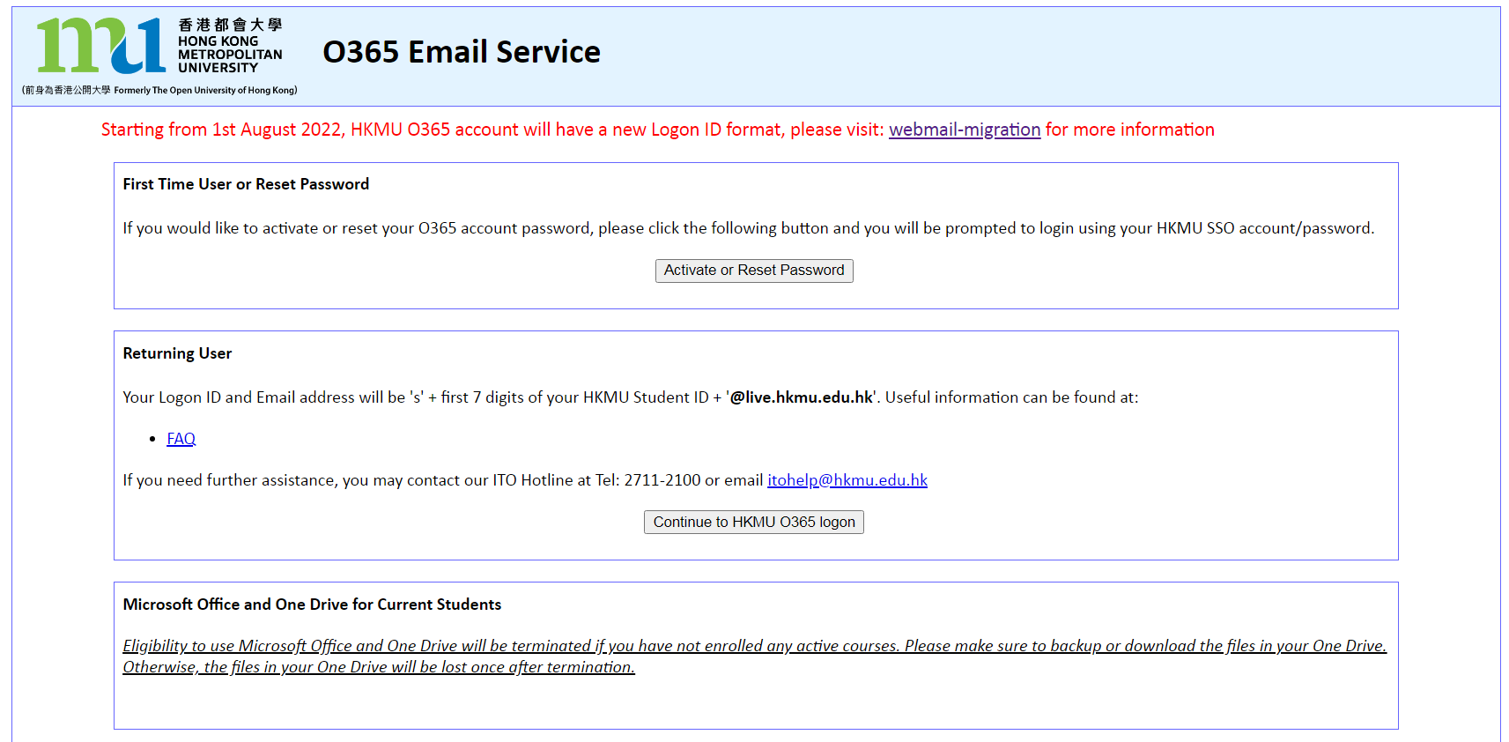

Slide 20
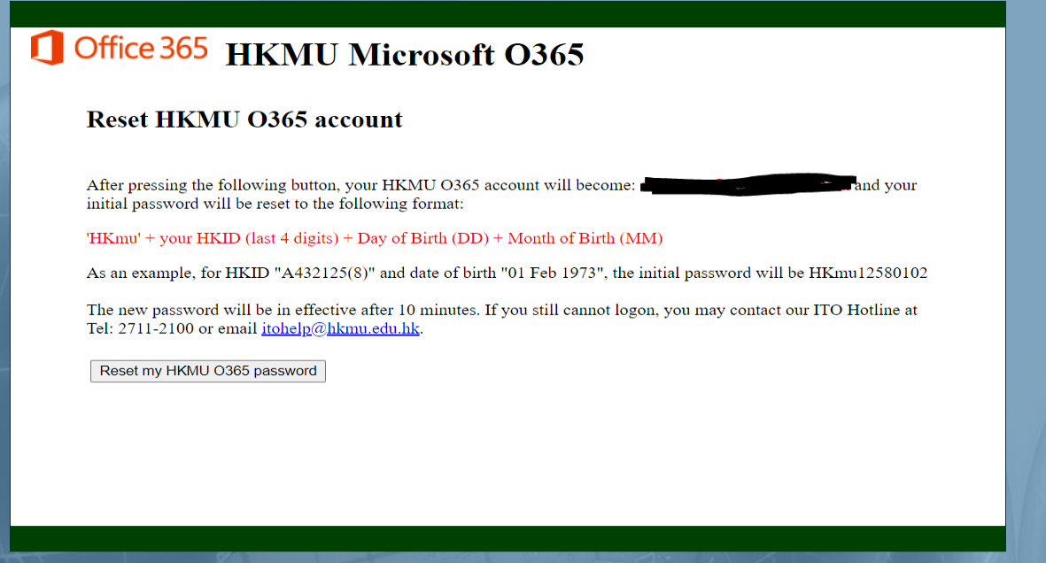

Slide 21
Login Email and OLE
登入 https://login.microsoftonline.com
  輸入你的「登入名稱」及 「密碼」
Enter the website: https://login.microsoftonline.com
  Enter your Logon ID and Password
你的登入名稱及電郵地址將會為 ‘s” +學員學生証號碼的前七位數字+ ‘@live.hkmu.edu.hk’
例如: 學生証號碼是 12345678 → s1234567@live.hkmu.edu.hk
Your Logon ID and Email Address will be ‘s” + first 7 digits of your HKMU student ID + ‘@live.hkmu.edu.hk’
If your student ID is 12345678 → s1234567@live.hkmu.edu.hk

Slide 22


  “s”+學員學生証號碼的前七位數字+ “@live.hkmu.edu.hk”
s1234567@live.hkmu.edu.hk

Slide 23
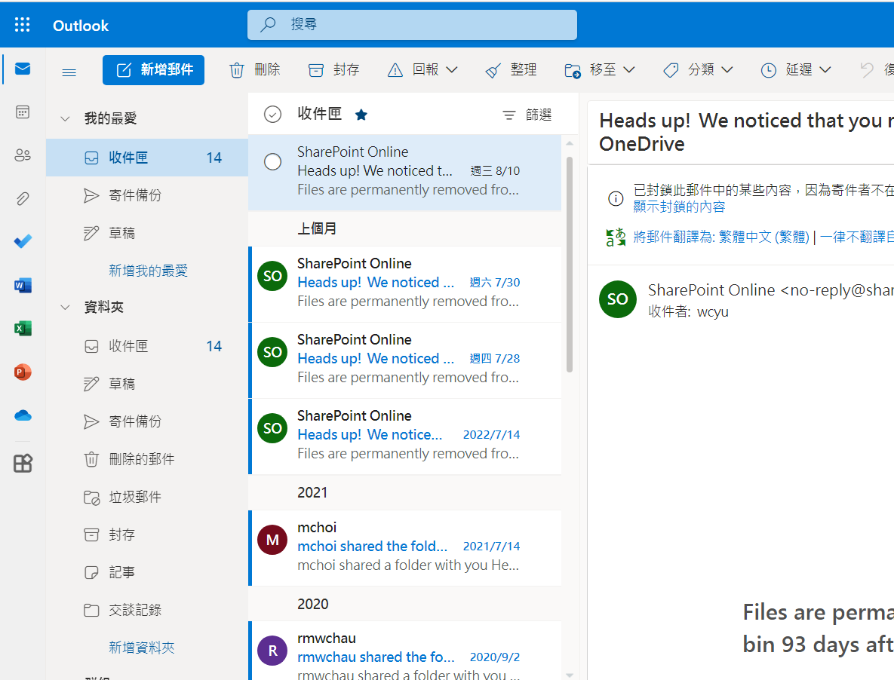
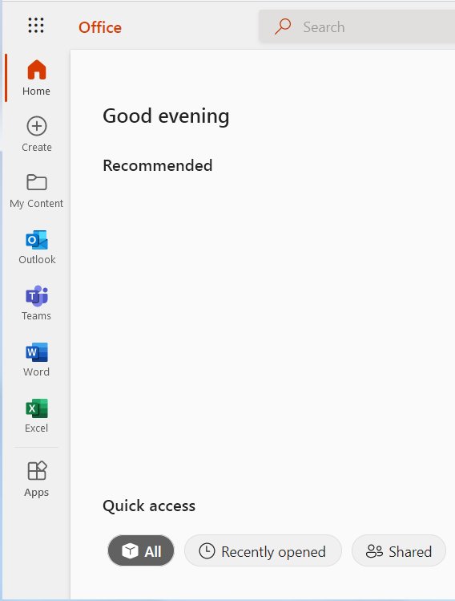

Slide 24
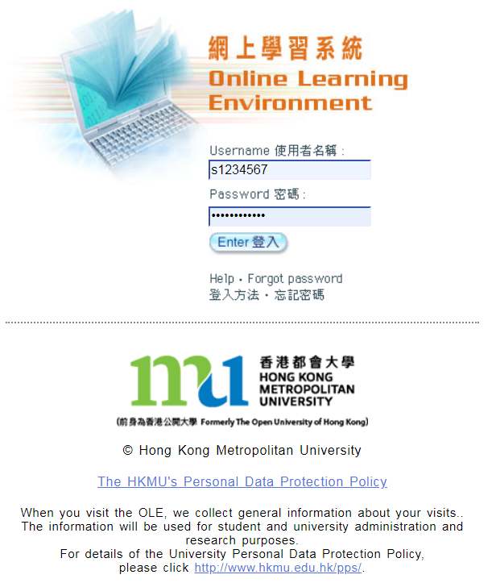
網上學習系統 Online Learning Environment (OLE)
登入 elipace.hkmu.edu.hk/
  使用者名稱：“s”+學員學生証號碼的前七位數字
  密碼：你的統一密碼
Enter the website: elipace.hkmu.edu.hk/
  Username： “s” + first 7 digits of your student
  number
  Password：Your Single Password
(For download of course materials, e.g. PPT, course schedule, and student handbook)

Slide 25
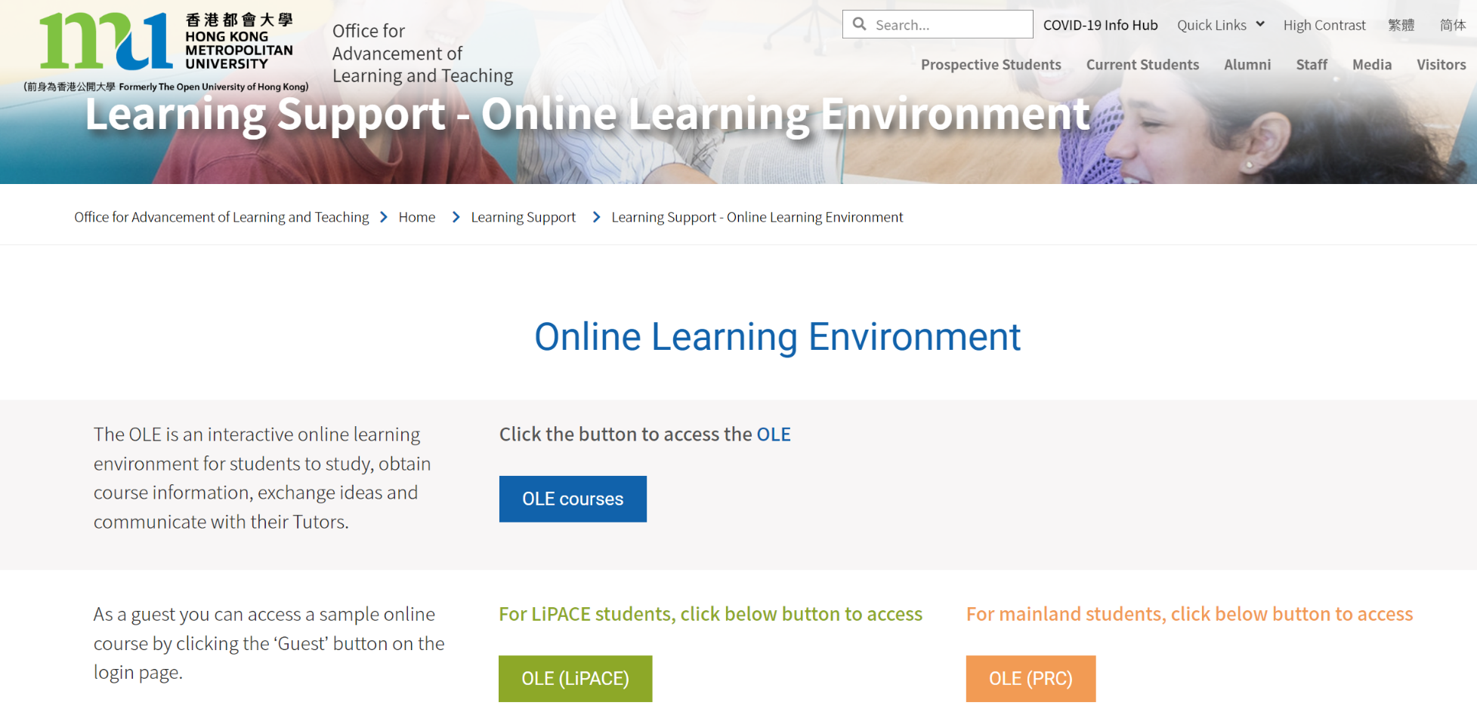

Slide 26
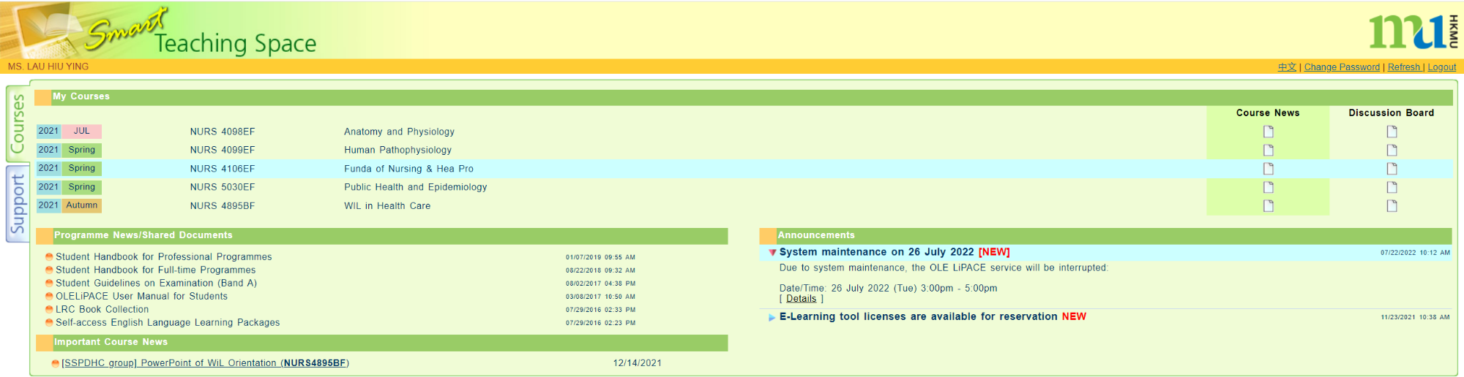
網上學習系統 Online Learning Environment (OLE)

Slide 27
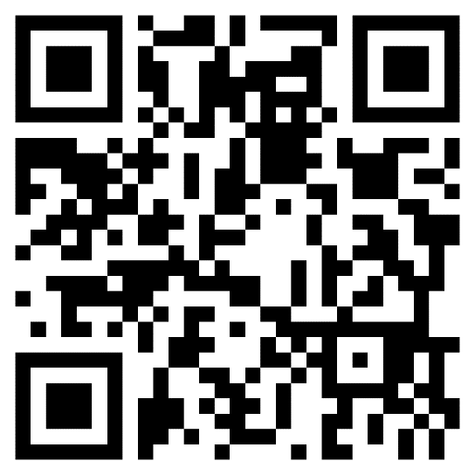
Timetable
到 「LiPACE學員專區」
https://www.hkmu.edu.hk/lipace/tc/ftp-student-area/
Go to ‘LiPACE Student Area’
https://www.hkmu.edu.hk/lipace/ftp-student-area/

Slide 28

1
2

Slide 29
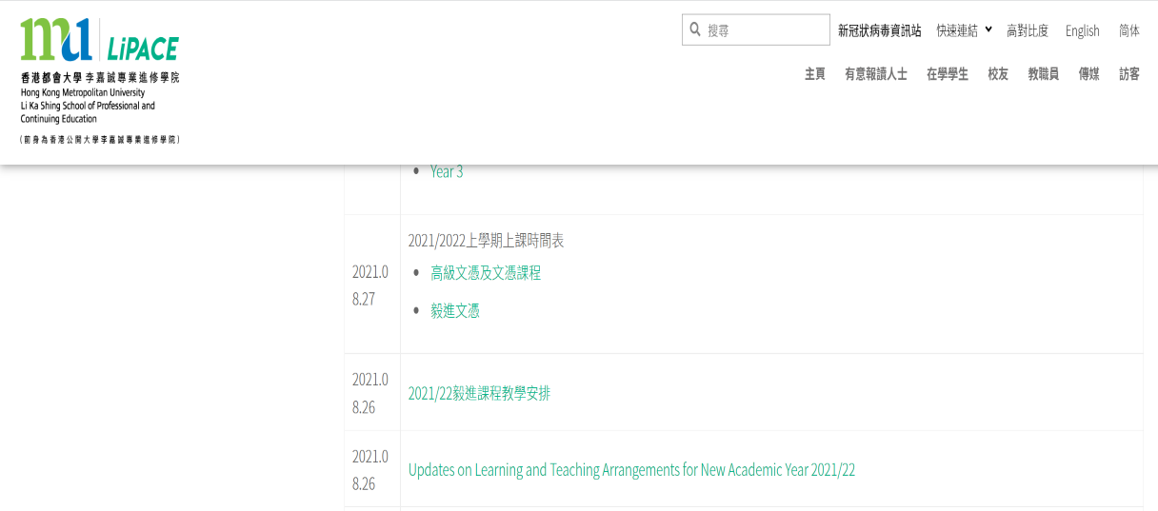
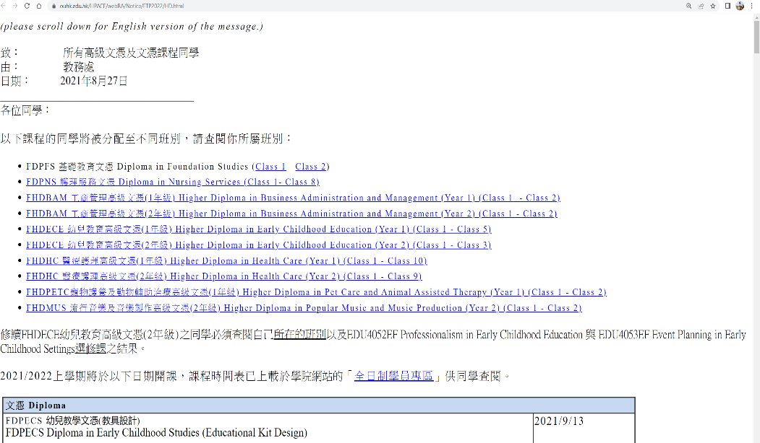
3
4

Slide 30
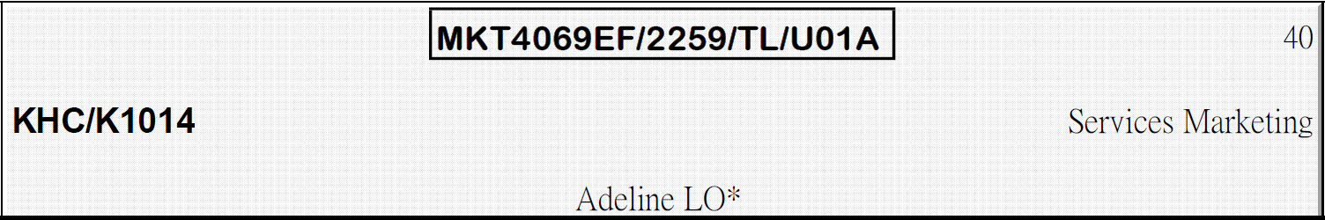
課程編號 / 學年 / 班號
Course Code / Intake / Class
MKT4069EF / 2259 / U01A
Teaching Venue
上課地點
Course Name
課程名稱
KHC - 葵興校園
(葵涌葵昌路51-53號九龍貿易中心第2座8-11樓)
8-11/F, Tower 2, Kowloon Commerce Centre, 51-53 Kwai Cheong Road, Kwai Chung, N.T.
Lecturer Name
講師名稱

Slide 31
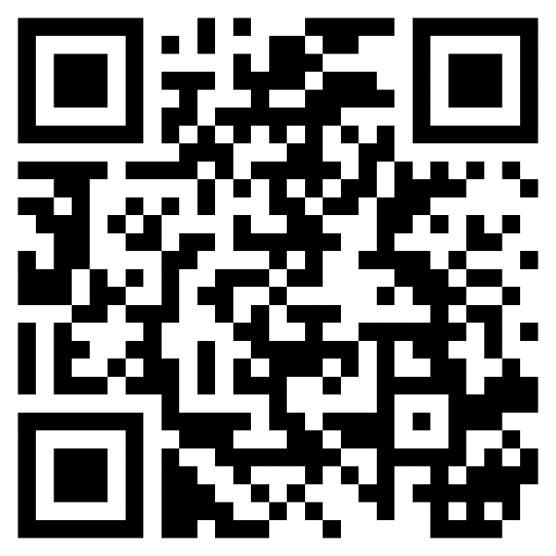
學生入門網站 MyHKMU Student Portal MyHKMU
登入 www.hkmu.edu.hk/current-students/
  使用者名稱：“s”+學員學生証號碼的前七位數字
  密碼：你的統一密碼
Enter the website: www.hkmu.edu.hk/current-students/
  Username： “s” + first 7 digits of your student number
  Password：Your Single Password

Slide 32
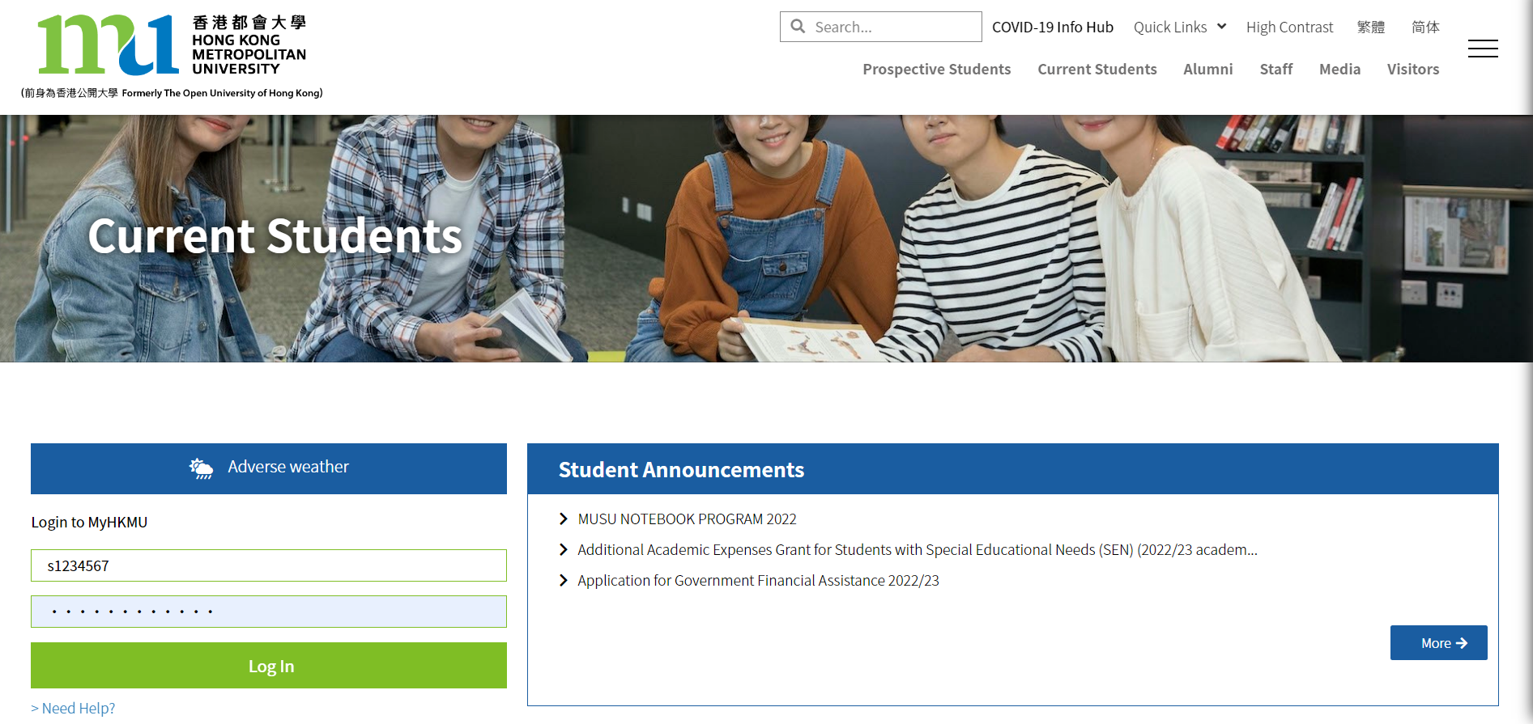

Slide 33
學生入門網站 MyHKMU Student Portal MyHKMU
香港都會大學李嘉誠專業進修學院之學生可透過「學生入門網站 MyHKMU」使用以下網上服務：
更新個人資料
查閱個人修業紀錄
下載專業進修課程的上課時間表
報讀課程 (只適用於無特定入學要求之課程)
查核學科最終成績
下載電子版〈非正式〉成績單
LiPACE students can access the student portal MyHKMU for the following online services:
Update personal particulars
Enquire your academic records
Download professional programme timetable
Enroll on courses without admission requirements
Enquire your continuous assessment marks and overall course grade
Download unofficial transcript

Slide 34
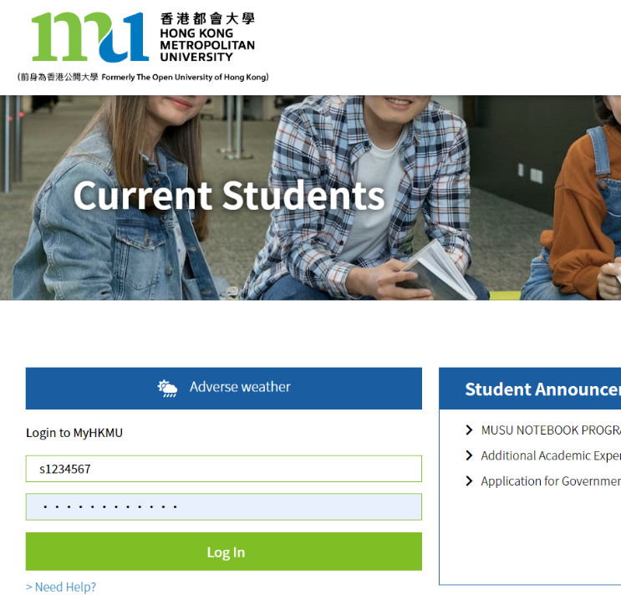
MyHKMU → 查閱成績 Checking Result
登入 MyHKMU
Login MyHKMU
www.hkmu.edu.hk/current-students/

Slide 35




Slide 36
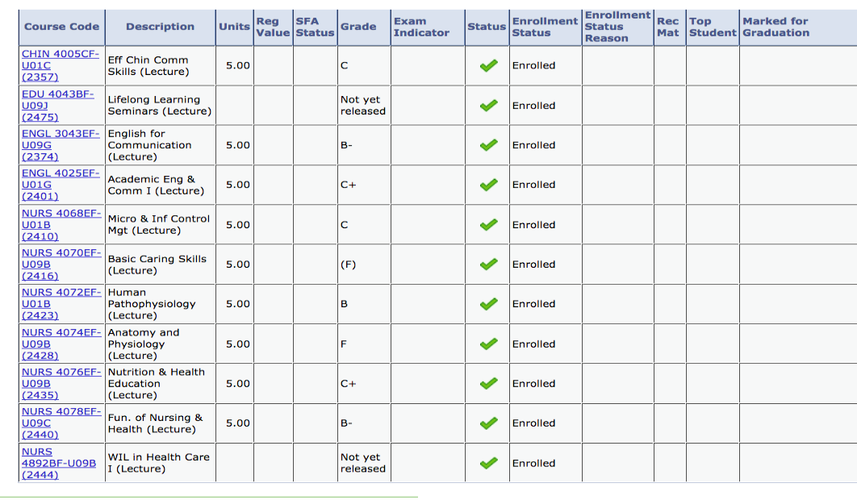

Slide 37



Completion of Entry Survey 完成入學問卷調查
https://hkmu.qualtrics.com/jfe/form/SV_bpB3veks5h4YdZc
Collection of Student Card 領取學生證
To help us understand about your learning expectation and support at LiPACE, please complete the Entry Survey before you pick up your Student ID Card and save the screenshot of the last page .
為了讓我們更了解您的學習期望和所需支援，請在領取學生證前完成入學問卷調查，並將最後一頁屏幕截圖。
Please show the screenshot / email proof of survey completion for collecting the Student Card.
請在領取學生證時出示完成問卷的屏幕截圖/電子郵件證明。

Slide 38
語文科目豁免政策
Language Course Exemption

Slide 39
Chinese/English courses – QF Level 3 & 4
Holders of any qualifications mentioned below:
A locally accredited sub-degree (at QF Level 4) or a post-secondary diploma offer by a recognized university or higher education institute overseas, or
A locally accredited Bachelor’s degree or above (at QF Level 5 or above) or a Bachelor’s degree or above offered by a recognized university overseas.
The qualification should be awarded by a university or institute where the medium of instruction and assessments of this qualification must be in English. This includes UK and colonies, US (mainland and territories), Canada, Australia, New Zealand, South Africa (must be in English speaking, not Afrikaans), Ireland and Singapore. Other English-medium universities in the British Commonwealth will be considered on a case-by-case basis.

Slide 40
Chinese/English courses – QF Level 3 & 4
Completion of a prior Chinese/English course at QF Level 3/4 or above
The course should be non-career specific.
(e.g. Business English courses and English courses for Tourism will not be considered.)

Slide 41
English courses – QF Level 3 & 4
Holders of a public examination qualification from a recognized examination body
 | QF Level 3 English for Communication I | QF Level 4 English for Communication II | QF Level 4 English for Communication III
HKDSE Level 3 or above | ✓
HKALE/GCE A-level Grade D or above | ✓
IELTS 6.0 or above overall and a minimum of 5.5 for each individual component | ✓
IELTS 6.5 or above overall and 6 in listening and speaking component | ✓ | ✓

Slide 42
English courses – QF Level 3 & 4
Holders of a public examination qualification from a recognized examination body (cont.)
The results of IELTS and TOEFL must not be more than 2 years from the date of the test or final examination to the date of commencement of study at LiPACE.
 | QF Level 3 English for Communication I | QF Level 4 English for Communication II | QF Level 4 English for Communication III
IELTS 6.5 or above overall and 6 in reading and writing component | ✓ |  | ✓
TOEFL scored -60 (iBT) | ✓
TOEFL score -79 (iBT) | ✓ | ✓ | ✓
TEFL/TESOL certification, Or CELTA holder | ✓ | ✓ | ✓

Slide 43


Documents required for exemption application
01
02
Course Issues Application Form
https://www.hkmu.edu.hk/lipace/tc/admission/enrollment-form/
Qualification certificate awarded by a recognized university/institute/examination body; or
Syllabus from a prior course providing information on learning outcomes, academic standard, coverage, duration and assessment criteria
Application deadline:
22 September 2025 (Monday)

Slide 44

Course Issues Application Form 課程事項申請表

Slide 45

THANKS
Staff contacts
Head of Languages
Dr. Sylvia SZE | swsze@hkmu.edu.hk | 3120 9715
Deputy Head of Languages
Ms. Melissa YEUNG | mylyeung@hkmu.edu.hk | 3120 9719
Effective Chinese Communication Skills 應用中文傳意技巧
Ms. Konnie TANG | kyhtang@hkmu.edu.hk | 3120 9822

Slide 46

香港都會大學
李嘉誠專業進修學院
課外活動、外藉英語老師及
英語學習支援
Heidi Cheng
https://drive.google.com/file/d/1fRO0az-JW6hWbN3-tUWhKmDn5q70_epP/view?usp=sharing

Slide 47
Student Affairs Office
學生事務處
https://drive.google.com/file/d/1Rj6_MKb9ElRzNpPh2F2Uau8e_F8BgONH/view?usp=sharing

Slide 48
Q&A

