Slide 1

幼兒教育高級文憑
FHDECE

Slide 2


Dean's Speech
院長致辭
https://drive.google.com/file/d/1lzeKxWE_EapKwS2VI7k-CrMUPPCCVfdT/view?usp=drive_link

Slide 3

Key Staffs of LiPACE 學院重要成員
Dean 院長
Dr Benjamin CHAN Tak-yuen
曾德源博士

Slide 4
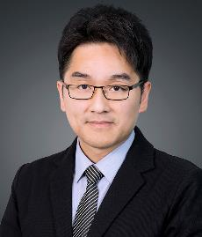
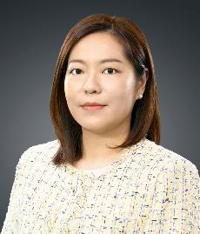

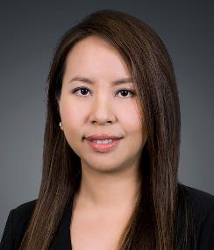
Key Staffs of LiPACE 學院重要成員
Associate Directors
副院長
Dr Ching Ka Wai Larry
程家偉博士
Dr Chen Yi-Fan Yvonne
陳羿帆博士
Ms. Pang Hoi Ning Helen
彭海寧女士
Dr Chim Hiu Man Kathleen
詹曉雯博士

Slide 5
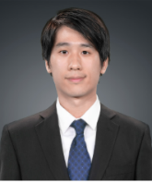
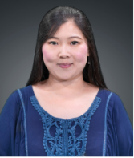


The ECE Team
Bruno Chiu
Ada Wong
Elli Hau
Hyde Tam

Slide 6
查詢 Enquiries
 | 幼兒教育高級文憑 Higher Diploma in Early Childhood Education
Programme Leader | Mr. Bruno Chiu
Programme Administrator | Ms. Hyde Tam
Office Number of Program Admin | 3588 7863
Email | lipace_ece_ft@hkmu.edu.hk
WhatsApp | 3588 7863

Slide 7
課程類別及升學階梯 Programme Type & Study Pathway
應用教育文憑
Diploma of Applied
Education /
基礎教育文憑
Diploma in
Foundation Studies
(1 year full-time)
高級文憑課程
Higher Diploma
副學士課程
Associate Degree
(2 years full-time)
本地或海外學位課程
Local or Overseas Degree
(香港都會大學、本地其他資助、自資大學
海外大學學士學位)
(1-2 years full-time/ 2 years part-time)

Slide 8
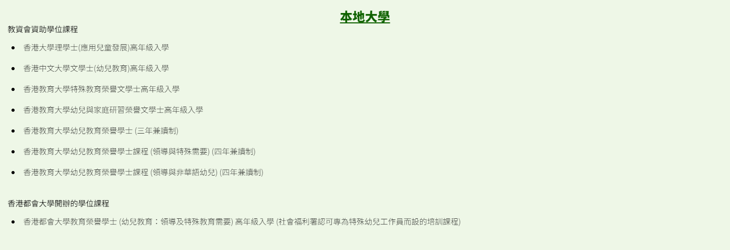
升學階梯 (ECE - 本地)
(Local) Top-up / Degree Programme

Slide 9
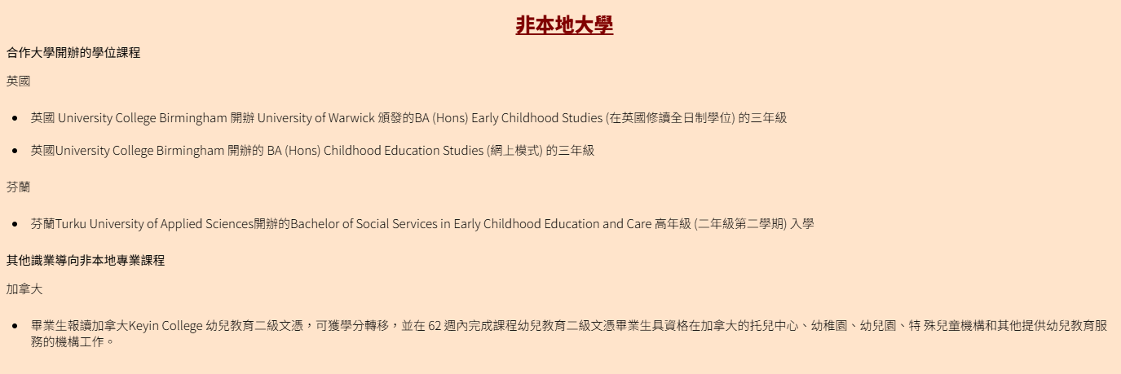
升學階梯 (ECE -非本地)
(non-Local) Top-up / Degree Programme

Slide 10
現在, 讓我們先處理所有你需要擁有的帳戶
Now, let's take care of all the accounts you need to have

Slide 11
如果你途中遇到困難, 不要害怕, 你身旁的同學願意協助你。
If you encounter difficulties, don't be afraid, your classmates are willing to help you.

Slide 12
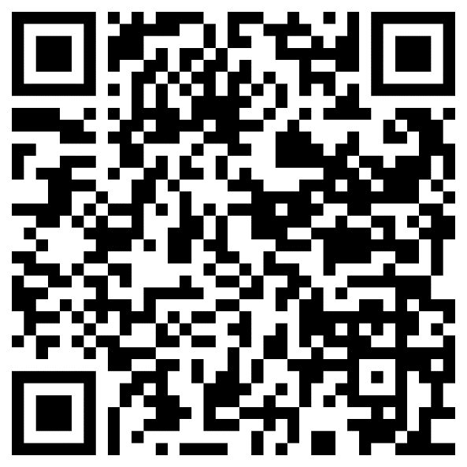
設定「統一密碼」 Activate Your Single Password
  www.hkmu.edu.hk → 在學學生 → 本科生及副學位 → 服務及支援 → 統一密碼管理 (學生)
  www.hkmu.edu.hk → Current Students → Undergraduate & Sub-degree → Services & Support → Single Password Management

Slide 13
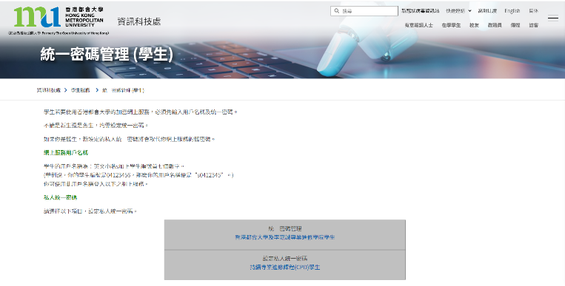
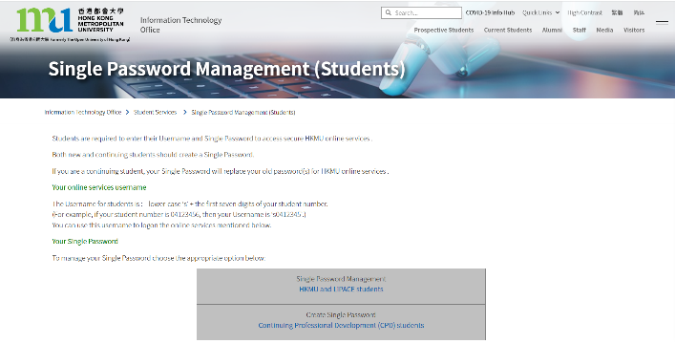

Slide 14
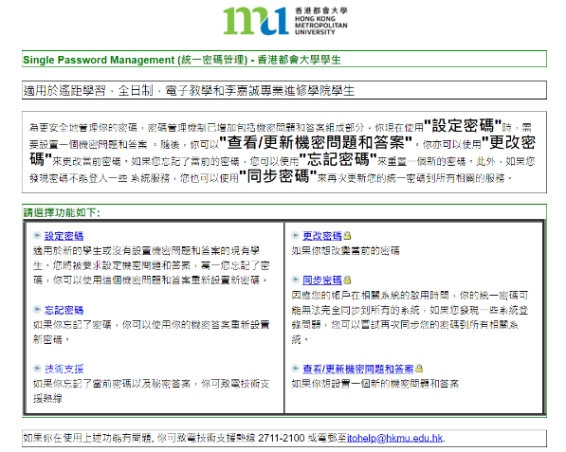
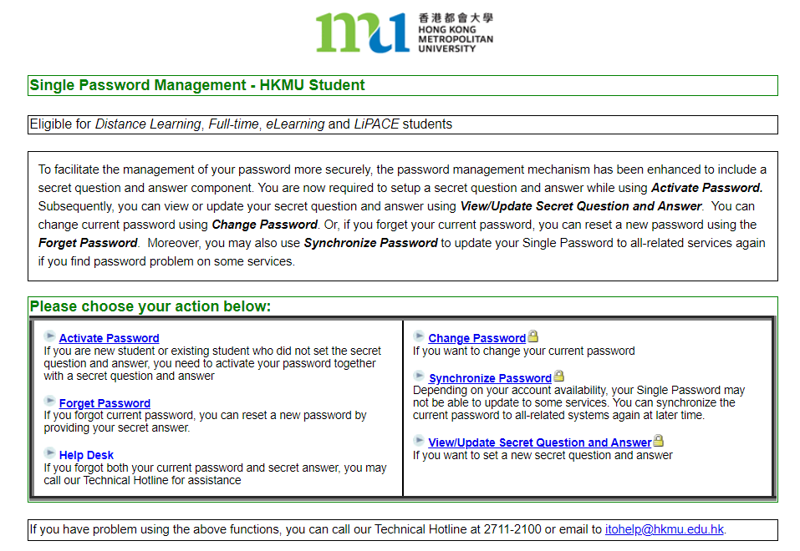

Slide 15
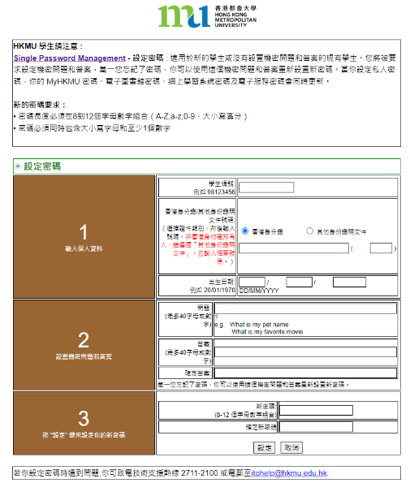
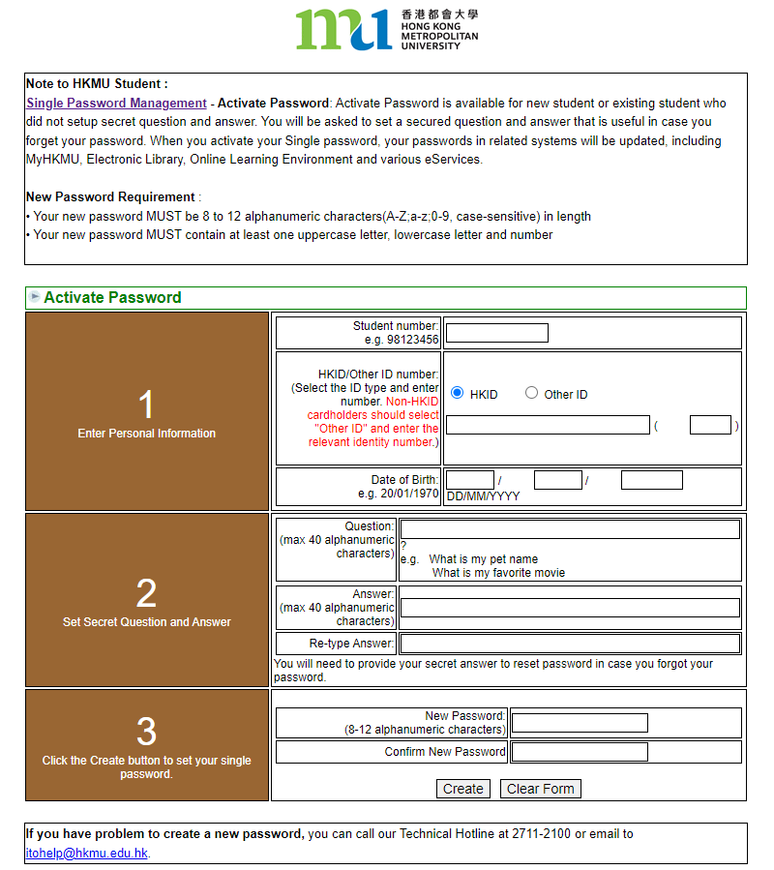
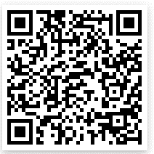
只可英文字母及數字 Letters & Numbers ONLY
(){}[]|`¬¦! "£$%^&*"<>:;#~_-+=,@.

Slide 16
「統一密碼」Single Password
適用於登入
- MyHKMU
elipace (網上學習系統)
內聯網 Intranet

Slide 17
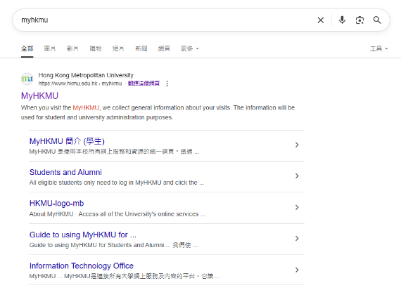
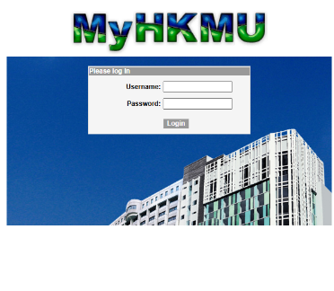

MyHKMU
  使用者名稱：“s”+學生証號碼的前七位數字
  密碼：你的統一密碼
  Username： “s” + first 7 digits of your student
  number
  Password：Your Single Password

Slide 18
香港都會大學李嘉誠專業進修學院之學生可透過「學生入門網站 MyHKMU」使用以下網上服務：
更新個人資料
查閱個人修業紀錄
下載專業進修課程的上課時間表
報讀課程 (只適用於無特定入學要求之課程)
查核學科最終成績
下載電子版〈非正式〉成績單
LiPACE students can access the student portal MyHKMU for the following online services:
Update personal particulars
Enquire your academic records
Download professional programme timetable
Enroll on courses without admission requirements
Enquire your continuous assessment marks and overall course grade
Download unofficial transcript

Slide 19

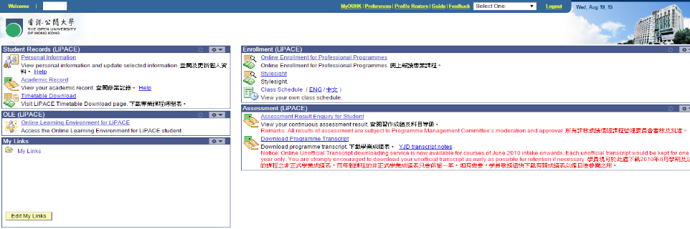

MyHKMU → 查閱成績 Checking Result

Slide 20
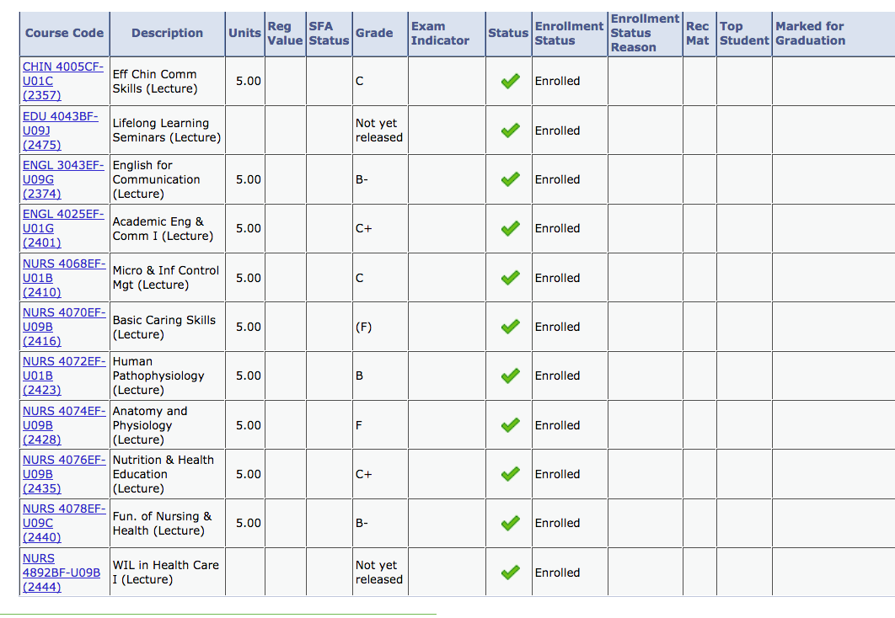

Slide 21
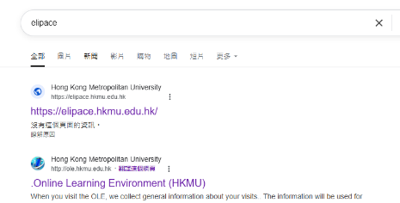

網上學習系統 Online Learning Environment (elipace)
  使用者名稱：“s”+學生証號碼的前七位數字
  密碼：你的統一密碼
  Username： “s” + first 7 digits of your student
  number
  Password：Your Single Password
(For download of course materials, e.g. PPT, course schedule, and student handbook)

Slide 22
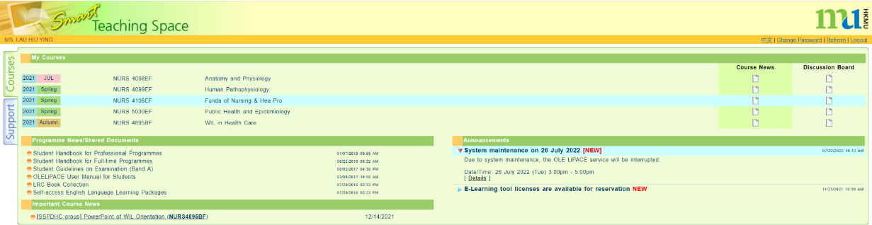
網上學習系統 Online Learning Environment (elipace)

Slide 23

啟動 O365 戶口 Activate Your O365 Account
到以下連結，根據指示啟動O365戶口
Go to the links below and follow the instructions to activate your O365 account
https://student.intranet.hkmu.edu.hk/hkmu_o365/
重中之重, 你需要先啟動O365才能看到學校的電郵
Very Important! You must activate the O365 Account in order to access your school email.

Slide 24

“s”+學員學生証號碼的前七位數字
  你的統一密碼
登入後，根據指示啟動O365戶口

Slide 25
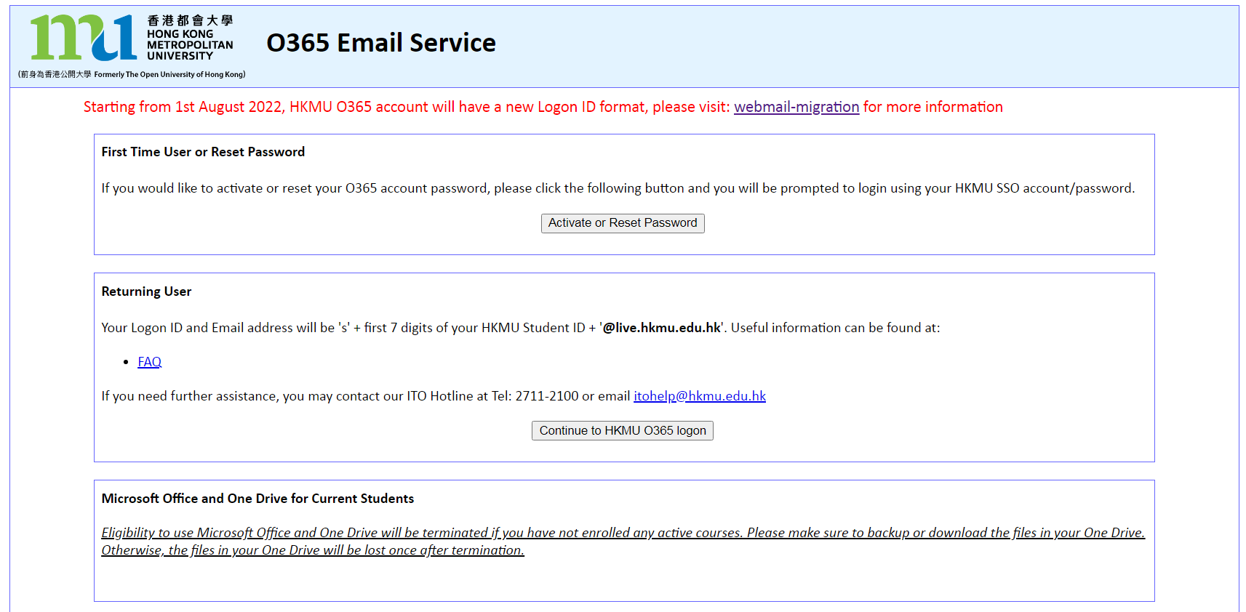

Slide 26
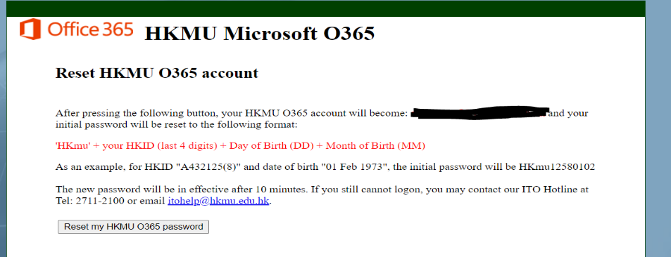
預設密碼 = HKmu+身份證尾四位+出生日子dd+出生月份mm
HK 大楷 mu 細楷
身份證尾四位 包括括號內的字
日子及月份要兩個位, 3月出世寫 03
例: 8月25日出世 身份證係A123456(7):
預設密碼: HKmu45672508

Slide 27
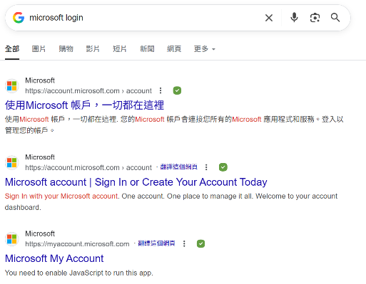
登入 O365 電郵帳戶 Login Your O365 Email Account
你的登入名稱及電郵地址是:
s+學員學生証號碼的前七位數@live.hkmu.edu.hk’
例如: 學生証號碼是 12345678 → s1234567@live.hkmu.edu.hk
Your Logon ID and Email Address will be
s + first 7 digits of your HKMU student ID@live.hkmu.edu.hk If your student ID is 12345678 → s1234567@live.hkmu.edu.hk
https://login.microsoftonline.com

Slide 28


s1234567@live.hkmu.edu.hk

Slide 29
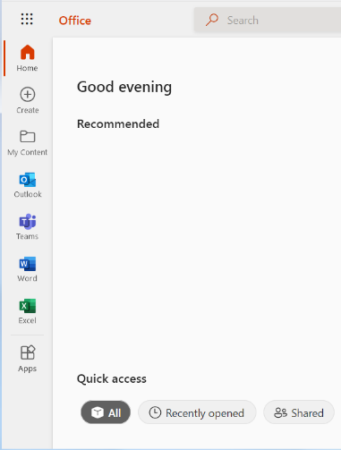
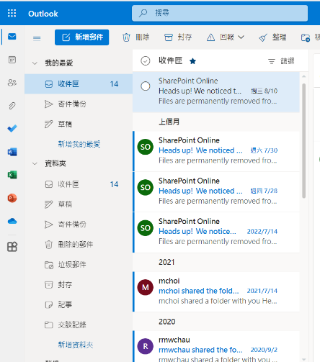
登入後找 「Outlook」
Click Outlook
不要相信這個介面, 介面會轉的, 找outlook就對了。
Don't believe this interface, the interface will change, just look for outlook.

Slide 30
學生號碼 Student number | 8 個數字, 沒有s 8 Number, with no s
Username of MyHKMU, elipace and student intranet | s +學生證號碼頭7個數字 s +first 7 numbers of student number
Password of MyHKMU, elipace and student intranet | 統一密碼 Single Password
Username of O365 | s +學生證號碼頭7個數字@live.hkmu.edu.hk s +first 7 numbers of student number@live.hkmu.edu.hk
Default Password of O365 | HKmu+身份證尾四位+出生日子dd+出生月份mm

Slide 31
O365 睇 email elipace 睇 lecture notes myHKMU做其他

Slide 32
接下來, 是有關語文科目的資訊
Next, there is information about the language subject

Slide 33
語文科目豁免政策
Language Course Exemption (FHDECE)

Slide 34
Chinese/English courses – QF Level 3 & 4
Holders of any qualifications mentioned below:
A locally accredited sub-degree (at QF Level 4) or a post-secondary diploma offer by a recognized university or higher education institute overseas, or
A locally accredited Bachelor’s degree or above (at QF Level 5 or above) or a Bachelor’s degree or above offered by a recognized university overseas.
The qualification should be awarded by a university or institute where the medium of instruction and assessments of this qualification must be in English. This includes UK and colonies, US (mainland and territories), Canada, Australia, New Zealand, South Africa (must be in English speaking, not Afrikaans), Ireland and Singapore. Other English-medium universities in the British Commonwealth will be considered on a case-by-case basis.

Slide 35
Chinese/English courses – QF Level 3 & 4
Completion of a prior English course at QF Level 3/4 or above
The course should be non-career specific.
(e.g. Business English courses and English courses for Tourism will not be considered.)

Slide 36
English courses – QF Level 3 & 4
Holders of a public examination qualification from a recognized examination body
 | QF Level 3 English for Communication I | QF Level 4 English for Communication II | QF Level 4 English for Communication III
HKDSE Level 3 or above | ✓
HKALE/GCE A-level Grade D or above | ✓
IELTS 6.0 or above overall and a minimum of 5.5 for each individual component | ✓
IELTS 6.5 or above overall and 6 in listening and speaking component | ✓ | ✓

Slide 37
English courses – QF Level 3 & 4
Holders of a public examination qualification from a recognized examination body (cont.)
The results of IELTS and TOEFL must not be more than 2 years from the date of the test or final examination to the date of commencement of study at LiPACE.
 | QF Level 3 English for Communication I | QF Level 4 English for Communication II | QF Level 4 English for Communication III
IELTS 6.5 or above overall and 6 in reading and writing component | ✓ |  | ✓
TOEFL scored -60 (iBT) | ✓
TOEFL score -79 (iBT) | ✓ | ✓ | ✓
TEFL/TESOL certification, Or CELTA holder | ✓ | ✓ | ✓

Slide 38
只適用於幼兒教育課程
Putonghua 普通話
普通話水平測試 60 分或以上（三級乙等）及相關修讀證明 或
教師普通話基準試達標成績 或
曾修讀與「 PTH3026CF/P - Putonghua in Use 普通話運用」相似的課程，需達資歷架構級別三級或以上，並提供已修讀課程的課程大綱、成績表及畢業證書

Slide 39


只適用於幼兒教育課程
For FHDECE Higher Diploma in Early Childhood Education
Maximum no. of courses to be exempted: 3

Slide 40


Documents required for exemption application
01
02
Course Issues Application Form
https://www.hkmu.edu.hk/lipace/tc/admission/enrollment-form/
Qualification certificate awarded by a recognized university/institute/examination body; or
Syllabus from a prior course providing information on learning outcomes, academic standard, coverage, duration and assessment criteria
Application deadline:
15 September 2025 (Monday)

Slide 41

Course Issues Application Form 課程事項申請表

Slide 42

THANKS
Staff contacts
Head of Languages, General Education & Digital Literacy
Dr. Sylvia SZE | swsze@hkmu.edu.hk | 3120 9715
Deputy Head of Languages
Ms. Melissa YEUNG | mylyeung@hkmu.edu.hk | 3120 9719
Effective Chinese Communication Skills 應用中文傳意技巧
Ms. Konnie TANG | kyhtang@hkmu.edu.hk | 3120 9822
Putonghua in Use 普通話運用
Ms. Ling LI | llcli@hkmu.edu.hk | 3588 7907

Slide 43
記得要選擇你評核語言
Remember to choose your language for assessment

Slide 44

香港都會大學
李嘉誠專業進修學院
課外活動、外藉英語老師及
英語學習支援
Heidi Cheng
https://drive.google.com/file/d/1fRO0az-JW6hWbN3-tUWhKmDn5q70_epP/view?usp=sharing

Slide 45
資訊有點多, 消化一下, 然後準備聽更多重要野
A little too much information maybe, take some time to understand them and get ready for the next part

Slide 46

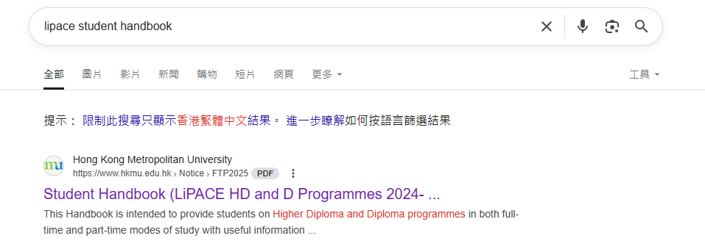
Student handbook

Slide 47
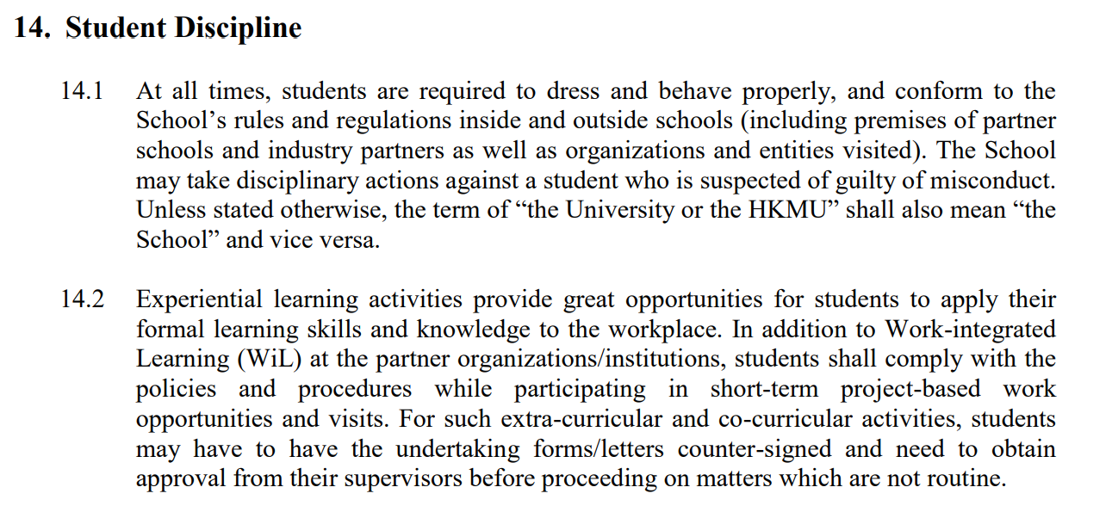

Slide 48
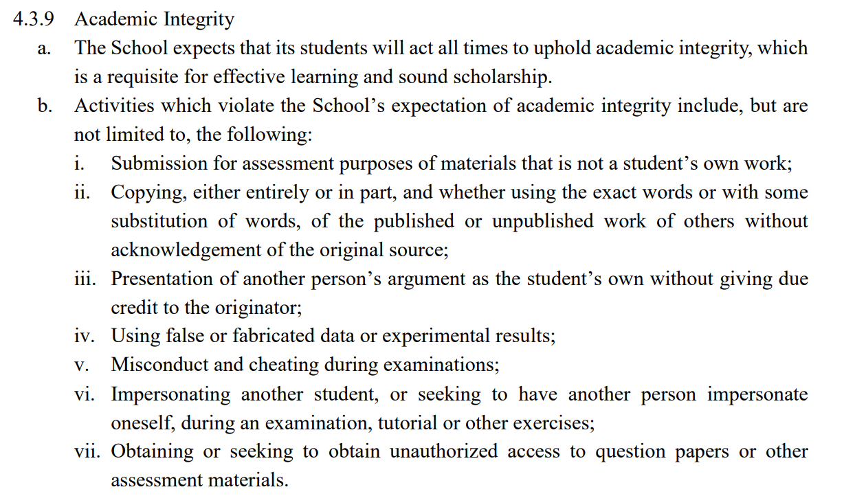

Slide 49
Semester A
1 September 2025 - 17 December 2025
Exam period:
22 Dec 2024 - 2 Jan 2025
Semester B
5 January 2026 - 28 April 2026
Exam period:
4 May 2026 – 16 May 2026

Slide 50
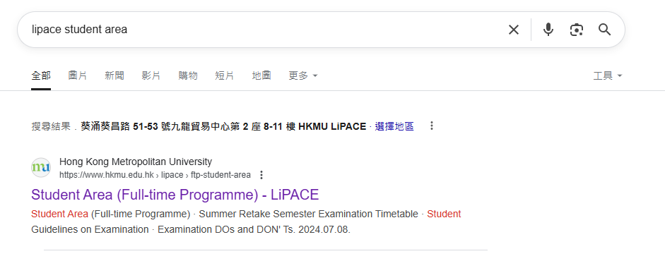
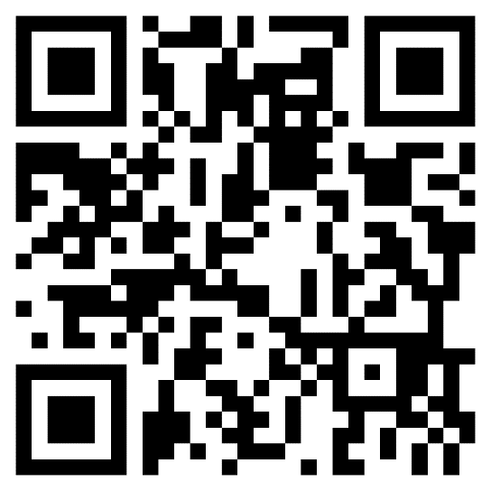
查閱上課時間表 Checking Timetable
Go to LiPACE Student Area
到 「LiPACE學員專區」
https://www.hkmu.edu.hk/lipace/tc/ftp-student-area/

Slide 51
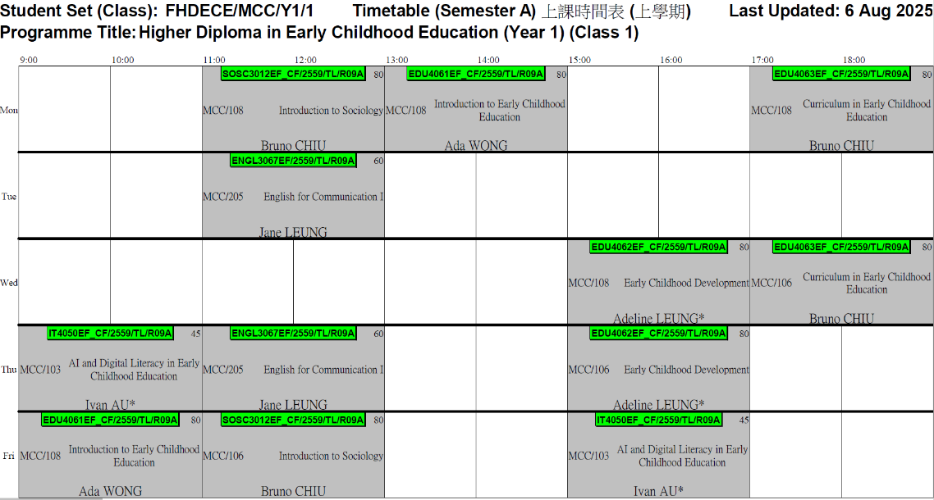
不用拍照, 這是假的
No need to take pictures, it's fake

Slide 52
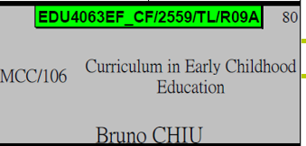
課程編號 / 學年 / 班號
Course Code / Intake / Class
MKT4069EF / 2259 / U01A
Teaching Venue
上課地點
(MCC = 荔景校園)
Course Name
課程名稱
Lecturer Name
講師名稱

Slide 53
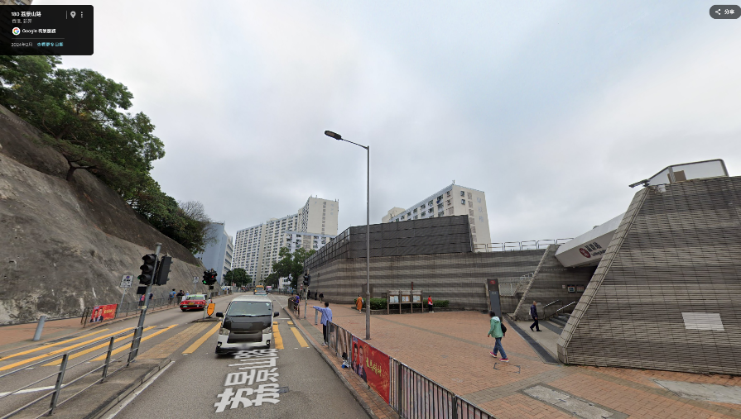
荔景校園 MCC = 香港都會大學－製衣業訓練局荔景校園 / HKMU CITA Campus
MCC
荔景站A1出口

Slide 54
Student Affairs Office
學生事務處
https://drive.google.com/file/d/1Rj6_MKb9ElRzNpPh2F2Uau8e_F8BgONH/view?usp=sharing

Slide 55
現在有4份表格需要大家填寫,
包括3份實體表格, 和1份網上入學問卷
There are now 4 forms to fill out, including 3 hardcopies and 1 online admission questionnaire

Slide 56
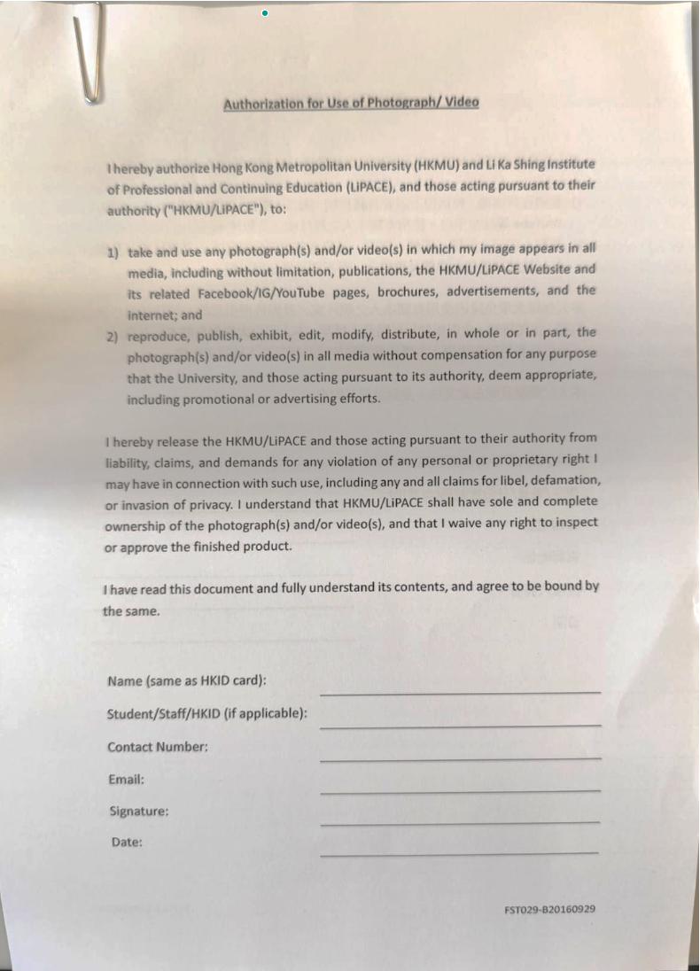
Authorization for the Photograph and Video
即係同意我哋上堂同活動時影相及拍片, 同明白啲相同片係機會被放上網
Agree to us taking pictures and video in lesson and activities, and understand that the pictures and video may put on internet

Slide 57
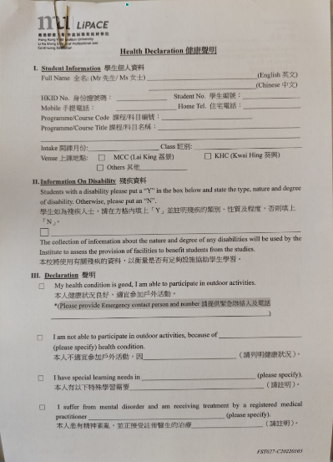
Health Declaration
即係同意自己身體狀況係可以參與出去參觀同交流活動
Claimed that you are in good condition that can join outing and exchanges

Slide 58
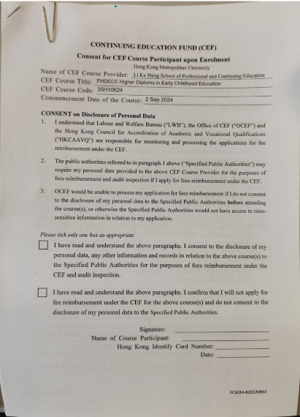
CEF Form
你宜家簽左, 畢業後先可以Claim CEF
You cannot claim CEF unless you have complete the form now

Slide 59


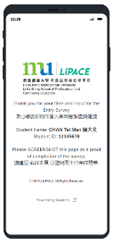
Completion of Entry Survey 完成入學問卷調查
https://hkmu.qualtrics.com/jfe/form/SV_bpB3veks5h4YdZc
Collection of Student Card 領取學生證
To help us understand about your learning expectation and support at LiPACE, please complete the Entry Survey before you pick up your Student ID Card and save the screenshot of the last page .
為了讓我們更了解您的學習期望和所需支援，請在領取學生證前完成入學問卷調查，並將最後一頁屏幕截圖。
Please show the screenshot / email proof of survey completion for collecting the Student Card.
請在領取學生證時出示完成問卷的屏幕截圖/電子郵件證明。

Slide 60
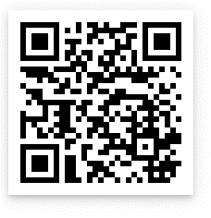
Complete the forms and
Q and A
Follow us!
https://www.instagram.com/ecelipace/

Slide 61
你們十分優秀! 9月1見!
You are very good! See you on Sept 1!

