Slide 1

FHDBAM
Higher Diploma in Business Administration and Management
工商管理高級文憑
FHDDBP
Higher Diploma in Digital Business Practice
數碼商業實務高級文憑
1

Slide 2

Dean's Speech
院長致辭
https://drive.google.com/file/d/1lzeKxWE_EapKwS2VI7k-CrMUPPCCVfdT/view?usp=drive_link

Slide 3
Key Staffs
重要成員
3

Slide 4

Key Staffs of LiPACE 學院重要成員
Dean 院長
Dr Benjamin CHAN Tak-yuen
曾德源博士

Slide 5




Key Staffs of LiPACE 學院重要成員
Associate Directors
副院長
Dr Ching Ka Wai Larry
程家偉博士
Dr Chen Yi-Fan Yvonne
陳羿帆博士
Ms. Pang Hoi Ning Helen
彭海寧女士
Dr Chim Hiu Man Kathleen
詹曉雯博士

Slide 6
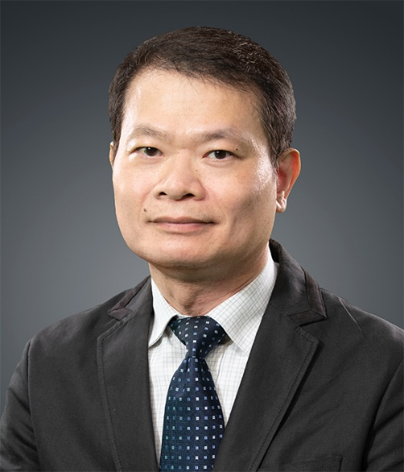
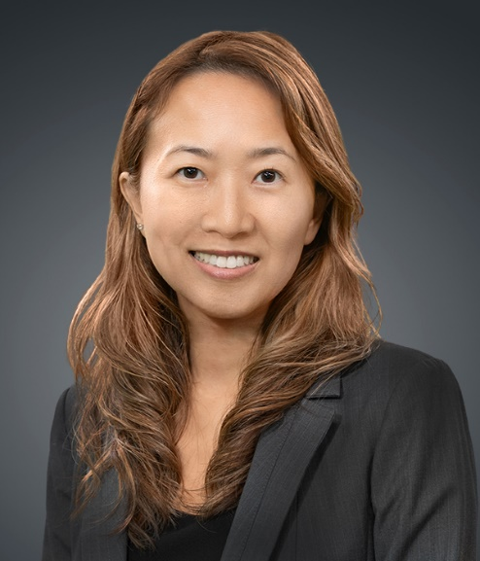
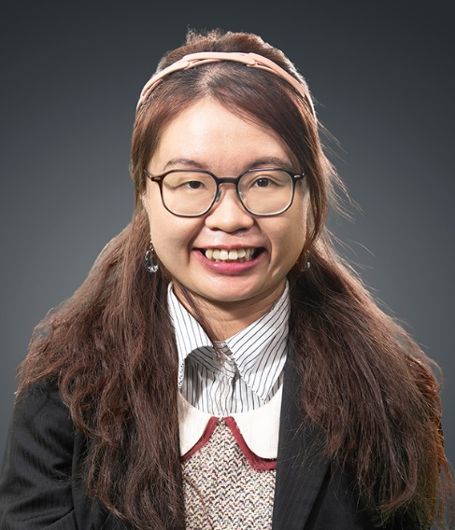
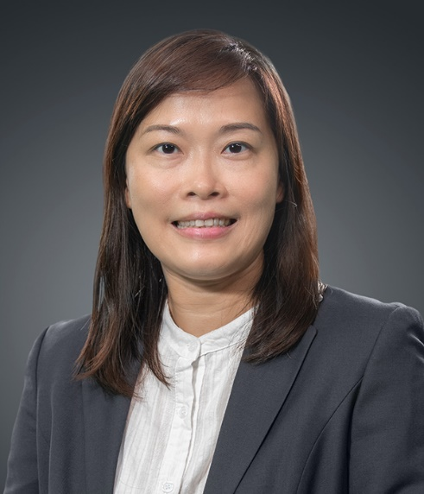
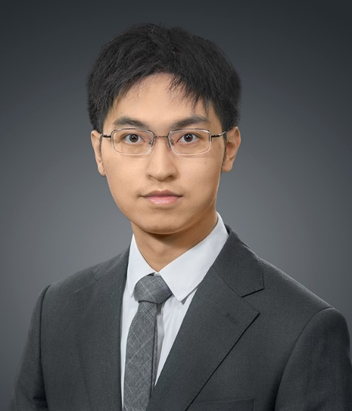
Key Staffs of BAM & DBP - BAM及DBP重要成員
FHDBAM
工商管理高級文憑課程
FHDDBP
數碼商業實務高級文憑
Alvis Chan
Program Leader of FHDBAM
amkchan@hkmu.edu.hk
+852-3120-9722
Lilian Ho
Deputy Program Leader of FHDBAM
llsho@hkmu.edu.hk
+852-3120-9604
Arna Heung
Lecturer
aheung@hkmu.edu.hk
+852-3120-9726
Kaman Lai
Program Leader of FHDDBP
kkmlai@hkmu.edu.hk
+852-3120-9711
Winko Lui
Lecturer
cwlui@hkmu.edu.hk
+852-3120-9713
Ms. Lucille LI: 3120 9707 - lic@hkmu.edu.hk
for administrative support (FHDBAM or FHDDBP)

Slide 7
LiPACE information and study path
學院資訊及升學階梯簡介
7

Slide 8

Programme Type & Study Pathway
課程類別及升學階梯
Level 3
Level 4
Level 5
應用教育文憑課程
Diploma of Applied Education
文憑課程 Diploma
(1 year full-time)
高級文憑課程
Higher Diploma
副學士課程
Associate Degree
(2 years full-time)
銜接至本地或海外學位課程
Articulated to Local or Overseas Degree
(2-3 years full-time programme)

Slide 9




Top-up / Senior Year Degree Programme
本地銜接學士學位/高年級入學課程
Level 3
Level 4
Level 5
學士學位
Bachelor Degree
高級文憑課程
Higher Diploma
應用教育文憑課程
Diploma of Applied Education
PolyU
Bachelor of Business Administration (Hons) in Marketing
CityU
Bachelor of Business Administration in Accountancy
LingnanU
Bachelor of Business Administration (Hons)
HKMU
Bachelor of Business Administration with Hons in Business Management
工商管理高級文憑
Business Administration and Management
市場及廣告、公共關係及市場活動策劃

Slide 10

Top-up / Senior Year Degree Programme
本地銜接學士學位/高年級入學課程
Level 3
Level 4
Level 5
學士學位
Bachelor Degree
高級文憑課程
Higher Diploma
應用教育文憑課程
Diploma of Applied Education
BU
Bachelor of Business Administration with Hons in Information Systems and Business Intelligence
CityU
Bachelor of Business Administration Business Decision Analytics
LingnanU
Bachelor of Business Administration with Hons in Digital Business
HKMU
Bachelor of Business Administration with Hons in Digital Business
數碼商業實務高級文憑
Digital Business Practice
市場及廣告、公共關係及市場活動策劃

Slide 11
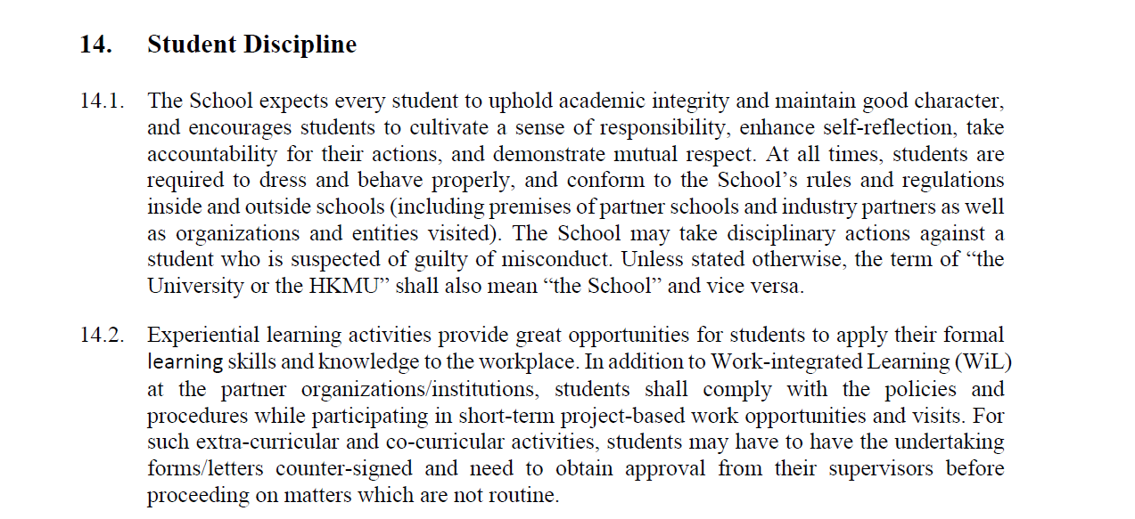
Student Handbook – Student Discipline
學生手冊 - 學生紀律

Slide 12
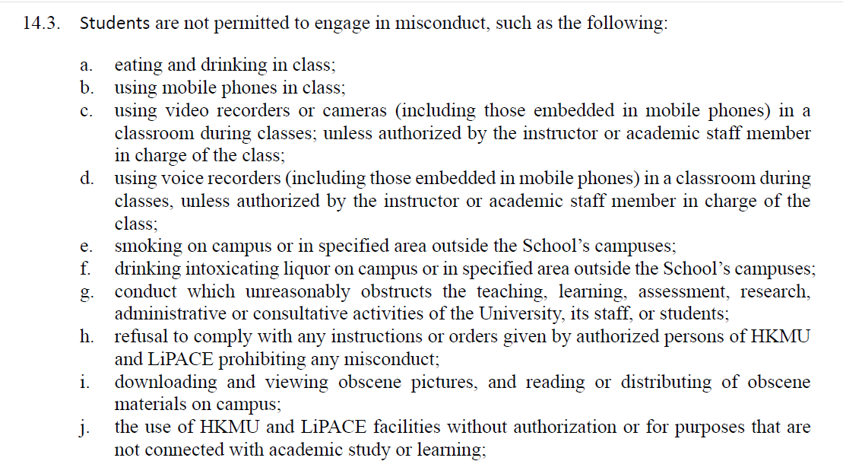
Student Handbook – Student Discipline
學生手冊 - 學生紀律

Slide 13
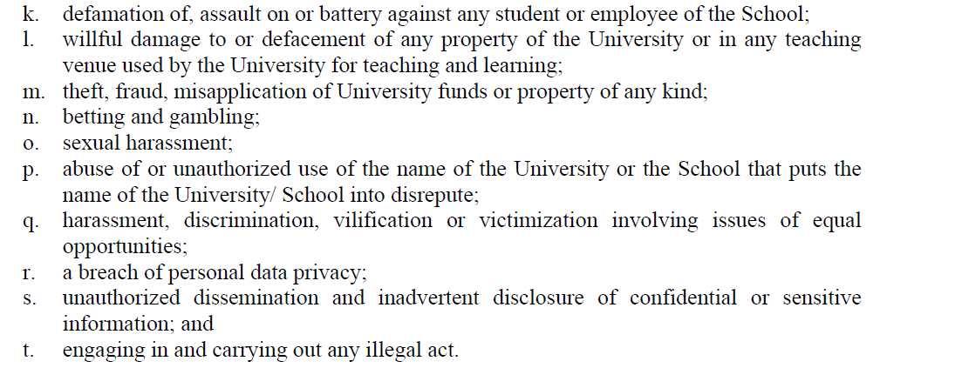
Student Handbook – Student Discipline
學生手冊 - 學生紀律

Slide 14
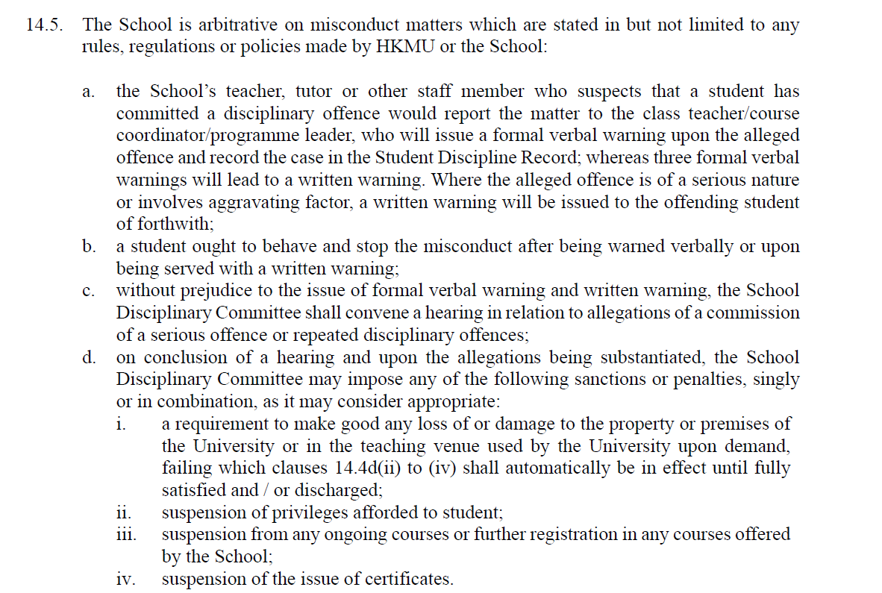
Student Handbook – Student Discipline
學生手冊 - 學生紀律

Slide 15
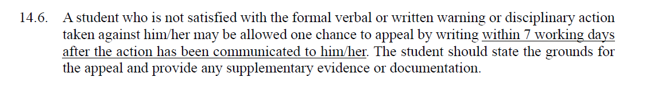
Student Handbook – Student Discipline
學生手冊 - 學生紀律
For details regarding student discipline, kindly refer to the Higher Diploma and Diploma Programmes student handbook 2025/26, P. 36 – 37.
有關學生紀律的詳情，請參閱高級文憑及文憑課程學生手冊 2025/26, 第 36 至 37 頁。

Slide 16
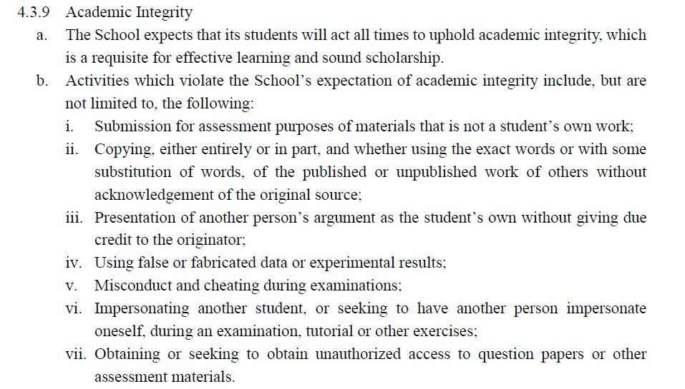
Student Handbook – Academic Integrity
學生手冊 -學術誠信
Notes:
https://www.hkmu.edu.hk/reg/tc/student-academic-integrity/

Slide 17
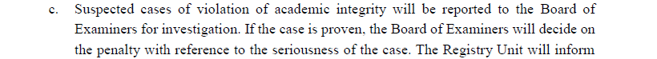
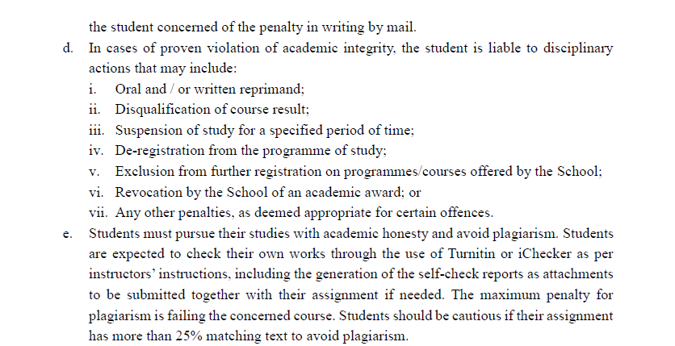
Student Handbook – Academic Integrity
學生手冊 -學術誠信

Slide 18
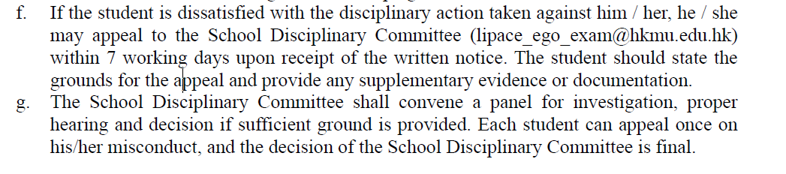
Student Handbook – Academic Integrity
學生手冊 -學術誠信
For details regarding academic integrity, kindly refer to the Higher Diploma and Diploma Programmes student handbook 2025/26, P. 23.
有關學術誠信的詳情，請參閱高級文憑及文憑課程學生手冊 2025/26, 第 23 頁。

Slide 19

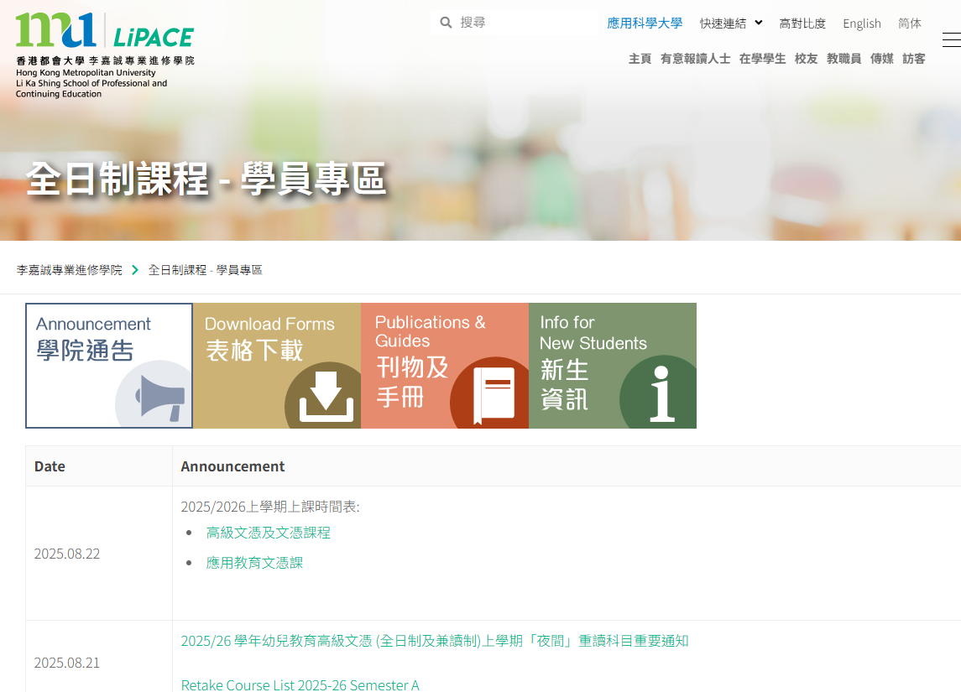
Access to the Student area
進入學員專區
Google Search
“LiPACE Student Area”
https://www.hkmu.edu.hk/lipace/tc/ftp-student-area/

Slide 20
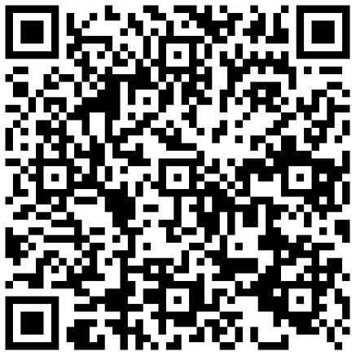
Activation of Single Password (& Email Account)
啟動統一密碼 (及電郵戶口)
Please refer to Student Handbook
Create a new password first
www.hkmu.edu.hk → Current Students → Undergraduate and Sub-degree→ Services and Support → Single Password Management
請參閱學生手冊
你需要先設定密碼
www.hkmu.edu.hk/ → 在學學生 →本科生及副學位→ 聯絡及支援→ 統一密碼管理 (學生)

Slide 21
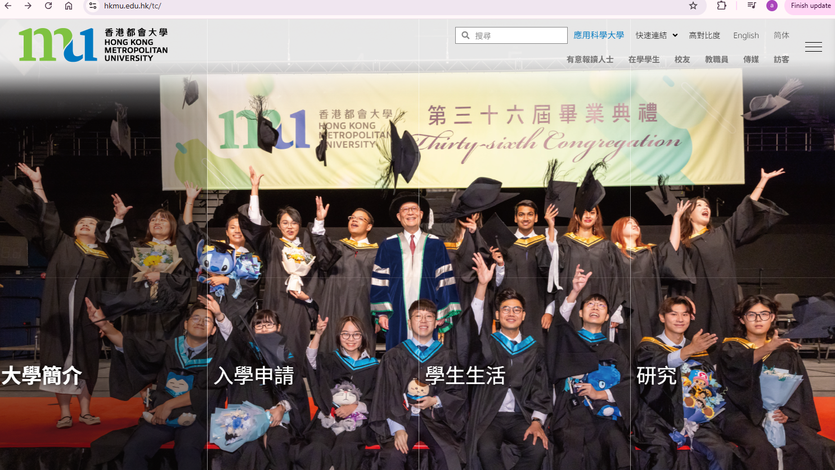
Activation of Single Password (& Email Account)
啟動統一密碼 (及電郵戶口)

Slide 22
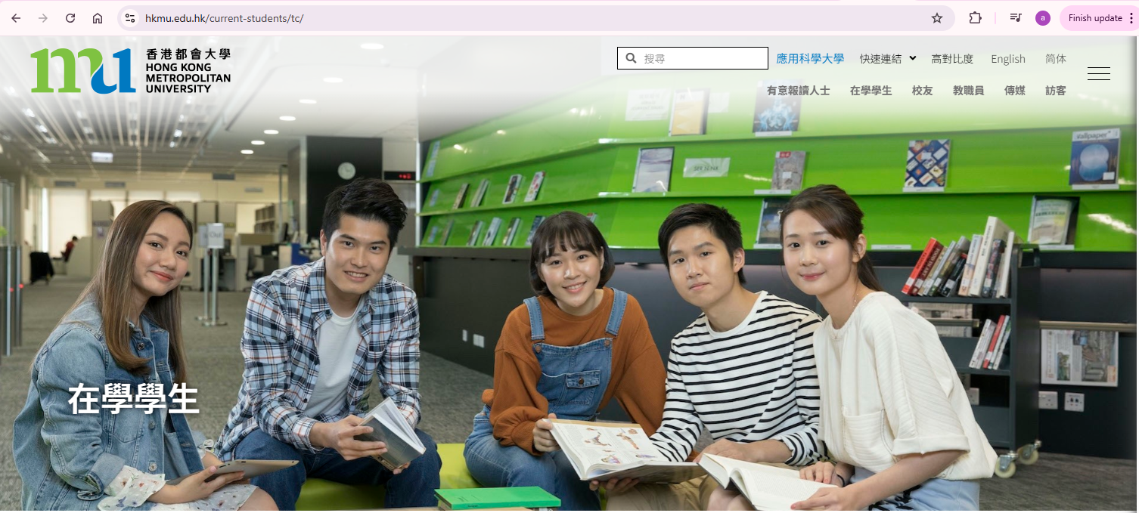
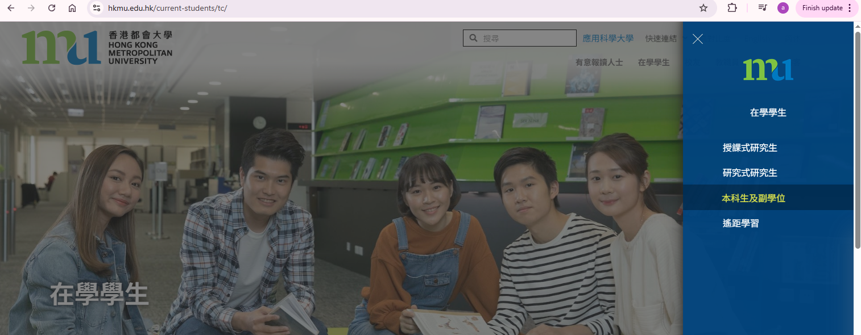
Activation of Single Password (& Email Account)
啟動統一密碼 (及電郵戶口)

Slide 23
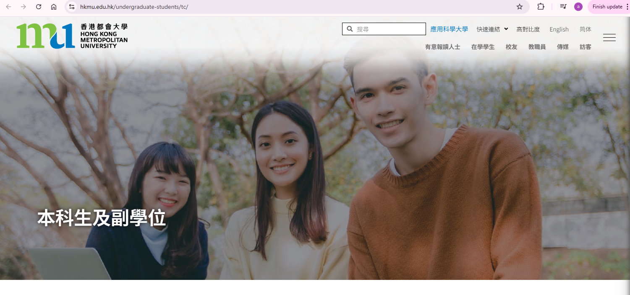
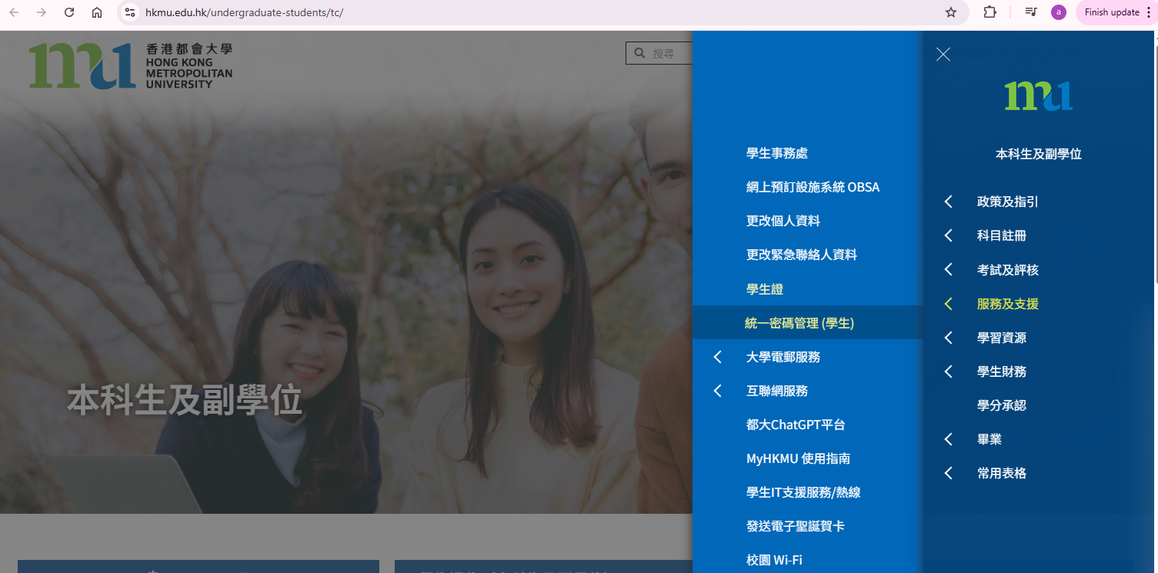
Activation of Single Password (& Email Account)
啟動統一密碼 (及電郵戶口)

Slide 24
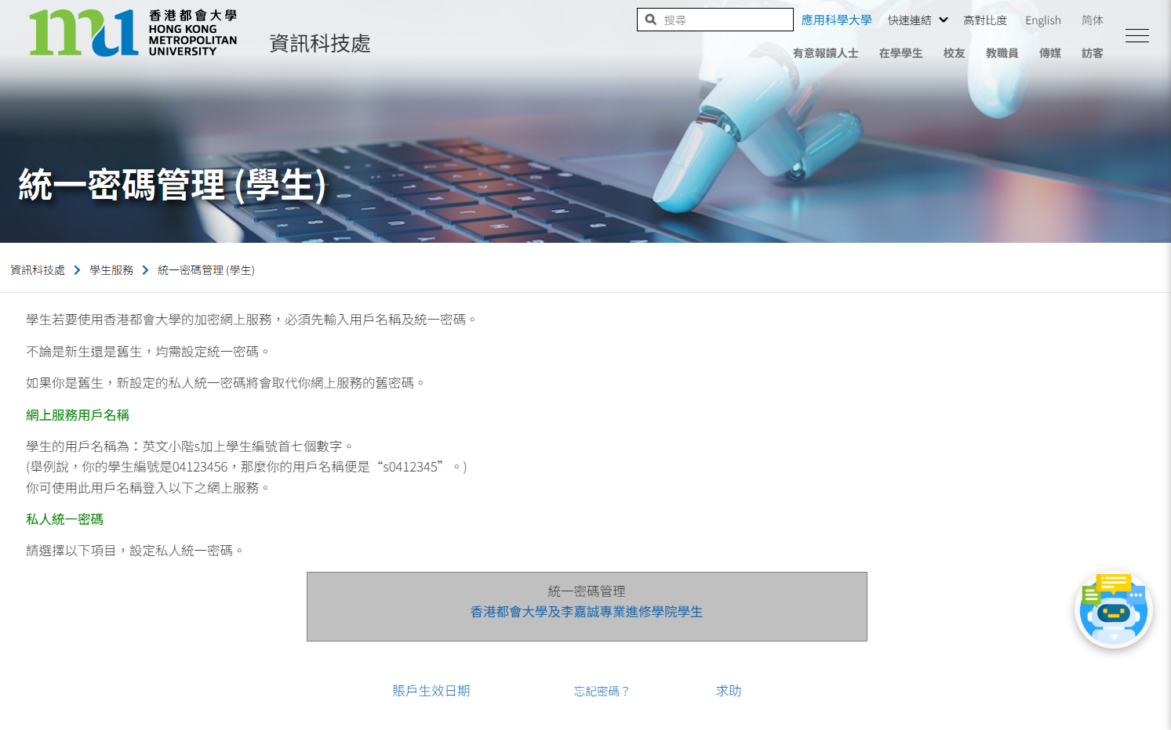
Activation of Single Password (& Email Account)
啟動統一密碼 (及電郵戶口)

Slide 25
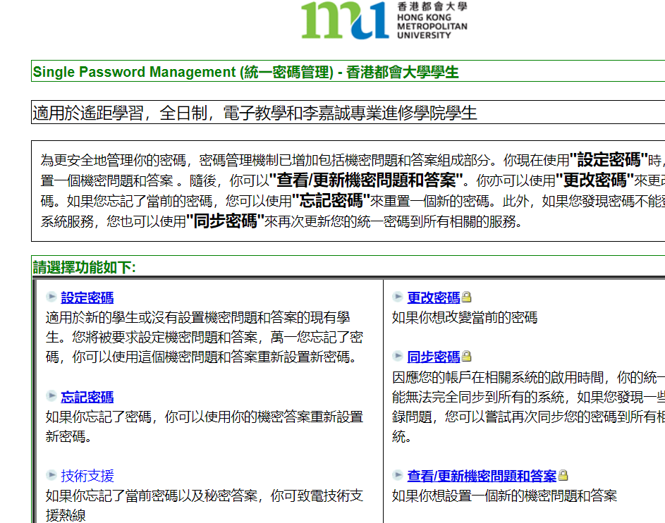
Activation of Single Password (& Email Account)
啟動統一密碼 (及電郵戶口)

Slide 26
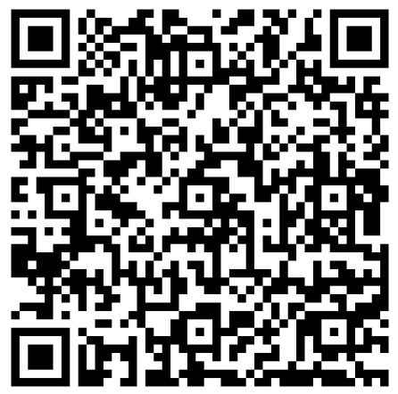
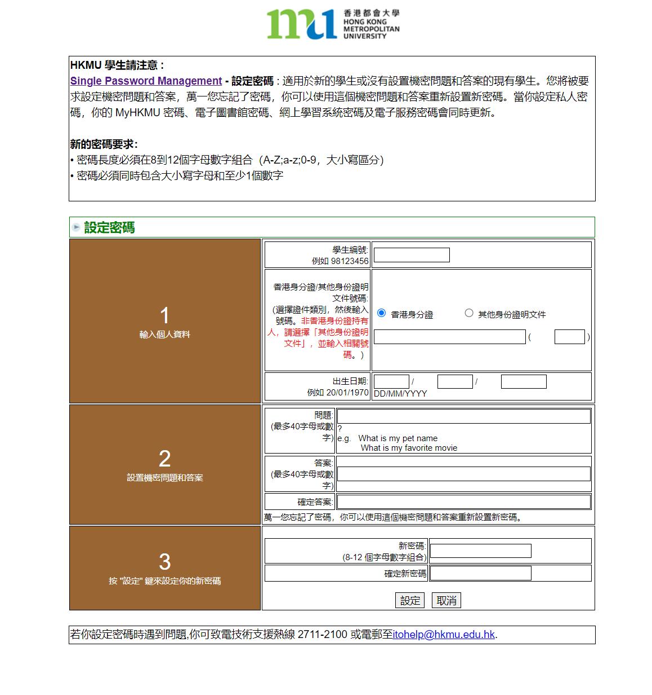
* Letters & Numbers ONLY
只可英文字母及數字 (8-12個字母數字組合)
* MUST contain at least one uppercase letter,
lowercase letter and number
同時包含大小寫字母和至少1個數字
(){}[]|`¬¦! "£$%^&*"<>:;#~_-+=,@.

Slide 27


Activation of Email Account
啟動電郵戶口
Log in to Your Email Account
HKMU Home Page → Current Students
→ Undergraduate & Sub-degree → Communication & Support → O365 Email
登入電郵戶口
香港都會大學主頁 → 在學學生
→ 本科生及副學位 → 服務及支援→ O365 Email
O365 Email: https://student.intranet.hkmu.edu.hk/hkmu_o365

Slide 28
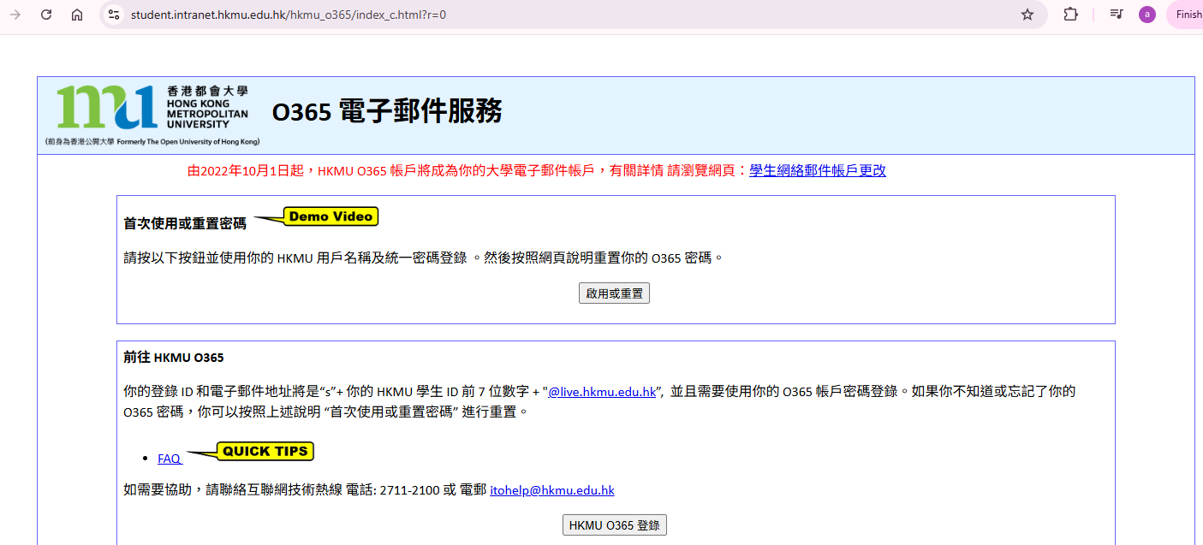
Login to Your Email Account
登入學生電郵帳戶
Input your user name and password:
User name : “s” + first 7 digits of your student number
Password: the single password that you have created
輸入您的用戶名稱和密碼：
用戶名稱： “s”+ 學生証號碼的 前七位數字
密碼：已自行設定的密碼
Teaching Demo 教學示範: https://student.intranet.hkmu.edu.hk/hkmu_o365/FAQ/activate.mp4
請記緊!!
學生証號碼是八個位的呀!
https://student.intranet.hkmu.edu.hk/hkmu_o365

Slide 29
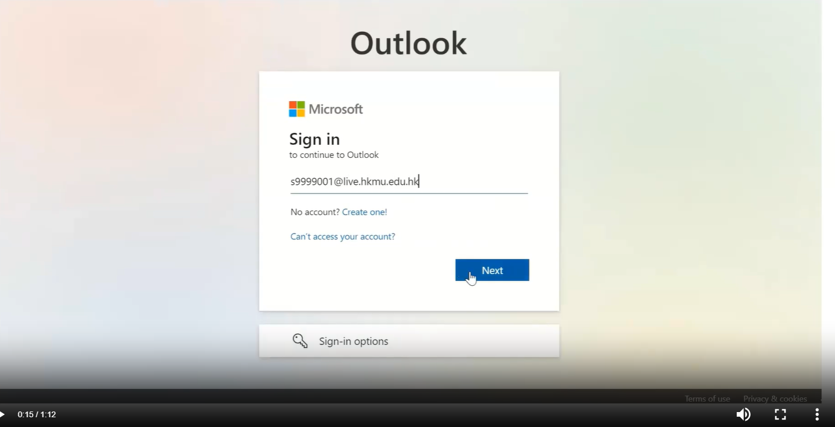
Login to Your Email Account
登入學生電郵帳戶
Input your user name and password:
User name : “s” + first 7 digits of your student number + @live.hkmu.edu.hk
Password: ‘HKmu’ + last 4 digits of your HKID + day of birth (DD) + month of birth (MM)
Example: HKID “A432125(8)” and date of birth “01 Feb 1973”, the initial password will be HKmu12580102
輸入您的用戶名稱和密碼：
用戶名稱： “s”+ 學生証號碼的 前七位數字 + @live.hkmu.edu.hk
密碼：‘HKmu’ + 你的香港身份證 (最後4 位數字或字母) + 出生日期(DD) + 出生月份(MM)
例子: 香港身份證號碼 “A432125(8)” 和出生日期 “1973年 2 月 1 日”。初始密碼為 HKmu12580102
Teaching Demo 教學示範: https://student.intranet.hkmu.edu.hk/hkmu_o365/FAQ/first_logon.mp4
https://student.intranet.hkmu.edu.hk/hkmu_o365
學校電郵係我地主要溝通渠道.
記住每日都要 check 丫!

Slide 30

Online Learning Environment (OLE)
網上學習系統
請參閱學生手冊
登入 https://elipace.hkmu.edu.hk/
在網上學習系統的登入版面輸入您的使用者名稱和密碼
(跟使用電郵服務一樣用戶)
Please refer to Student Handbook
Log in to https://elipace.hkmu.edu.hk/
Enter your Username and Password
(same as the one created for the e-mail service)

Slide 31
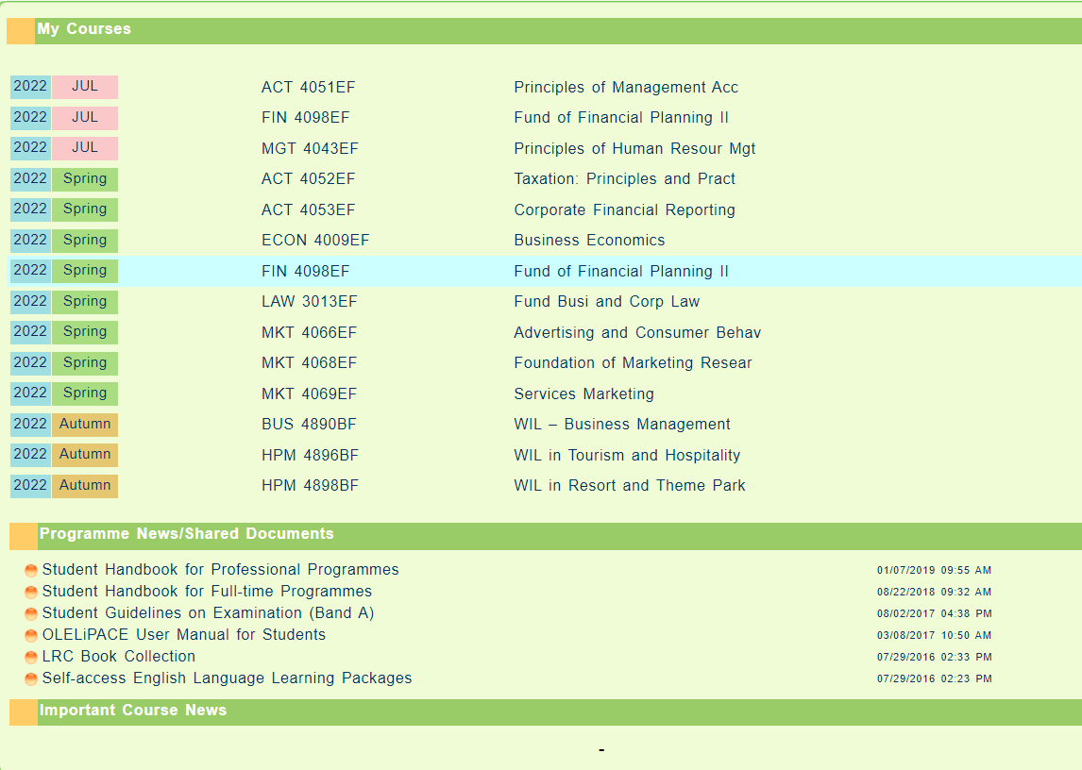
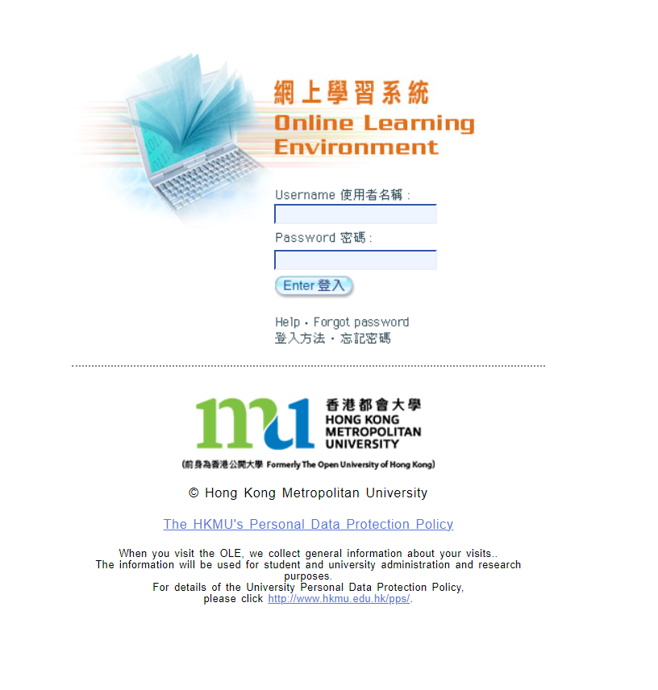
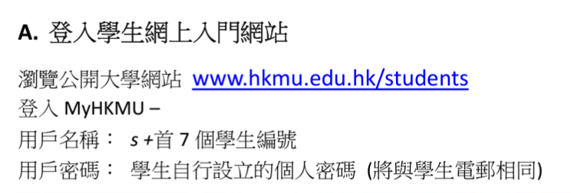
Online Learning Environment (OLE)
網上學習系統
Find Course
Download Handbook

Slide 32
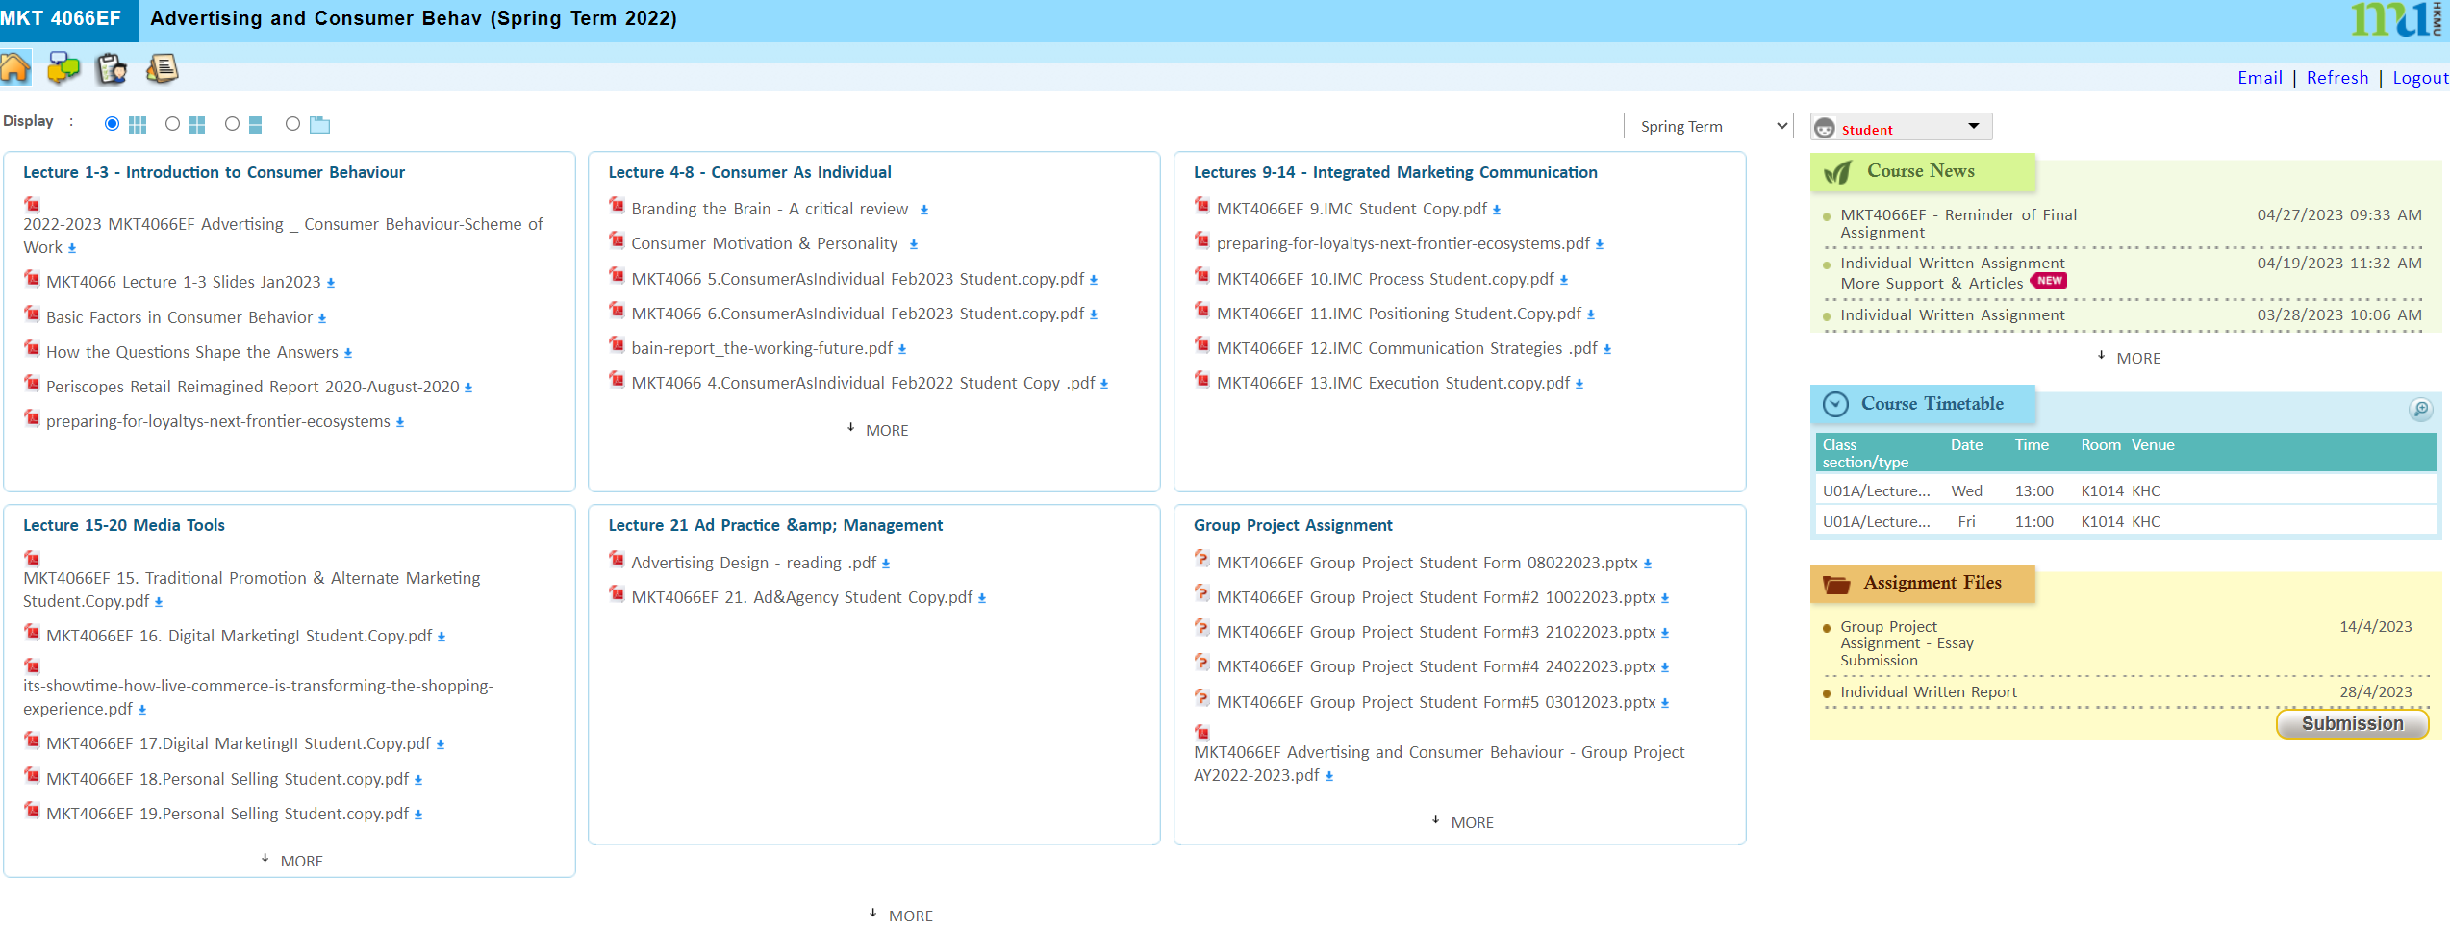
Online Learning Environment (OLE)
網上學習系統
Download Lecture Notes, Course News, upload Assignment Files
下載課程講義、課程最新資訊、上傳作業文件

Slide 33
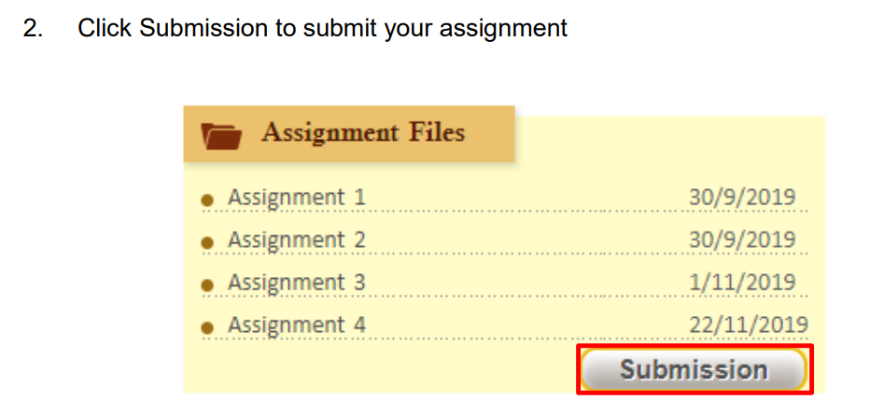
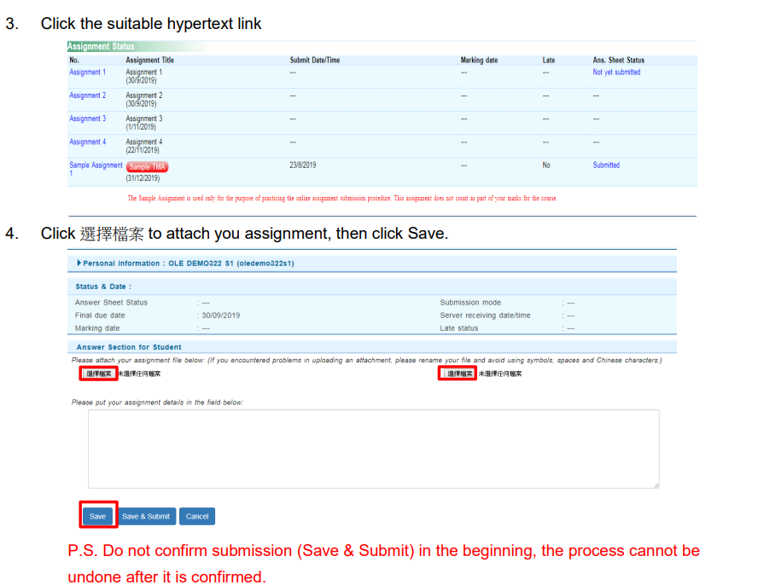
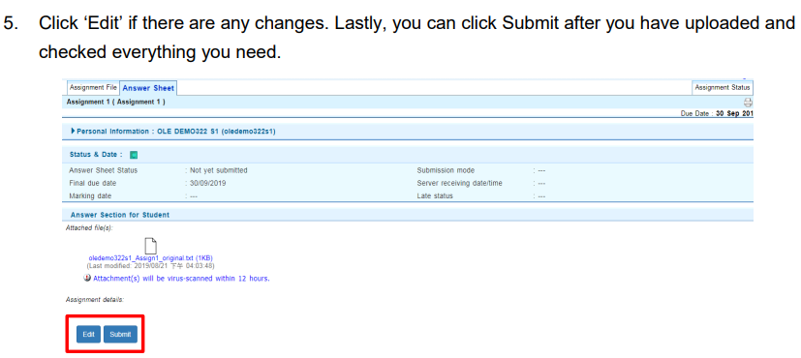
Online Learning Environment (OLE)
網上學習系統
For assignment submissions, remember to click “Submit”.
對於作業提交，請記住點擊「提交」。

Slide 34
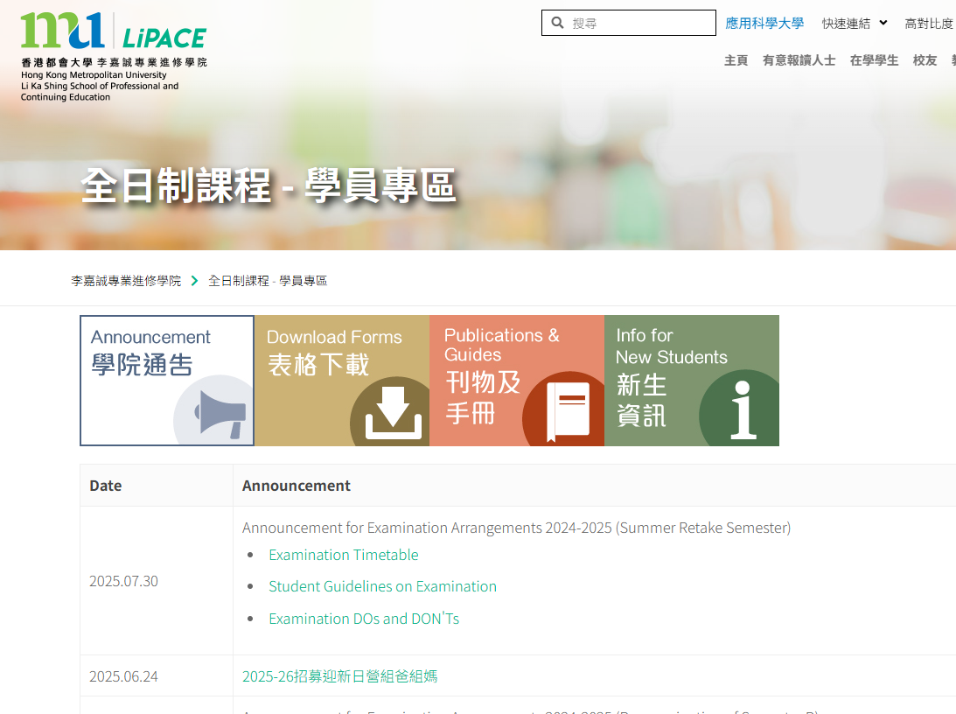
Timetable and Class Division
上課時間表及所屬班別
Google Search
“LiPACE Student Area”
https://www.hkmu.edu.hk/lipace/tc/ftp-student-area/

Slide 35
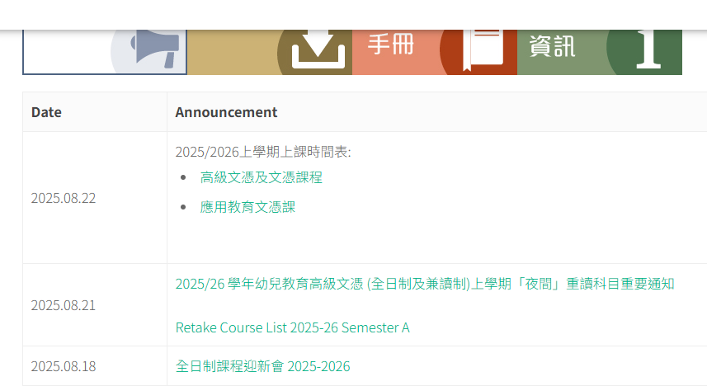
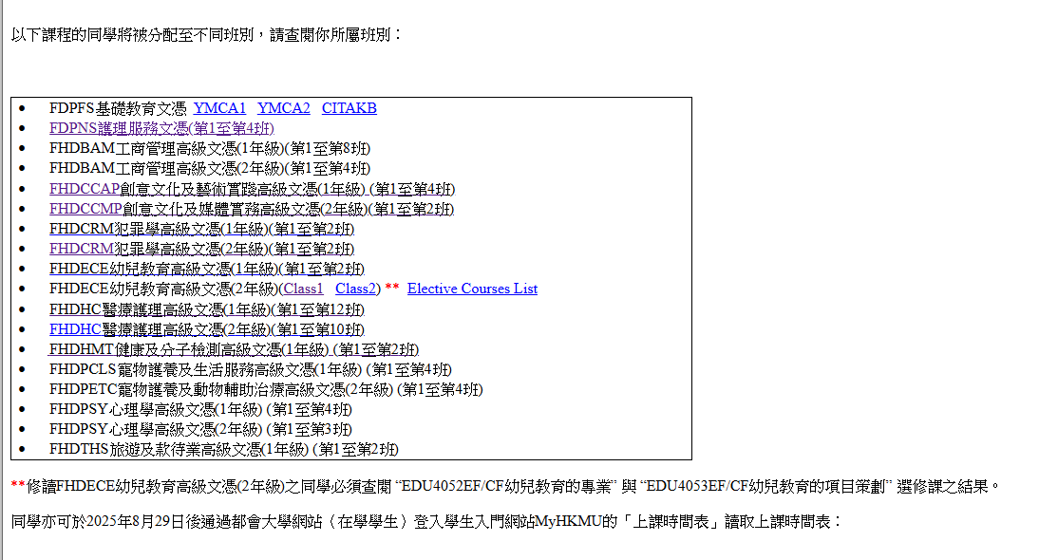
Checking Class Division
查閱所屬班別
1
FHDBAM工商管理高級文憑
FHDDBP數碼商業實務高級文憑
2

Slide 36
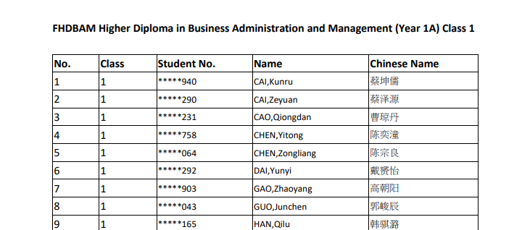
Checking Class Division
查閱所屬班別
FHDBAM Higher Diploma in Business Administration and Management (Year 1) (Class 1)
3
工商管理高級文憑 (一年級) (第一班)

Slide 37
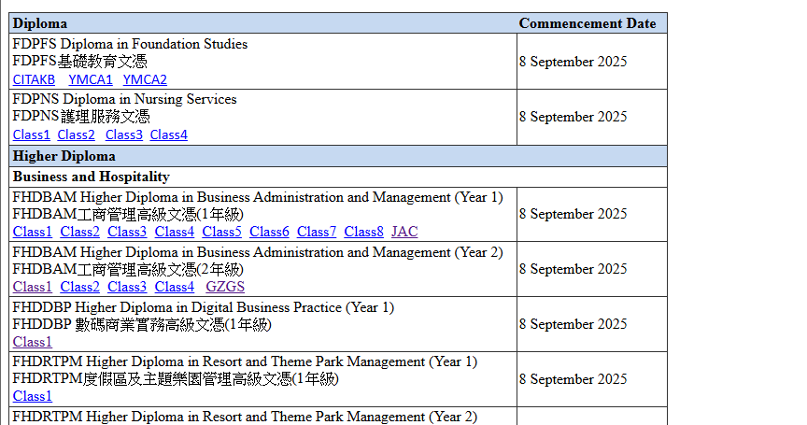
Checking Timetable
查閱上課時間表
4
FHDBAM工商管理高級文憑
FHDDBP數碼商業實務高級文憑

Slide 38
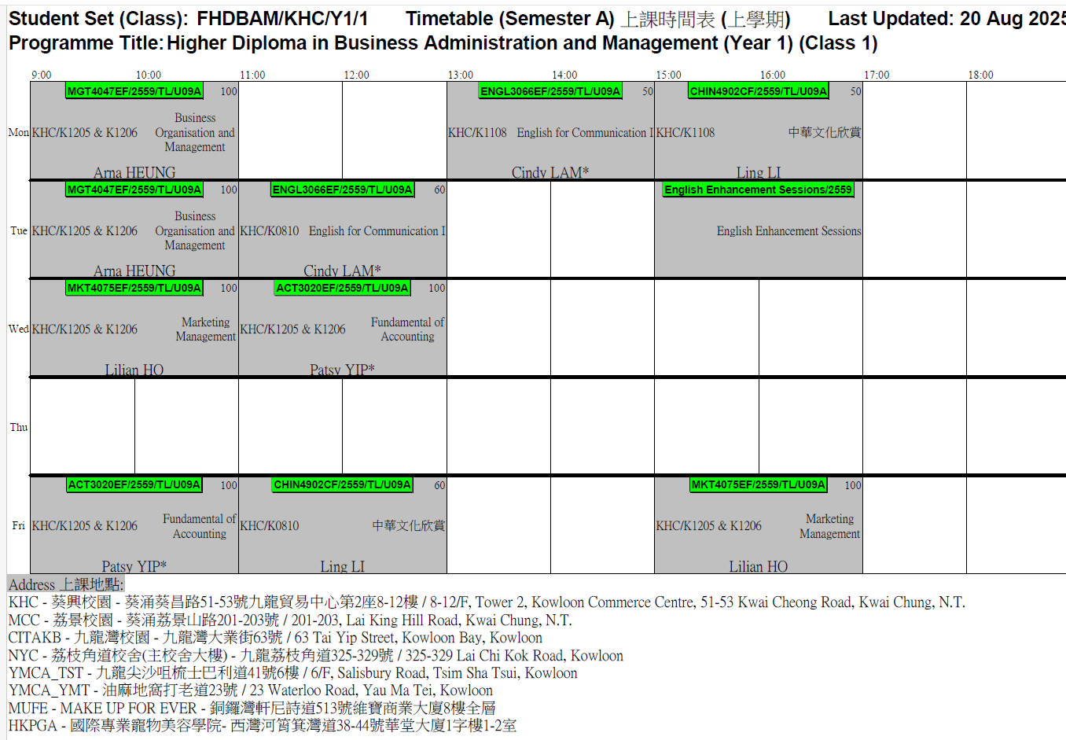

Slide 39
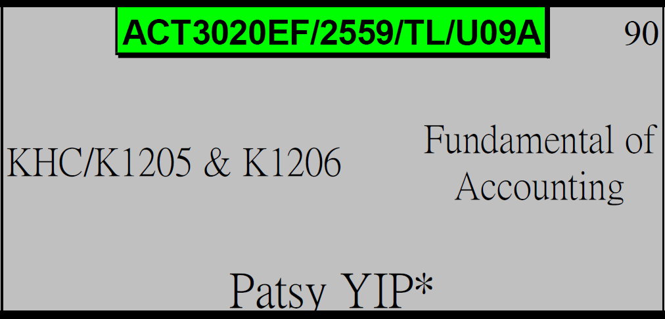
課程編號 / 學年 / 班號
Course Code / Intake / Class
ACT3020EF / 2559 / U09A
Teaching Venue
上課地點
Course Name
課程名稱
KHC - 葵興校園
(葵涌葵昌路51-53號九龍貿易中心第2座8-12樓)
8-12/F, Tower 2, Kowloon Commerce Centre, 51-53 Kwai Cheong Road, Kwai Chung, N.T.
MCC - 荔景校園
(葵涌荔景山路201-203號)
201-203, Lai King Hill Road, Kwai Chung
Lecturer Name
講師名稱

Slide 40
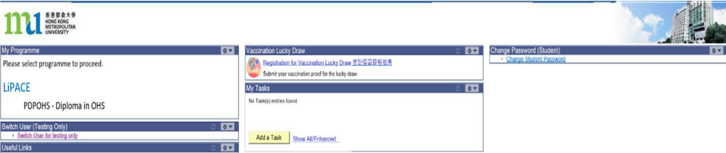
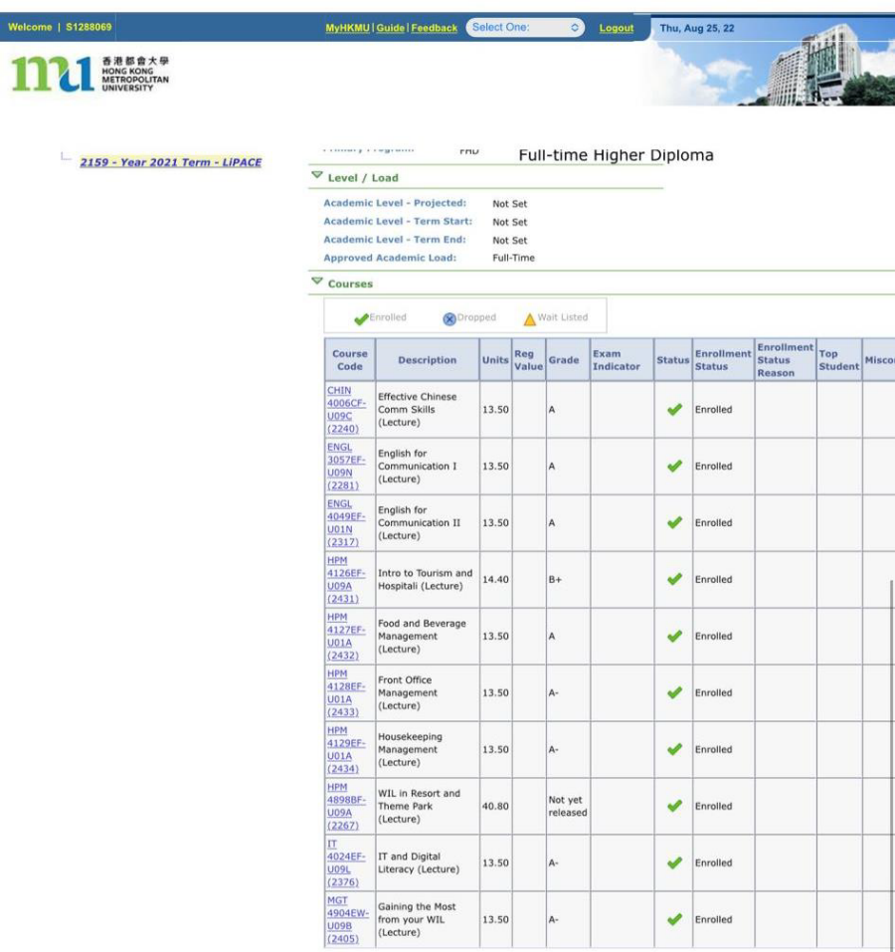

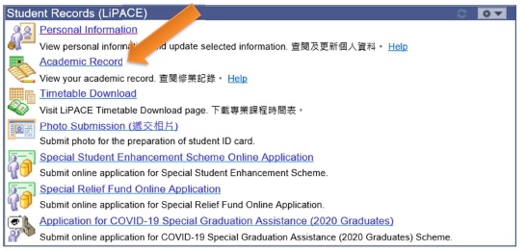
MyHKMU – checking Academic results (查閱成績)
Academic Record
MyHKMU
https://myhkmu.hkmu.edu.hk

Slide 41

One Student Account
(User Name:s1234567)
Timetable and Class Division
上課時間表及所屬班別
Online Learning Environment (OLE)
網上學習系統
MyHKMU
Student Email Account
學生電郵帳戶

Slide 42
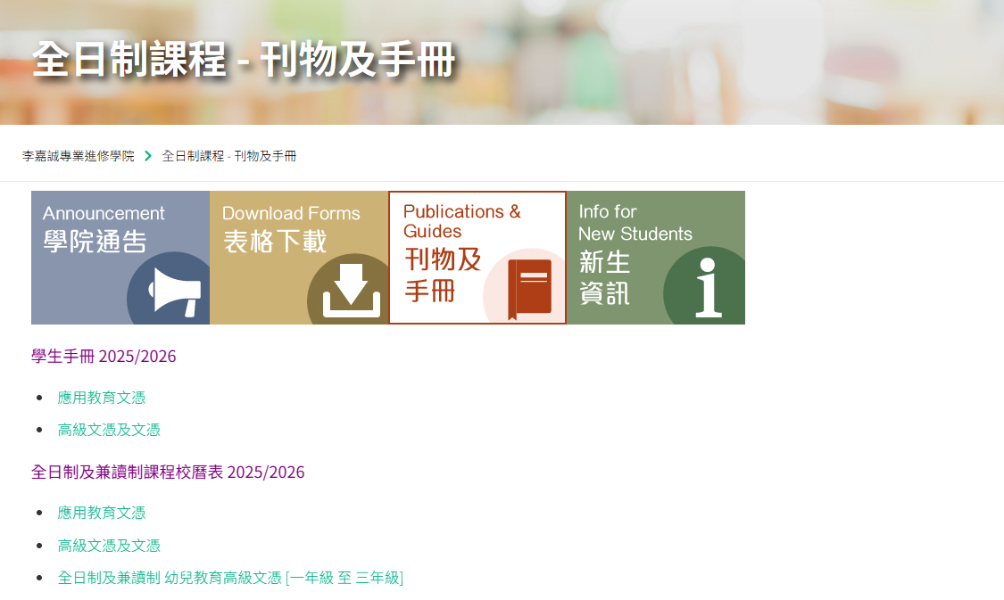
Others - Student Handbook & Academic Calendar
其他 - 學生手冊及校曆表
Student Handbook 學生手冊
Academic Calendar 校曆表

Slide 43
語文科目豁免政策
Language Course Exemption
43

Slide 44
Chinese/English courses – QF Level 3 & 4
Holders of any qualifications mentioned below:
A locally accredited sub-degree (at QF Level 4) or a post-secondary diploma offer by a recognized university or higher education institute overseas, or
A locally accredited Bachelor’s degree or above (at QF Level 5 or above) or a Bachelor’s degree or above offered by a recognized university overseas.
The qualification should be awarded by a university or institute where the medium of instruction and assessments of this qualification must be in English. This includes UK and colonies, US (mainland and territories), Canada, Australia, New Zealand, South Africa (must be in English speaking, not Afrikaans), Ireland and Singapore. Other English-medium universities in the British Commonwealth will be considered on a case-by-case basis.

Slide 45
Chinese/English courses – QF Level 3 & 4
Completion of a prior Chinese/English course at QF Level 3/4 or above
The course should be non-career specific.
(e.g. Business English courses and English courses for Tourism will not be considered.)

Slide 46
English courses – QF Level 3 & 4
Holders of a public examination qualification from a recognized examination body
 | QF Level 3 English for Communication I | QF Level 4 English for Communication II | QF Level 4 English for Communication III
HKDSE Level 3 or above | ✓
HKALE/GCE A-level Grade D or above | ✓
IELTS 6.0 or above overall and a minimum of 5.5 for each individual component | ✓
IELTS 6.5 or above overall and 6 in listening and speaking component | ✓ | ✓

Slide 47
English courses – QF Level 3 & 4
Holders of a public examination qualification from a recognized examination body (cont.)
The results of IELTS and TOEFL must not be more than 2 years from the date of the test or final examination to the date of commencement of study at LiPACE.
 | QF Level 3 English for Communication I | QF Level 4 English for Communication II | QF Level 4 English for Communication III
IELTS 6.5 or above overall and 6 in reading and writing component | ✓ |  | ✓
TOEFL scored -60 (iBT) | ✓
TOEFL score -79 (iBT) | ✓ | ✓ | ✓
TEFL/TESOL certification, Or CELTA holder | ✓ | ✓ | ✓

Slide 48


Documents required for exemption application
01
02
Course Issues Application Form
https://www.hkmu.edu.hk/lipace/tc/admission/enrollment-form/
Qualification certificate awarded by a recognized university/institute/examination body; or
Syllabus from a prior course providing information on learning outcomes, academic standard, coverage, duration and assessment criteria
Application deadline:
22 September 2025 (Monday)

Slide 49

Course Issues Application Form 課程事項申請表

Slide 50

Staff contacts – regarding language course exemption
工作人員聯絡方式 - 語文科目豁免政策
Head of Languages
Dr. Sylvia SZE | swsze@hkmu.edu.hk | 3120 9715
Deputy Head of Languages
Ms. Melissa YEUNG | mylyeung@hkmu.edu.hk | 3120 9719
Effective Chinese Communication Skills 應用中文傳意技巧
Ms. Konnie TANG | kyhtang@hkmu.edu.hk | 3120 9822

Slide 51
香港都會大學
李嘉誠專業進修學院
課外活動、外藉英語老師及
英語學習支援
Heidi Cheng
https://drive.google.com/file/d/1fRO0az-JW6hWbN3-tUWhKmDn5q70_epP/view?usp=sharing
51

Slide 52

Student Affairs Office
學生事務處
https://drive.google.com/file/d/1Rj6_MKb9ElRzNpPh2F2Uau8e_F8BgONH/view?usp=sharing
52

Slide 53

THANK YOU

Slide 54



Completion of Entry Survey 完成入學問卷調查
https://hkmu.qualtrics.com/jfe/form/SV_bpB3veks5h4YdZc
Collection of Student Card 領取學生證
To help us understand about your learning expectation and support at LiPACE, please complete the Entry Survey before you pick up your Student ID Card and save the screenshot of the last page .
為了讓我們更了解您的學習期望和所需支援，請在領取學生證前完成入學問卷調查，並將最後一頁屏幕截圖。
Please show the screenshot / email proof of survey completion for collecting the Student Card.
請在領取學生證時出示完成問卷的屏幕截圖/電子郵件證明。

