Slide 1


Slide 2

Dean's Speech
院長致辭
https://drive.google.com/file/d/1lzeKxWE_EapKwS2VI7k-CrMUPPCCVfdT/view?usp=drive_link

Slide 3

Key Staffs of LiPACE 學院重要成員
Dean 院長
Dr Benjamin CHAN Tak-yuen
曾德源博士

Slide 4




Key Staffs of LiPACE 學院重要成員
Associate Directors
副院長
Dr Ching Ka Wai Larry
程家偉博士
Dr Chen Yi-Fan Yvonne
陳羿帆博士
Ms. Pang Hoi Ning Helen
彭海寧女士
Dr Chim Hiu Man Kathleen
詹曉雯博士

Slide 5

Higher Diploma in
Creative Culture and Arts Practice (CCAP)

Slide 6
3
Teammates to connect
Higher Diploma in
Creative Culture and Arts Practice (CCAP)

Slide 7

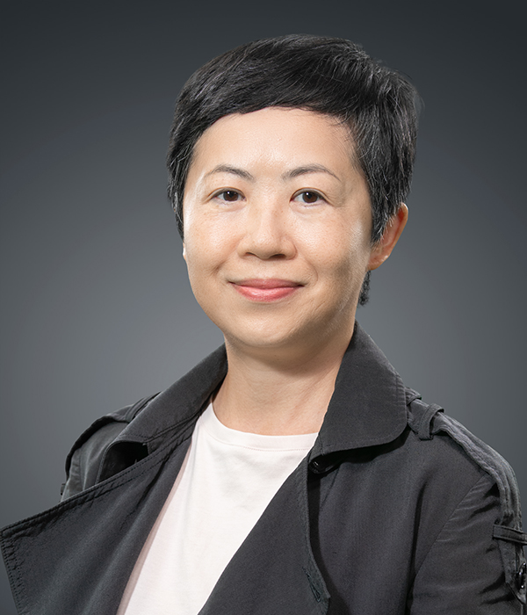
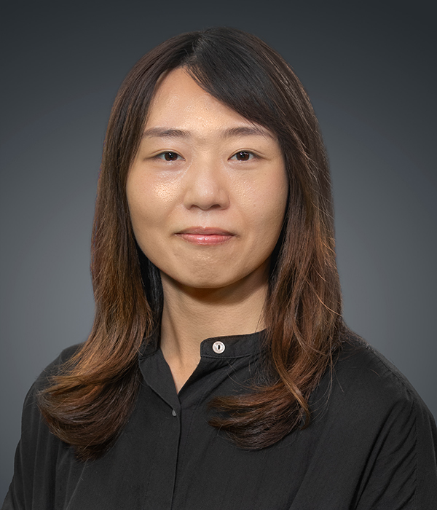
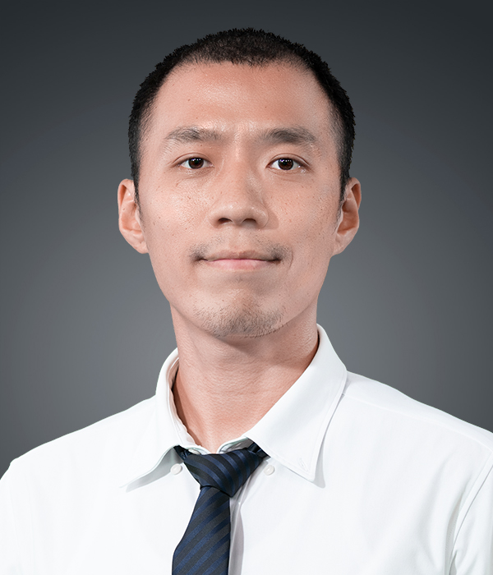
Programme Leader
Ms. May Yang
Tel: 3120-9626
mkyang@hkmu.edu.hk
Lecturer
Ms. Chris Yau
Tel: 3120-9929
cyau@hkmu.edu.hk
Programme Administrative Support
Mr. Alex Chau
Tel: 3120-9940, to be confirmed
aytchow@hkmu.edu.hk

Slide 8
4 semesters, semester A & B each academic year
2
Years to study
Higher Diploma in
Creative Culture and Arts Practice (CCAP)

Slide 9
1
Goal to meet
Higher Diploma in
Creative Culture and Arts Practice (CCAP)

Slide 10
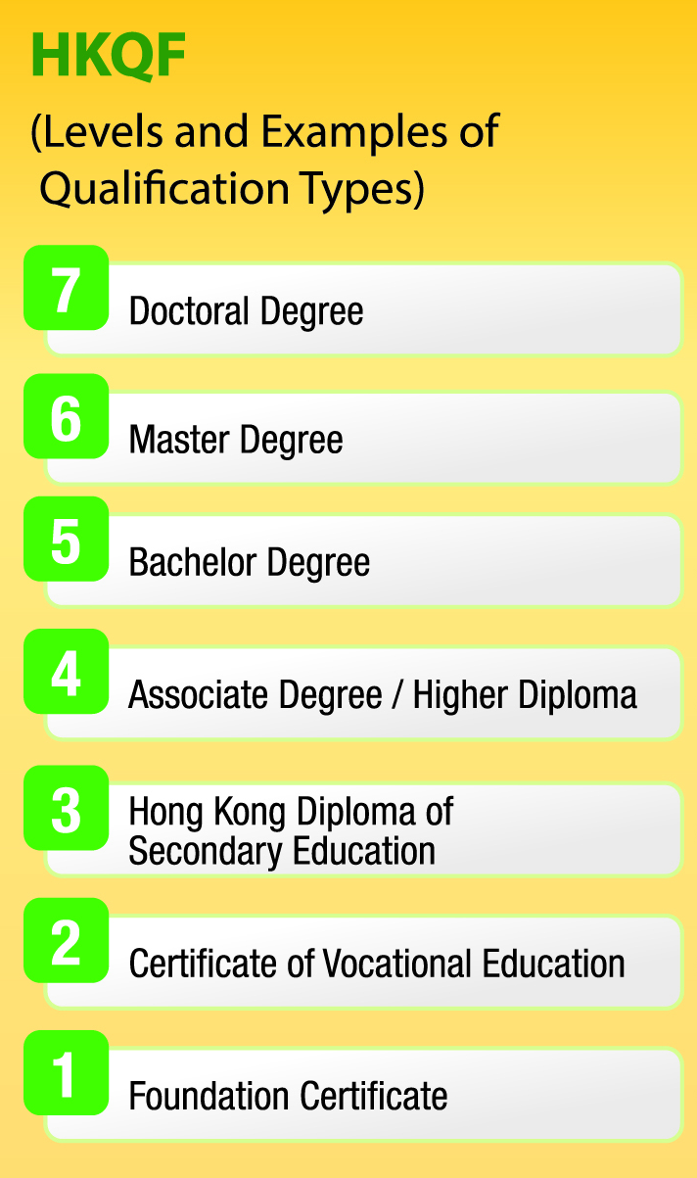
Programme Type & Study Pathway
27/28
Current 25/26
26/27
Higher Diploma in
Creative Culture and Arts Practice (CCAP)

Slide 11
City University of Hong Kong
BA (Hons) Media and Communication
The Education University of Hong Kong
Bachelor of Social Sciences (Hons) in Social Entrepreneurship and Development Studies
Hong Kong Baptist University (CIE) (SCE)
BA (Hons) in Communication
BA (Hons) in Creative Writing for Film, Television and New Media
BA (Hons) Cultural Studies and Creative Industries
Hong Kong Metropolitan University
BA (Hons) Creative Writing and Film Arts
BA (Hons) Creative Advertising and Media Design
BFA (Hons) in Animation and Visual Effects
Hong Kong Shu Yan University
BA (Hons) Journalism and Mass Communication
Lingnan University
Bachelor of Arts (Hons) in Creative Media Industries
Higher Diploma in
Creative Culture and Arts Practice (CCAP)

Slide 12
80%
Attendance rate
Higher Diploma in
Creative Culture and Arts Practice (CCAP)

Slide 13
50%
Passing mark
Higher Diploma in
Creative Culture and Arts Practice (CCAP)

Slide 14
Laptop Selection, PC/Mac
Make use of Education Price
when Semester starts
Higher Diploma in
Creative Culture and Arts Practice (CCAP)

Slide 15
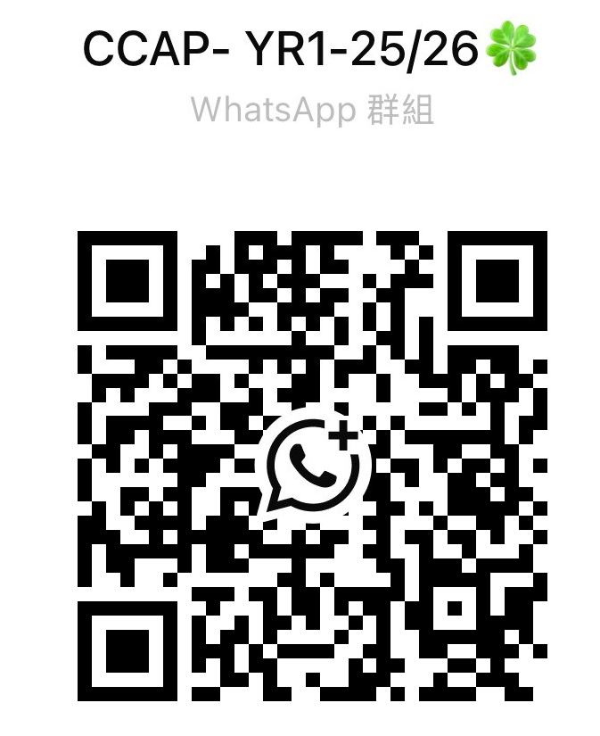
Join CCAP-year 1 WhatsApp's Group
Higher Diploma in
Creative Culture and Arts Practice (CCAP)

Slide 16
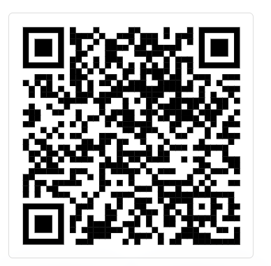
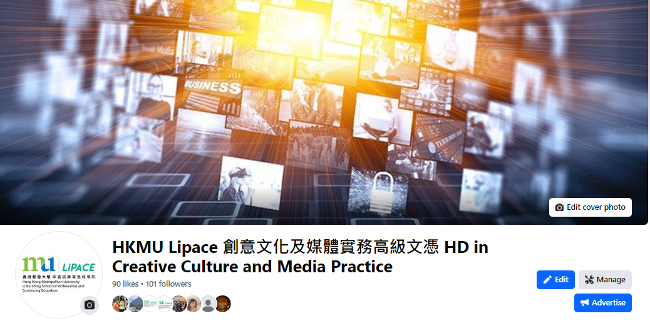

Bookmark!
FHDCCMP
Higher Diploma in Creative Culture and Art Practice
創意文化及媒體實務高級文憑
Higher Diploma in
Creative Culture and Arts Practice (CCAP)

Slide 17
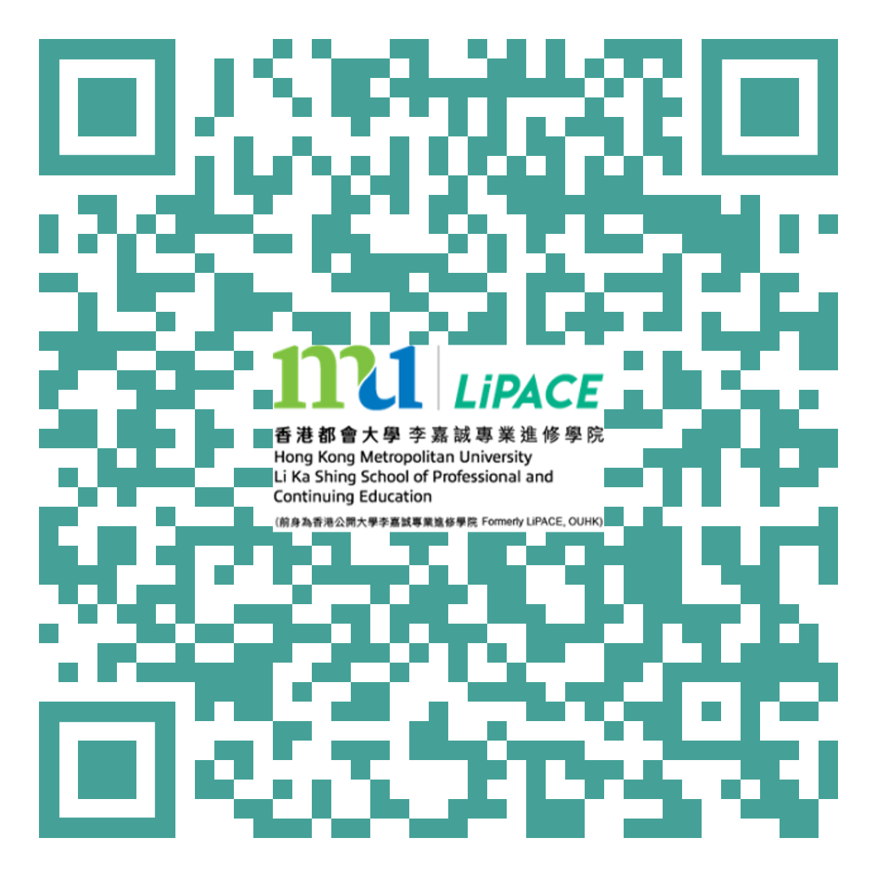
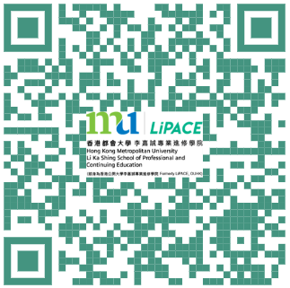


One Student Account
(User Name:s1234567)
Timetable and Class Division
上課時間表及所屬班別
Online Learning Environment (OLE)
網上學習系統
MyHKMU
Student Email Account
學生電郵帳戶

Slide 18
Check class division and timetable
Activate email
Activate O365 account
OLE, Online Learning Environment, check result
Student ID card
Student Handbook – 'Student disciplines' & 'Academic Integrity‘
Language course exemption, NET, SAO

Slide 19
1. Check class and timetable
We have 2 classes, 2 timetables
You belongs to?
Higher Diploma in
Creative Culture and Arts Practice (CCAP)

Slide 20
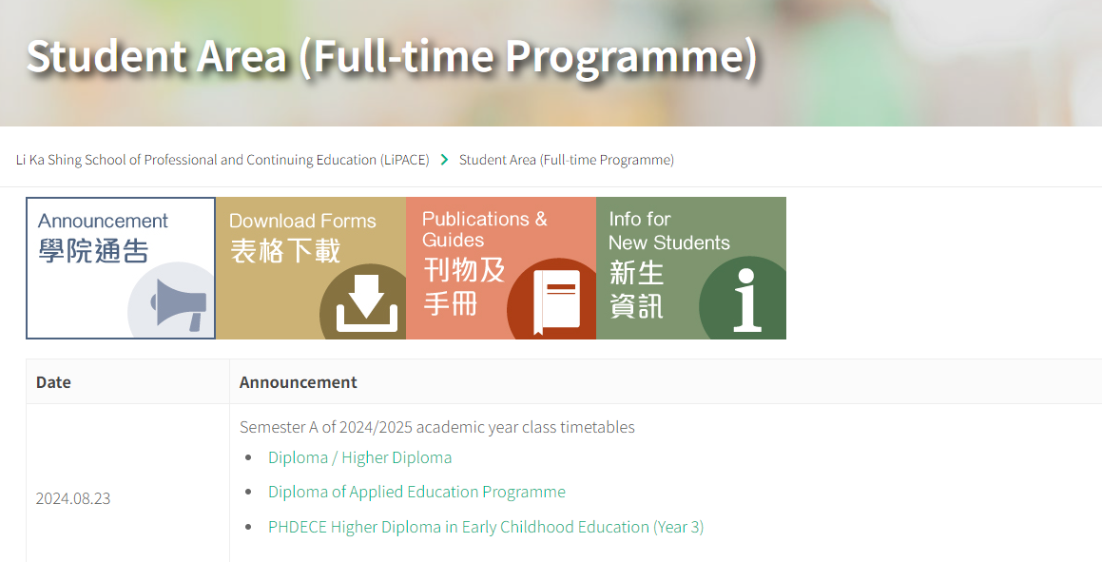
1. Check class and timetable
“LiPACE Student Area”
https://www.hkmu.edu.hk/lipace/tc/ftp-student-area/

Slide 21
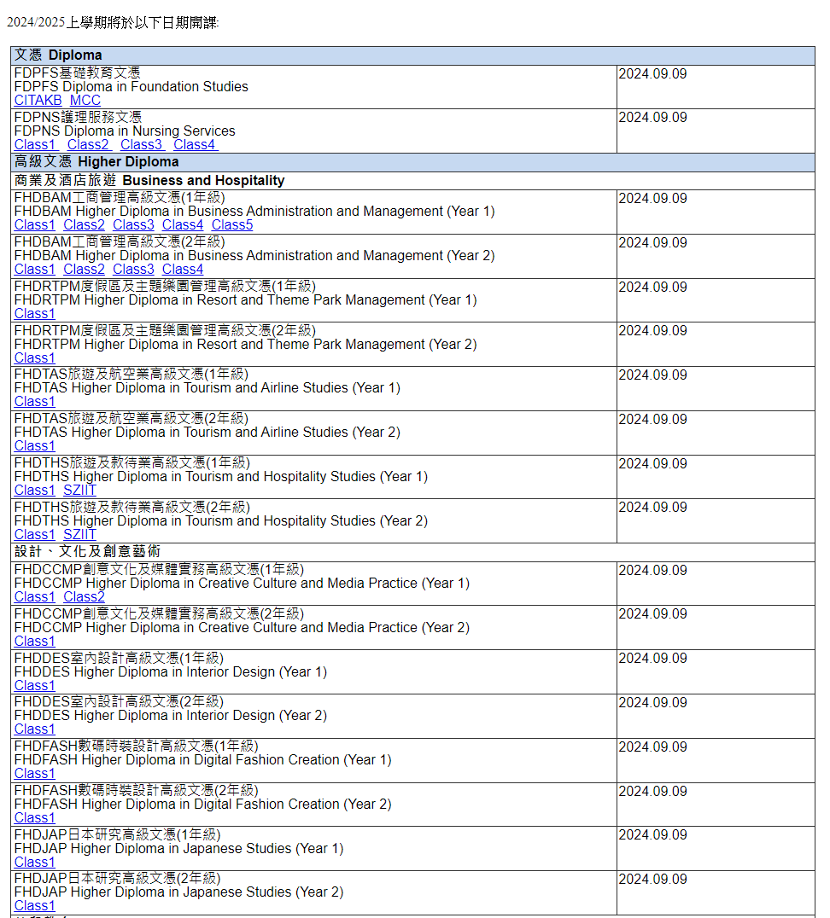
https://www.hkmu.edu.hk/LIPACE/webRA/Notice/FTP2025/20240823/HD/HD_D.htm
FHDCCAP

Slide 22
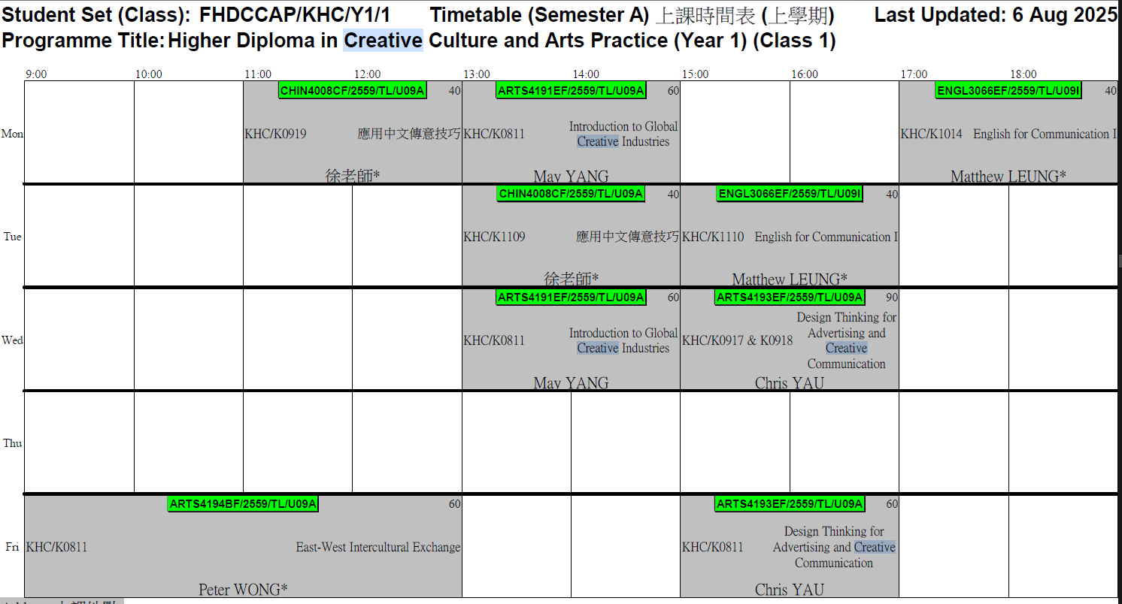
FHDCCAP Timetable (Class 1)
We hv 2 classes
9am
(reserved for) School Activities; Visit; ARTS4891BF (WiL)

Slide 23
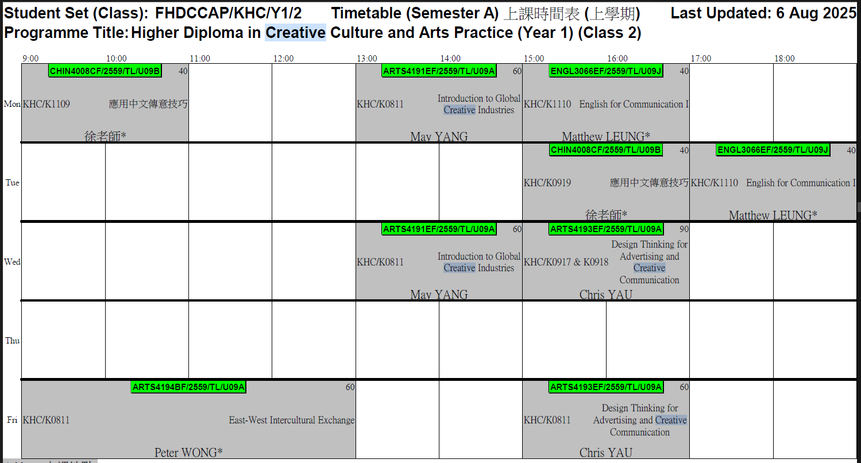
FHDCCAP Timetable (Class 2)
(reserved for) School Activities; Visit; ARTS4891BF (WiL)
(reserved for) School Activities; Visit; ARTS4891BF (WiL)

Slide 24
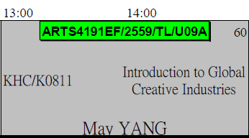
課程編號 / 學年 / 班號
Course Code / Intake / Class
ARTS4191ef / 2559 / U09
Course Name
課程名稱
Teaching Venue
上課地點
KHC - 葵興校園
(葵涌葵昌路51-53號九龍貿易中心第2座8-11樓)
8-11/F, Tower 2, Kowloon Commerce Centre, 51-53 Kwai Cheong Road, Kwai Chung, N.T.
Lecturer’s Name
講師名稱

Slide 25
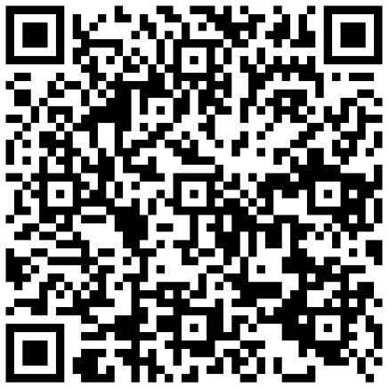
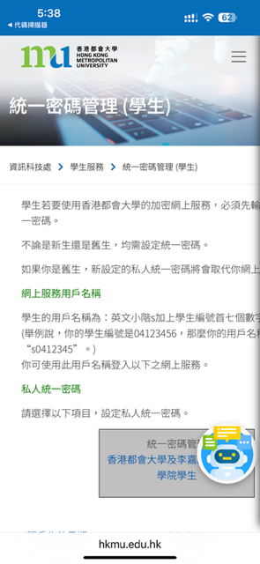
2. Activating Your Email Account

Slide 26
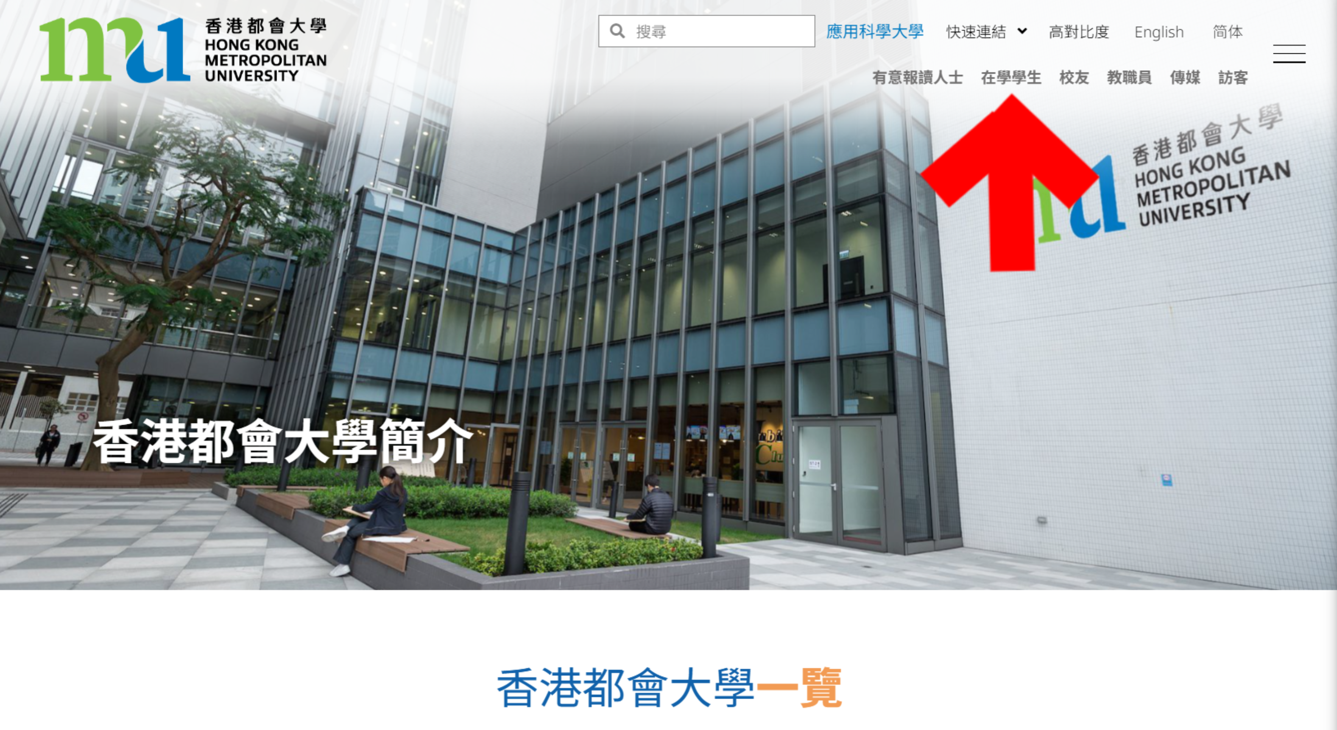
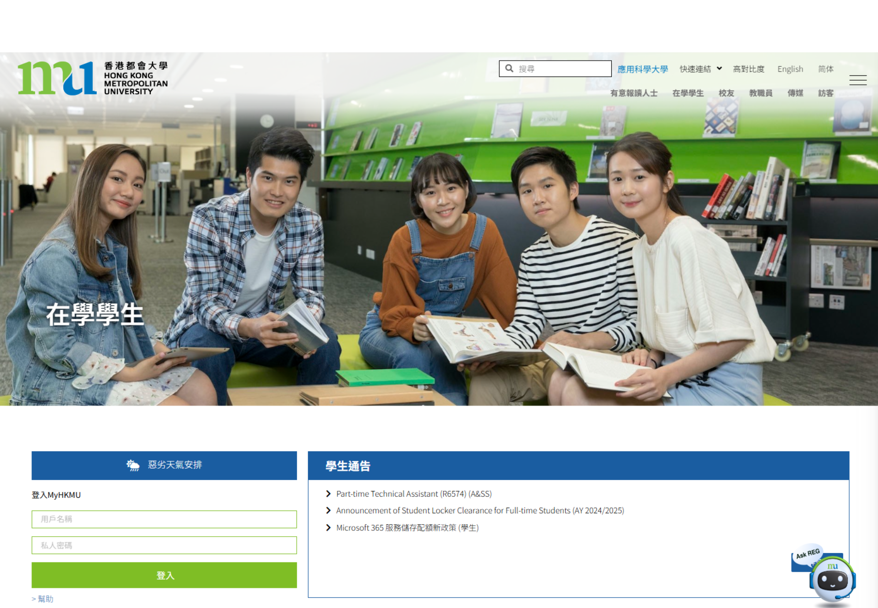
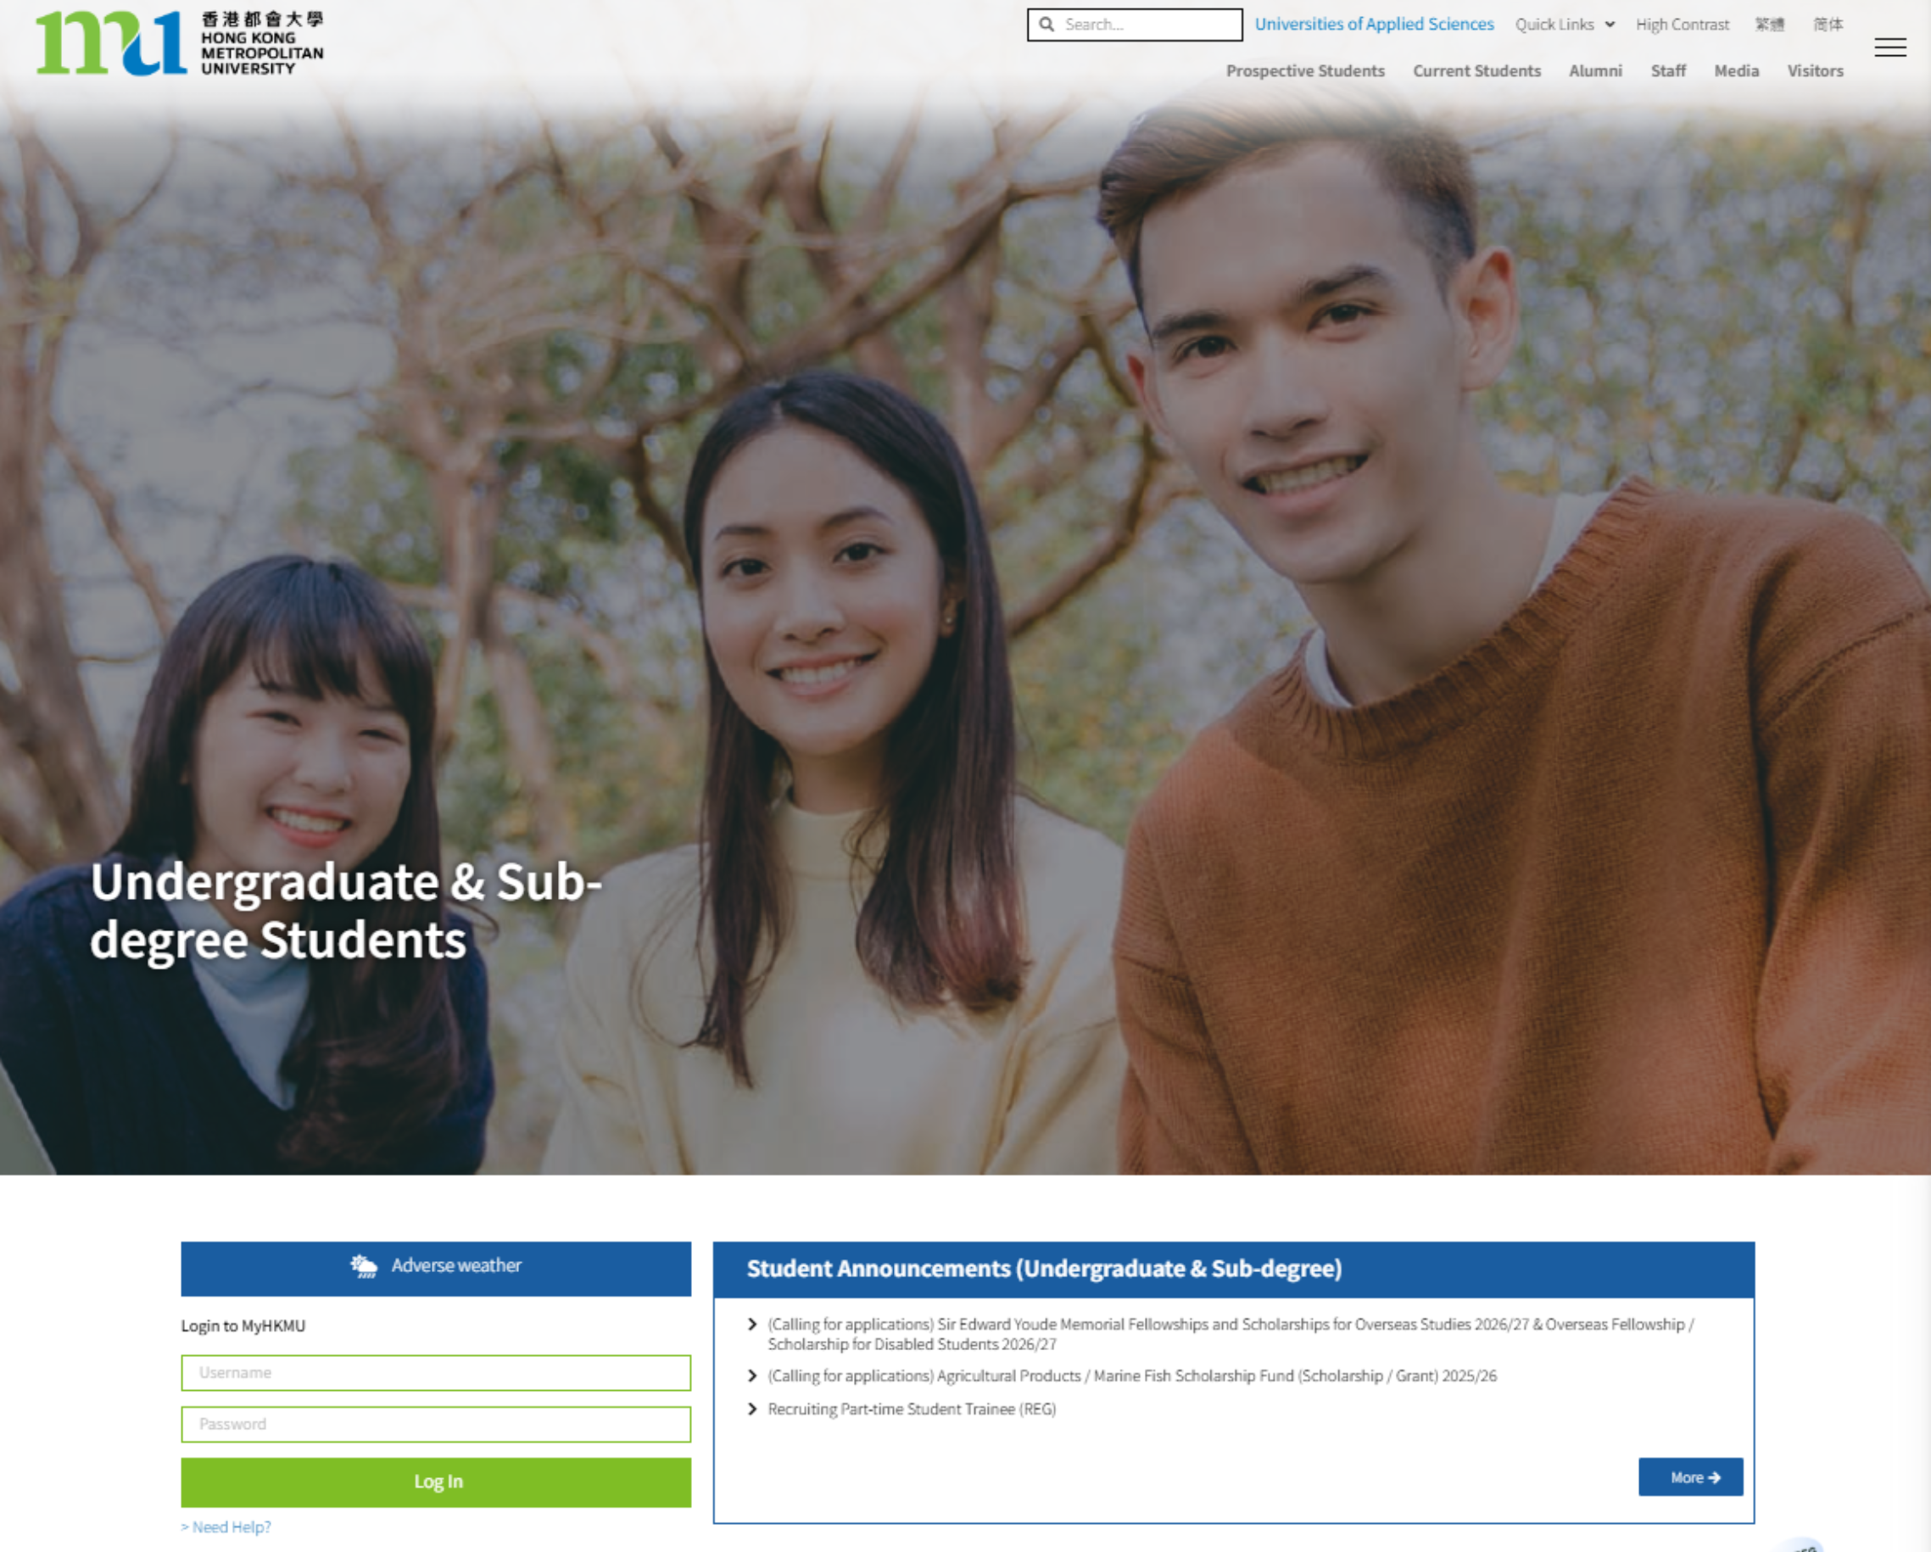
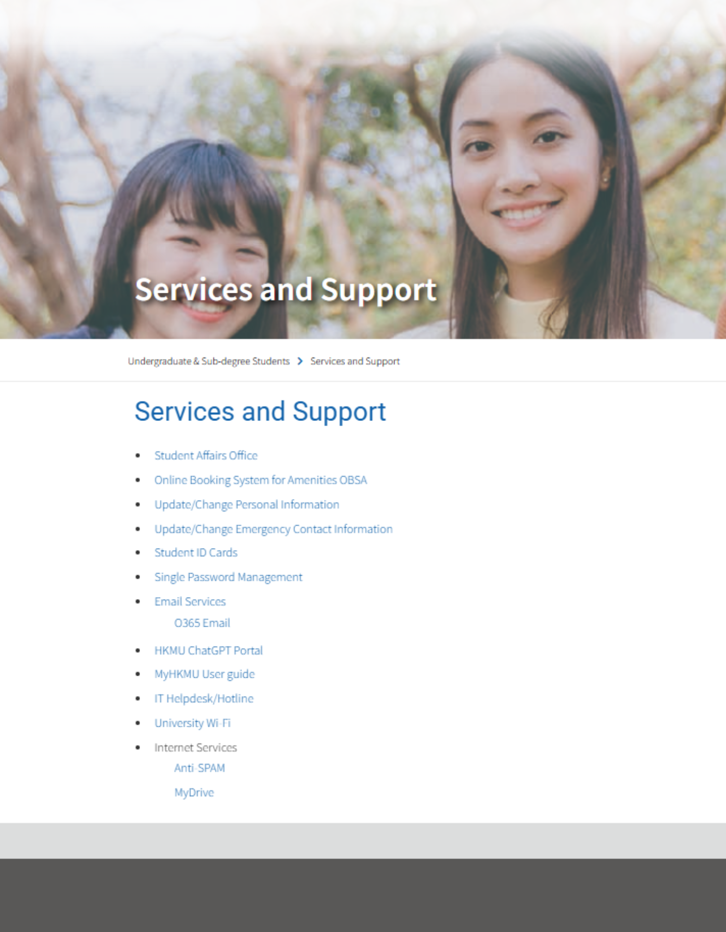
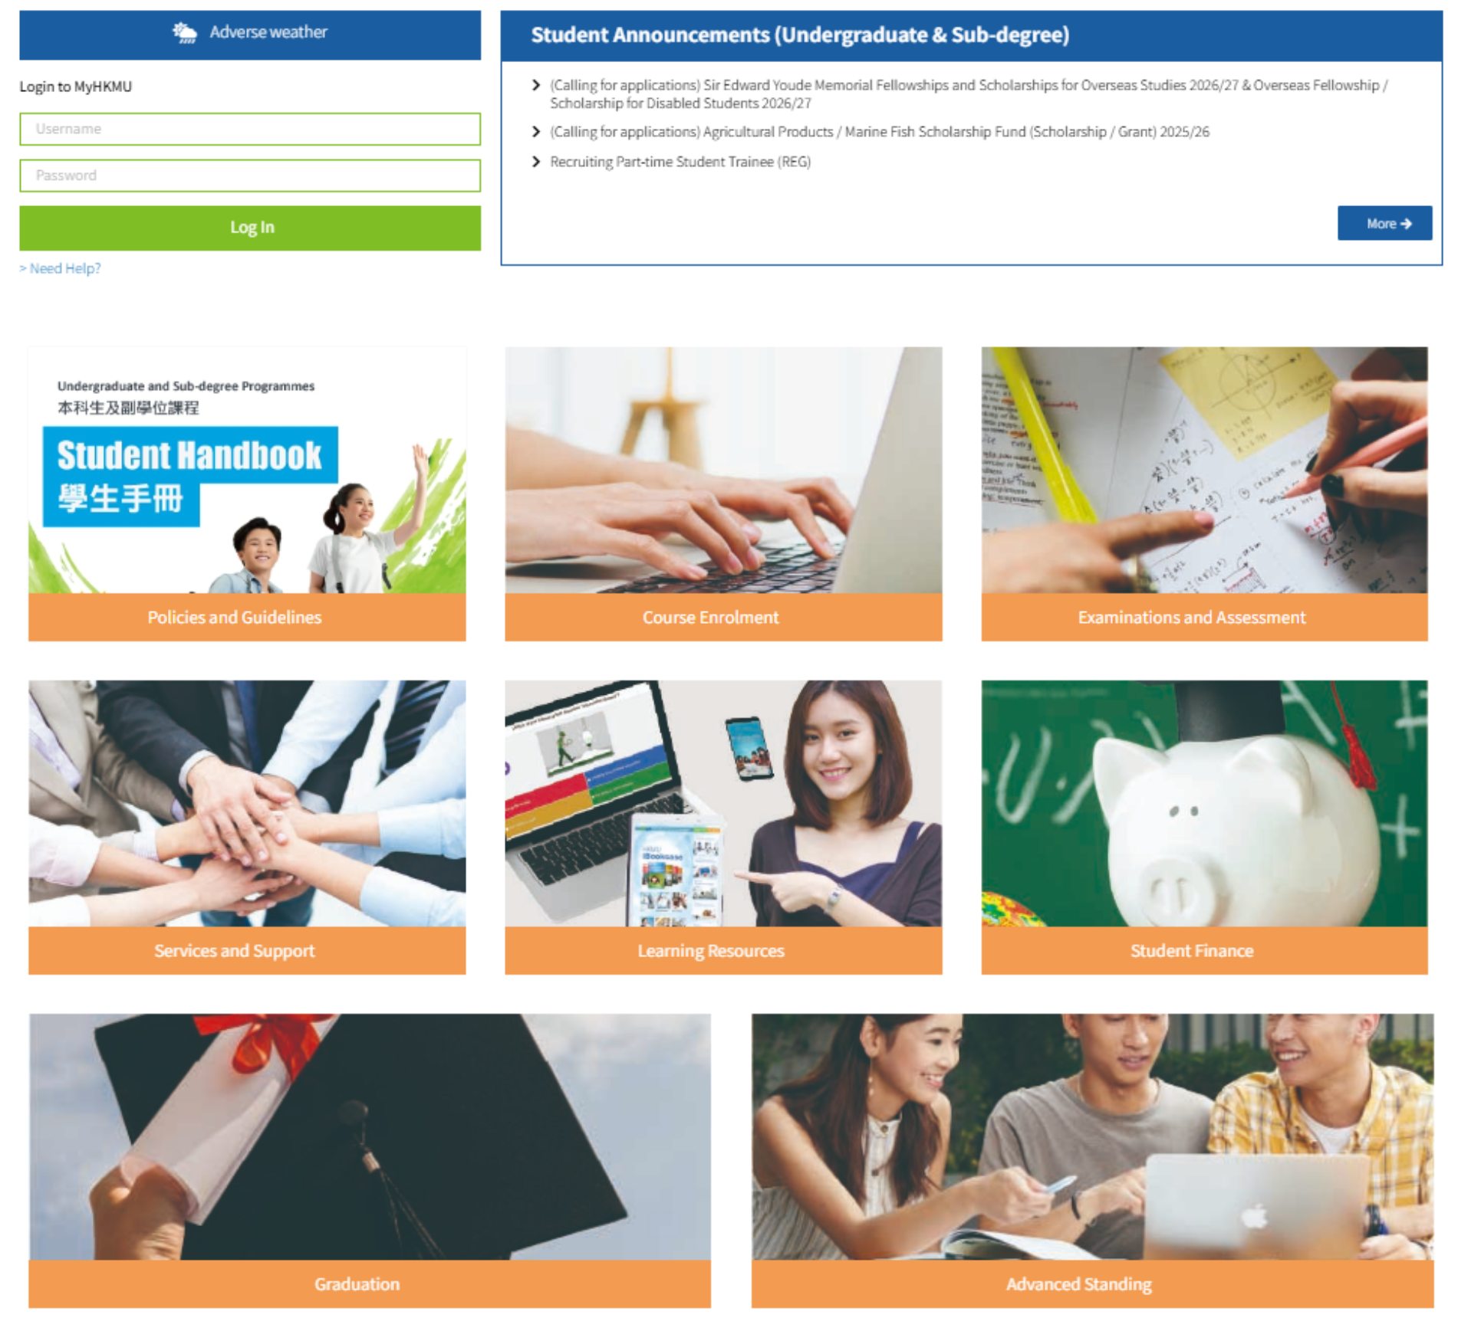
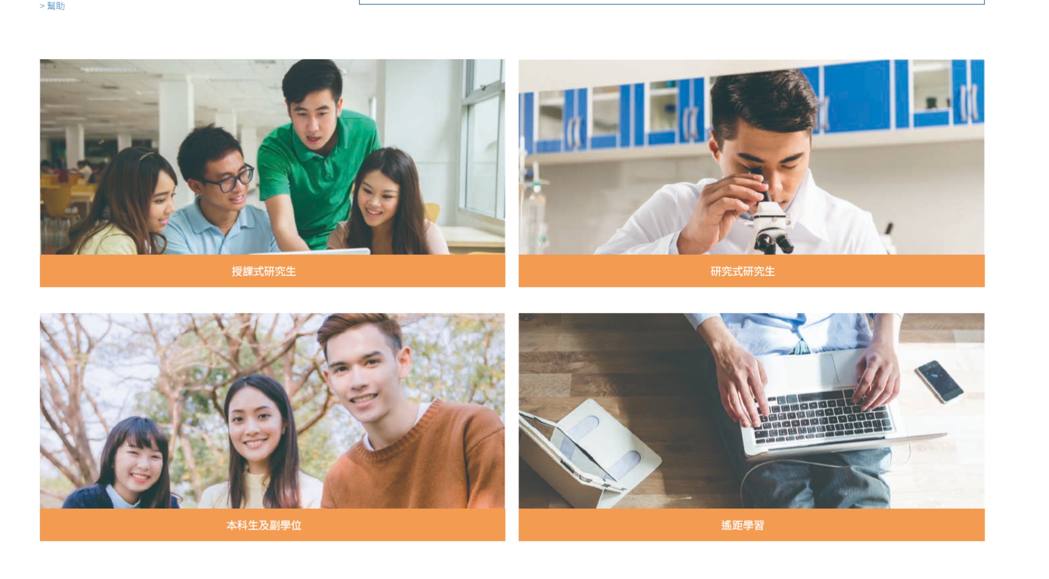
https://www.hkmu.edu.hk/ito/tc/student-services/single-password-management-students/
www.hkmu.edu.hk, Please refer to Student Handbook (Appendix A: Activate Your Email Account)
→ Current Students
→ Undergraduate and Sub-degree
→ Services and Support
→ Single Password Management

Slide 27
3. Activate o365 account
It includes anywhere access to the mailbox service across the desktop, web and mobile devices, free storage, document sharing and editing, instant messaging, and video chat. The account carries a domain name “@live.hkmu.edu.hk” which bears a lifelong identity of HKMU. Students can access O365 at anytime and anywhere through :
HKMU Website (Current Students) > Student Portal (Undergraduates & Sub-degree/Taught Postgraduate/Research Postgraduate/Distance Learning) > Services & Support > Email Services > O365 email;
OR
Direct link : https://student.intranet.hkmu.edu.hk/hkmu_o365
Higher Diploma in
Creative Culture and Arts Practice (CCAP)

Slide 28
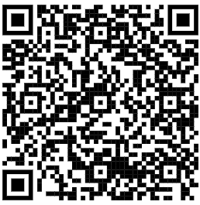
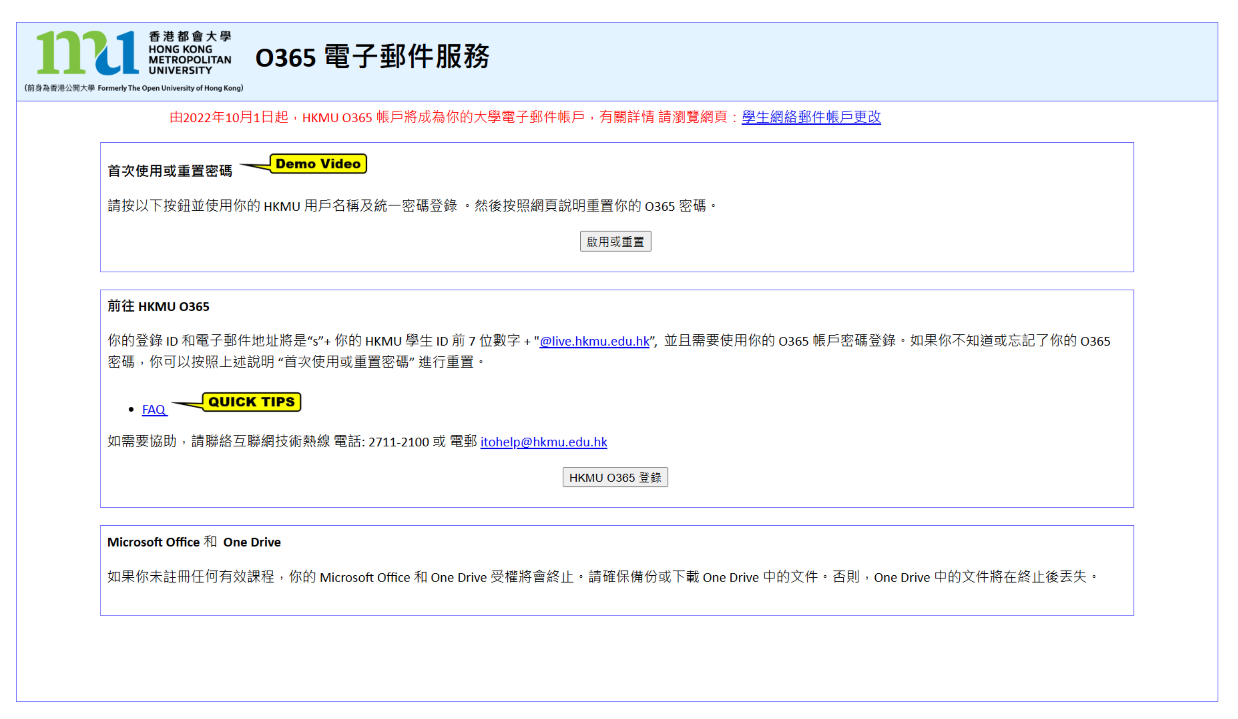
3. Activate o365 account
Bookmark!
Log in to Your Email Account
HKMU Home Page → Current Students
→ Undergraduate & Sub-degree → Communication & Support → O365 Email
O365 Email: https://student.intranet.hkmu.edu.hk/hkmu_o365/index_c.html?r=0

Slide 29
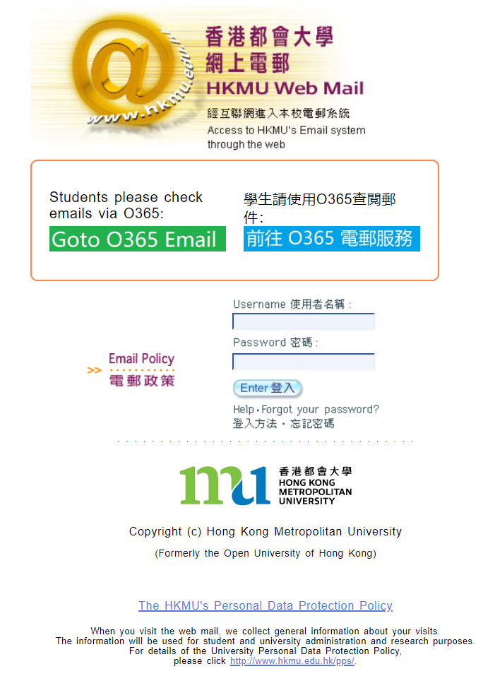
Input your user name and password:
User name : “s” + first 7 digits of your student number
Password : the single password that you have created
請記緊!!
學生証號碼是八個位!

Slide 30

“s”+學員學生証號碼的前七位數字
登入後，根據指示啟動O365戶口
  你的統一密碼

Slide 31
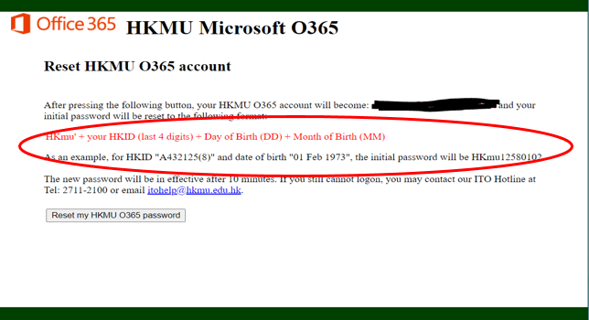
Activation of O365

Slide 32
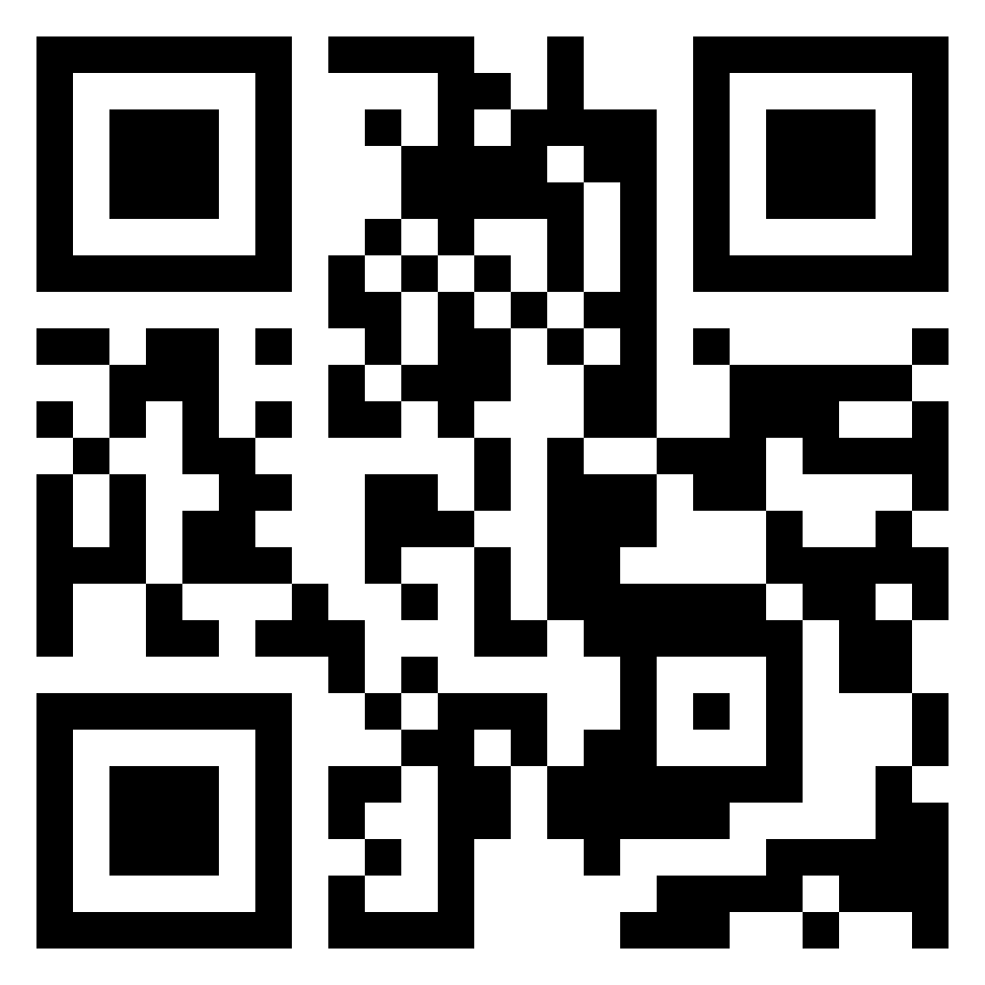
4. Online Learning Environment (OLE)
Please refer to Student Handbook
Log in to https://elipace.hkmu.edu.hk/
Enter your Username and Password
(same as the one created for the e-mail service)

Slide 33
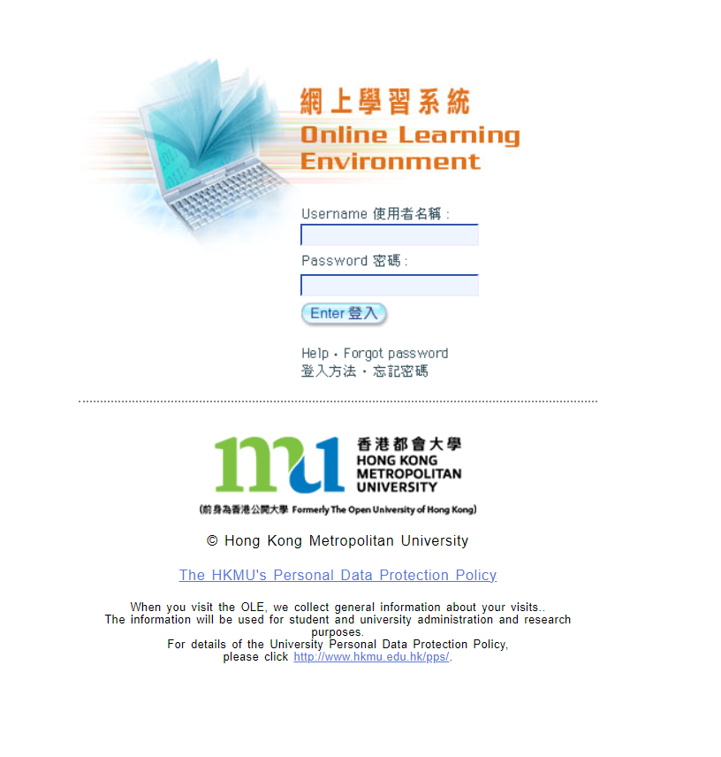
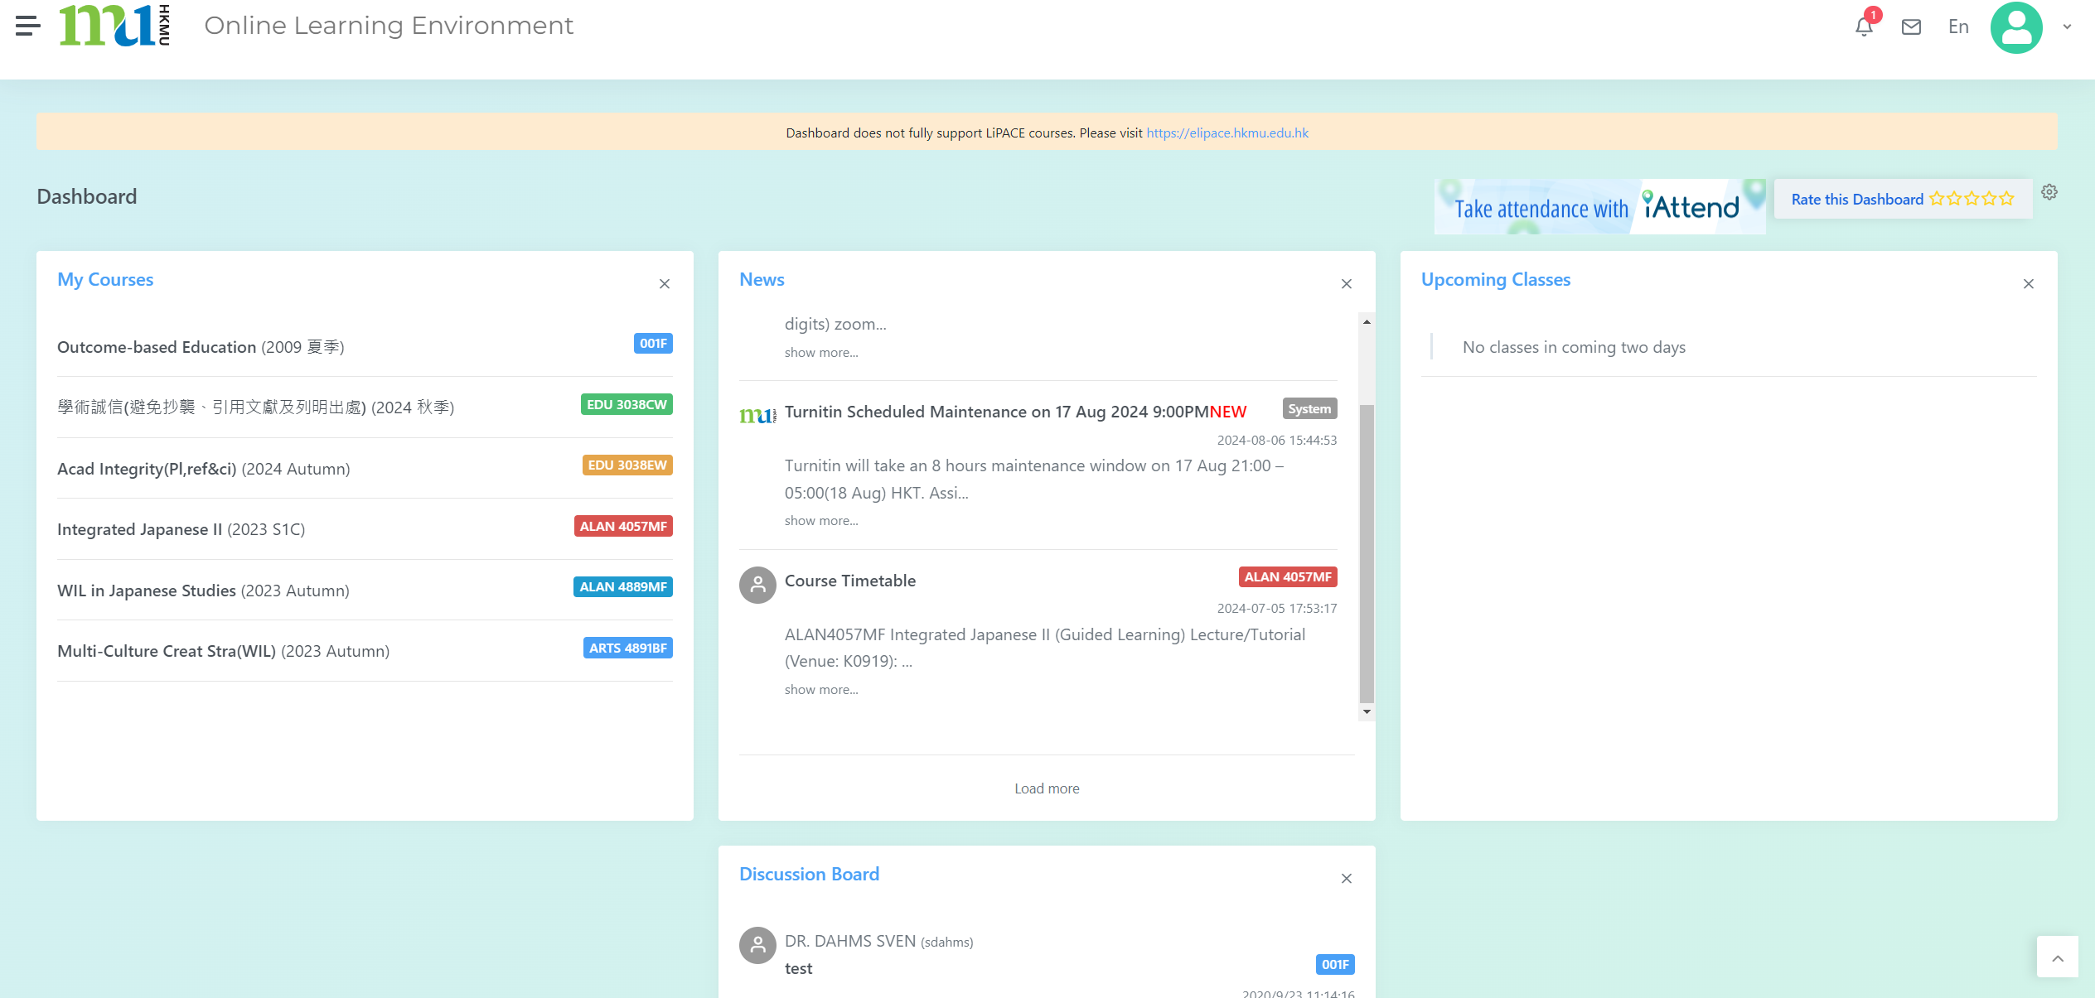
HKMU LiPACE
(Click HERE)
登入 elipace.hkmu.edu.hk/
  使用者名稱：“s”+學員學生証號碼的前七位數字
  密碼：你的統一密碼

Slide 34
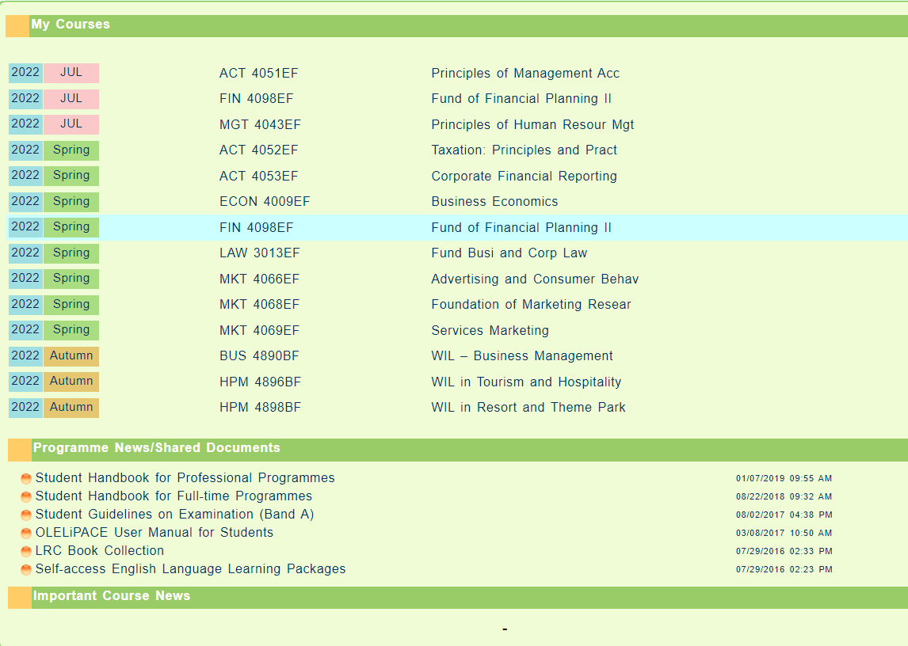
Find Course
Download Handbook

Slide 35
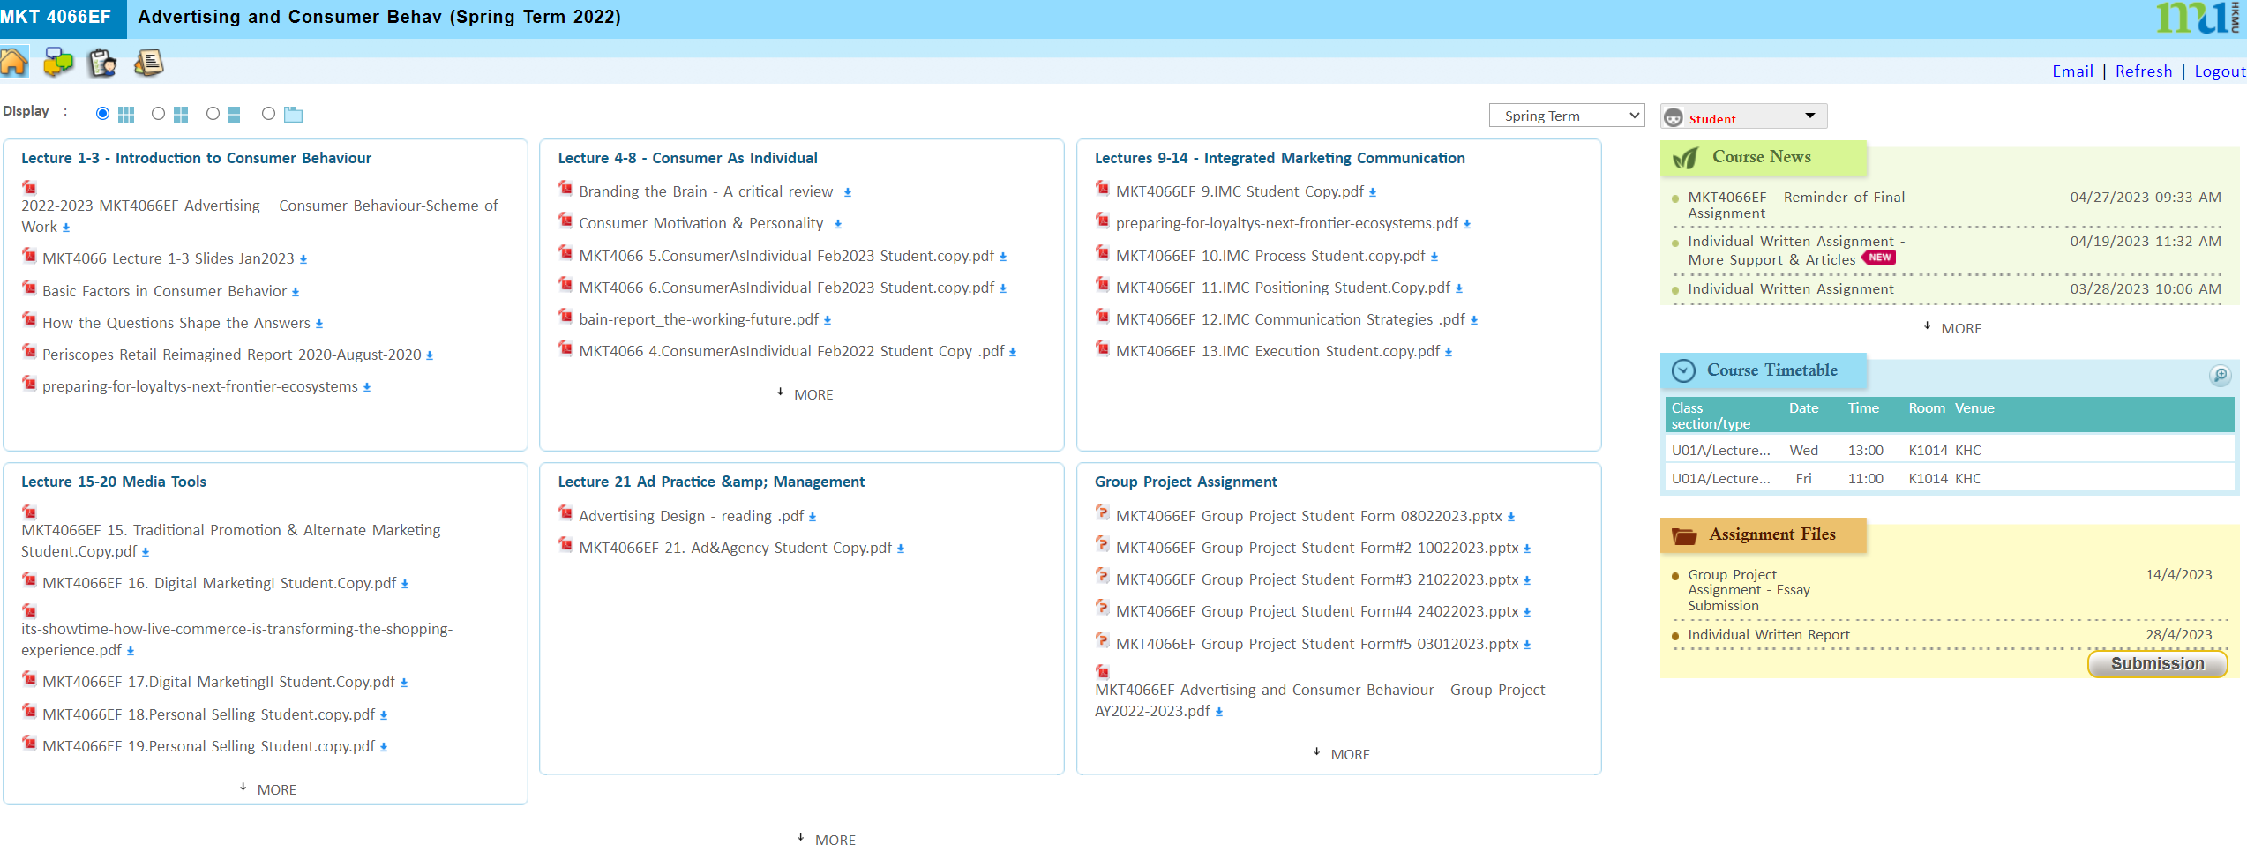
Download Lecture Notes, Course News, upload Assignment Files
下載課程講義、課程最新資訊、上傳作業文件

Slide 36
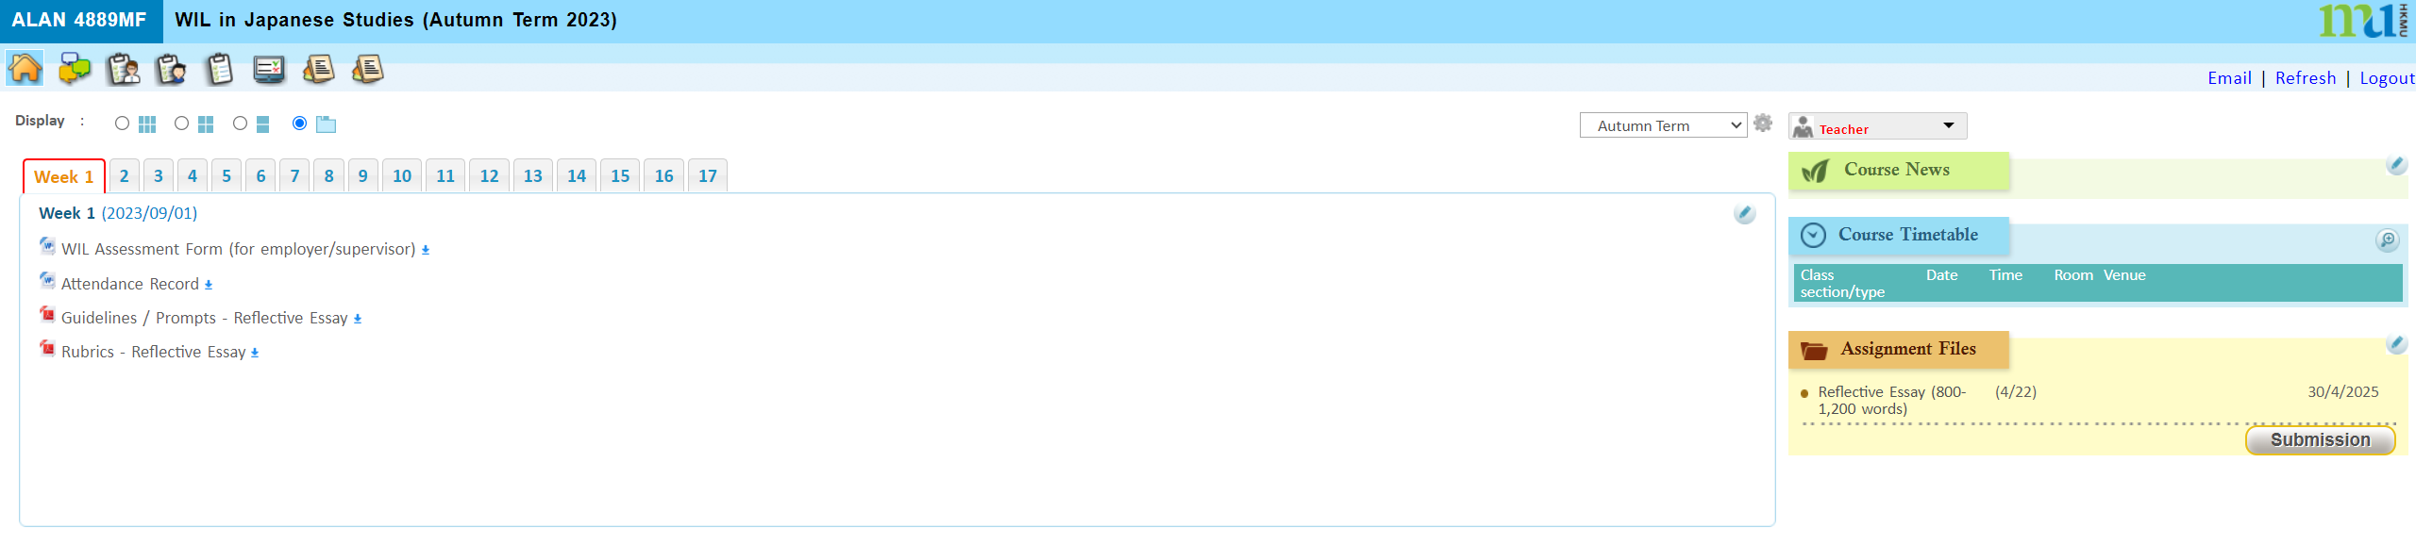
Download Lecture Notes, Course News, upload Assignment Files
下載課程講義、課程最新資訊、上傳作業文件

Slide 37
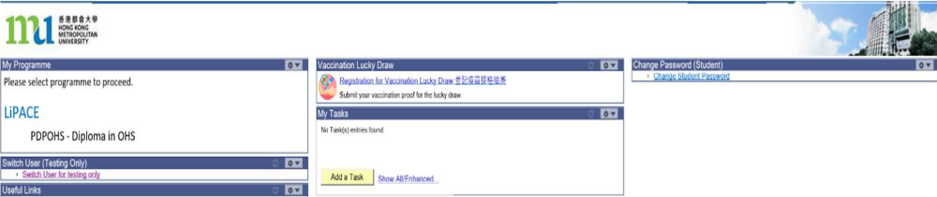
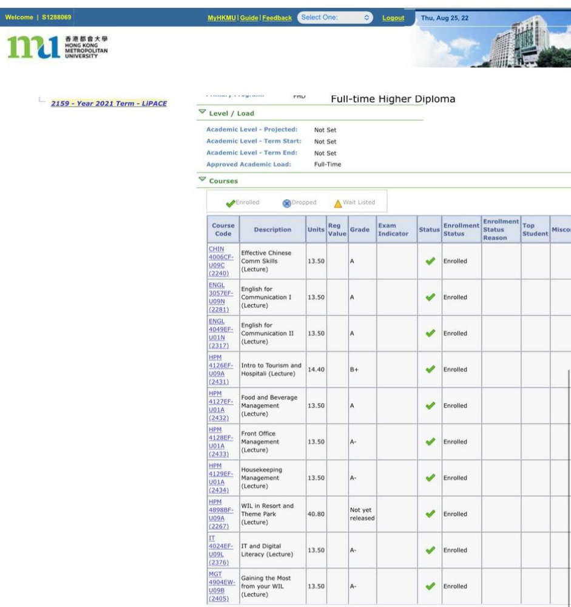
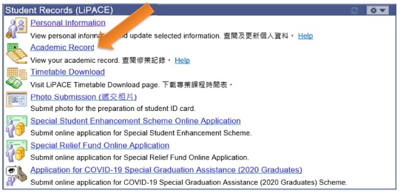
Checking Academic Results

Slide 38
One Student Account
(User Name:s1234567)
Timetable and Class Division
上課時間表及所屬班別
Online Learning Environment (OLE)
網上學習系統
MyHKMU
Student Email Account
學生電郵帳戶

Slide 39



5. Student card
Completion of Entry Survey 完成入學問卷調查
https://hkmu.qualtrics.com/jfe/form/SV_bpB3veks5h4YdZc
Collection of Student Card 領取學生證
To help us understand about your learning expectation and support at LiPACE, please complete the Entry Survey before you pick up your Student ID Card and save the screenshot of the last page .
為了讓我們更了解您的學習期望和所需支援，請在領取學生證前完成入學問卷調查，並將最後一頁屏幕截圖。
Please show the screenshot / email proof of survey completion for collecting the Student Card.
請在領取學生證時出示完成問卷的屏幕截圖/電子郵件證明。

Slide 40
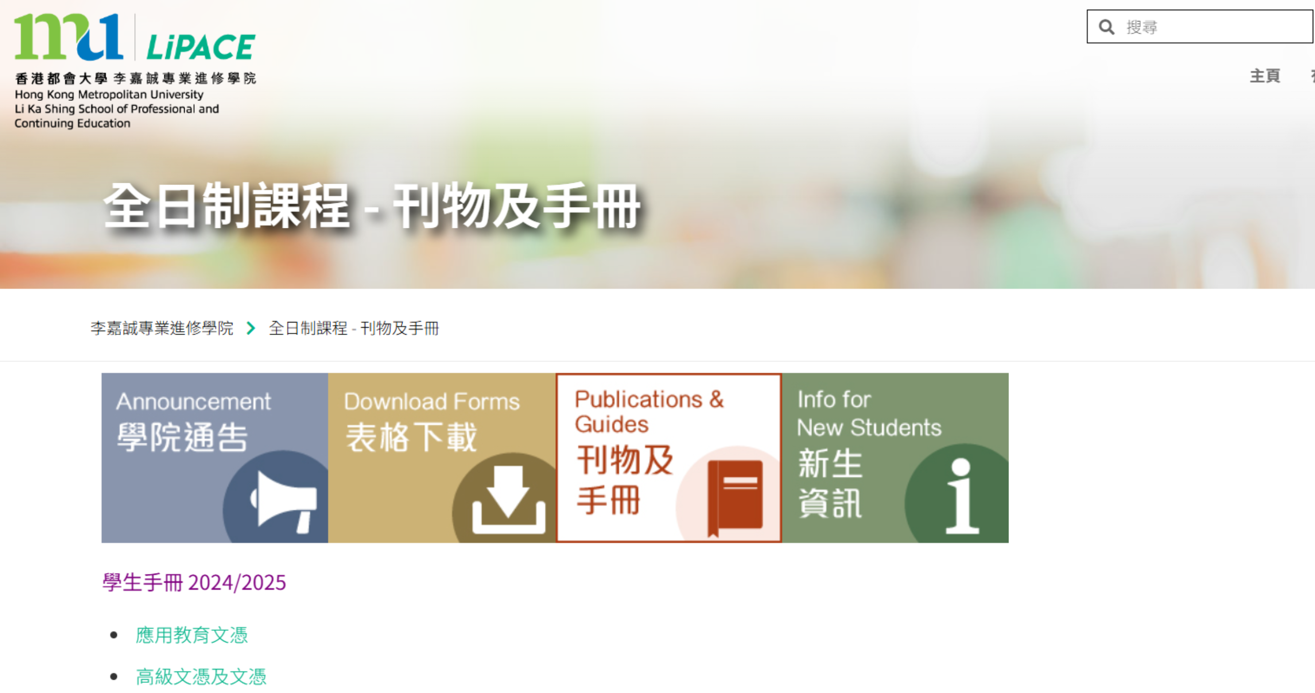
6. Student Handbook –
'Student disciplines' & 'Academic Integrity‘
“LiPACE Student Area”
https://www.hkmu.edu.hk/lipace/tc/ftp-student-area/

Slide 41
語文科目豁免政策
Language Course Exemption
7. Language Course Exemption

Slide 42
Chinese/English courses – QF Level 3 & 4
Holders of any qualifications mentioned below:
A locally accredited sub-degree (at QF Level 4) or a post-secondary diploma offer by a recognized university or higher education institute overseas, or
A locally accredited Bachelor’s degree or above (at QF Level 5 or above) or a Bachelor’s degree or above offered by a recognized university overseas.
The qualification should be awarded by a university or institute where the medium of instruction and assessments of this qualification must be in English. This includes UK and colonies, US (mainland and territories), Canada, Australia, New Zealand, South Africa (must be in English speaking, not Afrikaans), Ireland and Singapore. Other English-medium universities in the British Commonwealth will be considered on a case-by-case basis.

Slide 43
Chinese/English courses – QF Level 3 & 4
Completion of a prior Chinese/English course at QF Level 3/4 or above
The course should be non-career specific.
(e.g. Business English courses and English courses for Tourism will not be considered.)

Slide 44
English courses – QF Level 3 & 4
Holders of a public examination qualification from a recognized examination body
 | QF Level 3 English for Communication I | QF Level 4 English for Communication II | QF Level 4 English for Communication III
HKDSE Level 3 or above | ✓
HKALE/GCE A-level Grade D or above | ✓
IELTS 6.0 or above overall and a minimum of 5.5 for each individual component | ✓
IELTS 6.5 or above overall and 6 in listening and speaking component | ✓ | ✓

Slide 45
English courses – QF Level 3 & 4
Holders of a public examination qualification from a recognized examination body (cont.)
The results of IELTS and TOEFL must not be more than 2 years from the date of the test or final examination to the date of commencement of study at LiPACE.
 | QF Level 3 English for Communication I | QF Level 4 English for Communication II | QF Level 4 English for Communication III
IELTS 6.5 or above overall and 6 in reading and writing component | ✓ |  | ✓
TOEFL scored -60 (iBT) | ✓
TOEFL score -79 (iBT) | ✓ | ✓ | ✓
TEFL/TESOL certification, Or CELTA holder | ✓ | ✓ | ✓

Slide 46


Documents required for exemption application
01
02
Course Issues Application Form
https://www.hkmu.edu.hk/lipace/tc/admission/enrollment-form/
Qualification certificate awarded by a recognized university/institute/examination body; or
Syllabus from a prior course providing information on learning outcomes, academic standard, coverage, duration and assessment criteria
Application deadline:
22 September 2025 (Monday)

Slide 47

Course Issues Application Form 課程事項申請表

Slide 48

Staff contacts
Head of Languages
Dr. Sylvia SZE | swsze@hkmu.edu.hk | 3120 9715
Deputy Head of Languages
Ms. Melissa YEUNG | mylyeung@hkmu.edu.hk | 3120 9719
Effective Chinese Communication Skills 應用中文傳意技巧
Ms. Konnie TANG | kyhtang@hkmu.edu.hk | 3120 9822

Slide 49
香港都會大學
李嘉誠專業進修學院
課外活動、外藉英語老師及
英語學習支援
Heidi Cheng
7. NET
https://drive.google.com/file/d/1fRO0az-JW6hWbN3-tUWhKmDn5q70_epP/view?usp=sharing

Slide 50
Student Affairs Office
學生事務處
7. SAO
https://drive.google.com/file/d/1Rj6_MKb9ElRzNpPh2F2Uau8e_F8BgONH/view?usp=sharing

Slide 51
Q & A
Higher Diploma in
Creative Culture and Arts Practice (CCAP)

Slide 52
YOU DID IT!
See you in new semester!
Many thanks!
Higher Diploma in
Creative Culture and Arts Practice (CCAP)

